Slide 1
THE SOIL
of 3C
of 3c

Slide 2
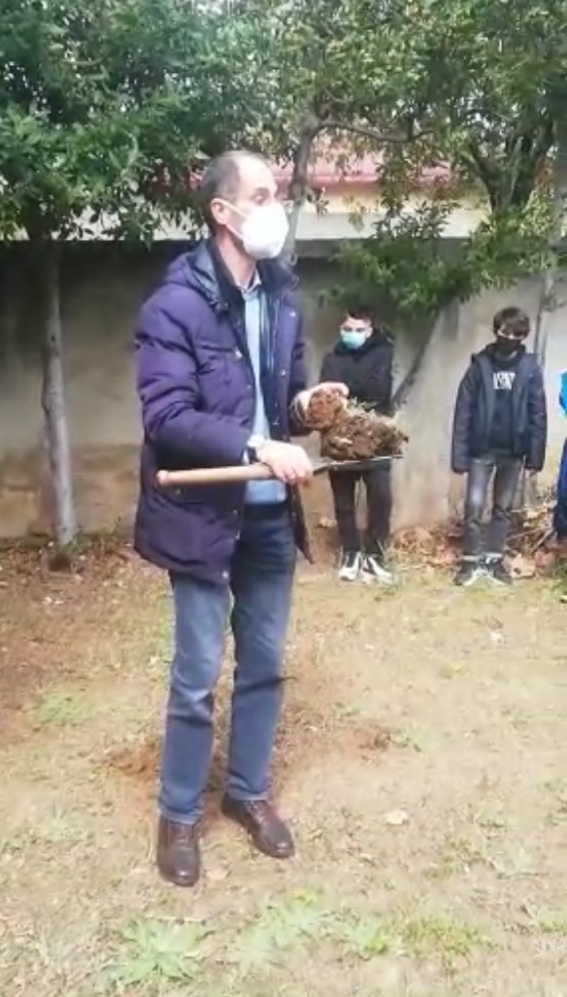
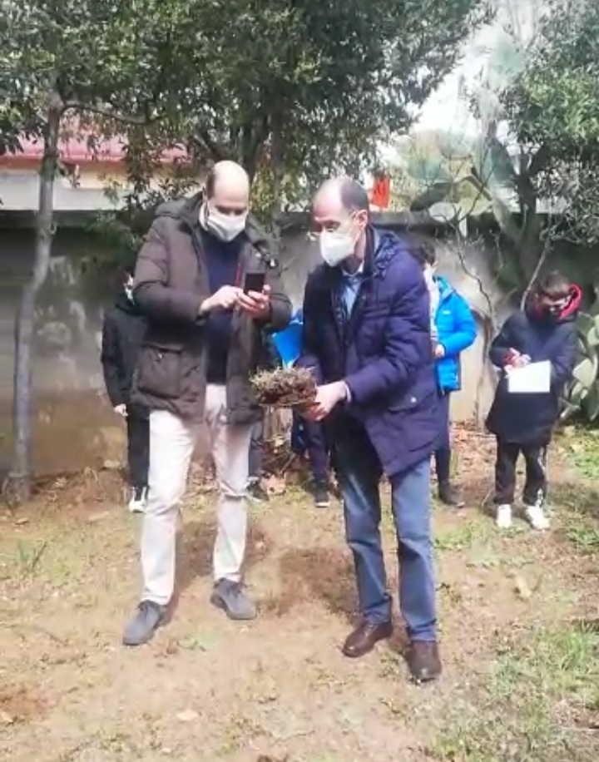
Because of the Pandemic, this year, instead of analyzing other sites, we have studied "our soil", the soil of our school green areas.
Mr Fabio Scarciglia, a geology teacher at the University of Calabria, gave us a lot of information alive and we were personally involved in the event

Slide 3
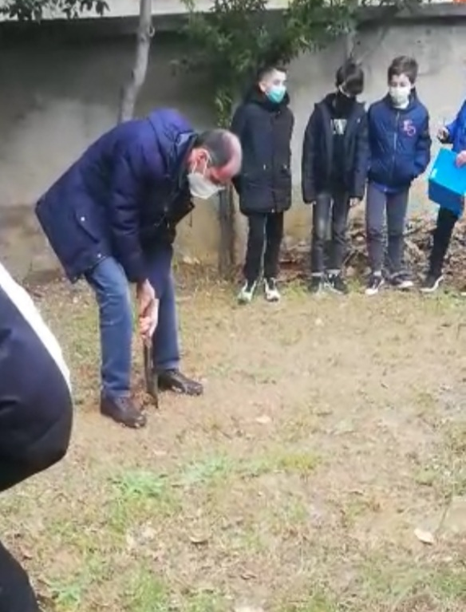
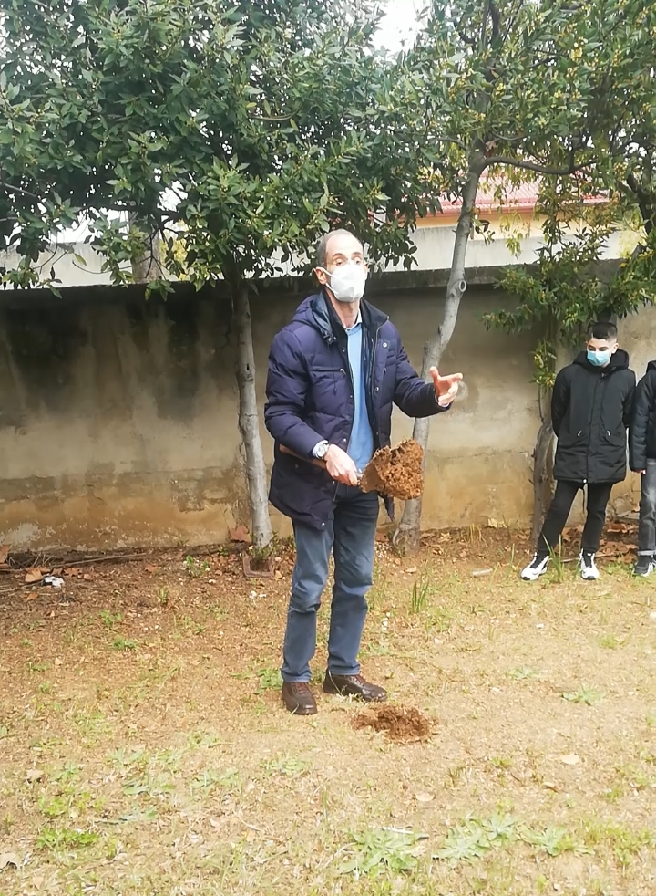
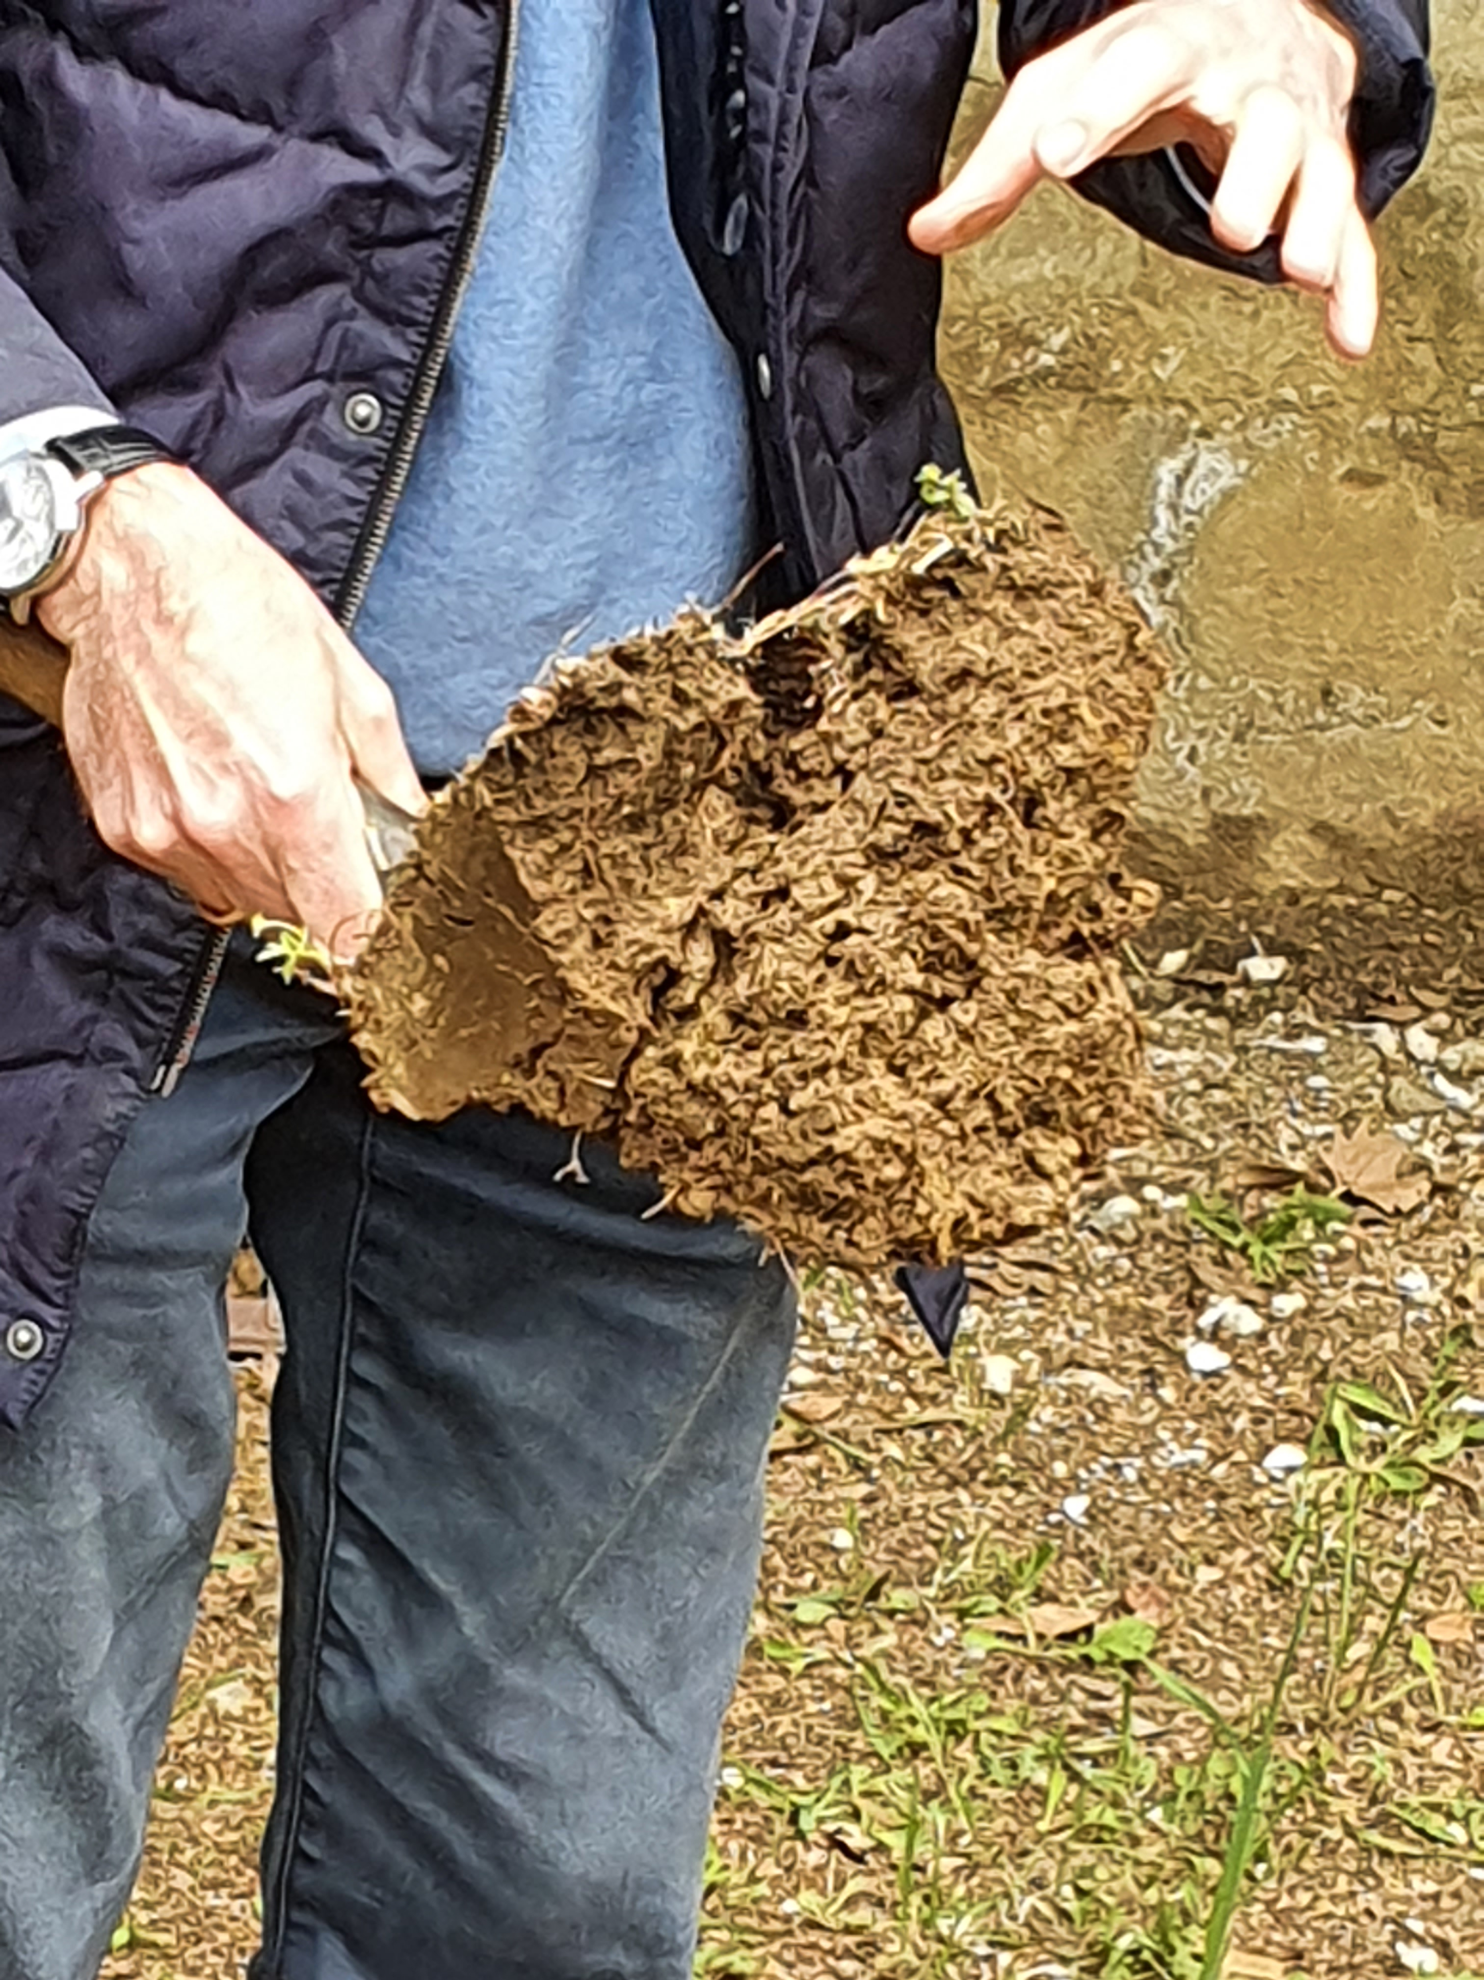
He performed an excavation and showed us how it is made, how it originates and how important it is for living beings.

Slide 4
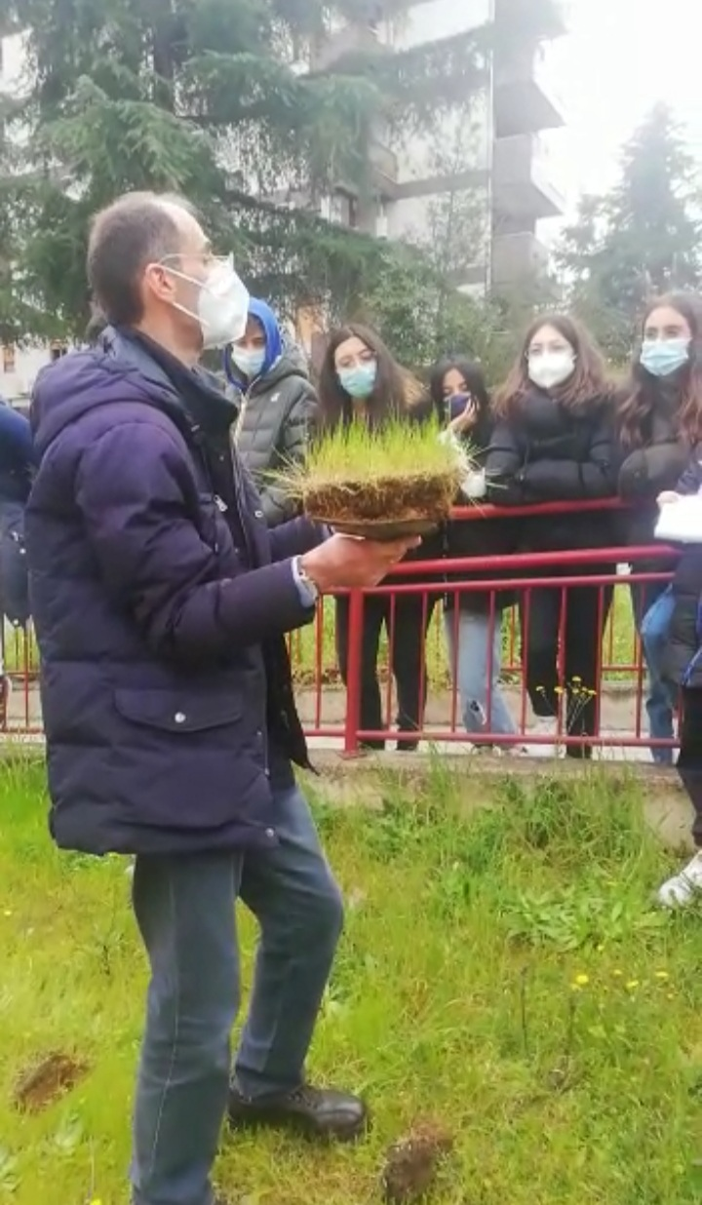
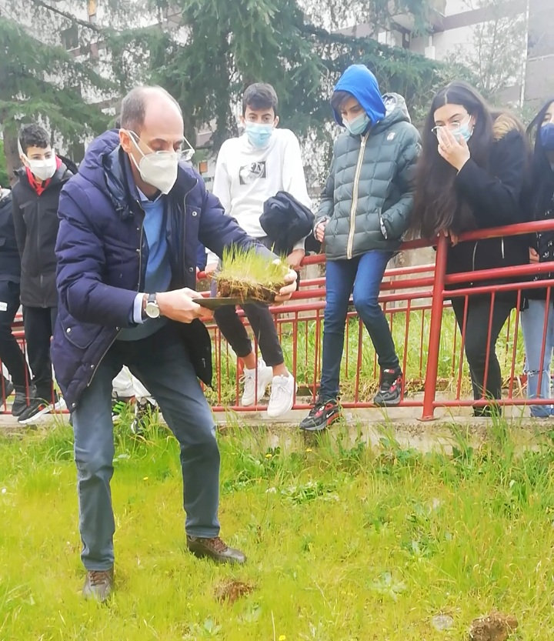
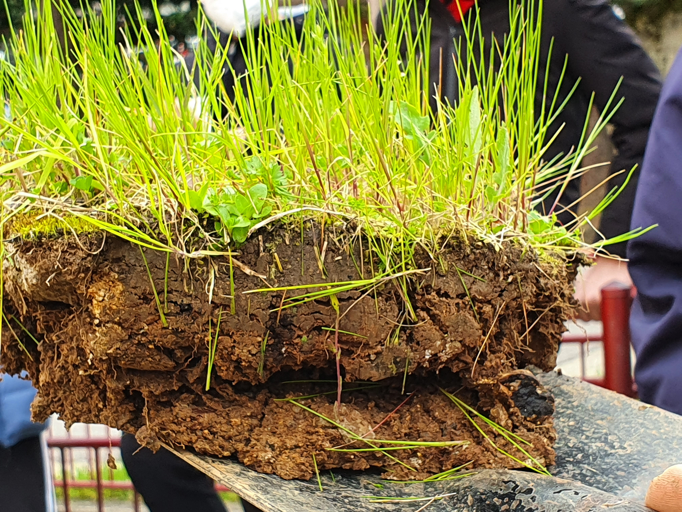
Then he performed another excavation near the first one and showed us the differences between the two soils.

Slide 5
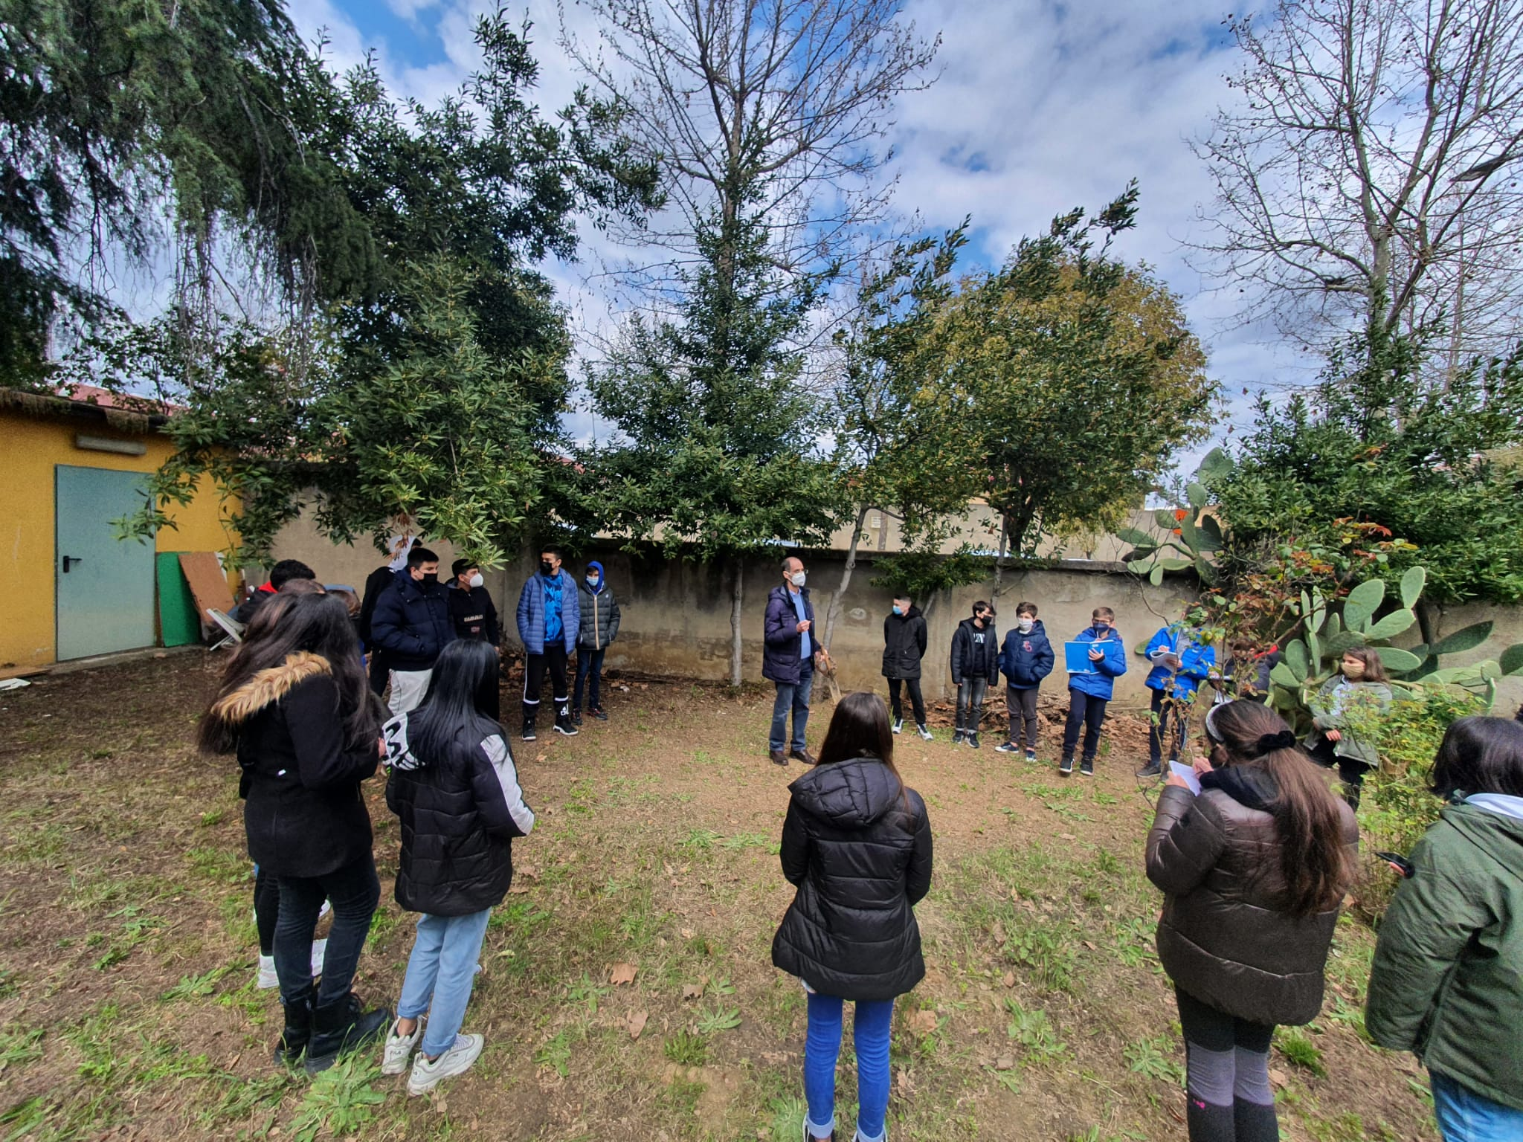
How much life and wealth in a few inches of earth!!!

Slide 6
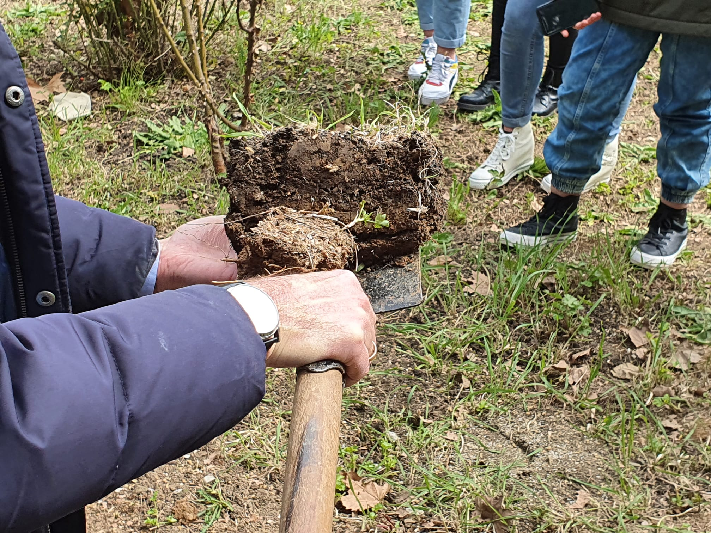
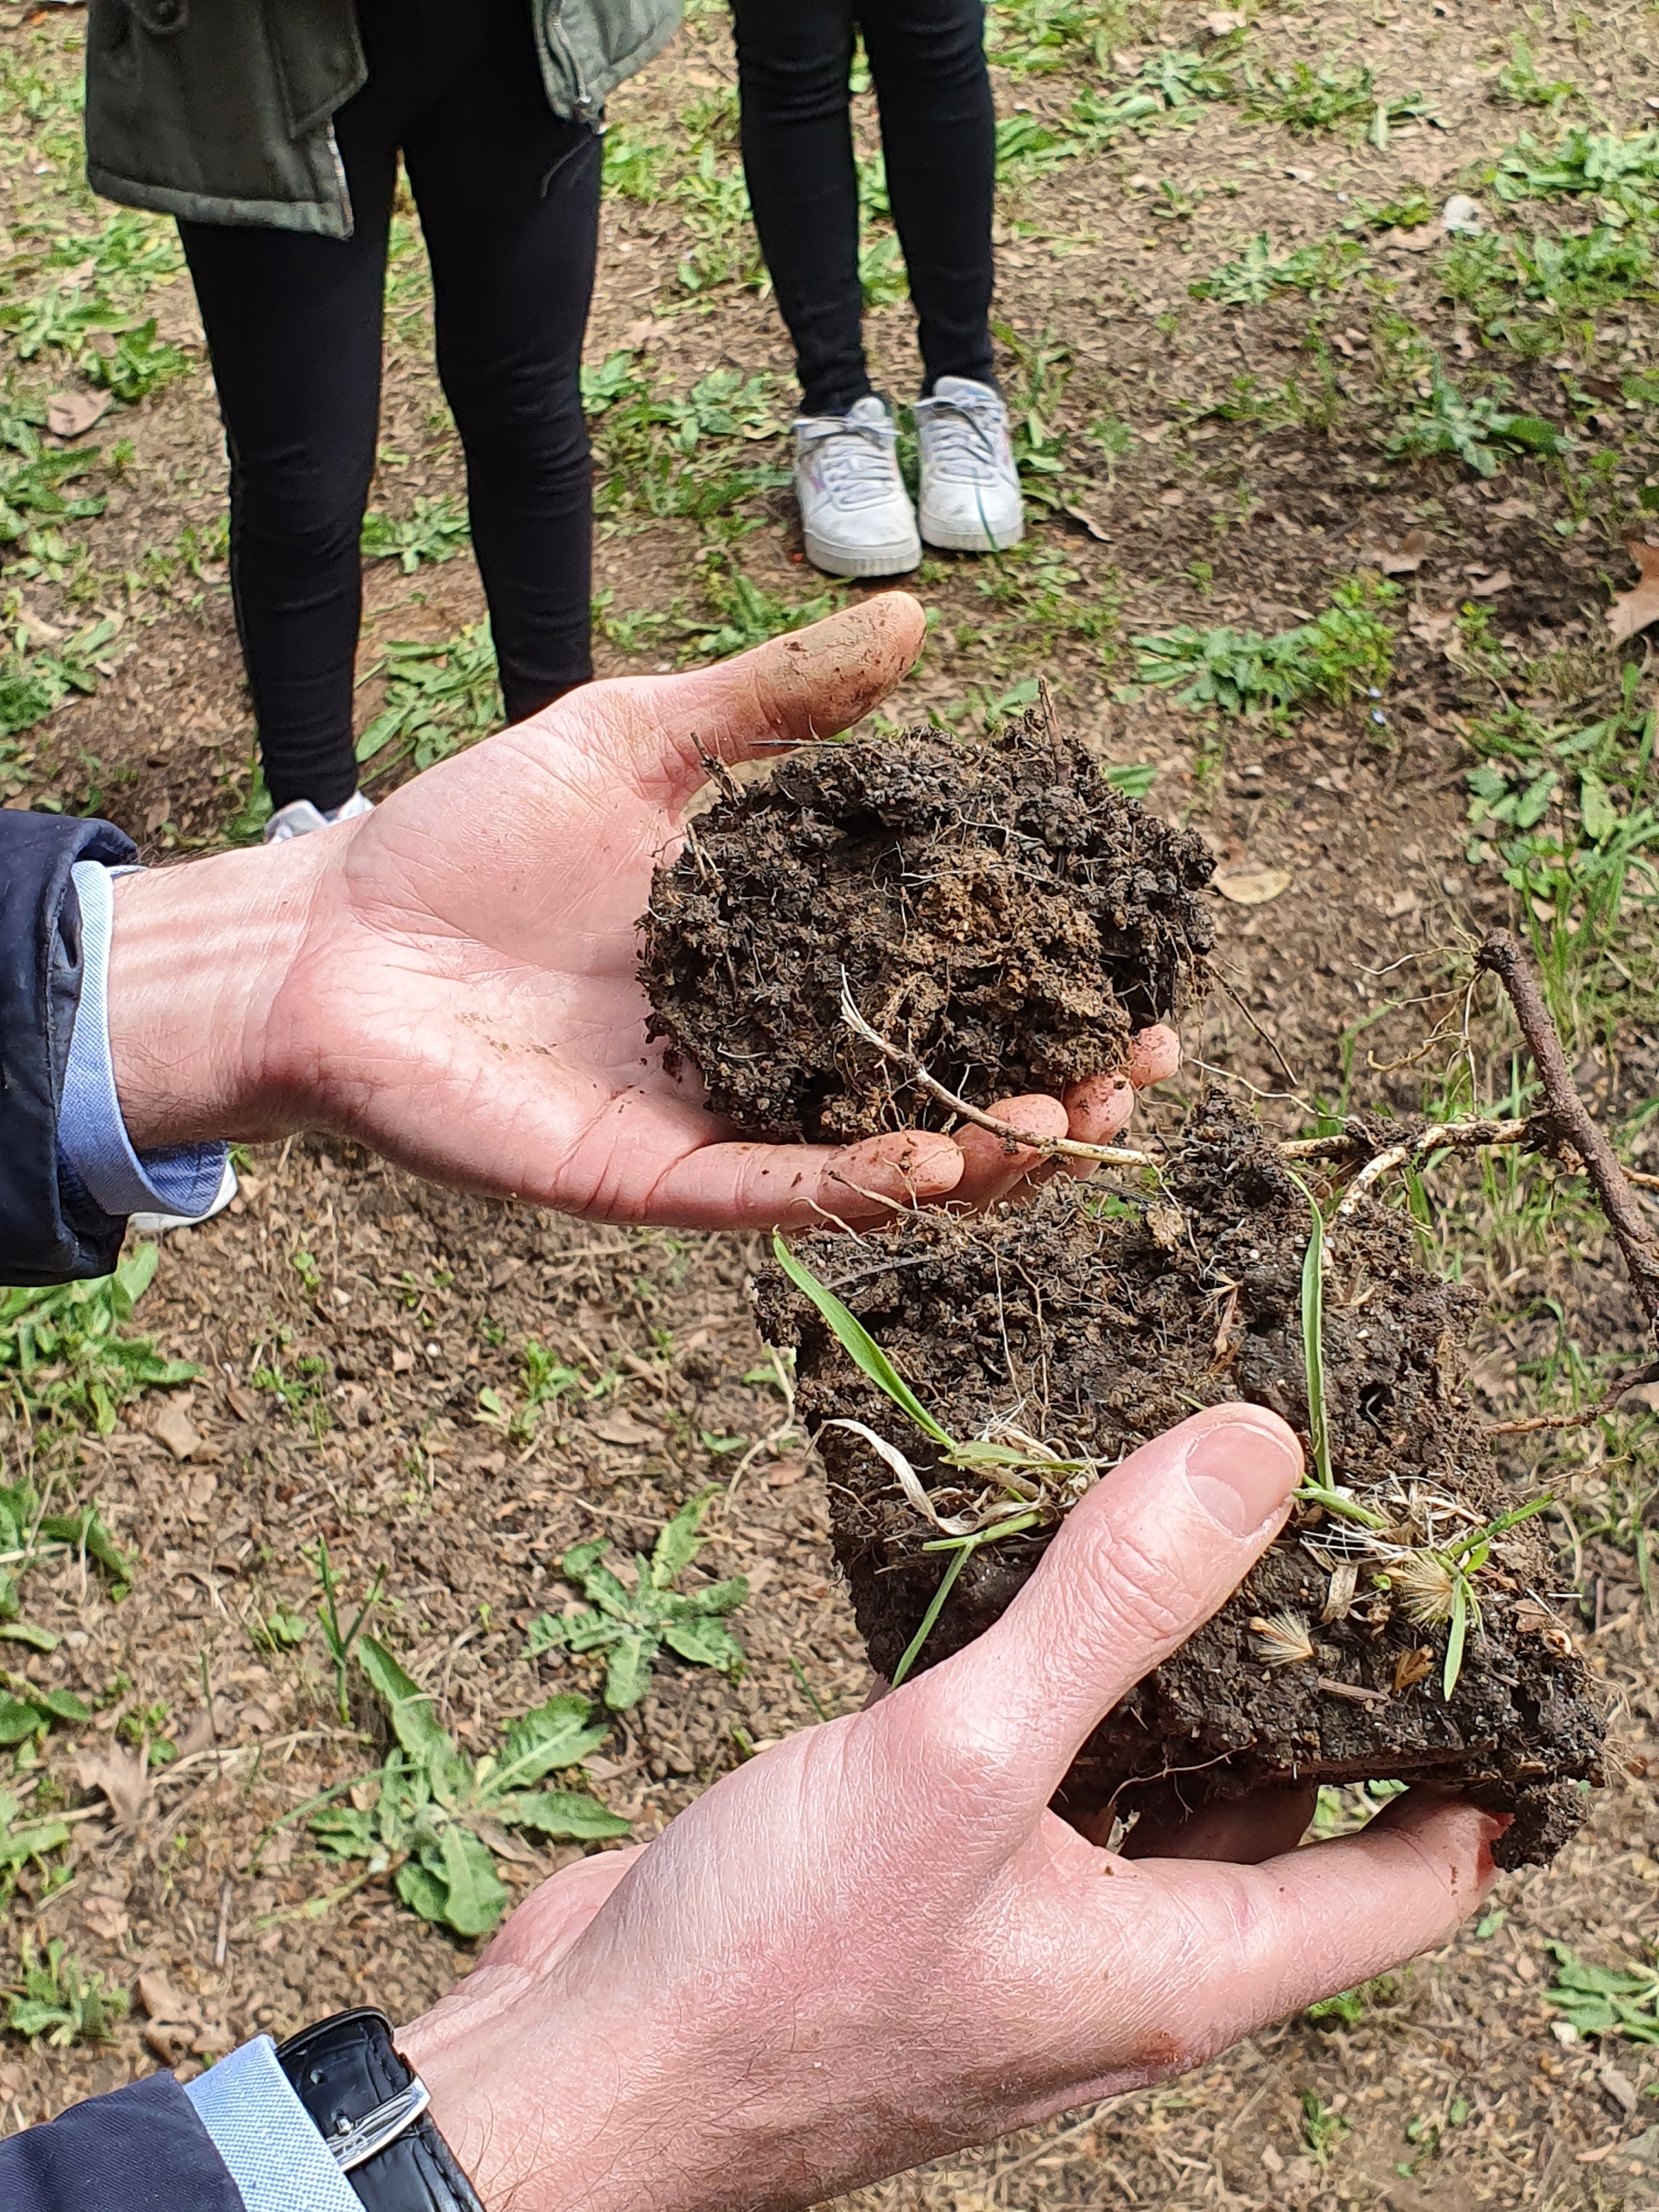
Yet another soil sample close to the first two, useful for observing different grain sizes and textures.

Slide 7
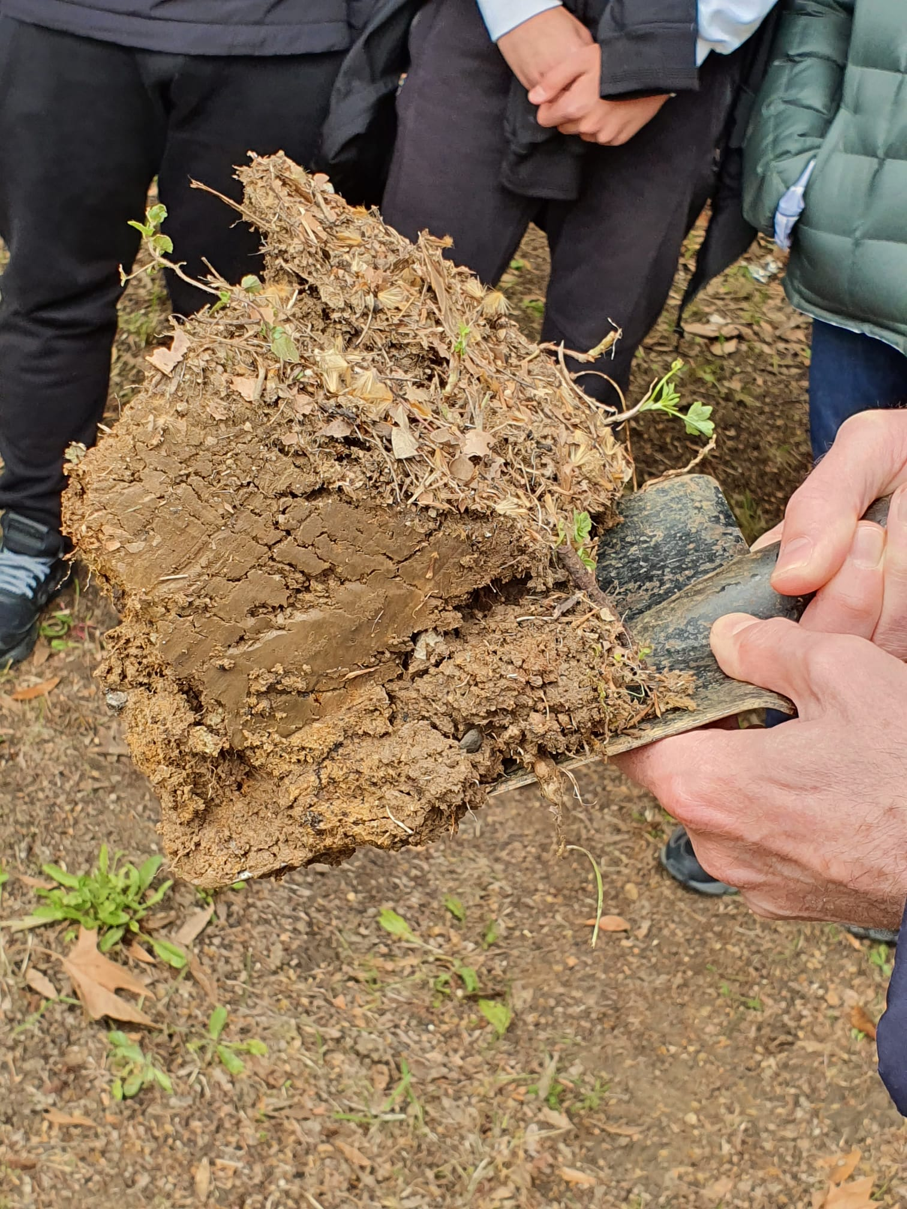
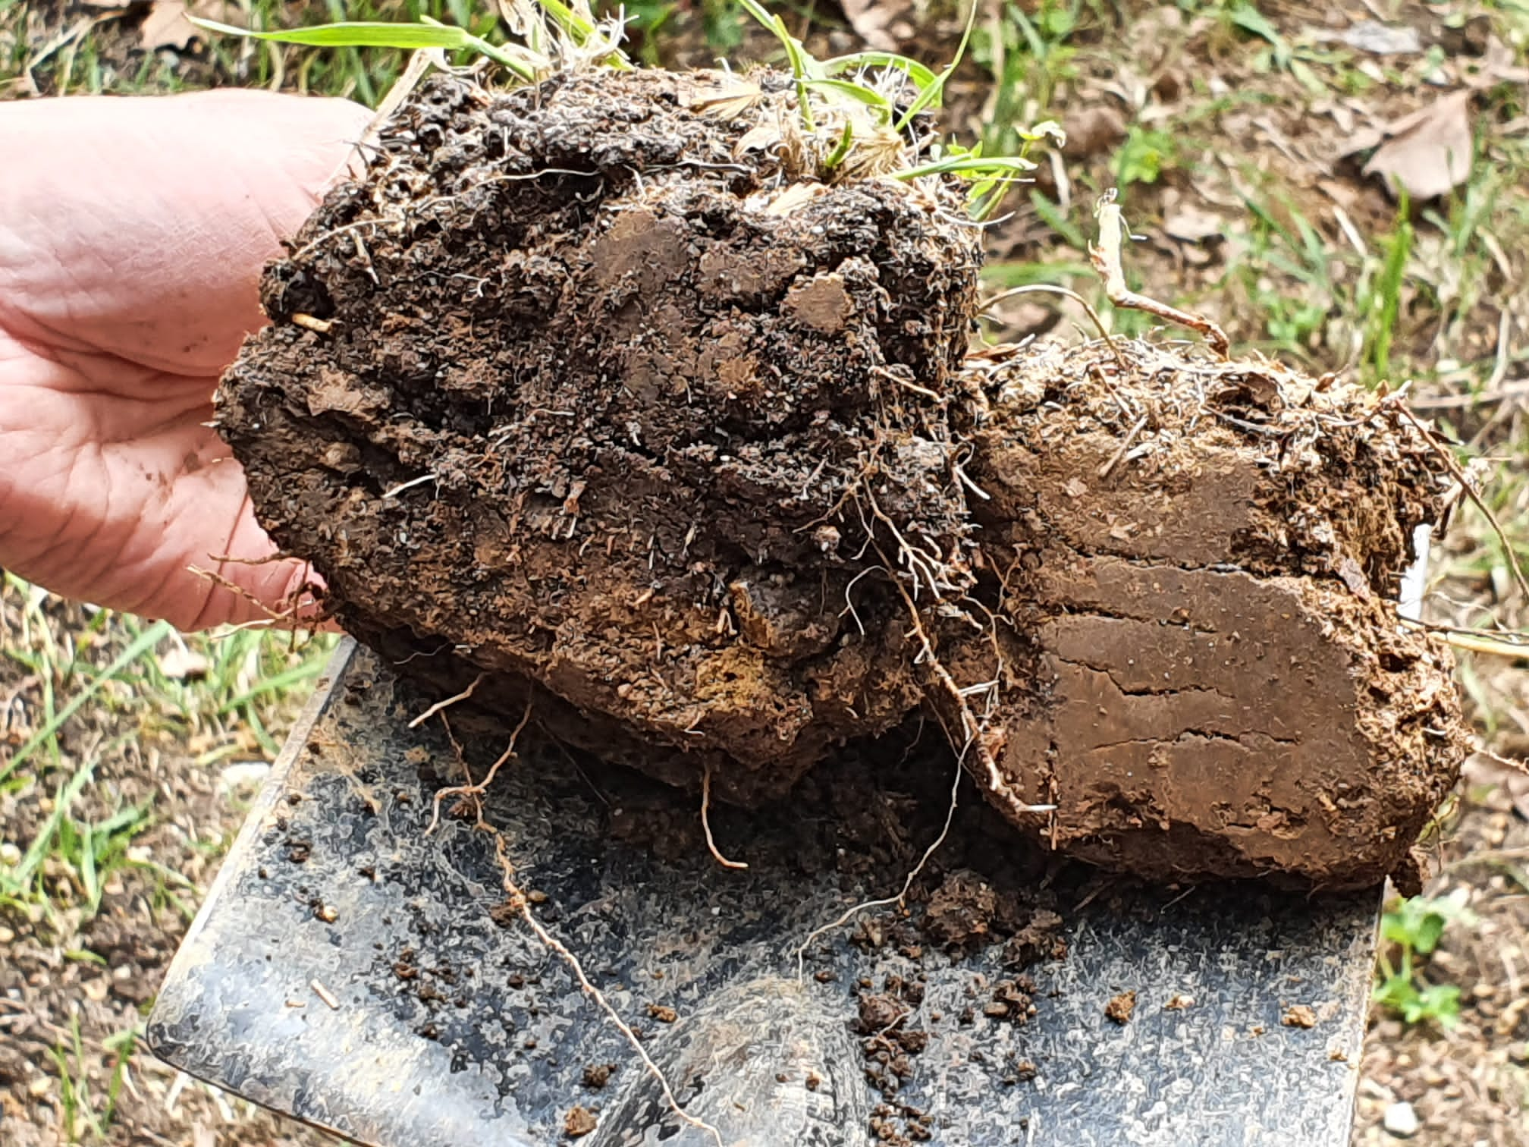
Different soil types observed

Slide 8
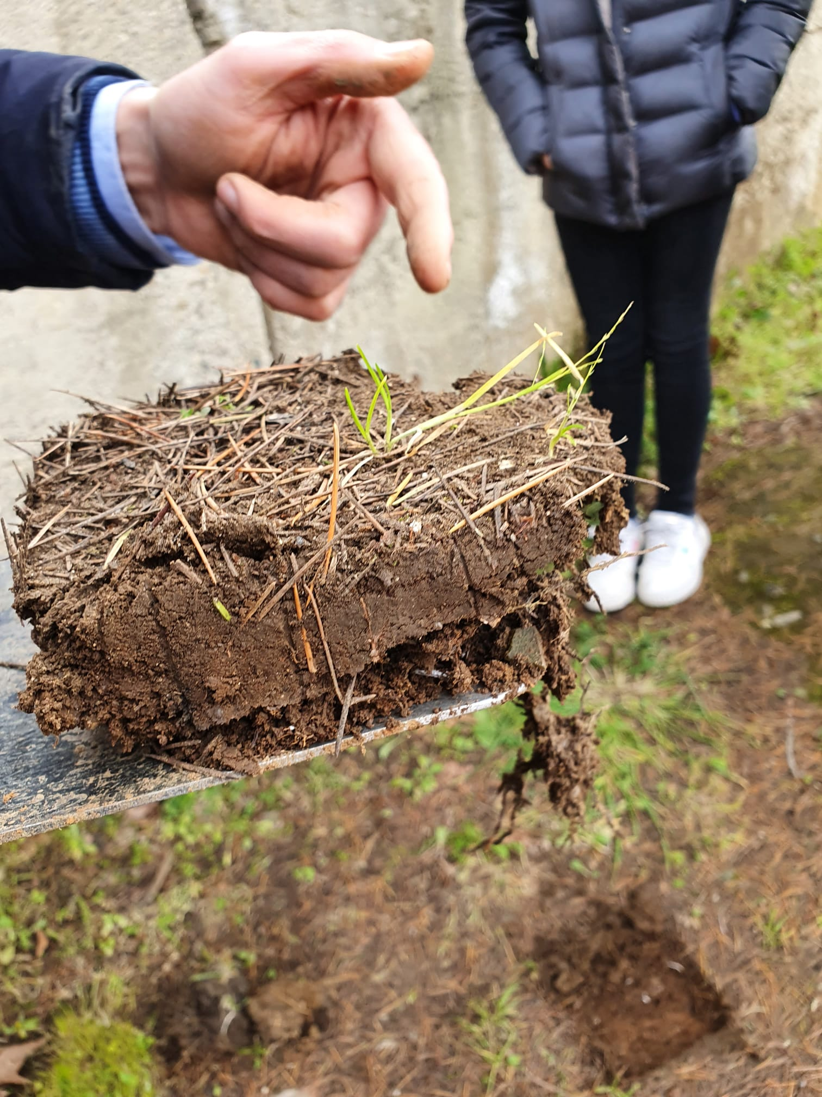
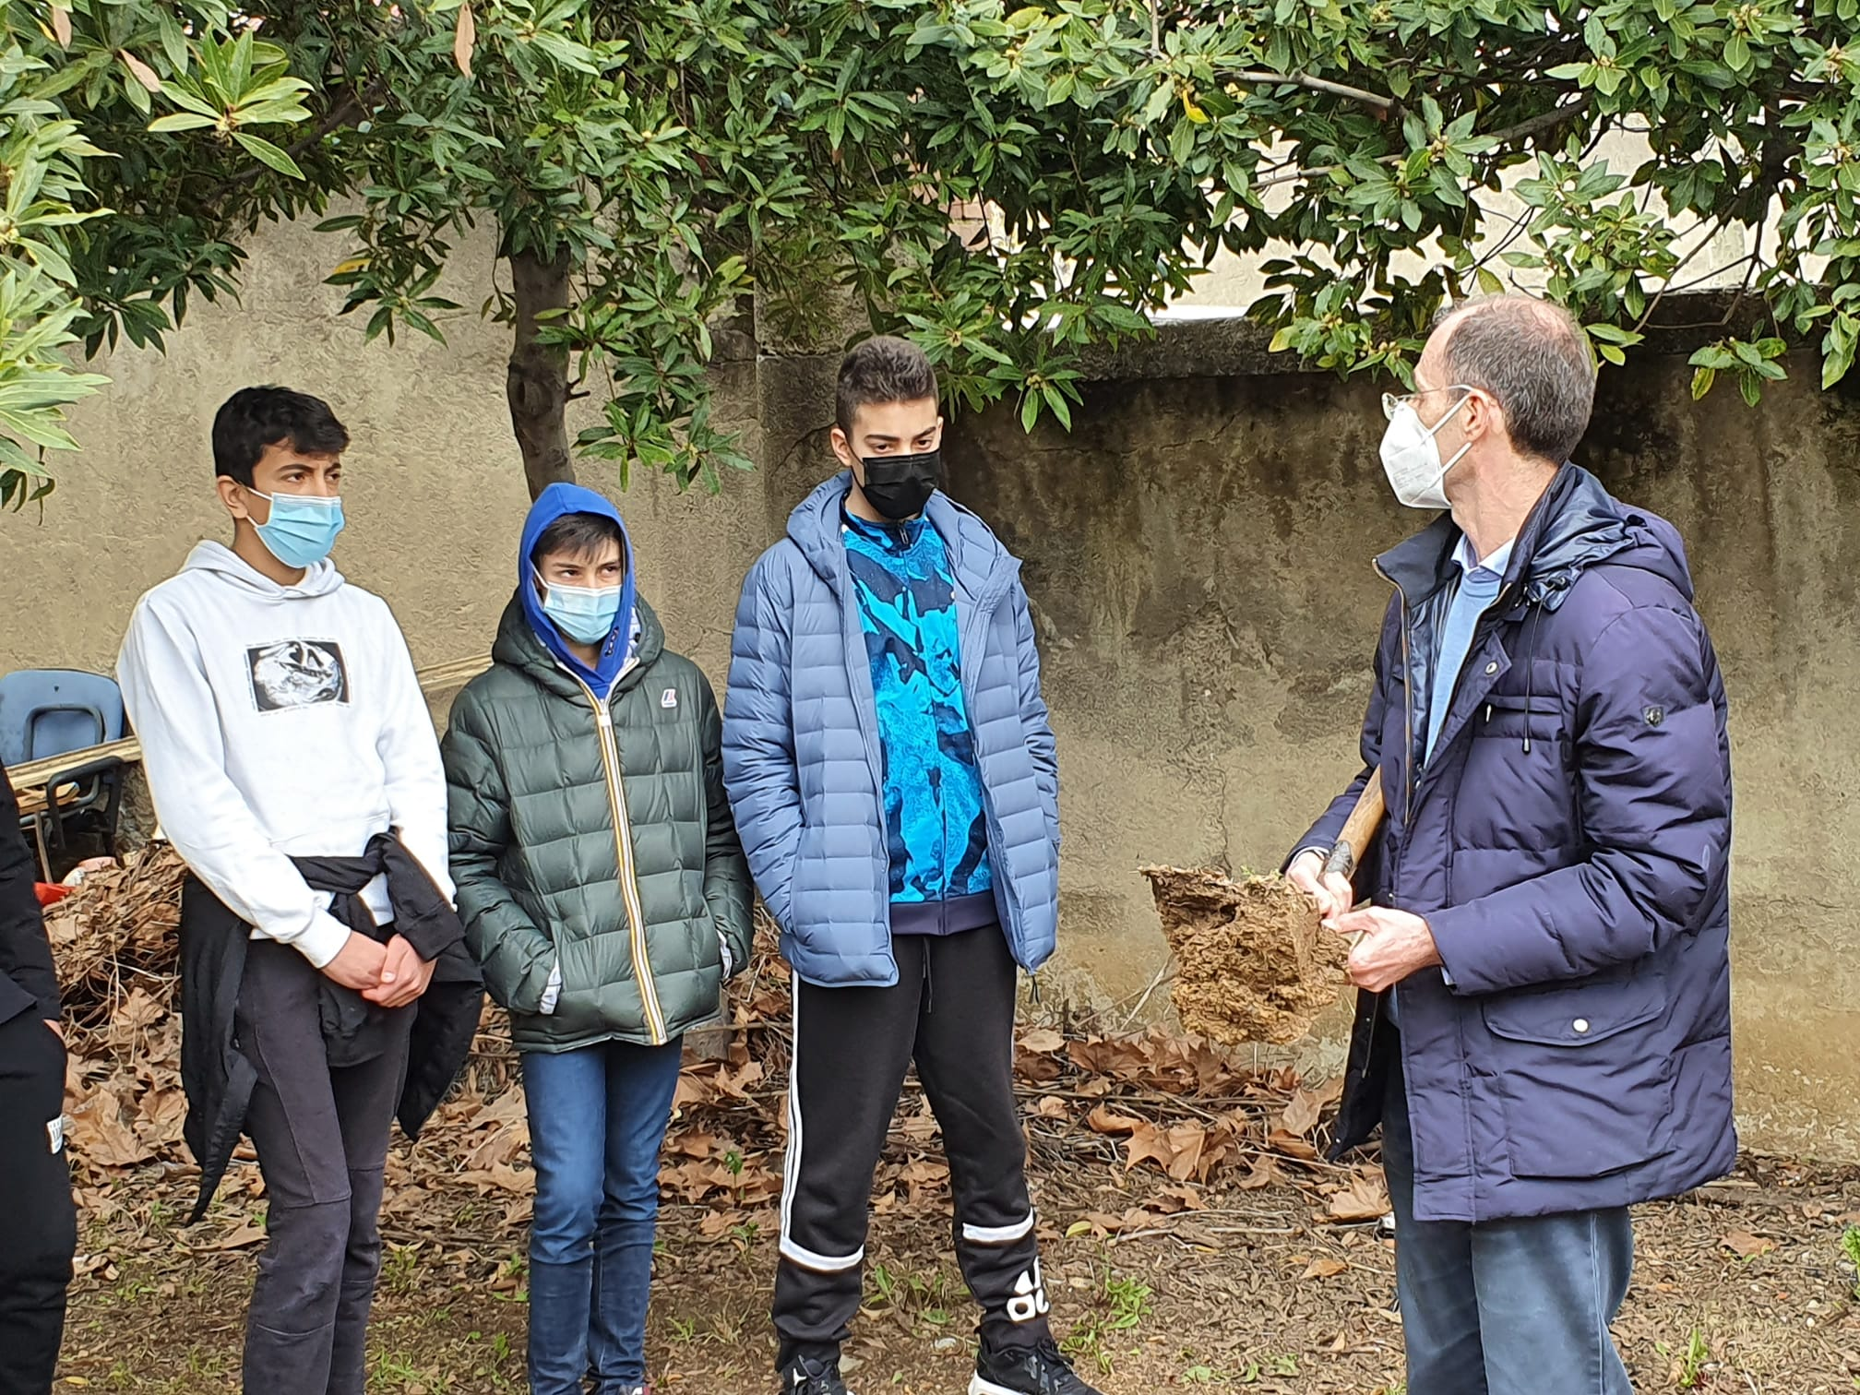
Humic soil, clay soil, limestone soil, all within a few metres of each other in our school beds.

Slide 9
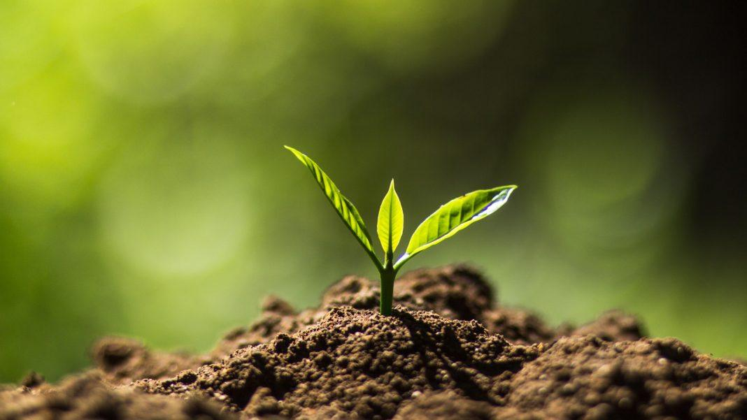
Keep soil alive, let’s protect biodiversity

