Slide 1
Let’s Talk About Soil Poland

Slide 2
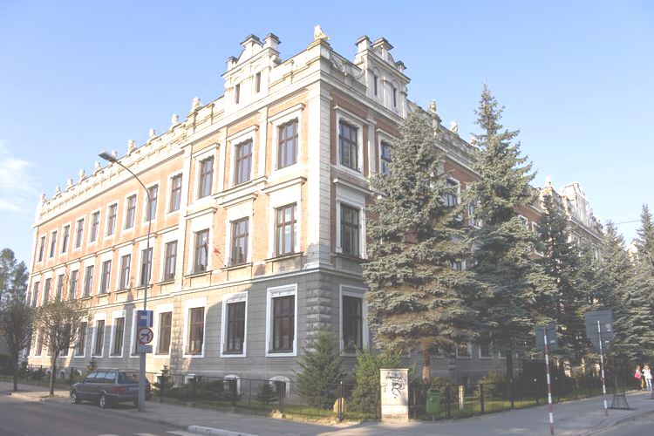
School

Slide 3
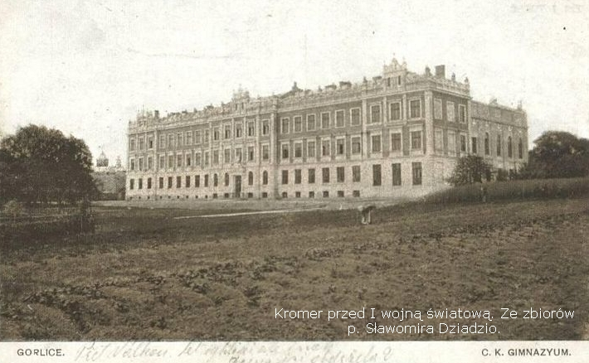
Marcin Kromer Secondary School in Gorlice is the oldest secondary school in the area, founded in 1906. The building of the school is one of the most magnificent buildings in the town. It was completed in 1913. The school was named after Marcin Kromer in1918.

Slide 4
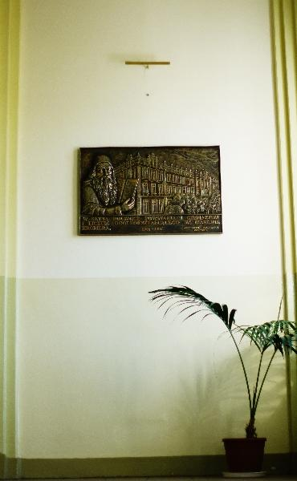
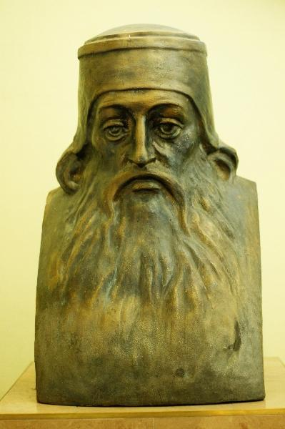
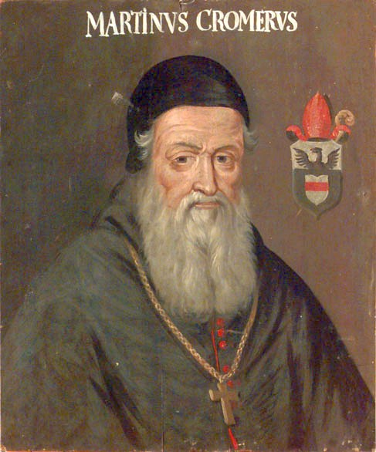
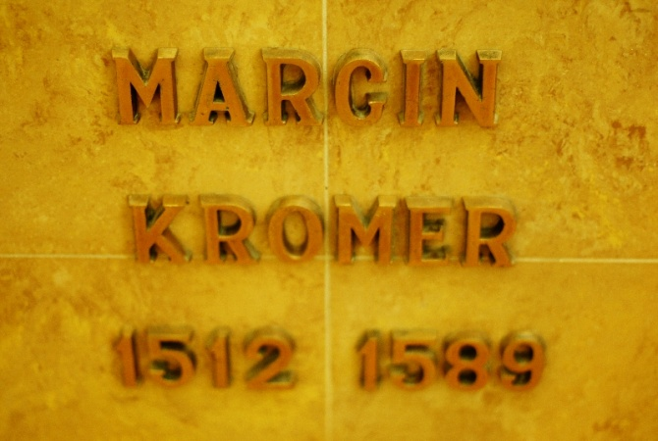
Marcin Kromer belonged to the group of the most distinguished Polish humanists of the 16th century. He was a historian, writer, music expert, diplomat and priest.

Slide 5
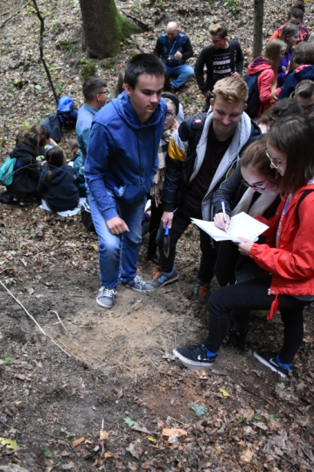
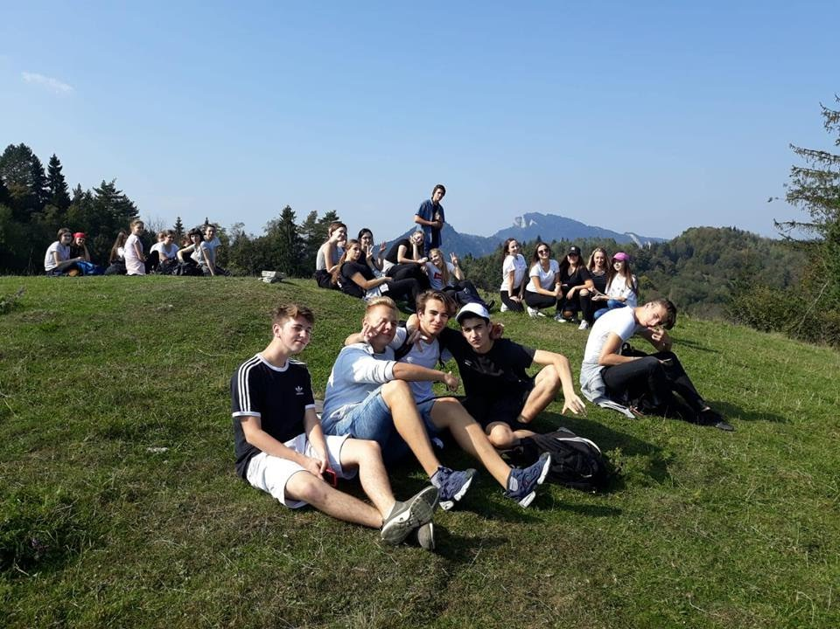
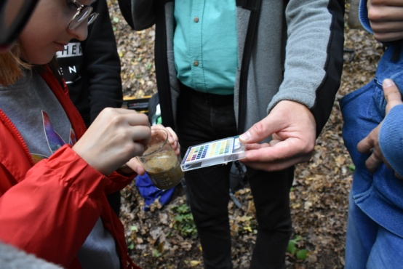
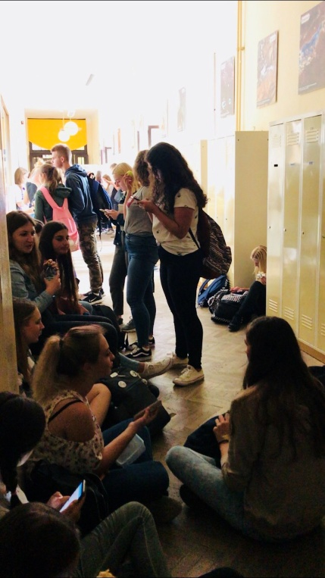
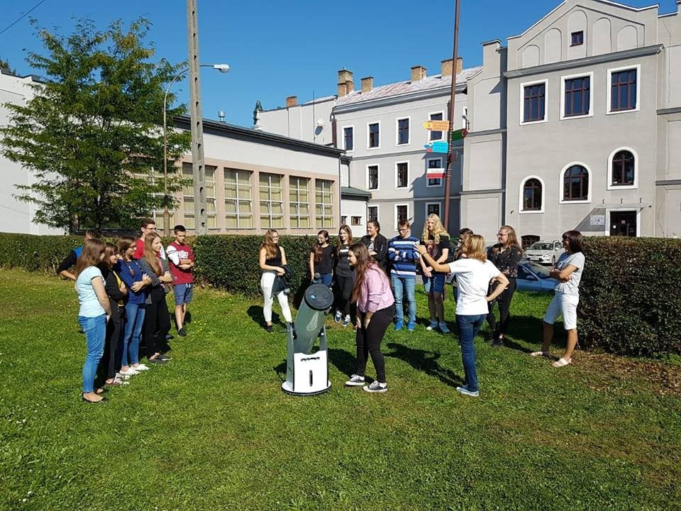
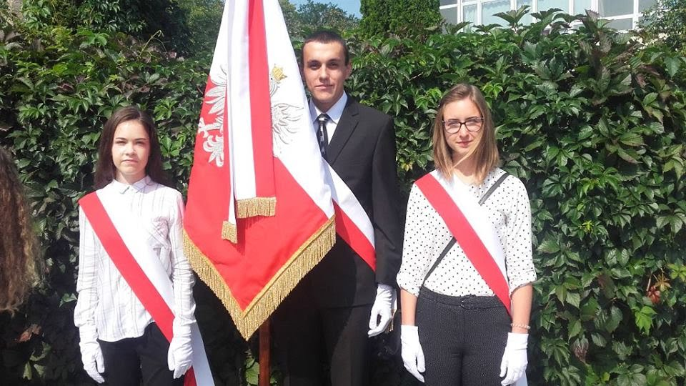
Our school offers a range of after school clubs in science, maths, sports, music, computer technology
foreign languages, biology and Polish. Secondary school education lasts three years. There are 580 students this year.

Slide 6
The town of Gorlice

Slide 7
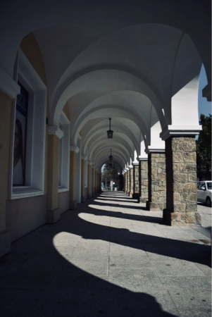
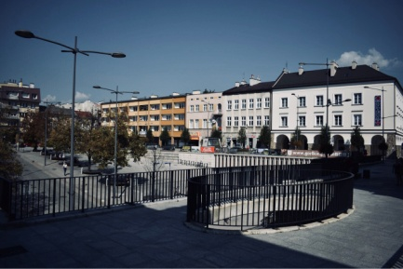
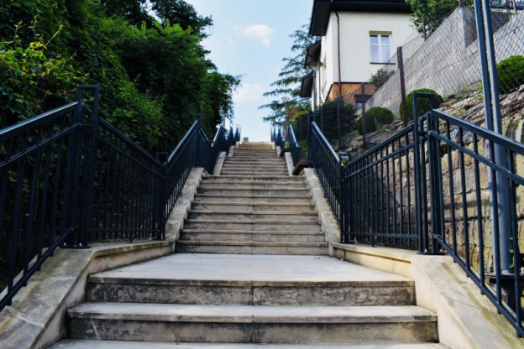
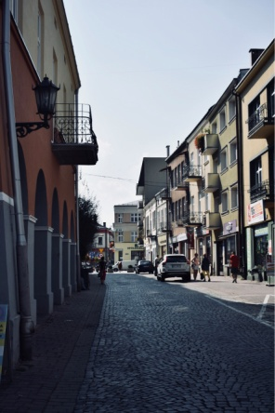
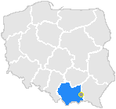
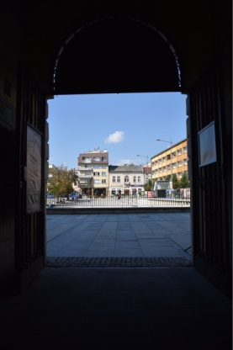
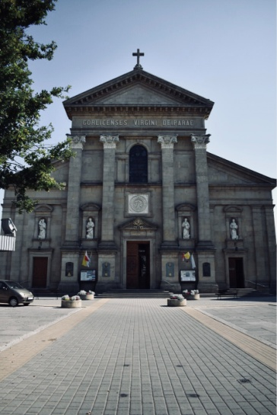
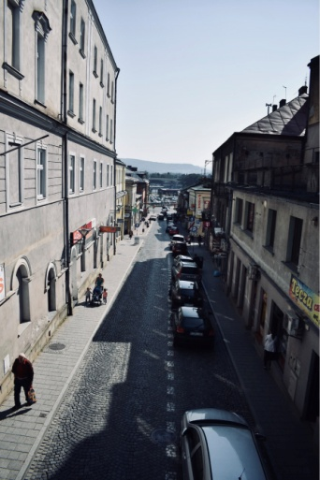
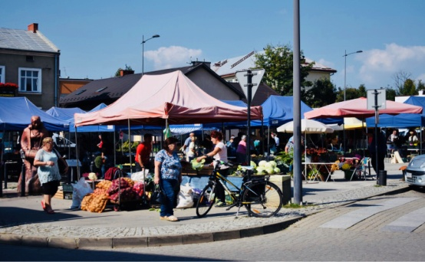
Gorlice is a small town located in the district of Małopolska, at the Ropa River in the Beskid Niski Mountains.
http://mapa.livecity.pl/miasto/Gorlice,0959903

Slide 8
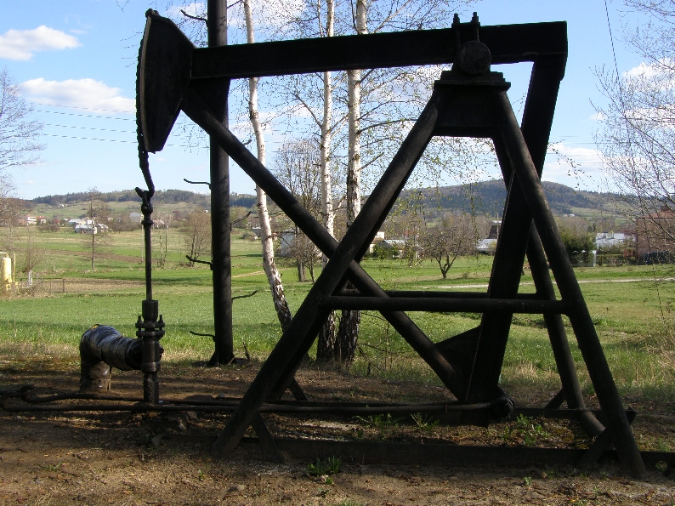
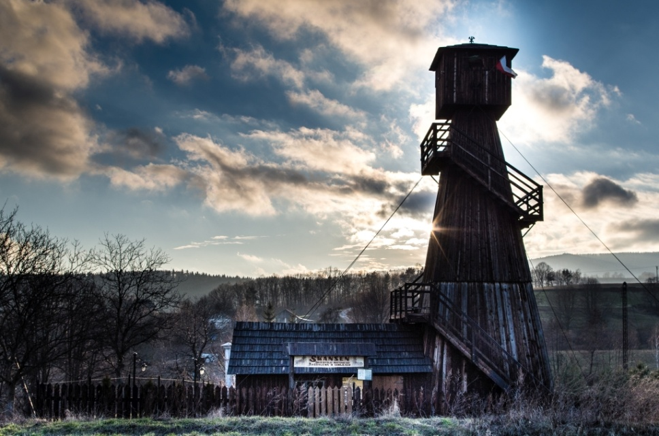
The area of Gorlice is the cradle of the world oil industry.
http://www.gmina.gorlice.pl/index.php?pid=94&id=77-miejscowosci_zabytki
http://www.gorlice.pl/pl/333/0/karpacki-trakt-naftowy.html

Slide 9
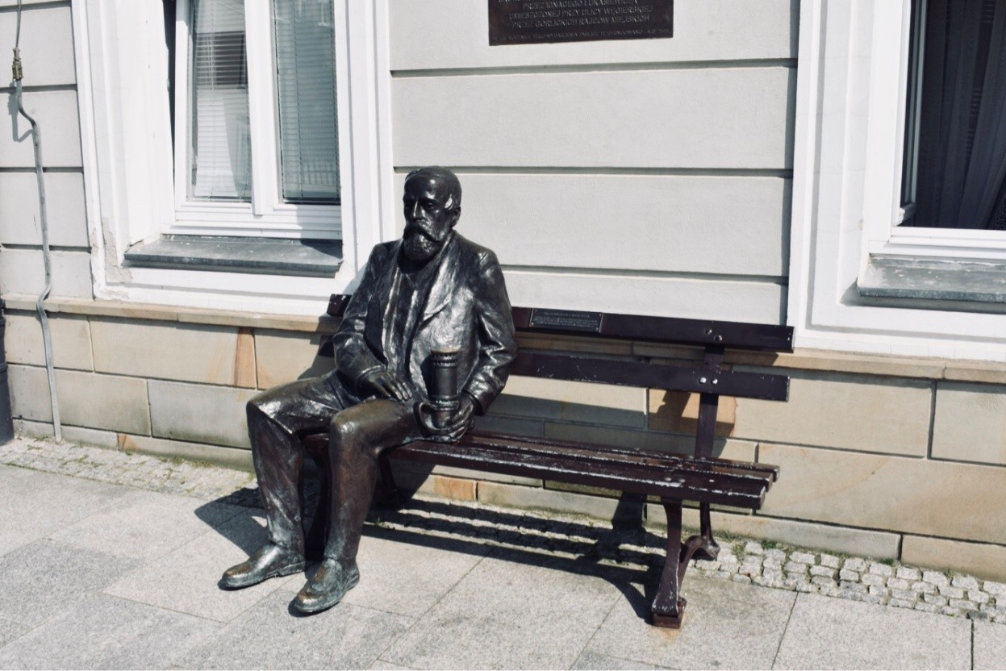
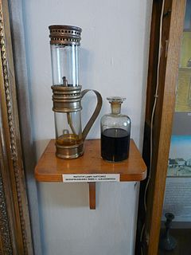
Ignacy Łukasiewicz, the inventor and constructor of the first oil lamp, lived and worked here. Also here, in Gorlice, the first in the world oil lamp was lit in 1854.
https://pl.wikipedia.org/wiki/Lampa_naftowa

Slide 10
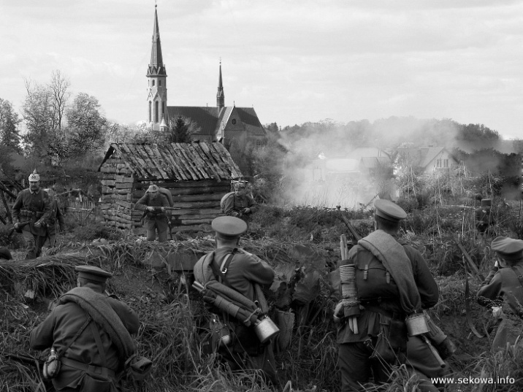
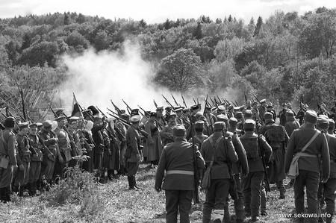
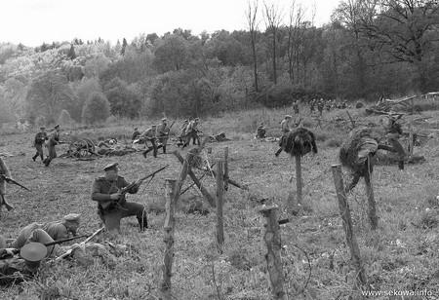
Gorlice was an important strategic point in the First World War. Here, in 1914 the famous Battle of Gorlice took place.
http://www.sekowa.info/index.php?go=12&id2=688
http://www.sekowa.info/index.php?go=12&id2=688
http://www.sekowa.info/index.php?go=12&id2=688

Slide 11
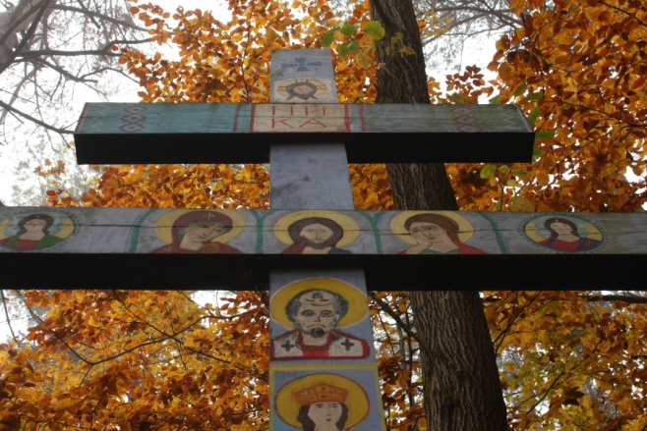
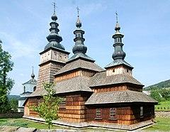
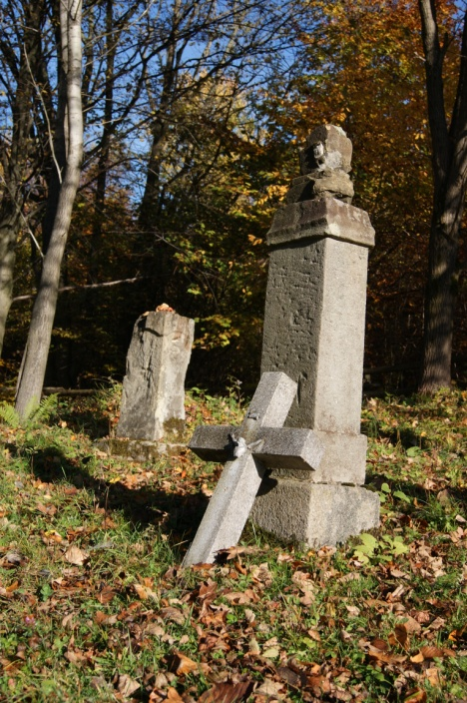
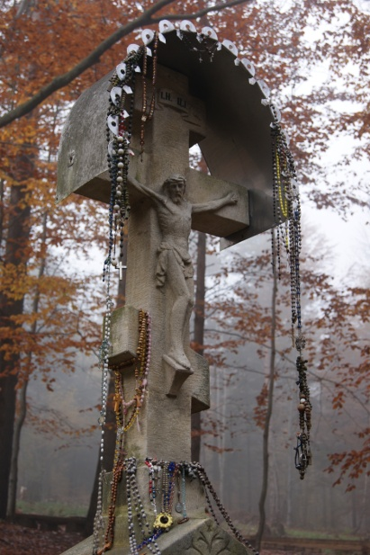
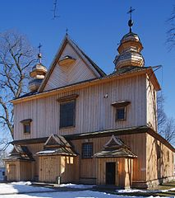
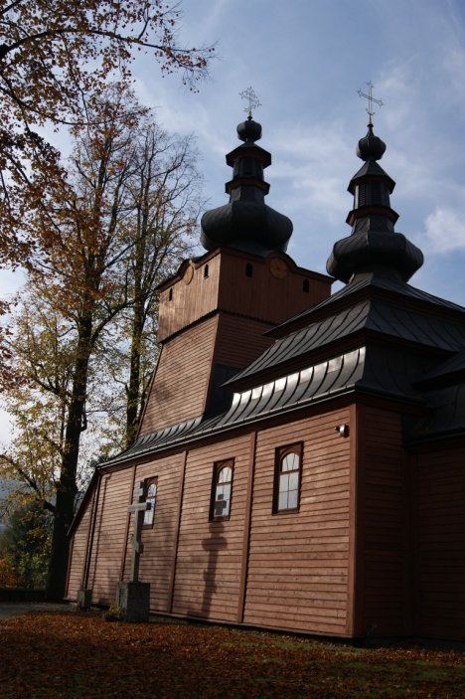
Now, there are numerous war cemeteries and monuments in the nearby villages and on the mountain hills.
https://pl.wikipedia.org/wiki/Owczary_(powiat_gorlicki)
https://pl.wikipedia.org/wiki/Ko%C5%9Bci%C3%B3%C5%82_%C5%9Bw._Micha%C5%82a_Archanio%C5%82a_w_Szalowej

Slide 12
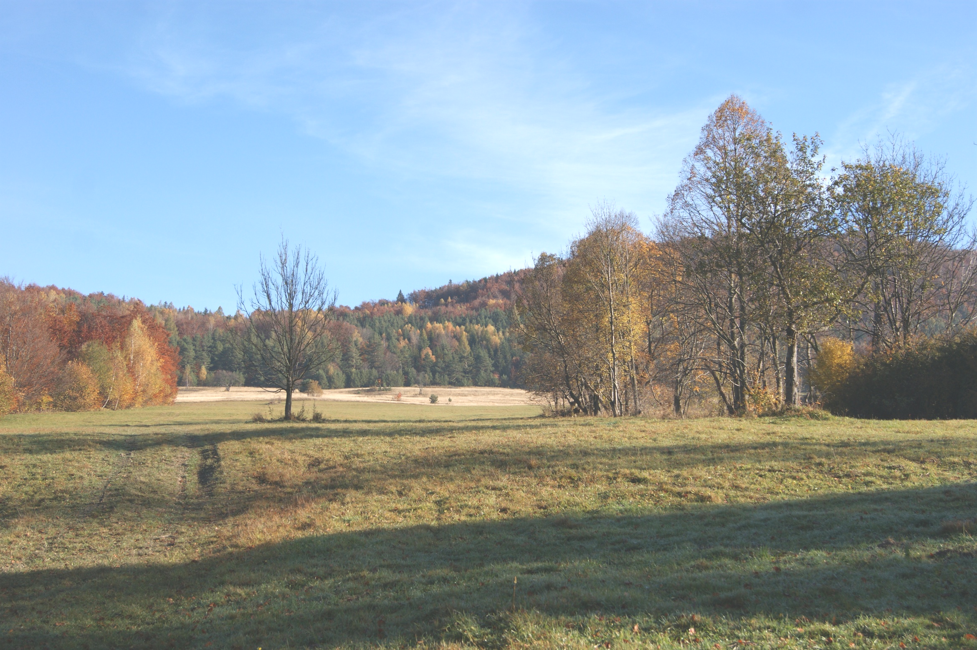
Beskid Niski

Slide 13
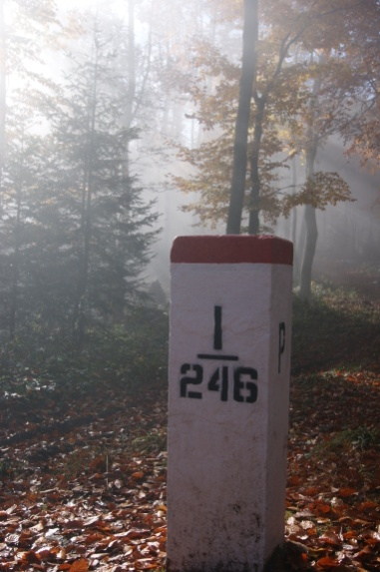
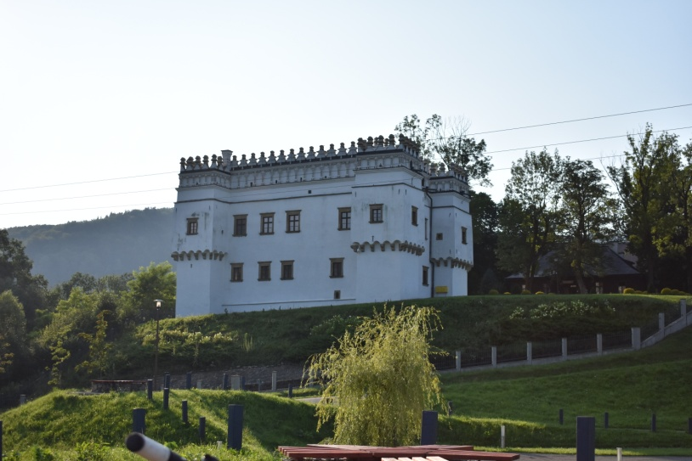
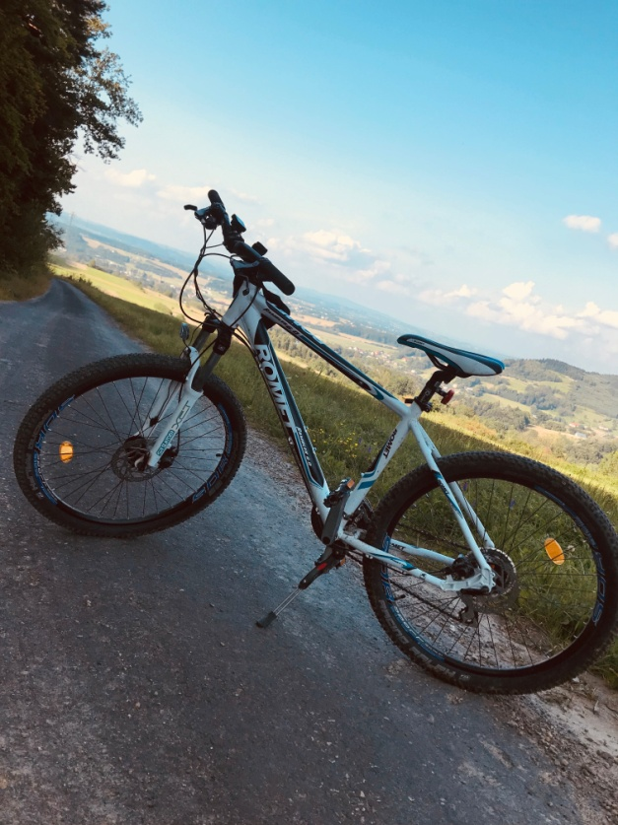
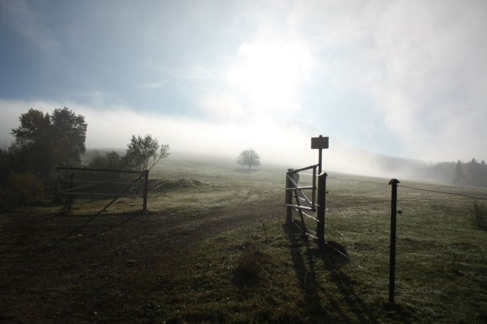
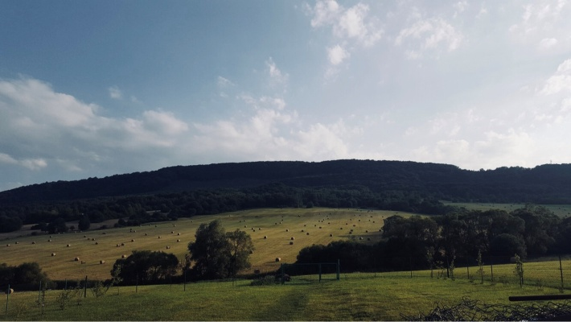
In the area of Gorlice there are many leisure facilities such as football stadiums, ski slopes, swimming pools. There are also many tourist trails in the surrounding forests.

Slide 14
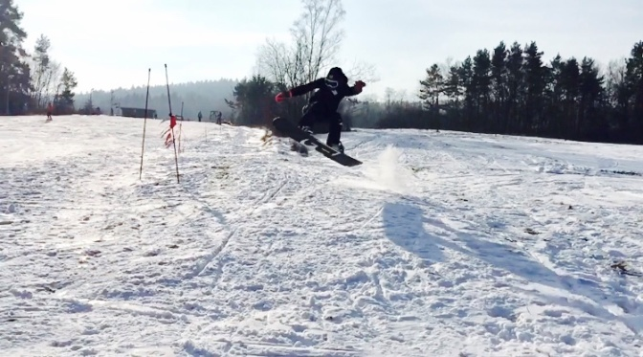
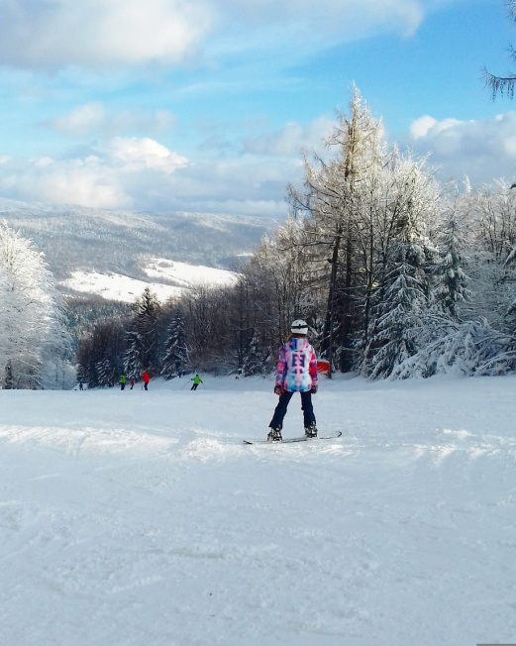
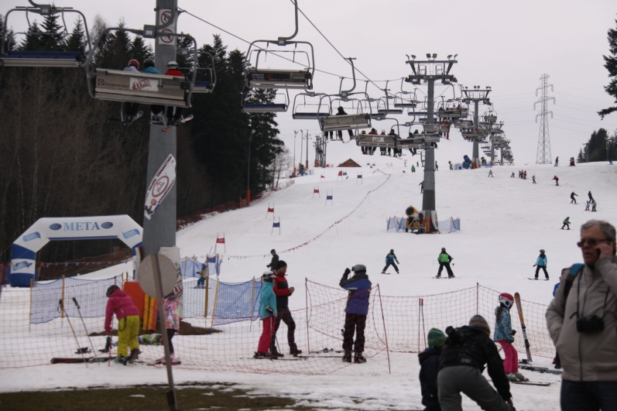
In winter you can go skiing, snowboarding or cross-country skiing here.

Slide 15
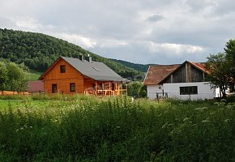
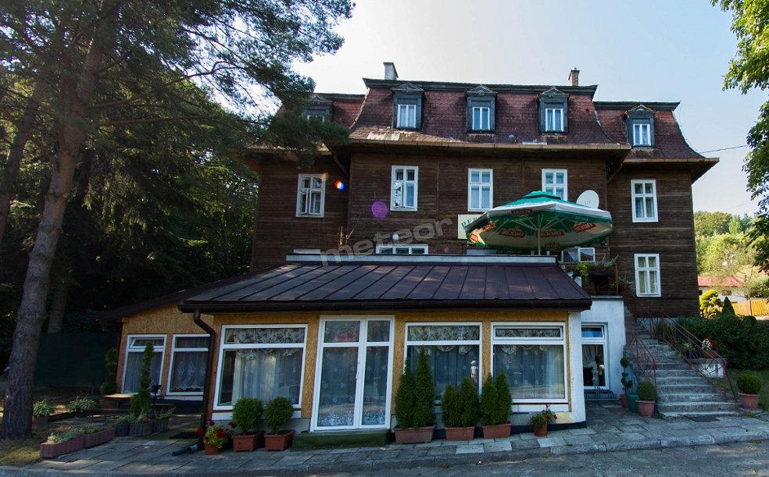
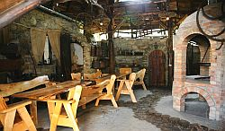
If you want to stay longer in this area, you can book a room in numerous bed-and-breakfasts.
https://meteor-turystyka.pl/willaperelka,szymbark.html
https://meteor-turystyka.pl/skraweknieba-losie,losie.htm
http://www.123noclegi.pl/malopolskie/mecina.html

Slide 16
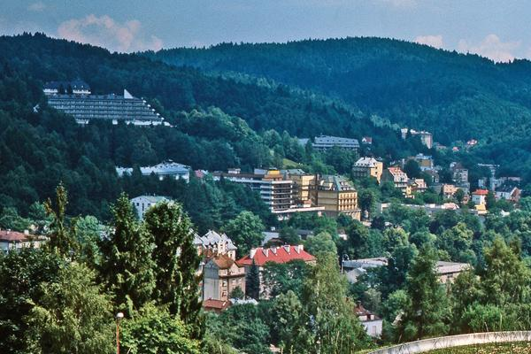
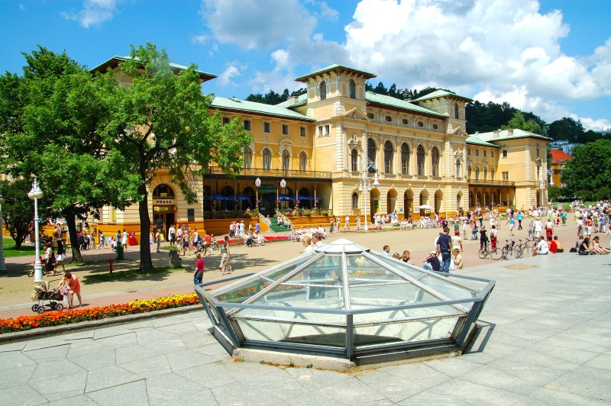
Krynica Zdrój
Krynica is the biggest SPA in Poland.
http://www.krynica-zdroj.pl/
http://www.krynica.pl/Wody-mineralne-c71.html

Slide 17
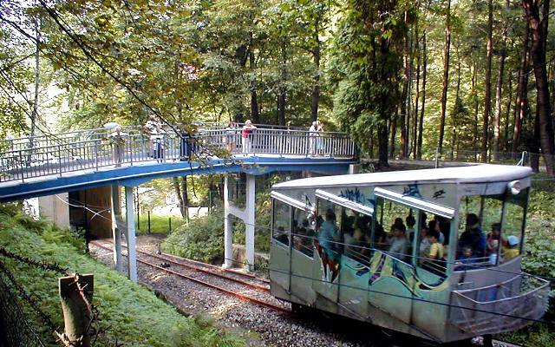
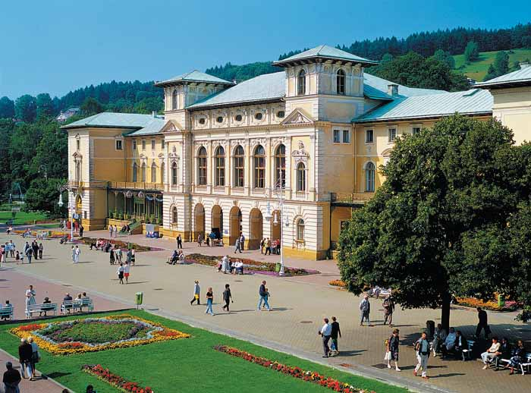
You can find here the Museum of Toys, a Pump Room and Wooden Architecture Trail. There are a lot of most beautiful examples of wooden architecture in the town, so it’s a fine place to take a walk and relax.
https://gazetakrakowska.pl/tag/gora-parkowa
http://www.beskidsadecki.eu/index.php?id=sadecki_miejscowosci&sk=Krynica

Slide 18
Pump Room
There is a range of medical mineral waters of different kinds such as Jan, Słotwinka, Tadeusz, Zdrój Główny or Zuber. The last one is extremely famous because it cures stomach and digestive problems.
http://www.krynica-zdroj.pl/pl/362/12/pijalnia-slotwinka.html
http://www.garnek.pl/ewinek2/2823719/krynica-zdroj-pijalnia-wod

Slide 19
Stróże Bartnik Sądecki
Bee garden Sądecki Bartnik buys and sells all possible bee products.They particularly care about the quality of honey.
/
http://www.krajoznawcy.info.pl/bartnik-sadecki-czyli-krolestwo-pszczol-37302
http://ekologia.yum.pl/index.php/pasieka-hodowlana-sadecki-bartnik/

Slide 20
http://ozpsandomierz.pl/2017/02/25/dom-pszczelarza-w-kamiannej
http://www.appen.pl/koronasadecka/?attachment_id=313

Slide 21
Mountains

Slide 22
The Tatra Mountains
You can take active holiday here, climbing, hiking and admiring the breathtaking views.

Slide 23
In winter you can practise different kinds of winter sports here.
The highest peak in Poland is Rysy at 2499 m.
http://jozef-pyce.flog.pl/wpis/10541266/slawkowski-szczyt-widok-na-gerlach
http://gorskazawierucha.pl/tatry/tatry-wysokie/rysy/attachment/rysy-19-ciezki-szczyt-wysoka-i-gerlach/

Slide 24
Bieszczady Mountains

Slide 25
Pieniny Mountains

Slide 26
The most beautiful cities and places in Poland.

Slide 27
Cracow
Cracow is the ex- capital of Poland and the main tourist attraction in the south of our country. There are a lot of magnificent monuments here, like St Mary’s Church or the most famous Wawel Castle- in the past the home to the Polish royal families.
https://krakow.onet.pl/wawel

Slide 28
One of the most glamourous sites in Cracow is its Main Market Square which is one of the most famous medieval town squares in Europe.
https://fr.dreamstime.com/images-stock-cracovie-%C3%A9glise-de-rue-mary-pologne-image23342644

Slide 29
Wrocław
The fourth biggest city in Poland.There are over 8 000 historical buildings from 19th and early 20th centuries.

Slide 31
Warsaw
Warsaw is the capital of Poland and the biggest Polish city with the population of 2mln.
https://pl.abpoland.com/package/trakt-krolewski/
http://podroze.gazeta.pl/podroze/7,114158,20244742,warszawa-atrakcje-co-warto-zobaczyc-i-zwiedzic.html
https://pl.wikivoyage.org/wiki/Warszawa#/media/File:Warsaw_-_Royal_Castle_Square.jpg

Slide 32
Places to see in Warsaw:
The Royal Castle
Łazienki Royal Park
National Football Stadium
https://www.lazienki-krolewskie.pl/pl/poznaj-lazienki
https://pl.wikipedia.org/wiki/Zamek_Kr%C3%B3lewski_w_Warszawie

Slide 33
Moszna Castle
The Moszna Castle - a barque palace- is located near Opole.
https://www.polskieszlaki.pl/zamek-w-mosznej.htm
http://www.polskazdrona.pl/zamek-moszna-49.html
http://niezlasztuka.net/podroze/moszna-zamek-w-polsce-jak-z-filmu-harry-potter/

Slide 34
Energylandia Theme Park in Zator

Slide 36
The Baltic Sea

Slide 37
The Baltic Sea has beautiful sandy beaches.

Slide 38
The dunes in Słowinski National Park are located by the Baltic Sea near Łeba. It’s the biggest area of moving dunes in Europe. The dunes look like the Sahara Desert.

Slide 39
Gdańsk
Gdańsk is the biggest town at the seaside. It is famous for its Neptun Fountain, Town Hall and the Old Town.

Slide 40
The Mazury Lakes
This area of beautiful lakes is located in the north-west of Poland. You can go sailing here or do other water sports.
https://pl.pinterest.com/pin/637892734694576285/
http://www.national-geographic.pl/traveler/kierunki/10-ciekawostek-o-mazurach-ktore-moga-cie-zaskoczyc

Slide 41
Interesting Facts
Poland is the biggest amber exporter in the world
Almost 35% of Poles live abroad
There are 32 letters in the Polish alphabet while there are only 26 in the English one

Slide 42
The End
This presentation has been made by:
Wiktor Kretowicz
Agata Szurek
Izabella Szkaradek
within the framework of Erasmus+ project
Let’s talk about soil

