Slide 1
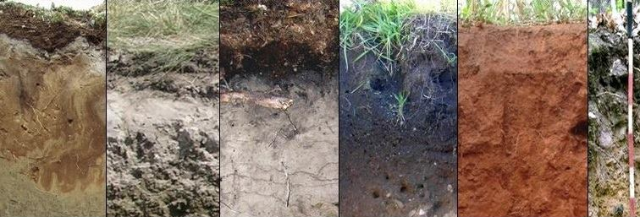
Let`s talk about soil PEDOLOGICAL workshops in carpathian mountains
Erasmus+

Slide 2
We enter Ciezkowice Nature Reserve- the place of our workshops

Slide 3
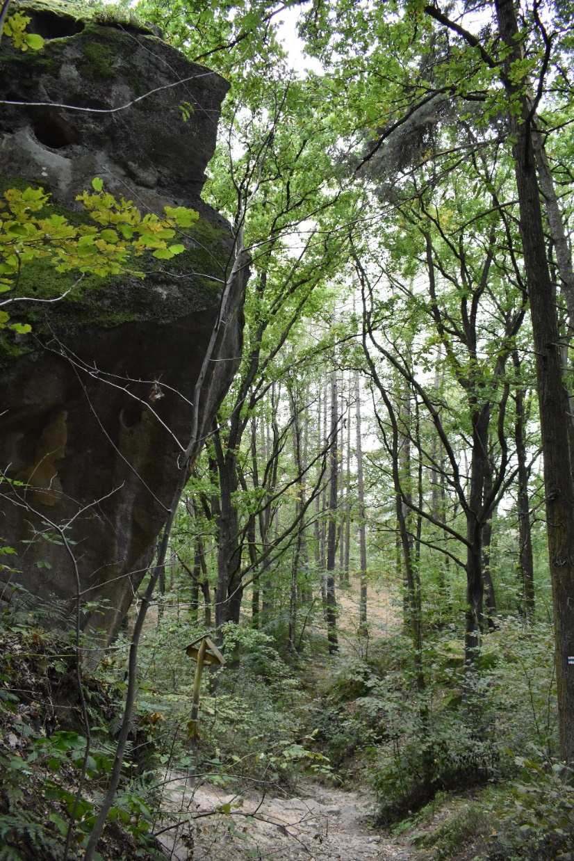
We determine our geographical position

Slide 4
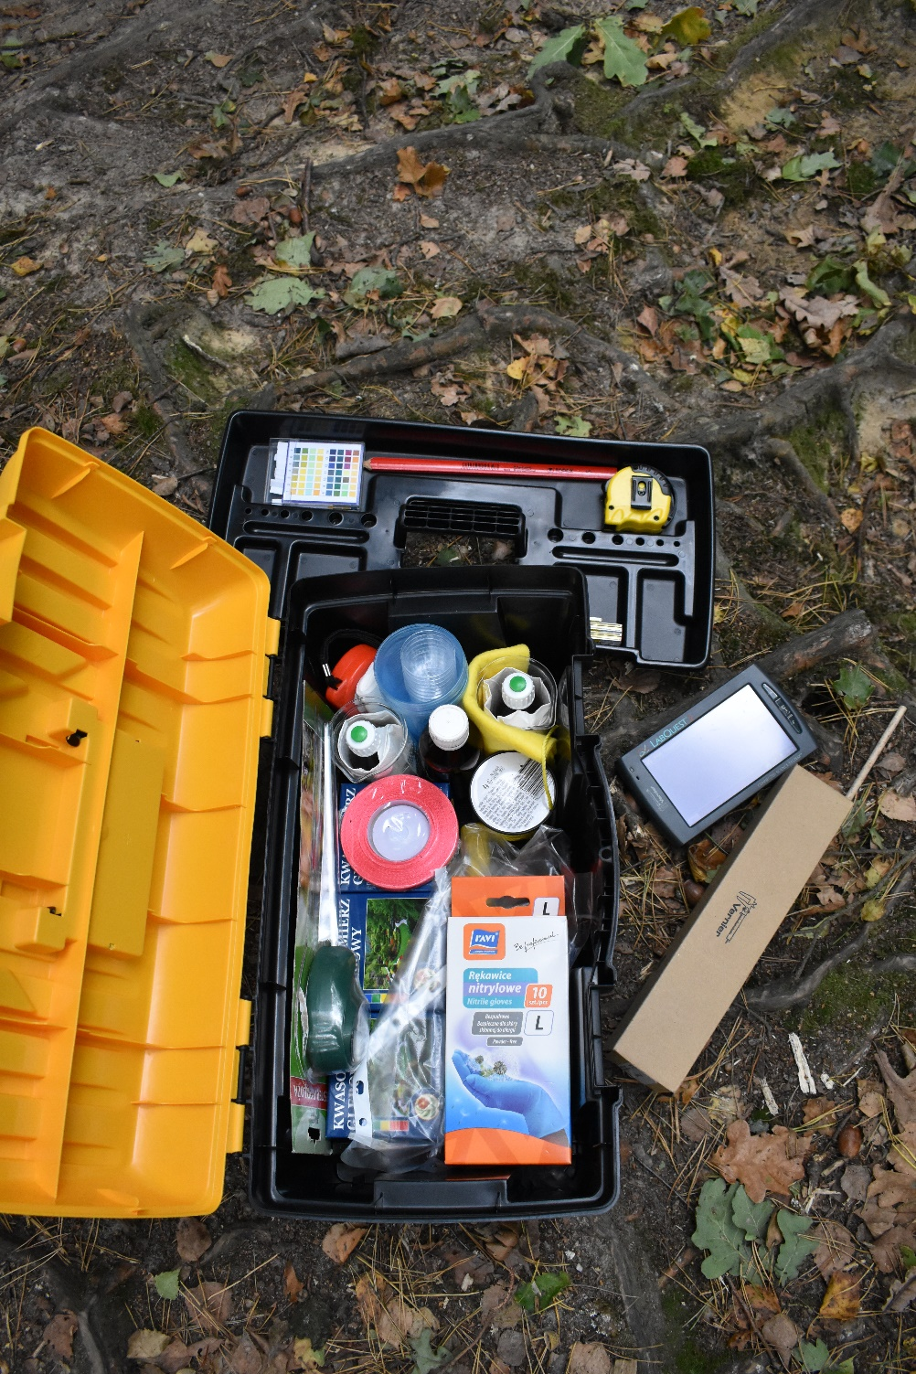

Slide 5
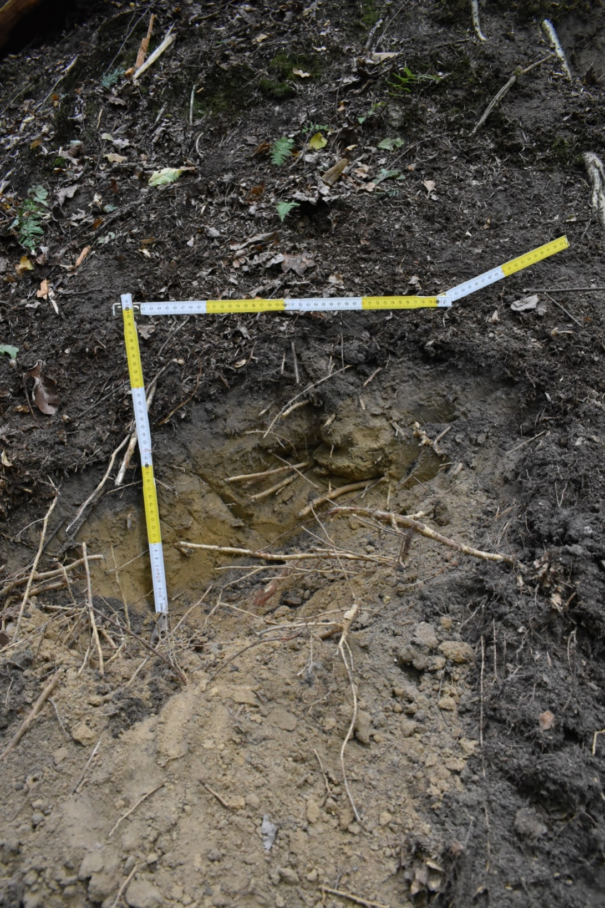
First, we measure
the soil horizon
to 60 cm underground

Slide 6
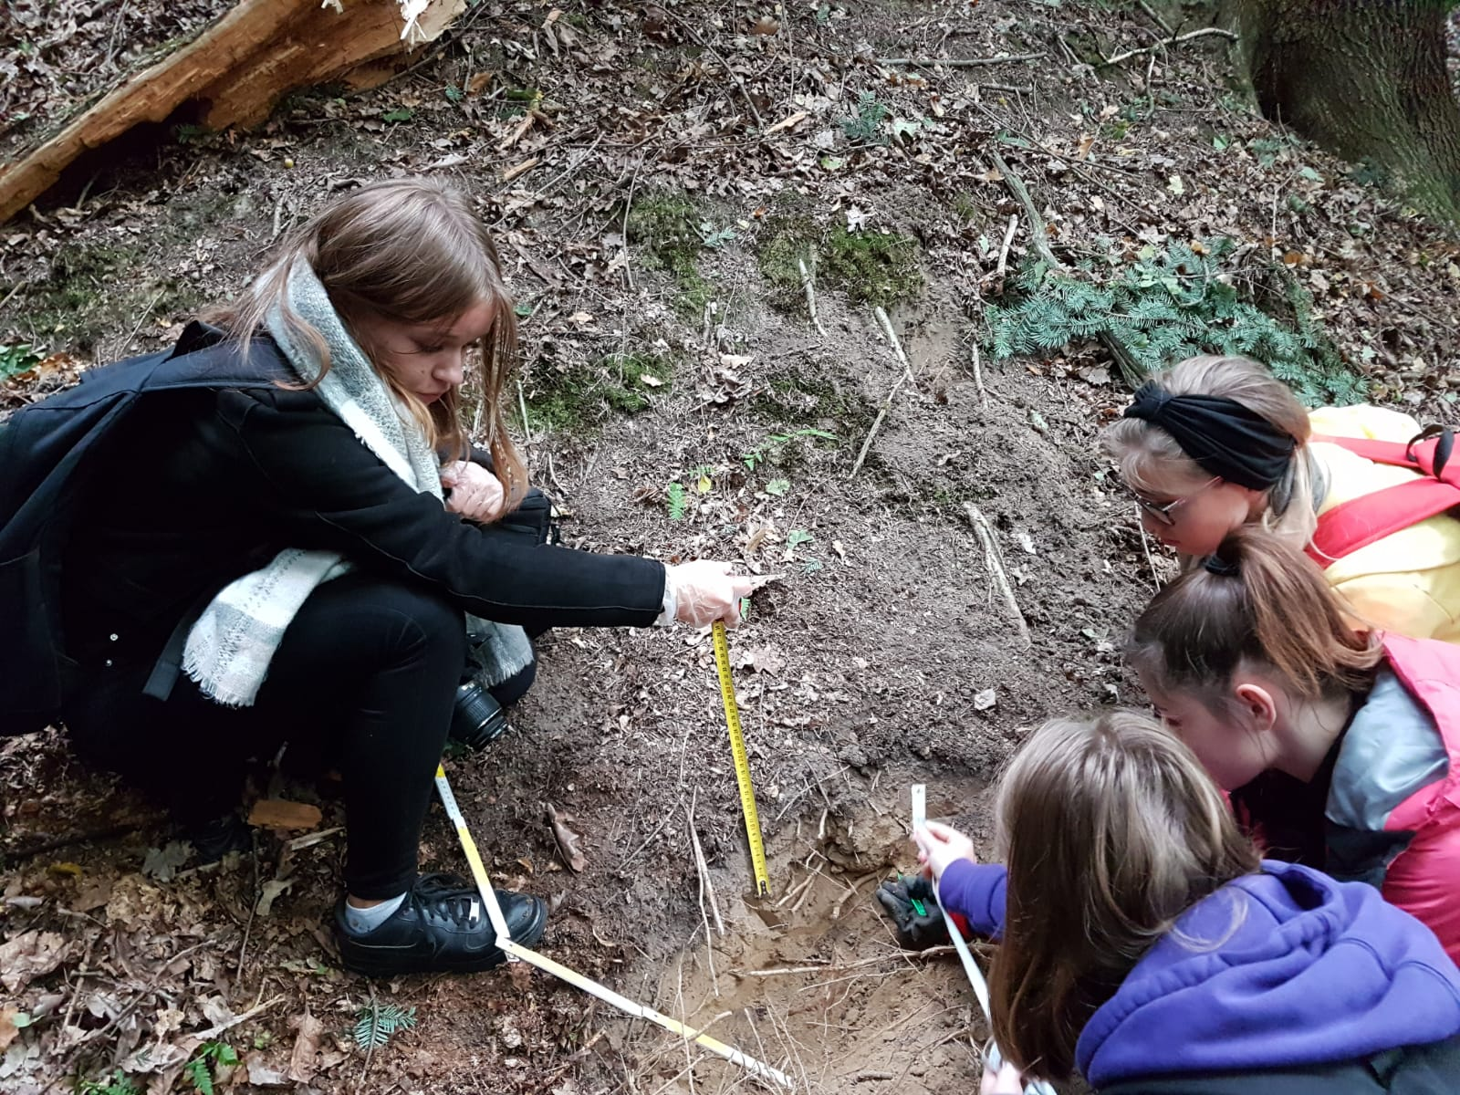

Slide 7
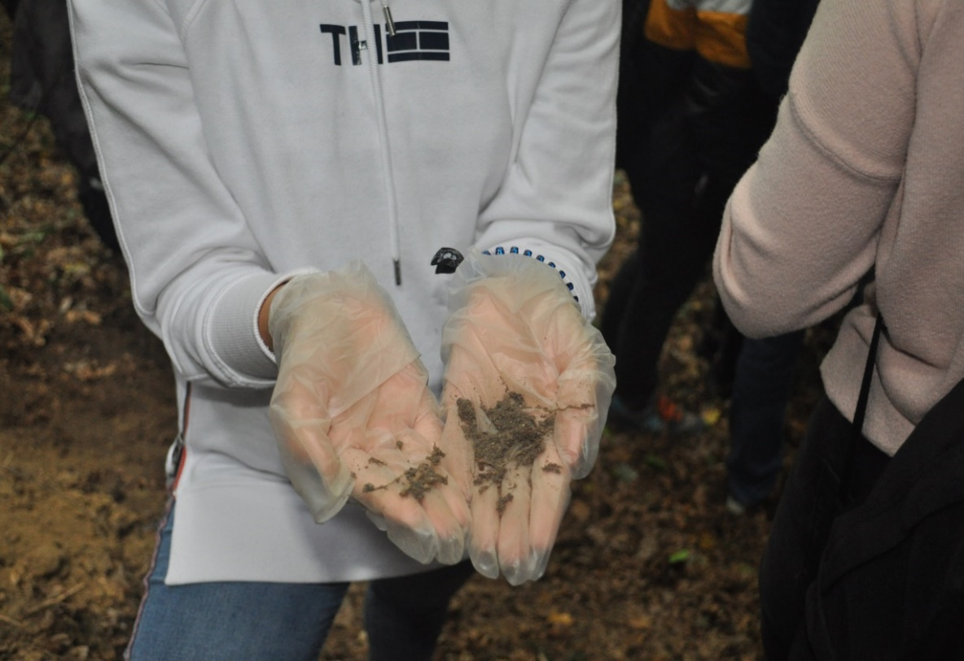
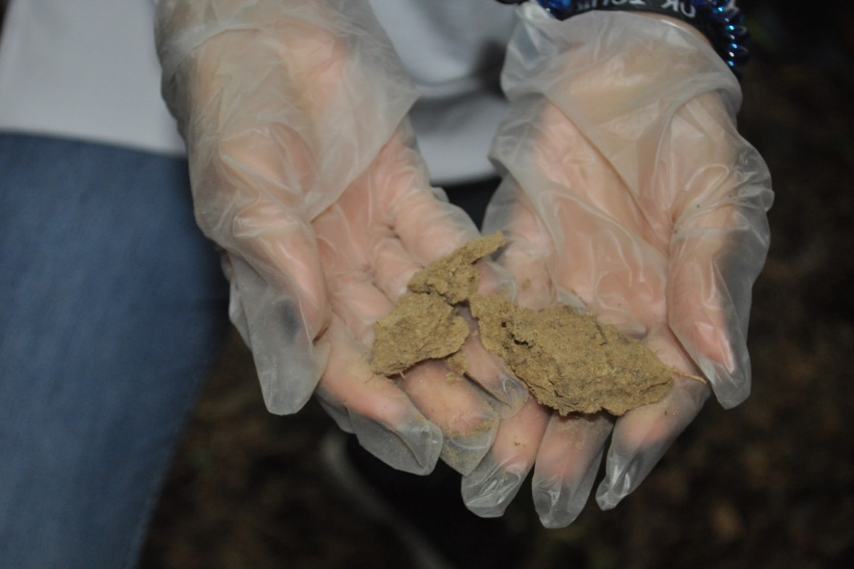
Next, we test the tint of the humus
layer, its texture and moisture.
Then we repeat the same steps for the top soil layer.

Slide 8
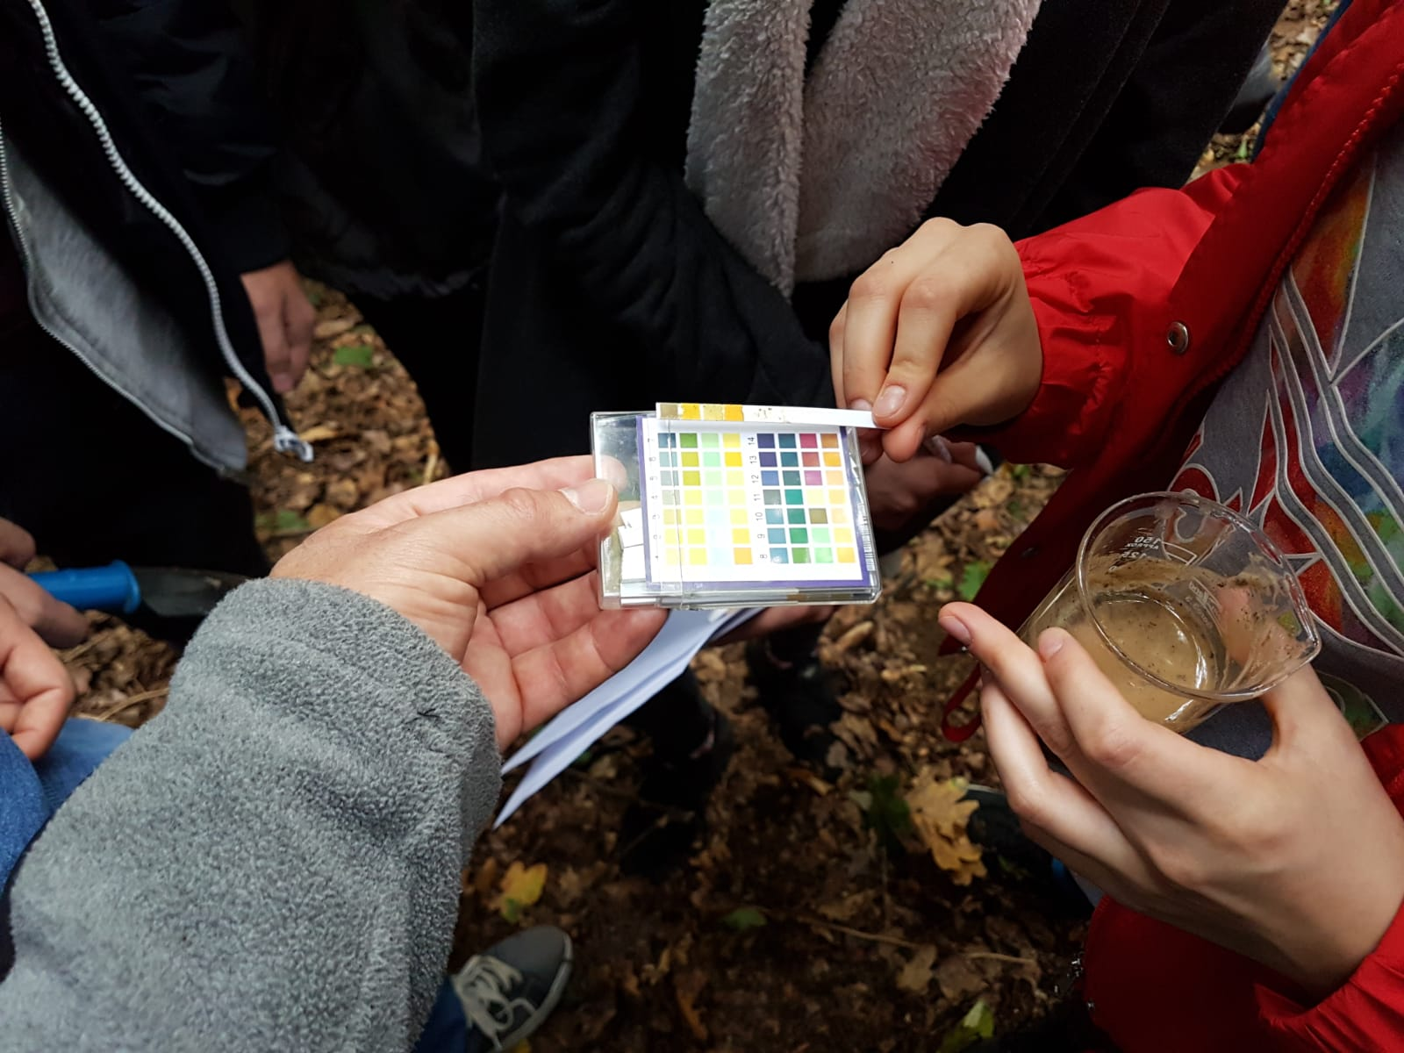
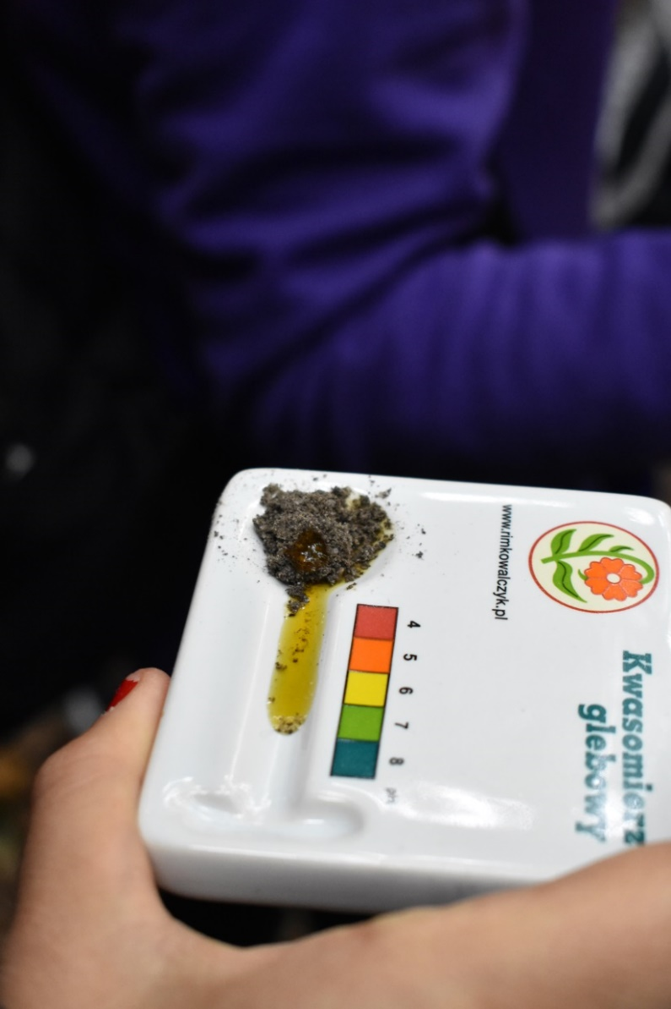
After that we determine the soil pH using a soil acidometer for both layers.

Slide 9
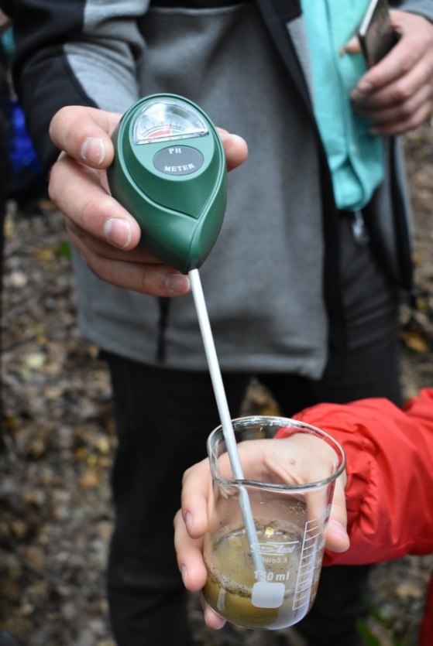

Slide 10
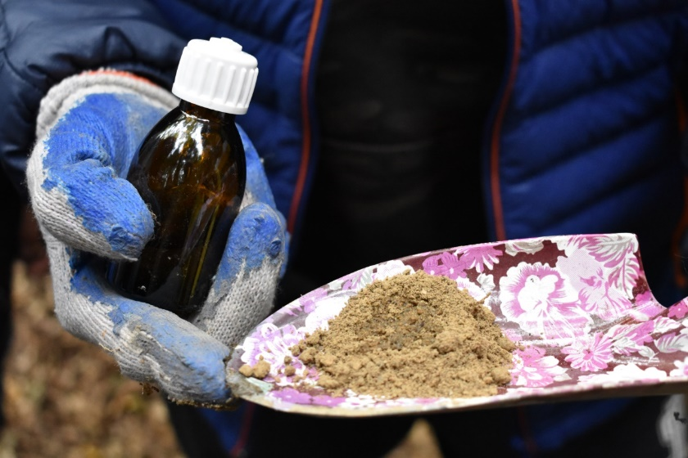
Finally, we test the carbonate minerals within both layers.

Slide 11
Conclusions
Location and description of the soil test pit:
Site: Pogórze Ciężkowickie (Carpathian Mountains, south-east region of Poland)
Elevation: around 320 metres above sea level
Geographic location: 49º 46’ N, 20º 57’ E
Land use: forest
Type of vegetation: mixed forest

Slide 12
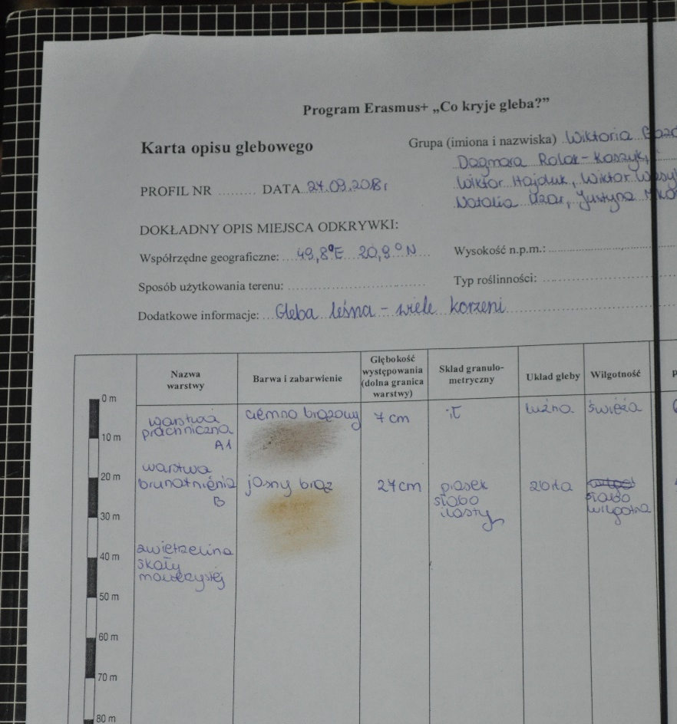
Performed research:
Depth of the soil profile: 60cm
Depth of each soil horizon:
Forest bed (surface layer)- 3cm
Humus (top soil)- 30cm
Partly weathered rock- 20 cm
Colour of soil: brown,yellow
Granulation: dust and sand
Moisture: dry
Soil pH: 5-6 (acidic)
Carbonate content: less than 1% (no reaction with hydrochloric acid solution )

Slide 13
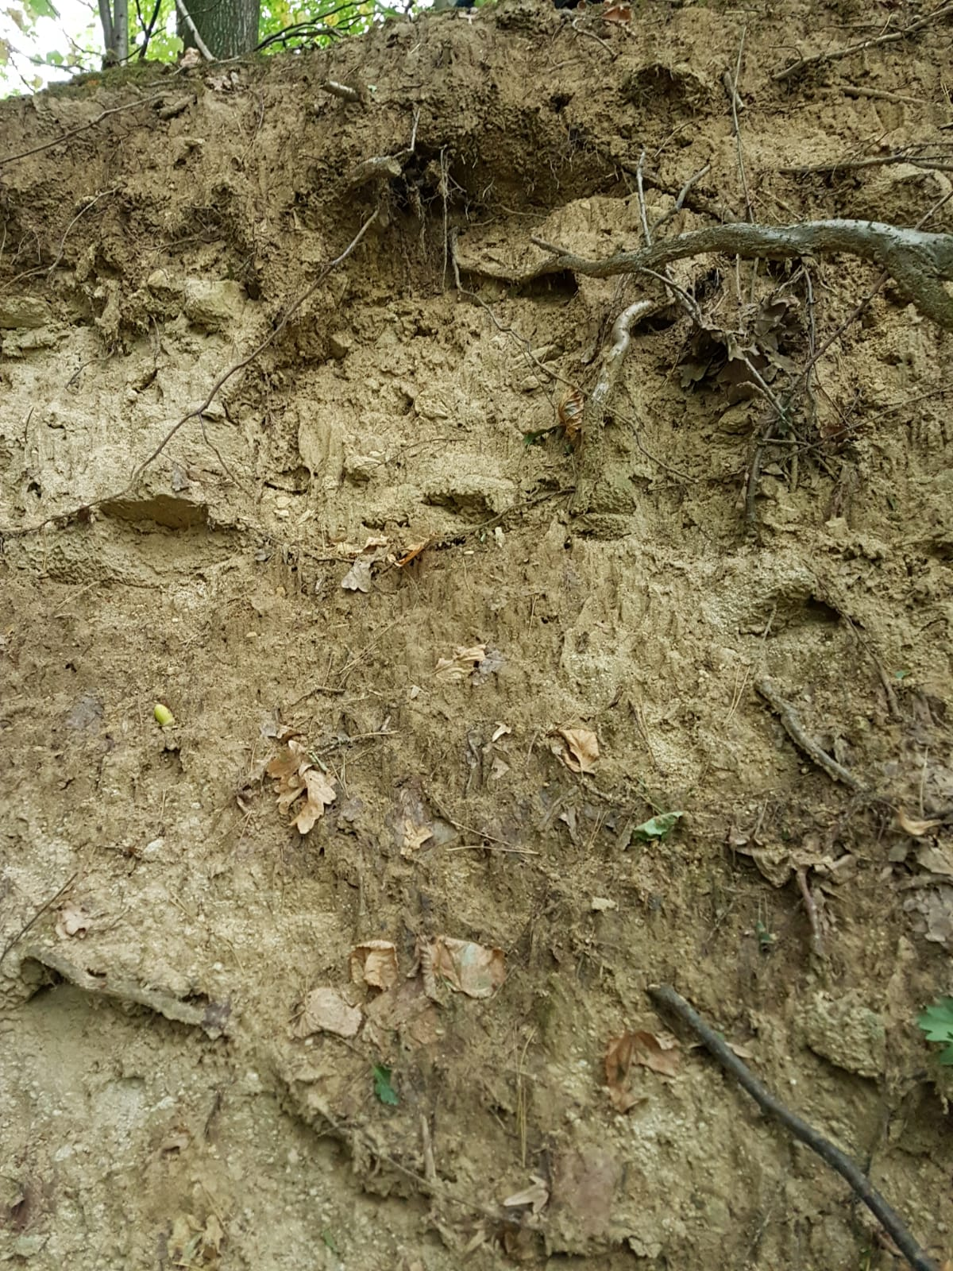
Type of soil
Brown soil (formed on sedimentary rock-sandstone and shale of the Carpathian flysch belt)

Slide 14
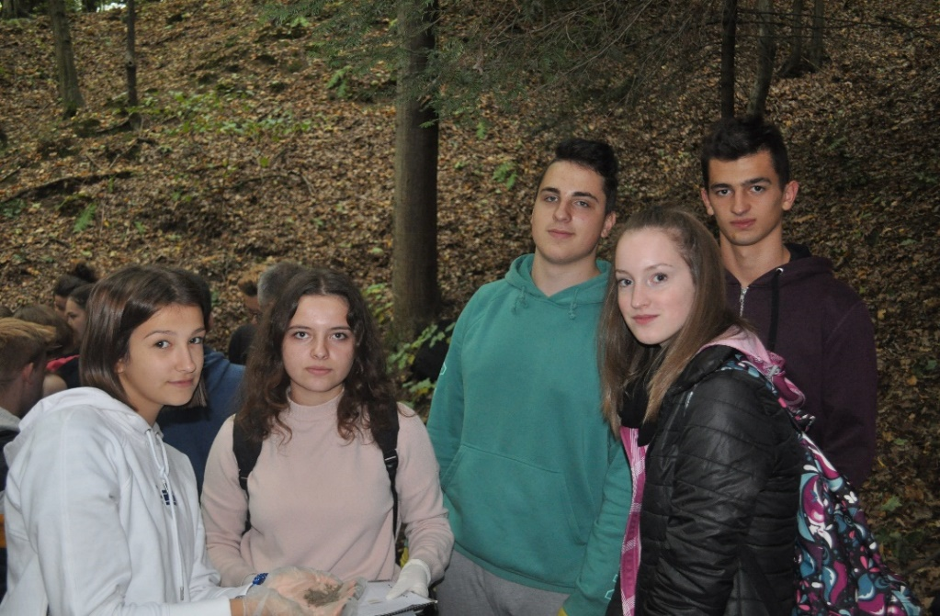
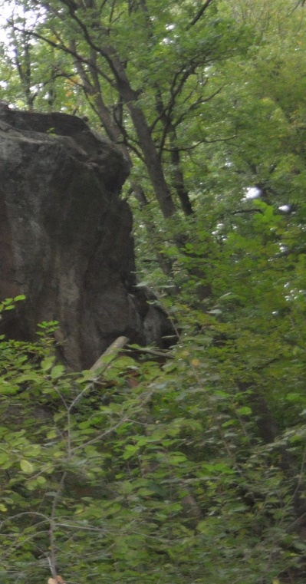
Our team

Slide 15
I Liceum Ogólnokształcące im. M. Kromera
Made by:
Julia Zawlik
Olga Pełechacz
Zuzanna Nikiel

