Slide 1
Investigation of the soil
By jasper chrust, Ramon geenen, Sabine Kooiman & Danique krijgsman

Slide 2
Types of soil
0-21cm (O) mixture of sand, gravel and clay
21-43cm(A) mixture of sand, gravel and clay
43-60cm(A) mixture of sand, gravel and clay
60-80cm(B) mixture of sand, gravel and clay, with a little bit of peat-soil (also called ‘turf’)
80-100cm(C) mostly peat-soil
100-120cm(C) mostly peat-soil

Slide 3
Moisture percentages of the soil
Depth (in cm) | Mass before drying (in g) | Mass after drying (in g) | The amount of moisture (in %)
0-21 | 433,85 | 347,93 | 19,80
21-43 | 532,47 | 397,95 | 25,26
43-60 | 516,27 | 358,67 | 30,53
60-80 | 431,06 | 305,47 | 29,14
80-100 | 415,43 | 279,33 | 32,76
100-120 | 498,56 | 288,96 | 42,04

Slide 4
Level of nitrate
0-21cm 500 mg/L
21-43cm 60 mg/L
43-60cm 30 mg/L
60-80cm 100 mg/L
80-100cm 100 mg/L
100-120cm 100 mg/L

Slide 5
Level of sulfate
Depth (in cm) | Amount of sulfate (in mg/L)
0-21 | Between 400-800
21-43 | Less than 400
43-60 | Less than 400
60-80 | Less than 400
80-100 | Less than 400
100-120 | Less than 400

Slide 6
Level of phosphate
0-21cm 0,5 mg/L
21-43cm 0,25 mg/L
43-60cm 1,5 mg/L
60-80cm 1,0 mg/L
80-100cm 0,75 mg/L
100-120cm 1,25 mg/L

Slide 7
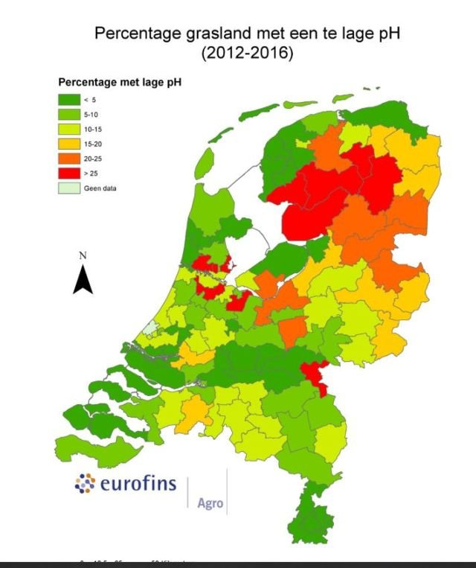
pH-value of the soil
Plants grow at their best, when the pH-value is between the 5 and 6.5
The pH-value in Dutch soil is between the 4 and 26
We found a pH-value in our soil between the 5 and 6

