Slide 1
From Farm to Fork
P.O.C.K.E.T

Slide 2
What is Farming?
Section 1:

Slide 3
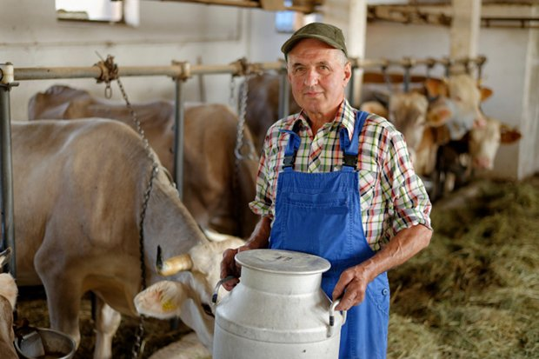
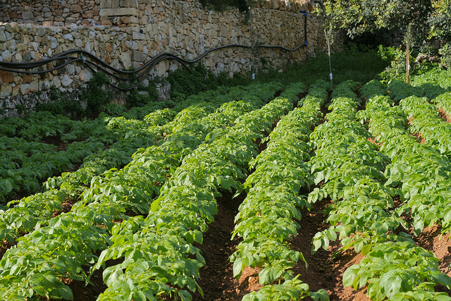
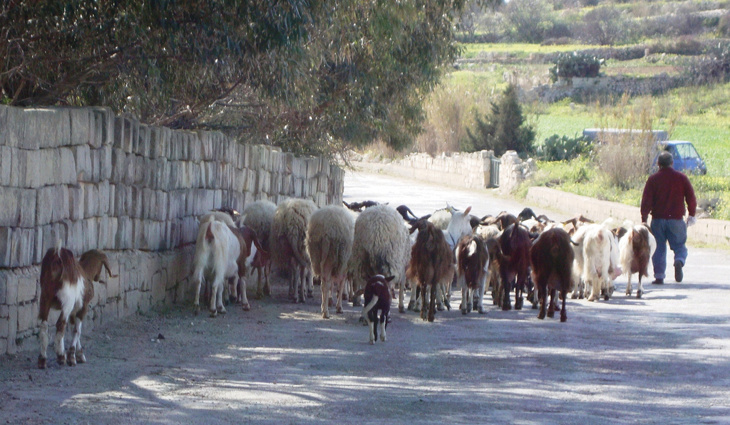
Farming is the process producing crops or raising of animals for human consumption.

Slide 4
Farming could be divided into 5 sectors:
Intensive
Semi-Intensive
Extensive
Mixed Farming
Organic

Slide 5
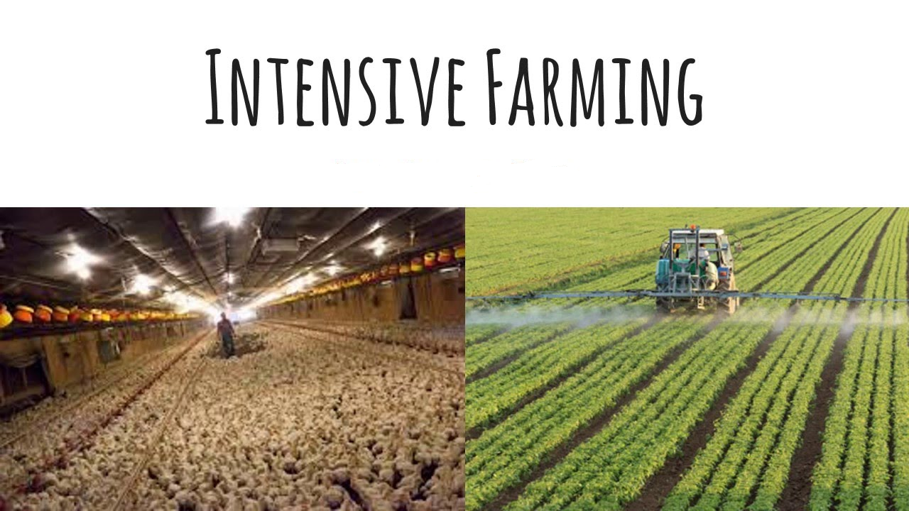
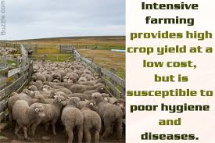
Intensive Framing:
It is also referred to as intensive agriculture or factory farming.
It is a kind of agriculture where a lot of money and labour are used to increase the yield that can be obtained per area of land.
It involves the use of large amounts of pesticides for crops, and of medication for animal stocks.

Slide 6
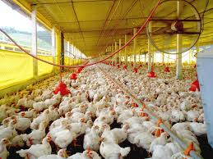
Semi-Intensive Farming:
This is when all the animals are bread and kept indoor but can go out side.
All animals are still normally given medication and farms are of an industrial scale.

Slide 7
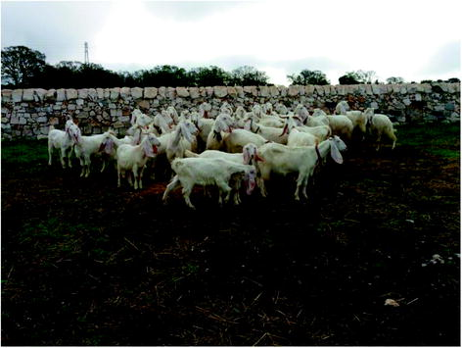
Extensive Farming:
It is the opposite of Intensive farming.
It uses traditional methods of farming where less technology is used.
Animals are given natural food and are kept outdoors.

Slide 8
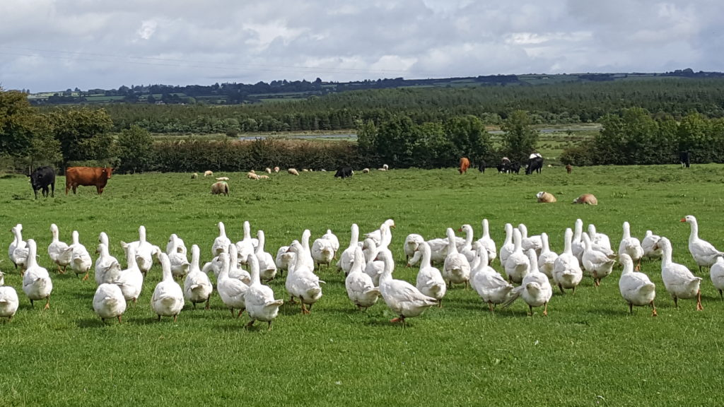
Mixed Farming:
It involves both the growing of crops as well as the raising of livestock on the same farm.
It is a form of sustainable farming as farmers grow both crops to sell as well as to feed their livestock.
Farm animals also provide fertilizer for the farm, help farmers on the fields by pulling ploughs and help them transport crops to the local market.

Slide 9
Organic Farming:
Organic Framing is the production of crops and livestock without the use of synthetic chemicals and in-organic fertilizers.
It always existed from the beginning of time, starting off with Cave men, Romans, Egyptians, Barbarians…..
Nowadays it aims for a healthy human life.

Slide 10
What is Organic Farming?
Section 2:

Slide 11
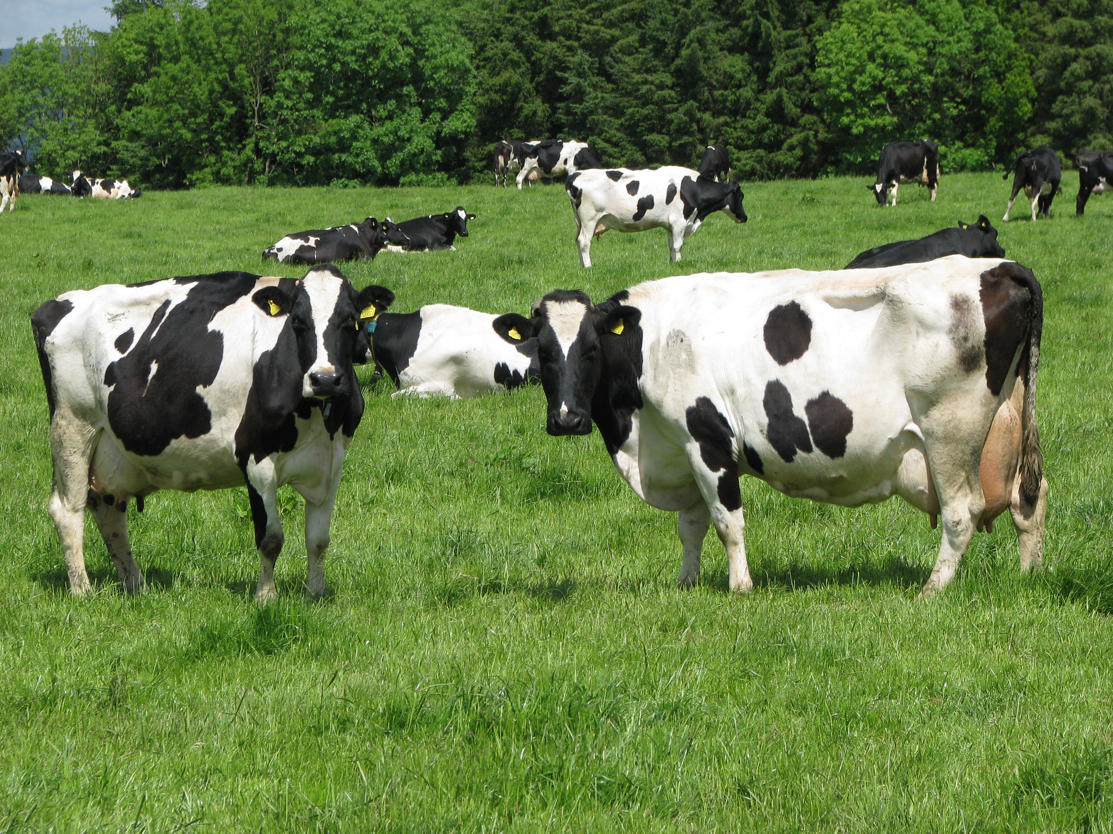
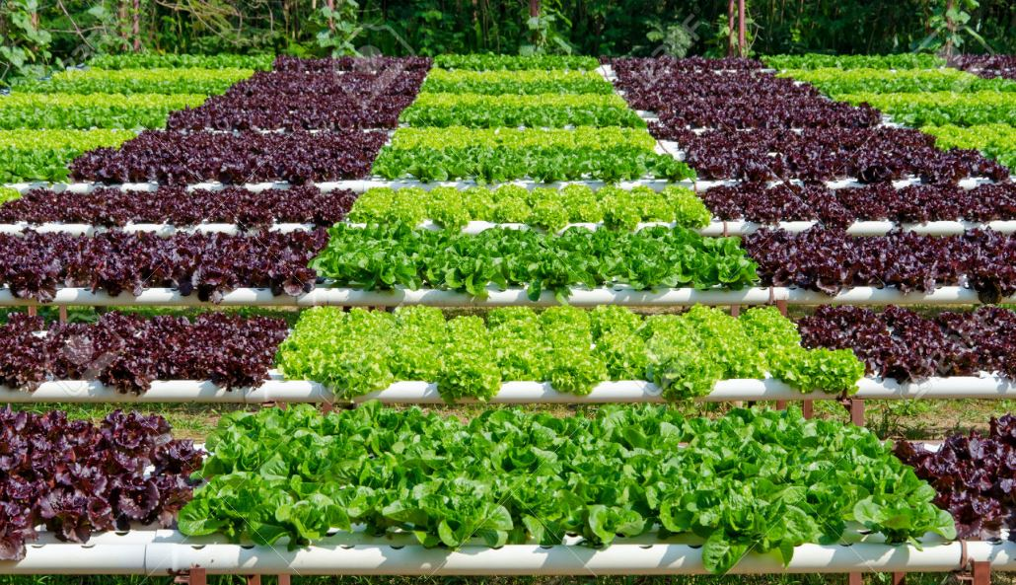
What is Organic?
Examples of Organic Animal and Crop Farming
The Organic Food Label

Slide 12
Principles of Organic Farming:
Wide crop rotation as a prerequisite for an efficient use of on-site resources.
Very strict limits on chemical synthetic pesticide and synthetic fertiliser use, livestock antibiotics, food additives and processing aids and other inputs.
Absolute prohibition of the use of genetically modified organisms.
Taking advantage of on-site resources, such as livestock manure for fertiliser or feed produced on the farm.
Choosing plant and animal species that are resistant to disease and adapted to local conditions.
Raising livestock in free-range, open-air systems and providing them with organic feed.
Using animal husbandry practices appropriate to different livestock species.

Slide 13
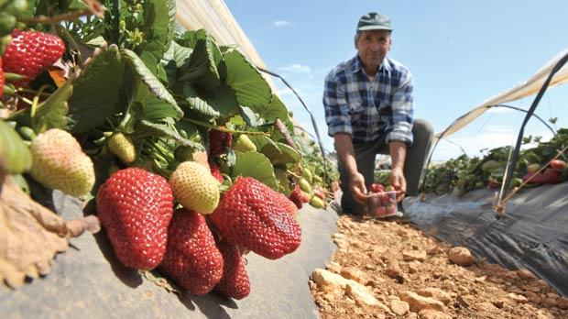
Dealing with Organic Farming:
Keep in mind that welfare of the animals are kept to standard by natural remedies and food.
When dealing with crops one has to keep in mind that crops have to be all naturally grown without any forms of technology.
There is no harm in anyway to humans or wildlife.

