Slide 1






SOIL LOSS AND PROTECTION OF ARABLE LAND
Let’s talk about soil
Wikipedia.org
Pixabay.com
Pixabay.com
Pngimg.com
Wikipedia.org

Slide 2
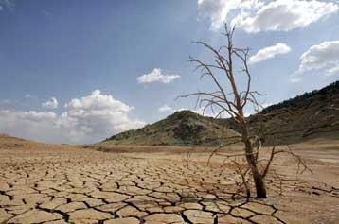
In Europe more than 20 million acres of soil were degraded from industrial waste and acid rain due to pollution. Every year we lose 24 billion tones of arable land.
Pnosodal.gr

Slide 3
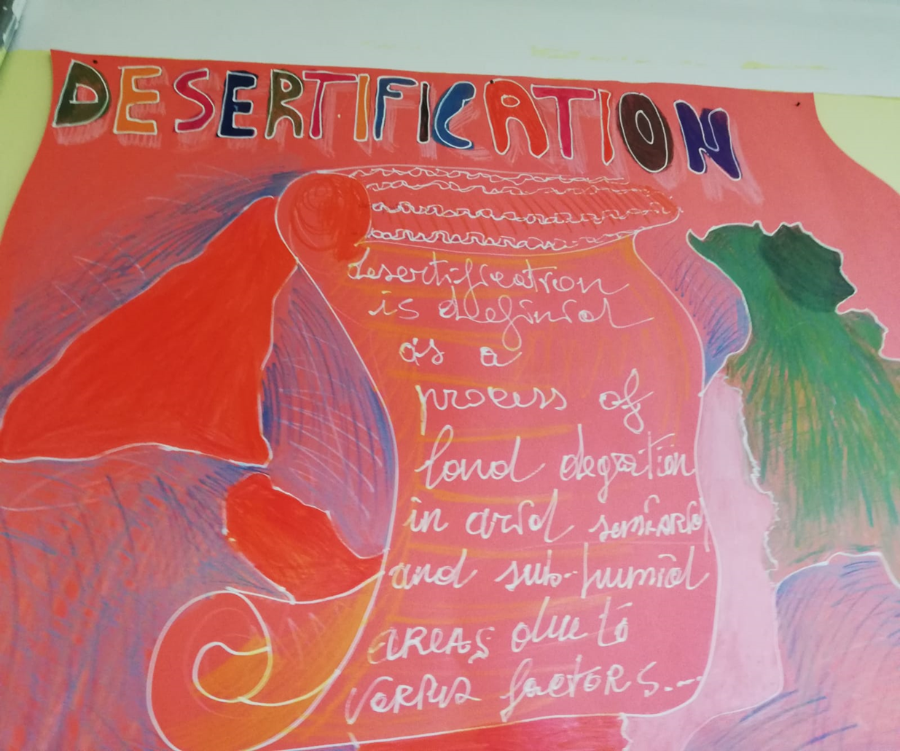
Desertification is the definition of the loss of soil.

Slide 4


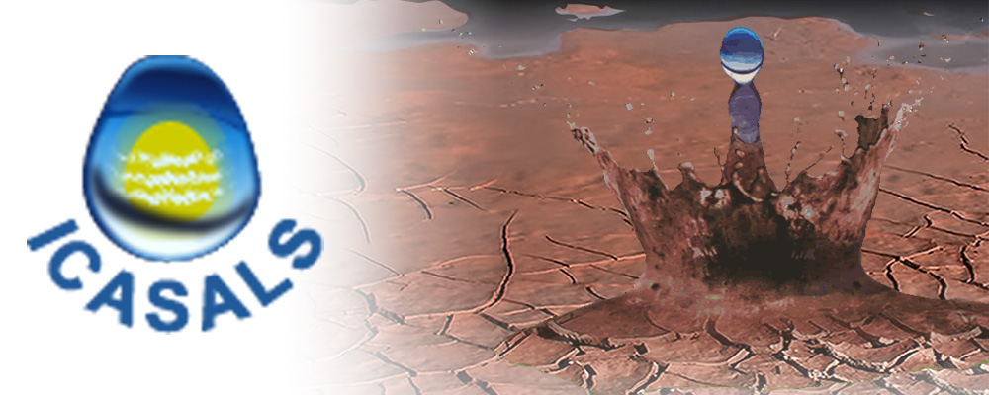
The difference between desertification and dryness.
Fundamental steps of definition of the problem of loss of soil:
1977 The UNEP ( United Nation Enviromental Program) organized the first mondial conference about desertification.
1988 – 90 GLASOD project (global assesment of soil degradation) organized by FAO (food and agriculture organization).
1991 ICASALS (international centre for arid and semiarid land studies-Texas).
1992 Conference about enviroment and development in Rio De Janeiro.
Wikipedia.org
Wikipedia.org
Depts.ttu.edu

Slide 5
At the time the scientific international community understood that desertification had to be considered a set of processes of decline of soil productivity.
1994 UNEP Defines desertification all those degradation phenomenas of dry, semiarid and submoist lands arising from various factors.
1997 Italy approved the adhesion to CCD (convention to combat desertification) establishing the National Comitee for the Desertification Fight which in 1999 wrote the first «National Comunication for Desertification Fight».

Slide 6
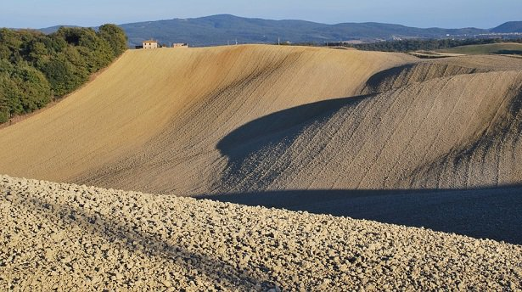
Official definition of desertification:
Desertification is a destruction or reduction process of soil potencial.
Ideegreen.it

Slide 7
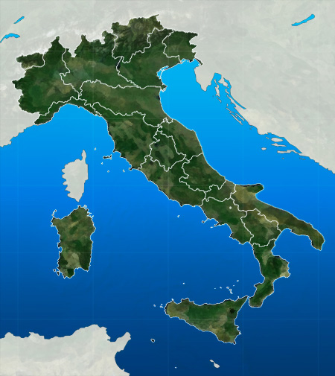
In Italy about the 27% of the territory is threatened by the drying up processes of the soil. Drought, erosives phenomenas, hydrogeological distruptions, waterproofing, salinization and metals pollution are some of the causes of decrease of soil productiveness.
Meteo.it

Slide 8
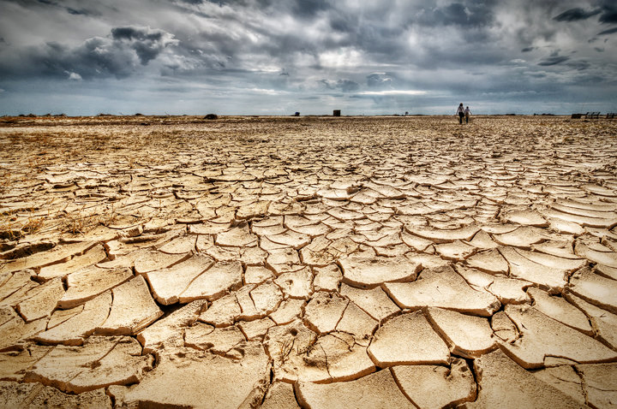
Soil deterioration process is related to:
Enviromental factors
Rain erosivity
Territory morphology
Orography
Vegetable cover
Aridity
Drought
Tpi.it

Slide 9
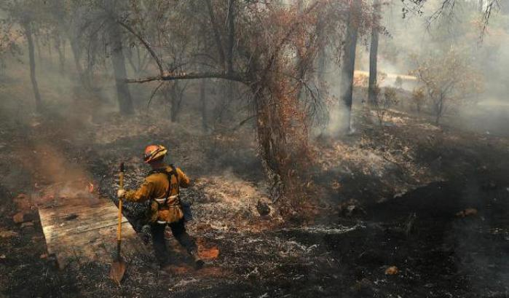
Anthropic factors
Exploitation of water resources
Deforestation
Fire
Mismanagement of lands
Urbanization
Meteoweb.ev

Slide 10
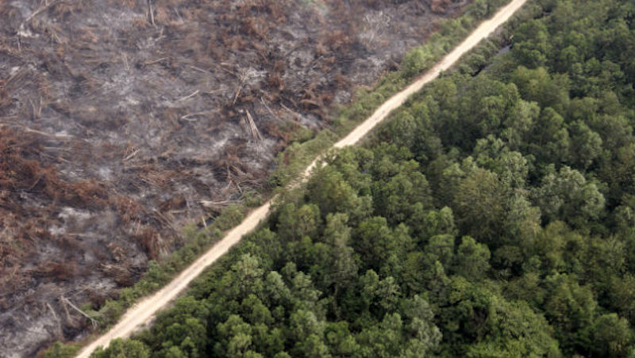
Deforestation
It is used to transform forest ecosystems into agricultural ecosystems, but it also causes soil degradation, which is due to the lack of protection offered by trees. We must also take into account the considerable reduction in the capacity of water retention by the soil.
Globalist.it

Slide 11
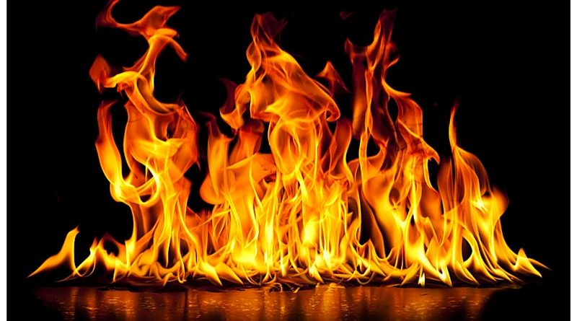
FIRE
Fire has negative effects on the chemical-physical properties of soil
l
Notes:
11

Slide 12

As a result of a fire, the soil is exposed to solar radiation, which causes the residual organic substances to migrate to the deeper layers and generates a water-repellent and waterproof layer that contributes to increasing the erosion phenomenon.
Notes:
12

Slide 13
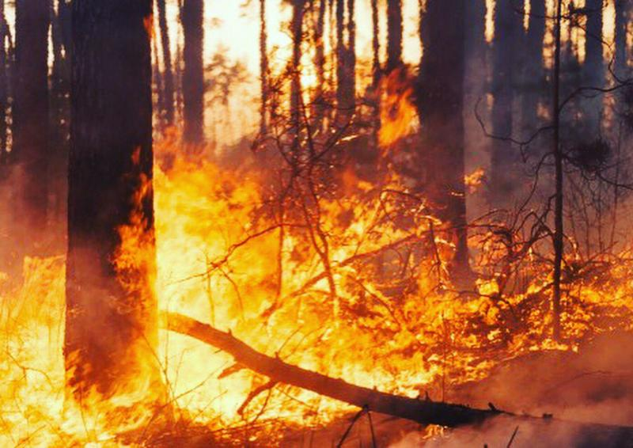
periodicoitalianomagazine
Notes:
13

Slide 14

Irrational management of agricultural areas
In this case the soil degradation processes derive from the mismanagement of the means of production and of the agricultural surfaces themselves, with relevant effects on soil compaction and consequently on its fertility.
Notes:
14

Slide 15
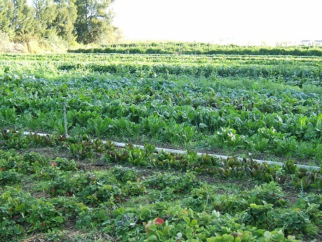
contributi-di-approfondimento-scientifico-sullagricoltura-biologica
Notes:
15

Slide 16
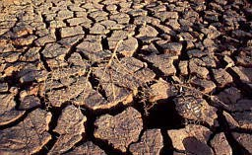
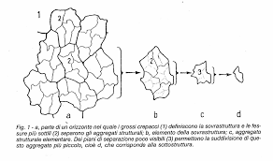
Soil degradation processes
In the context of degradation processes it is necessary to distinguish:
processes that determine the drying of the soil.
  processes that determine the loss of the
  resource in terms of surface and volume
  subtraction.
Notes:
16

Slide 17
Salinization
Salinization is the consequence of the massive extraction of fresh ground water, which, near the coast, determines the phenomenon of marine intrusion into the aquifer and the consequent irrigation with an increasingly high saline content water with fatal consequences on the productivity of the various crops. A team of researchers has identified 18 hotspots from southern Europe to Australia, Chile and the United States of America, covering a wide range of problems, from soil erosion by wind or water, to salinization and droughts or flash floods.
Notes:
17

Slide 18
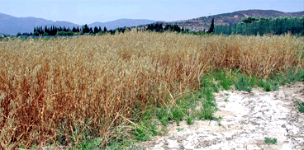
sardegnaagricoltura
Notes:
18

Slide 19
Contamination
Soil and subsoil contamination means the direct or indirect introduction, as a result of human activity, of substances, preparations, organisms or micro-organisms harmful to human health or natural resources into soil and subsoil.

Slide 20
Compaction
It is the main process of physical degradation of the soil which manifests itself in a decrease in the porosity of the soil, in a destruction of its structure and in the pulverization of the surface layer with a progressive reduction of the infiltration capacity of the water. The consequences seem obvious: increase in surface runoff, impediment of plant growth and exposure to the erosive action of meteoric agents.

