Slide 1
LET'S INTRODUCE…

Slide 2
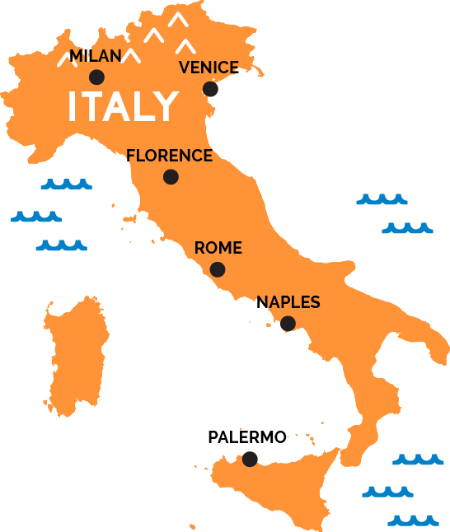
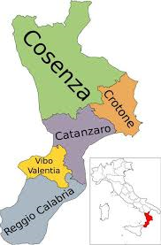
COSENZA

Slide 3
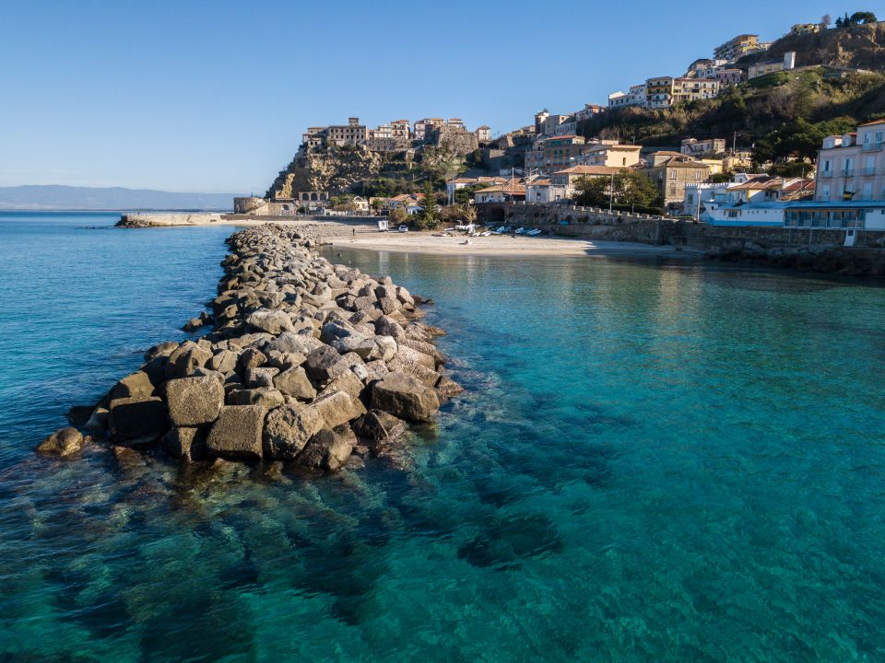
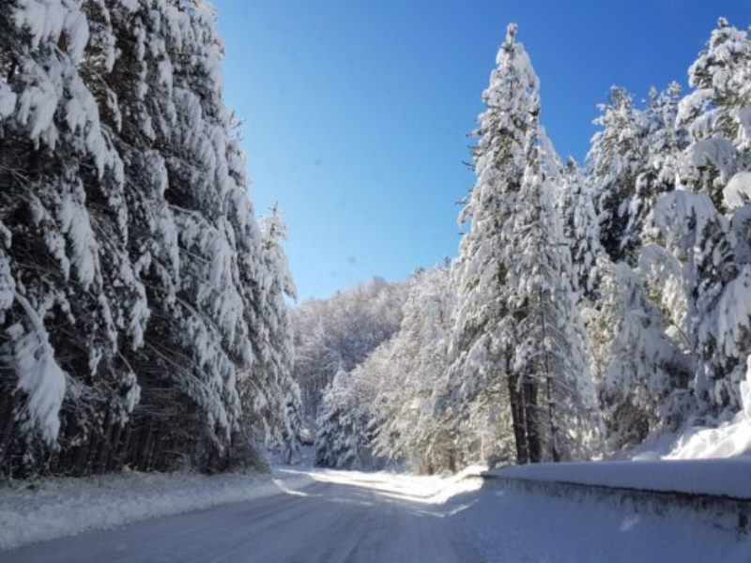
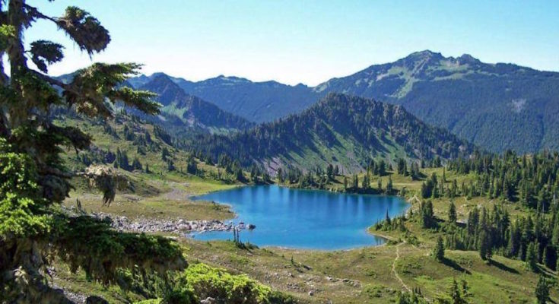
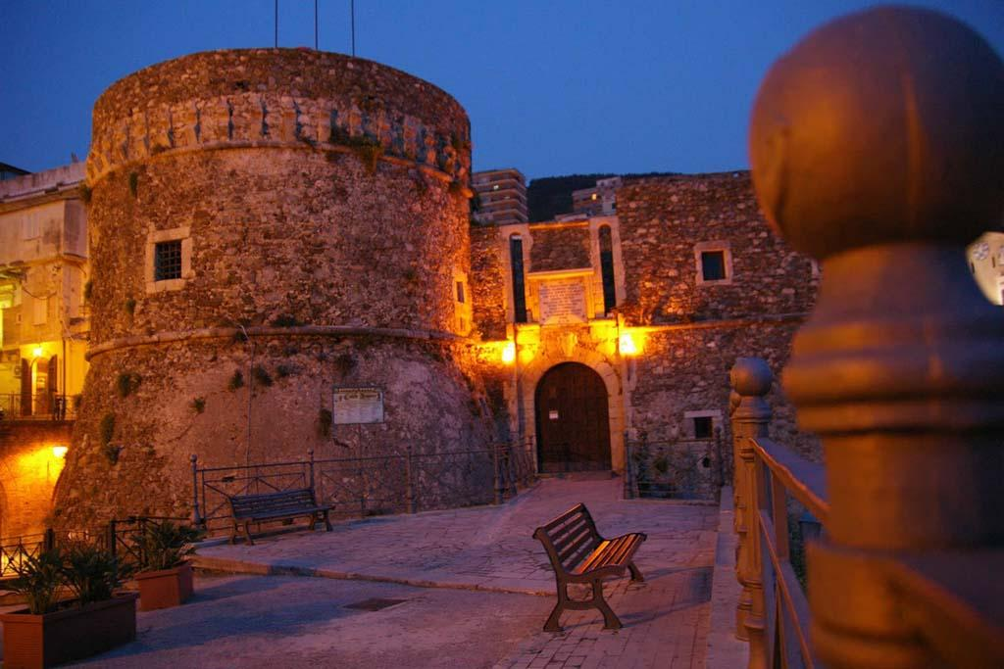
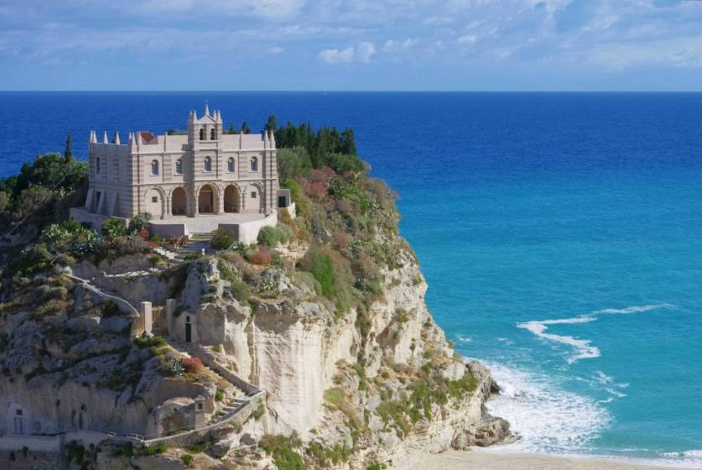
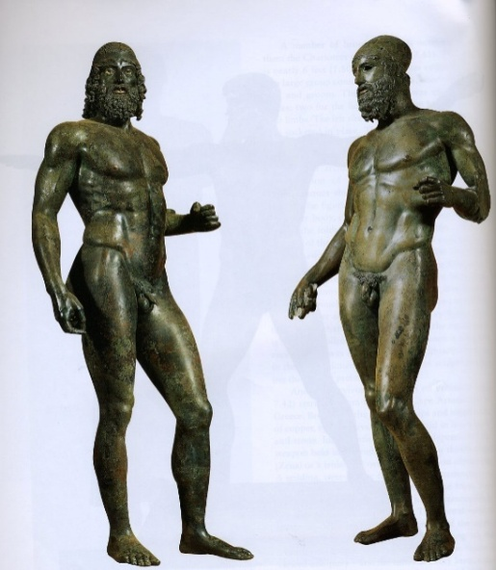
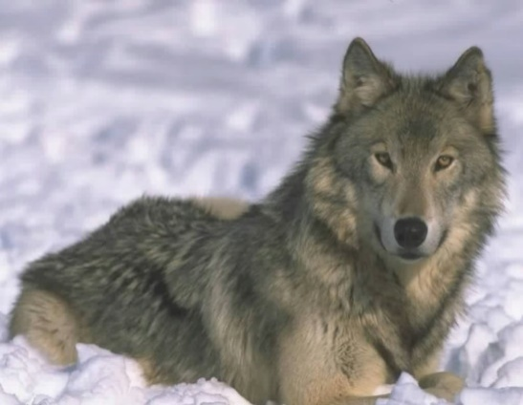

Slide 4
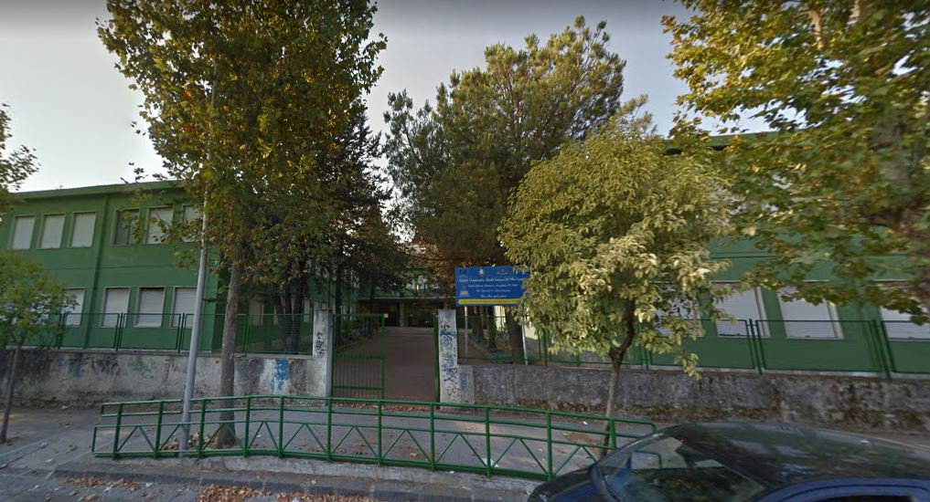
Our School: I.C. Cosenza III – Via Negroni

Slide 5
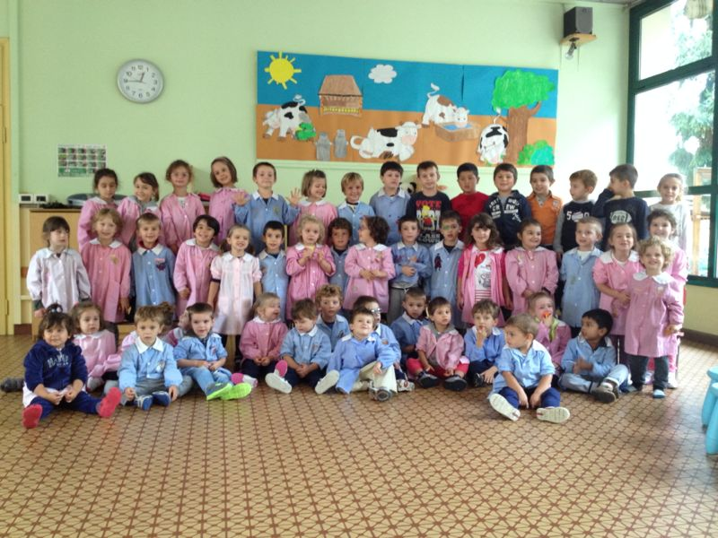
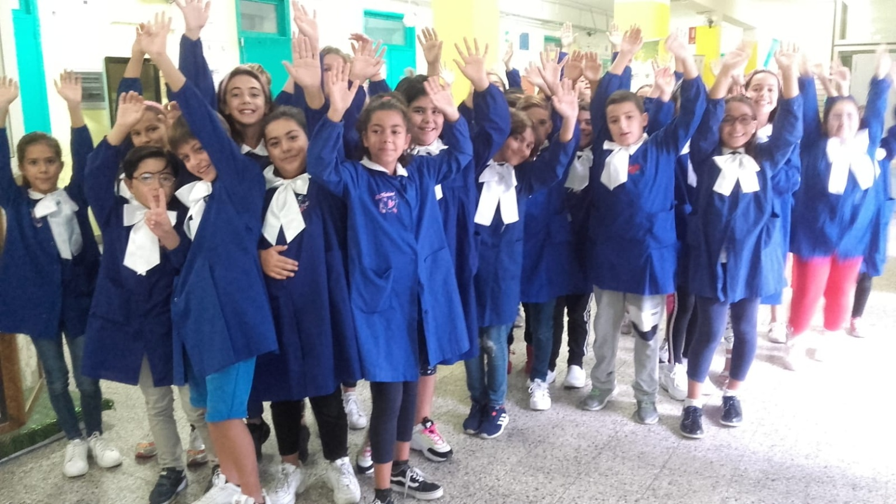
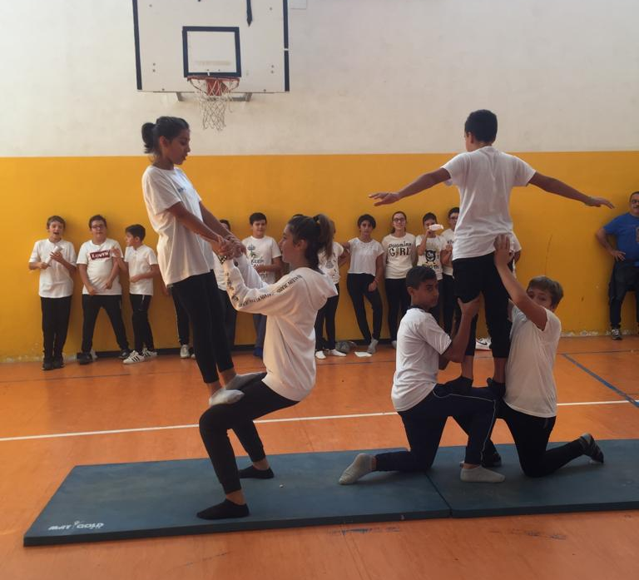
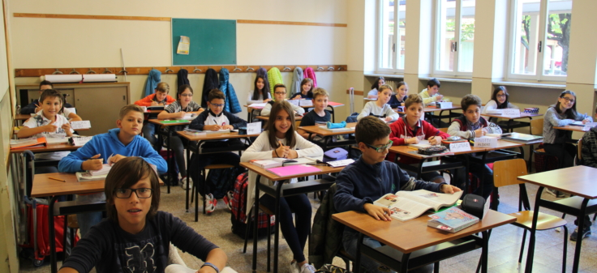

Slide 6
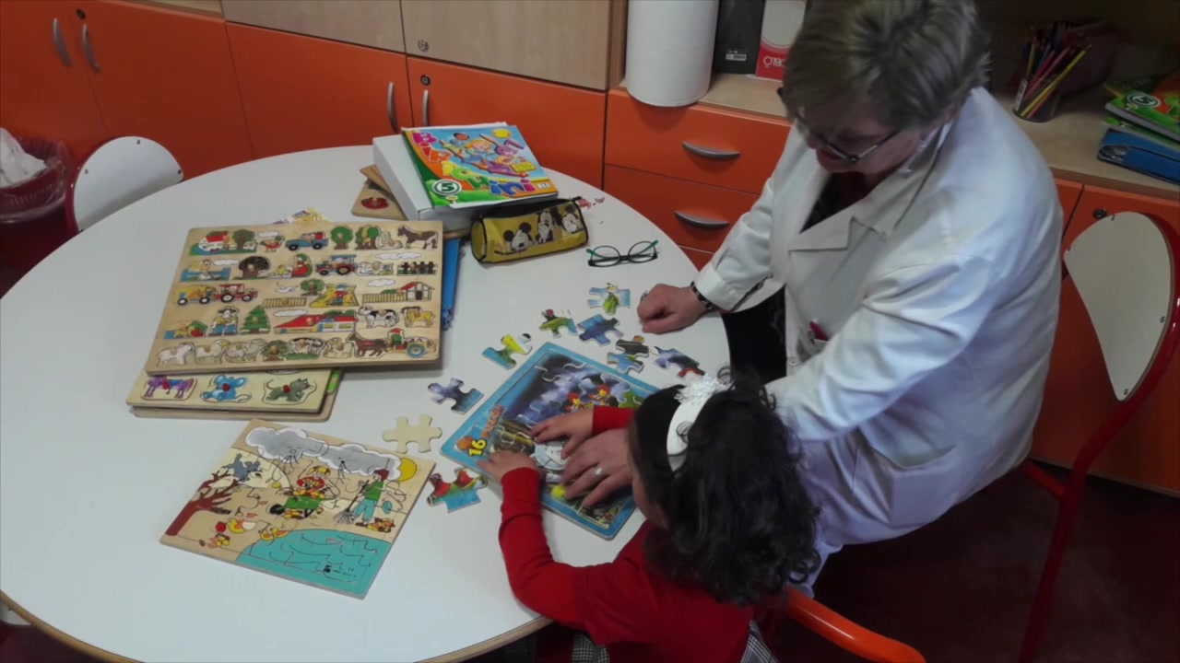
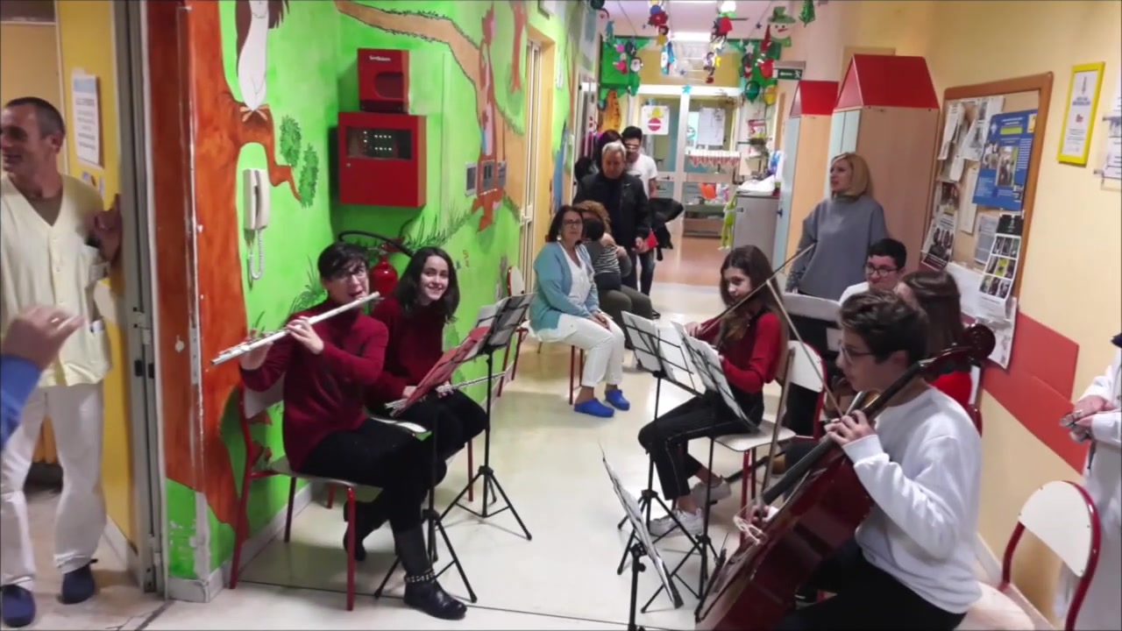
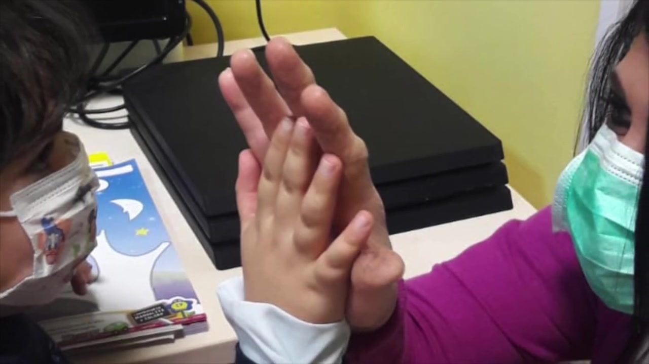
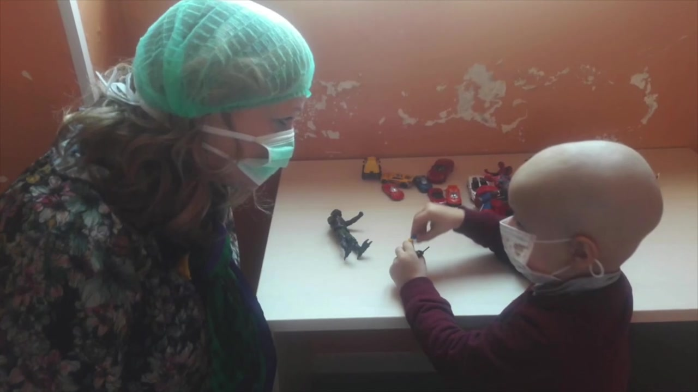
>> School in hospital

Slide 7
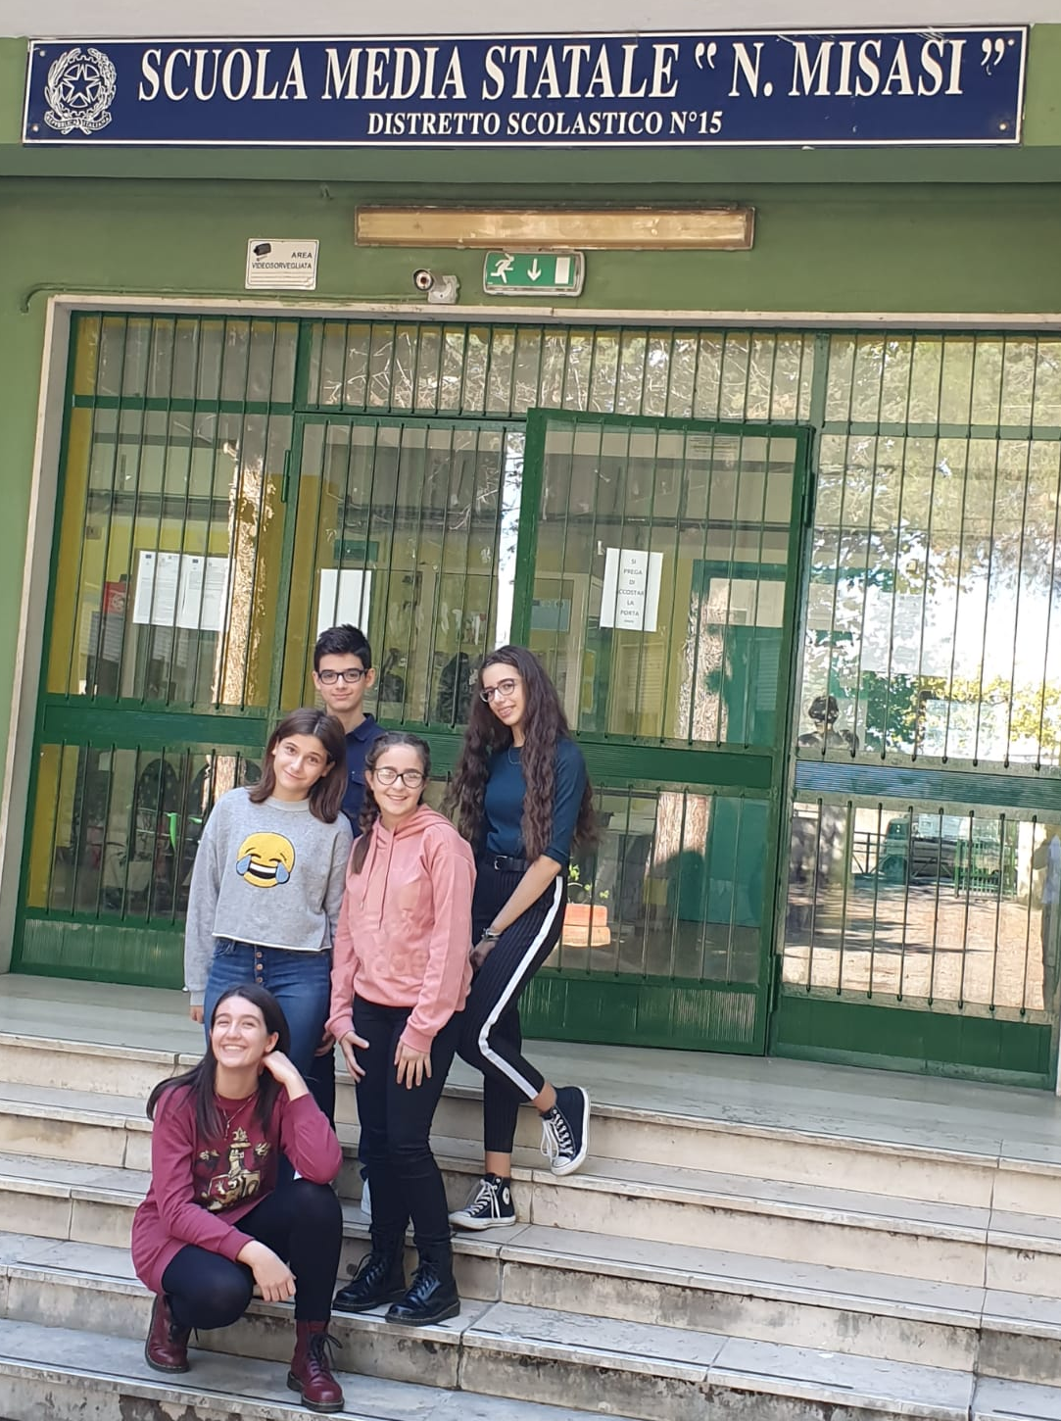
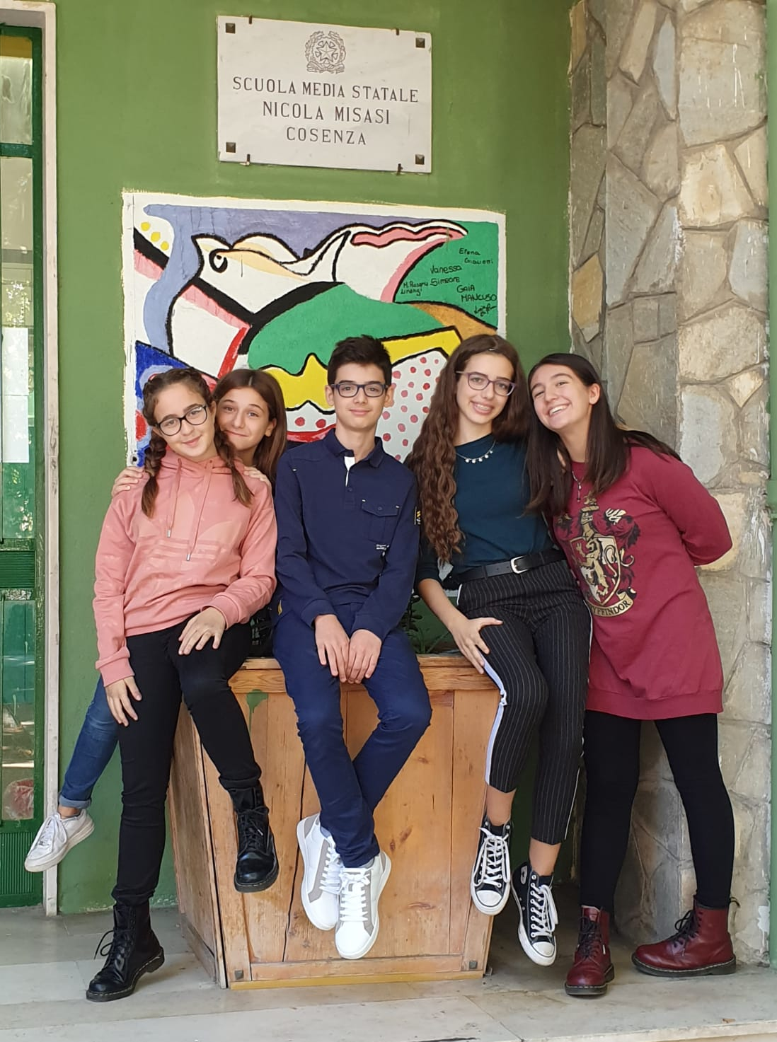
This is the Italian team…

Slide 8
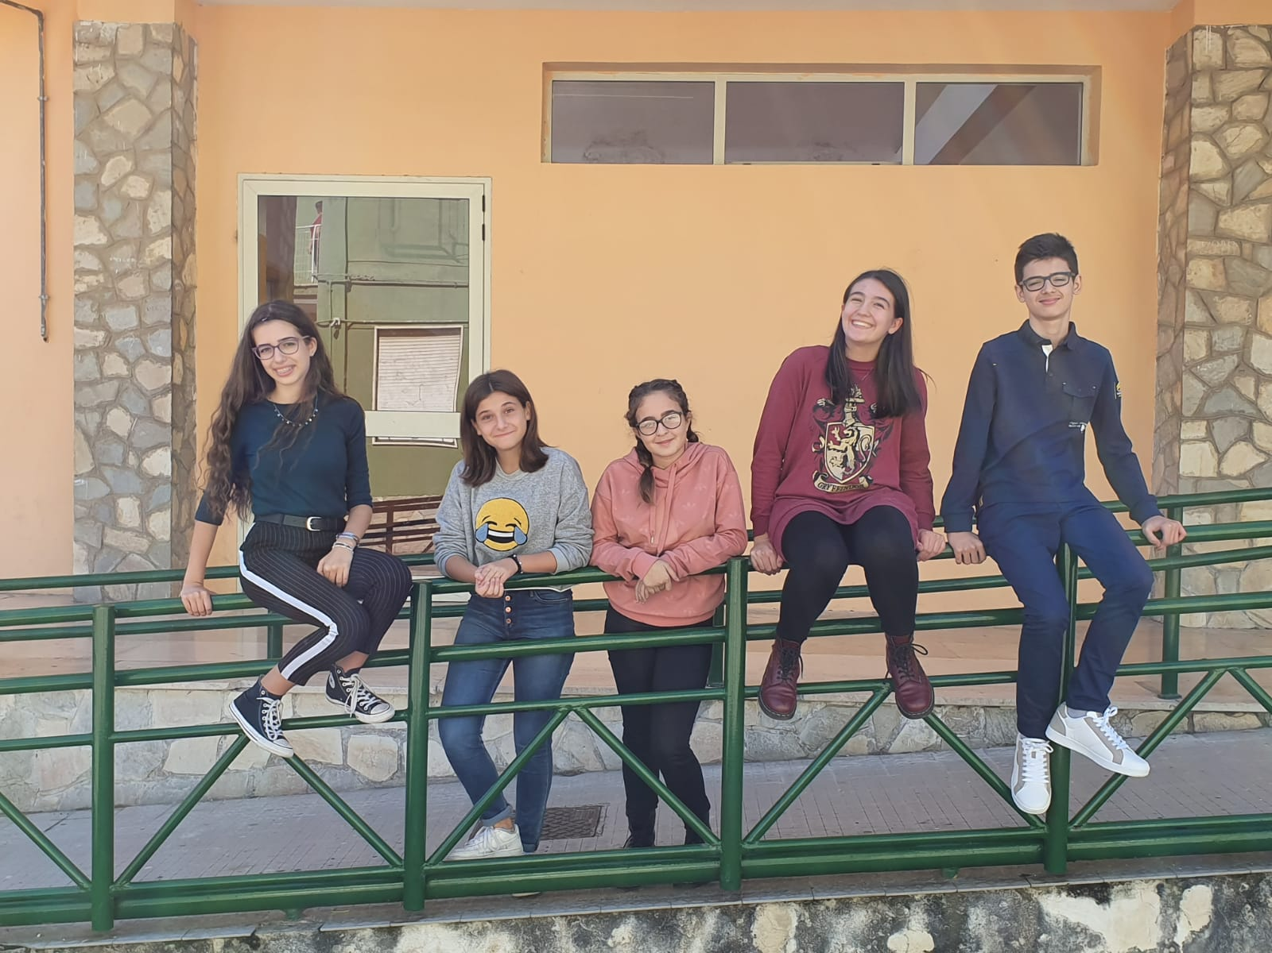
Claudia
Matteo
Claudia
Claudia
Irene

Slide 9
LOCAL FOOD PRODUCTION

Slide 10
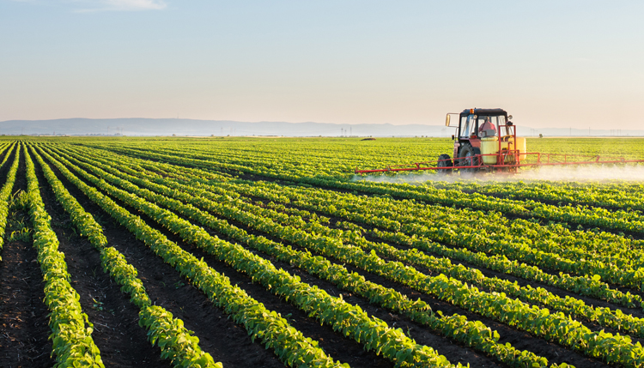
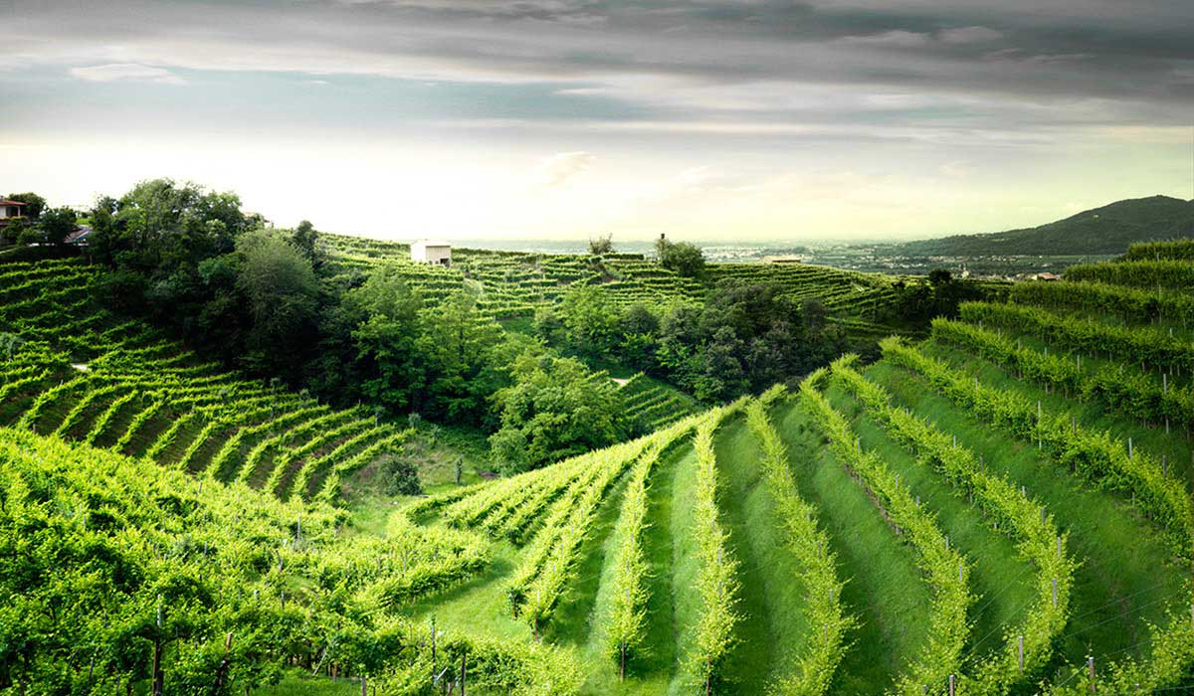
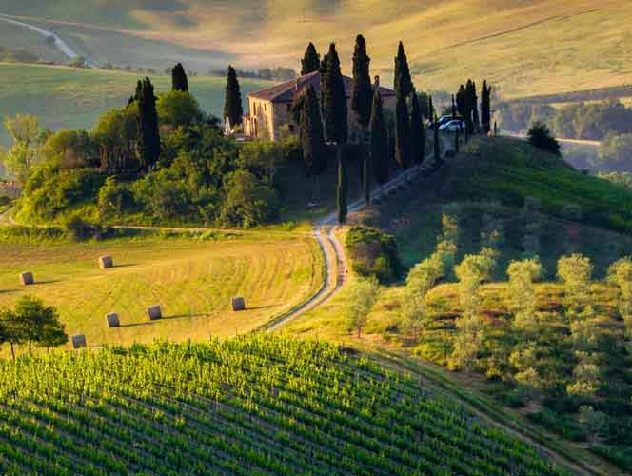
Italy is the third largest agricultural power in the EU …
…mainly thanks to Calabria!

Slide 11
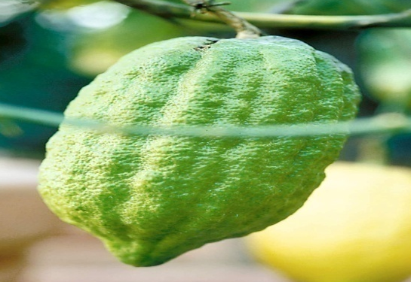
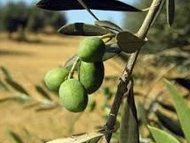
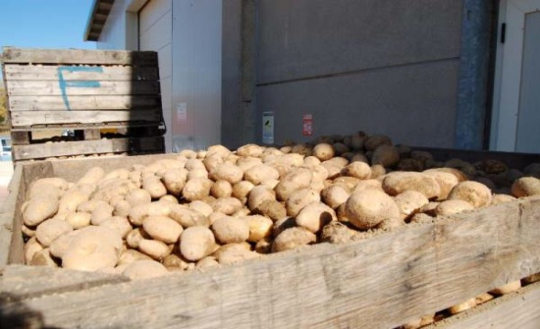
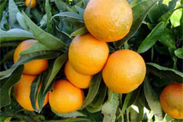
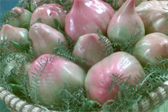
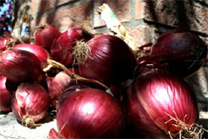
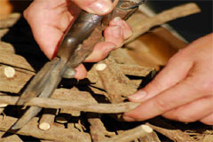
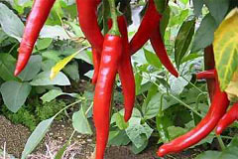
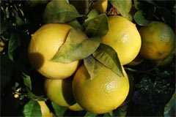
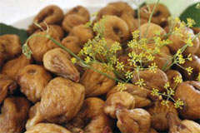
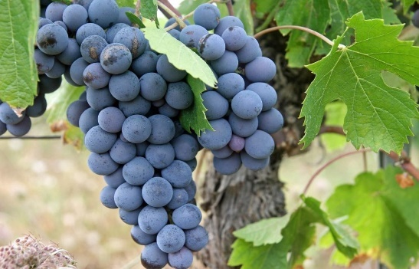
WHAT IS GROWN IN CALABRIA?
Potatoes from Sila
Onions from Tropea
Bergamots from Reggio
Cedars from Diamante
Clementines from Corigliano
Licorice sticks from Rossano
Dried figs
Olives
BelmonteTomatoes
Chilli
Grapes

Slide 12
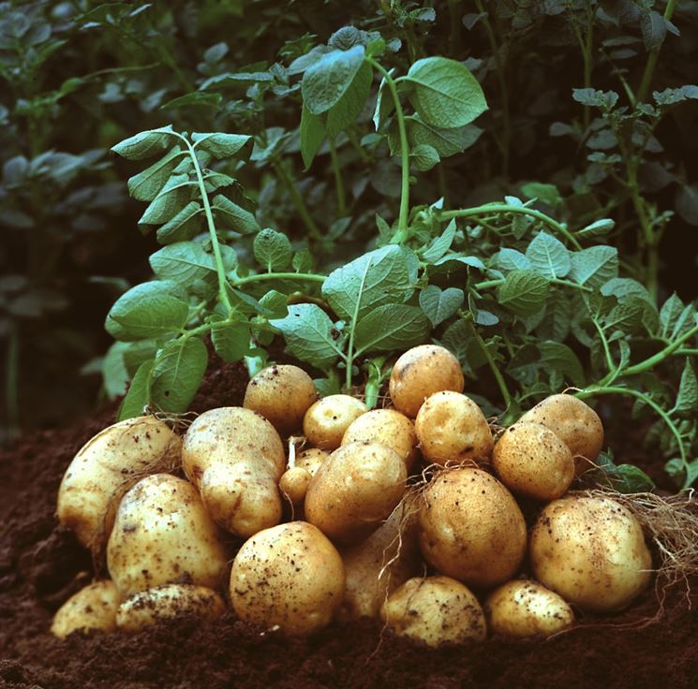
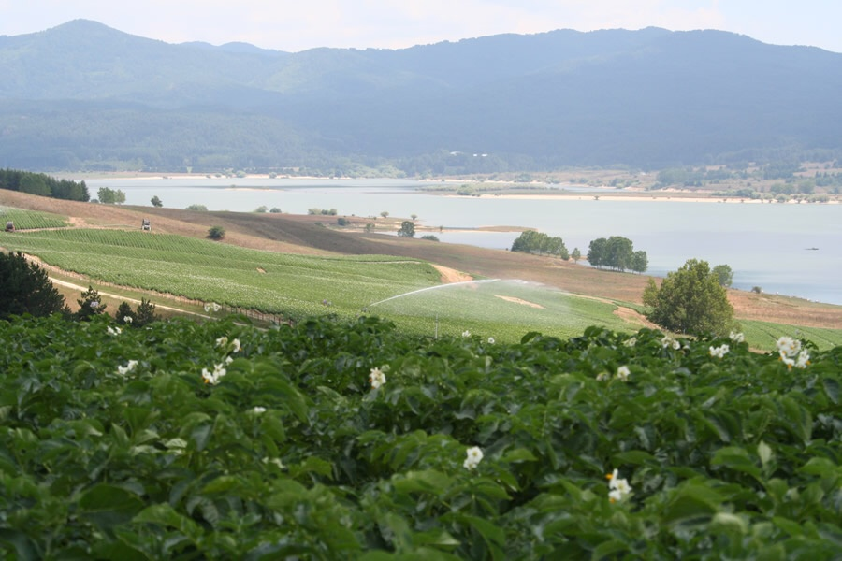
SILA POTATOES
Potatoes from Sila are regarded as a product of quality.
The better soil to grow potatoes is humic

Slide 13
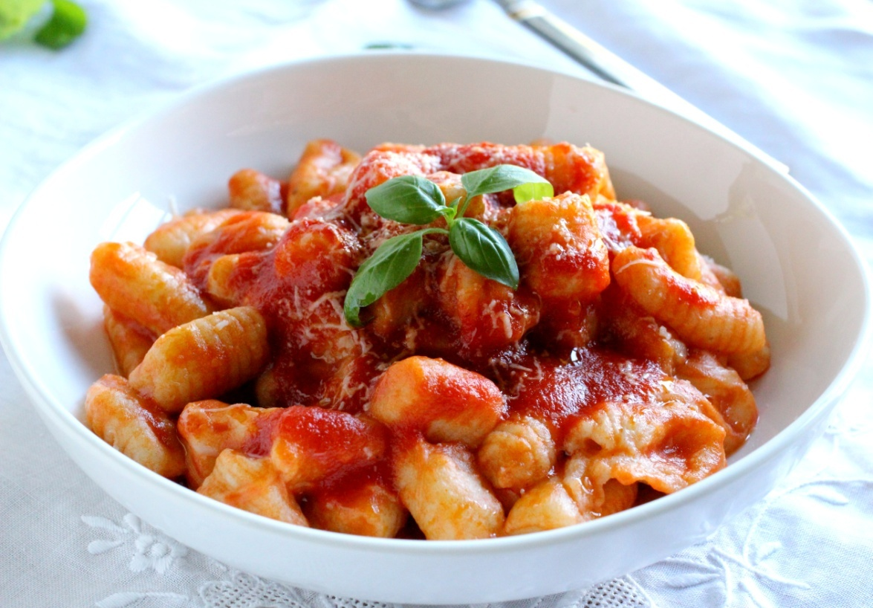
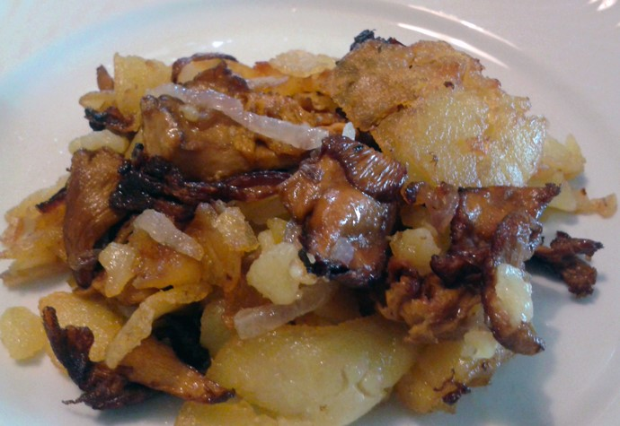
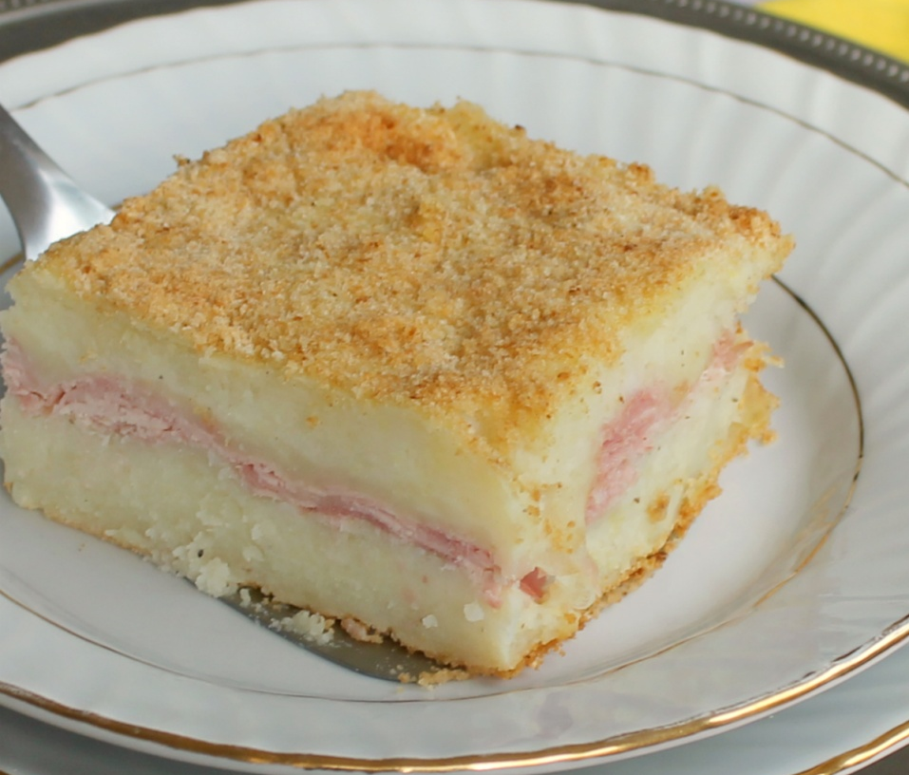
SILA POTATOES
GNOCCHI
They’re greatly used for cooking delicious, traditional dishes.
PATATE ‘MBACCHIUSE
GATEAU

Slide 14
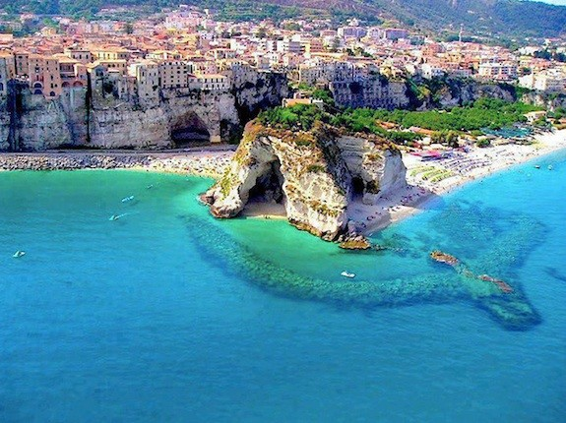
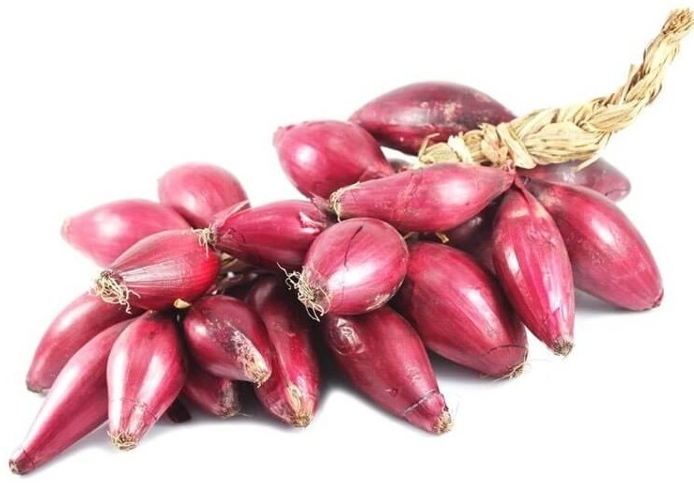
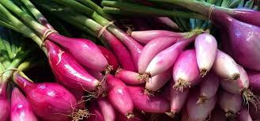
RED ONION – TROPEA
90% water, 1% protein, very few fats and important mineral elements (potassium, calcium and phosphorus).
Why is it red?
>> Because it is rich in anthocyanins
It grows better in a draining soil

Slide 15
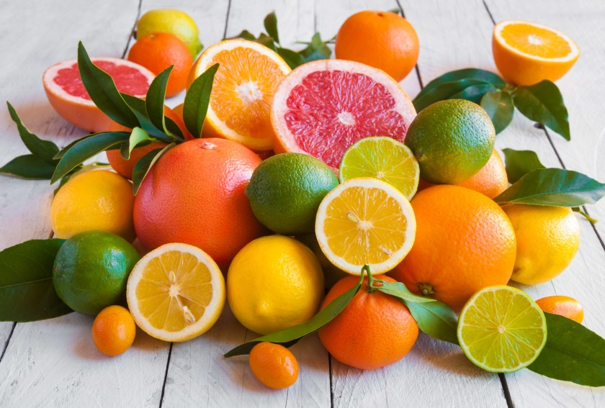
CITRUS FRUITS
>> CLEMENTINE
>> BERGAMOT
>> CEDAR
They grow better in an alluvial soil

Slide 16
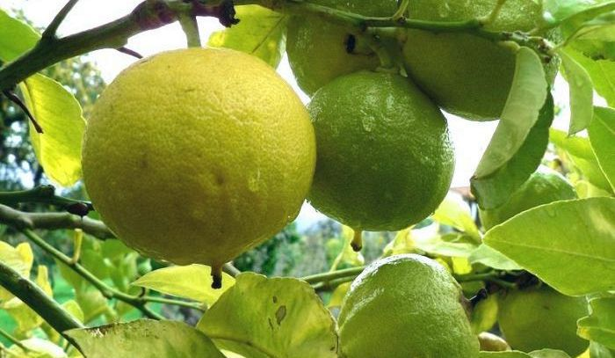
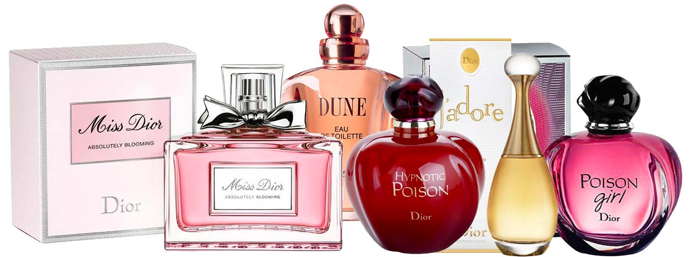
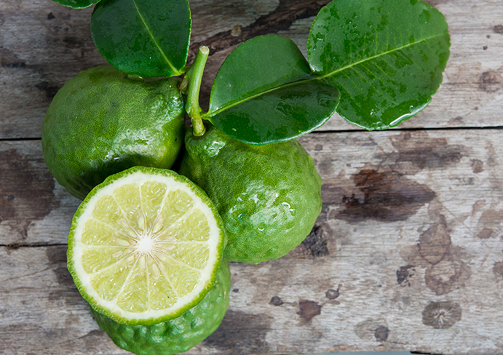
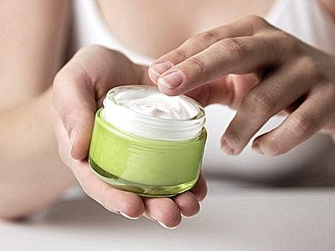
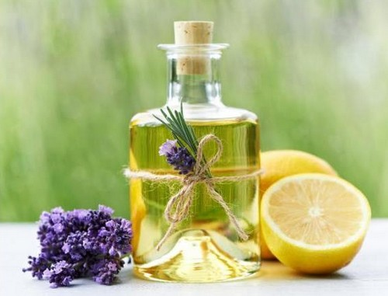
THE BERGAMOT
The Bergamot (Citrus bergamia) is a yellow-skinned fruit.
The production of Bergamot in the province of Reggio is 80% of the world production.

Slide 17
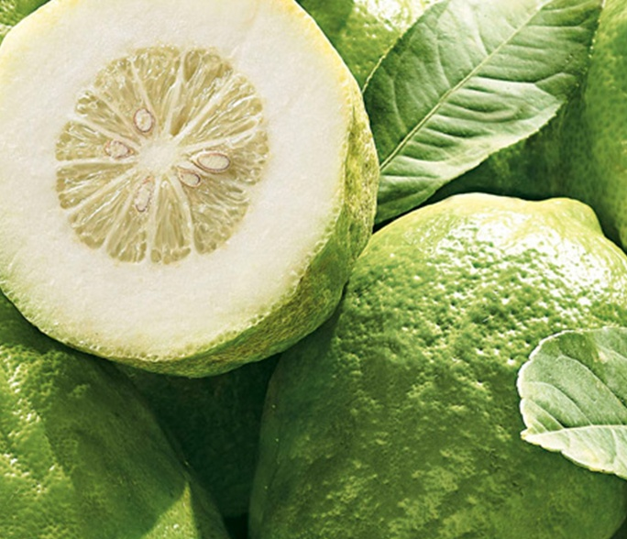
It is the most precious fruit for the Jewish religion.
Every summer, rabbis meet in Santa Maria del Cedro to select one by one the best cedars for their “Tabernacles feast” (Sukkoth).
THE
CEDAR
Candied cedar

Slide 18
THE CLEMENTINE
Calabrian clementine is a fruit product typical of the Region.
Clementines are particularly rich of organic acids and of vitamin C, vitamin A and, vitamin B1, B2 and B3.
The clementine is a hybrid between a tangerine and a sweet orange.

Slide 19
LICORICE
Licorice (or liquorice) from Rossano, Calabria, Italy is the very best in the world.
The root can be chewed in its raw form or drunk in an infusion.
To make into candy or lozenges, the licorice root is boiled to produce an extract that may then be used in its pure state or mixed with sugar.
It grows better in a draining soil

Slide 20
FIGS
A very popular fruit typical in summer is the fig.
It can be eaten both fresh, in summer, and dried during the year.
They are particularly tasty with a chocolate topping or ice cream.
It grows better in a humic soil

Slide 21
OLIVES
In Calabria the presence of the olive tree is documented at least since the ancient Greeks (VIII century bC).
Olives grow better in clayey
and calcareous soil.

Slide 22
OLIVES
20% of Italian oil is produced in Calabria but then bottled and marketed elsewhere.

Slide 23
BELMONTE TOMATOES
The Belmonte tomato is named "il Gigante“ (the Giant) due to its huge size. The average weight of a single tomato varies from 700 to 1500 grams.
Kg 1,330
They grow better in a humic and draining soil

Slide 24
CHILLI
Chilli peppers are a small, fiery variety of capsicum. In general, the smaller the chilli, the more potent.
Chillies are used widely in a lot of dishes, even with chocolate!
They grow better in a humic, draining and acid soil

Slide 25
GRAPES
The Gaglioppo grape is greatly used by winemakers but the Magliocco variety is also used to produce good quality, modern wines.
These varieties of grapes grow better in a draining and carbonate soil.

Slide 26
GRAPES
The Hellenic colonization introduced viticulture in the whole Mediterranean area and in particular in Calabria renamed Enotria (land of wine).
The wines produced in Calabria were offered to the winners of the Olympic Games of ancient Greece held every 4 years at the city of Olympia.

Slide 27
PEDOLOGICAL WORKSHOP

Slide 28
On 4th June, we went to a little town near Cosenza to look at a soil profile. A professor of geology from the University of Calabria helped us to find all the layers of the soil.

Slide 29
After cleaning the soil profile, we classified the three layers according to their colour (by means of the Mensell table) and their composition .

Slide 30
We found a full layer of humus and two layers with a lot of clay and a dark color. In the deeper layer we also found a small amount of stagnant water.

Slide 31
We also took some soil samples that we analized at the university during the workshop.

Slide 32
>> EXPERIMENTS IN THE LABORATORY
In the morning of June 6th, 2019 we went to the DIBEST Department of the University of Calabria, where we visited some laboratories.
This is the laboratory of electronic microscopy and the device is an optical scanning microscope.

Slide 33
We were taken to the chemistry laboratory, where Professor Scarciglia, showed us how to estimate soil porosity and the soil pH value.

Slide 34
A certain quantity of soil (100 g.) was put into a funnel in which a filter paper had previously been inserted. The funnel containing the soil sample, was put over a beaker. In another calibrated vessel we had 90 ml of distilled water which was poured into the funnel.

Slide 35
A student poured water to moisten the soil. He stopped when the water started flowing into a vessel below. We repeated the experiment with two different soil samples (humic - clayey). Then we compared the different amounts of water poured, noting the differences due to the different soil porosity.

Slide 36
Then the pH was estimated using the litmus paper. We placed 8 g of soil and water samples in a small beaker, getting a pH around 6.2. The experiment was repeated with another soil sample from another very clayey soil with a value of 7.2 .

Slide 37
The first sample was weakly acidic, while the second was neutral. Furthermore, some drops of dilute acid was poured on two samples. The first didn’t show any reaction to HCl, while the second showed a strong reaction of effervescence, it made small bubbles that indicate a good presence of limestone.

Slide 38
Ciao ciao…
…see you in Italy in March!

