Slide 1
Istituto Comprensivo Cosenza III «Via Negroni» Scuole Infanzia, Primaria e Secondaria di Primo Grado Cosenza ERASMUS PLUS KA229 Codice 2018-1-S101-KA229-046994_4 CUP: C89F18000610001
Co-funded by the
Erasmus+ Programme
of the European Union
Our Second Pedological Workshop

Slide 2
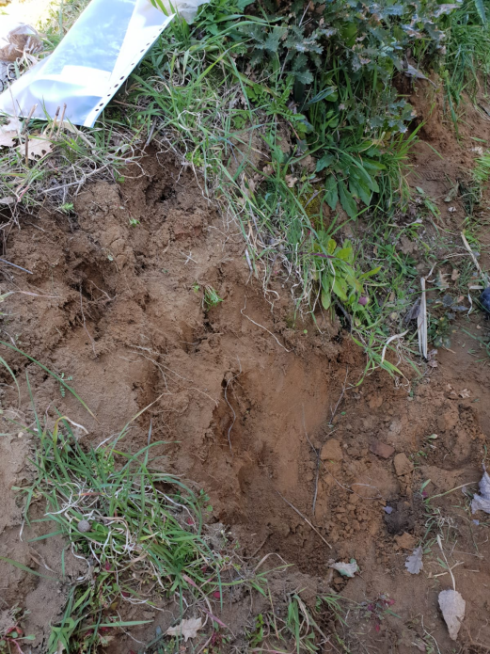
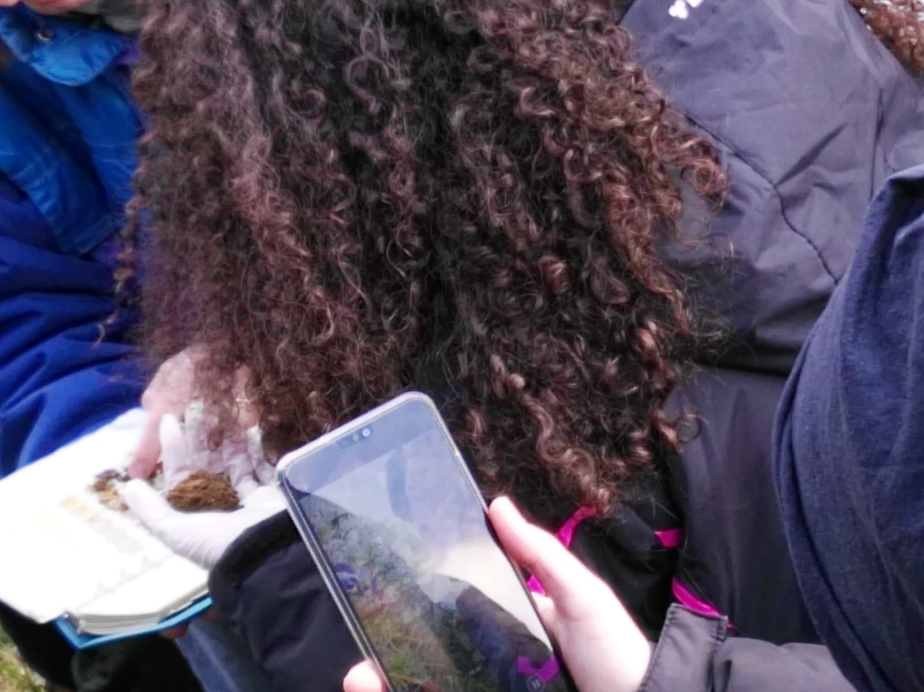
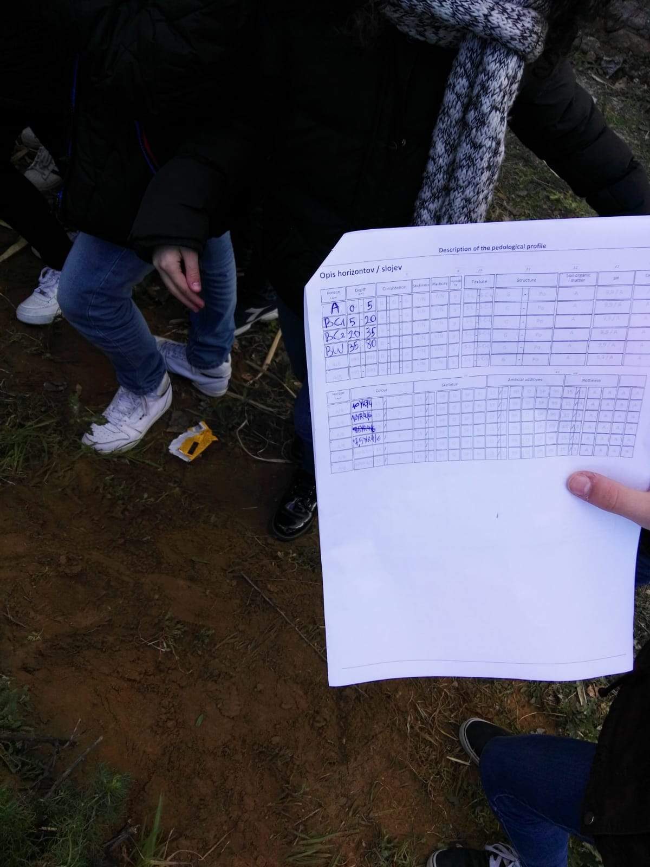
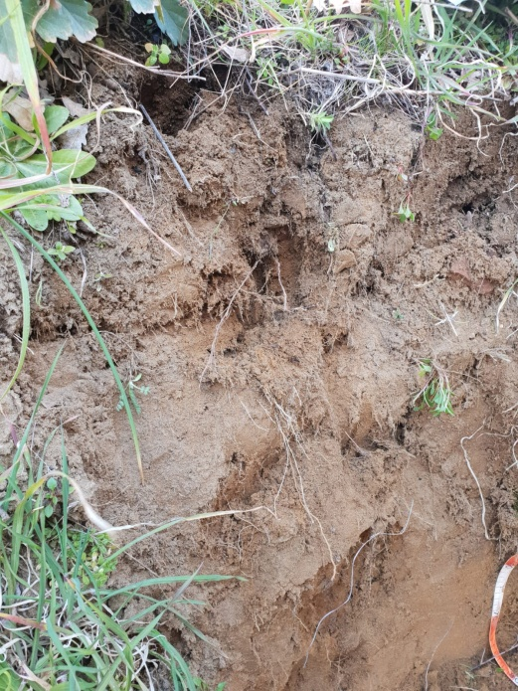
On Monday, 25th February, some students from different classes of I.C. Cosenza III (2E, 2H and 2G – i.e. students from the second year in a middle class school, according to the Italian school system) were taken to Zumpano, in the Mennavence district, to look at a soil profile.

Slide 3
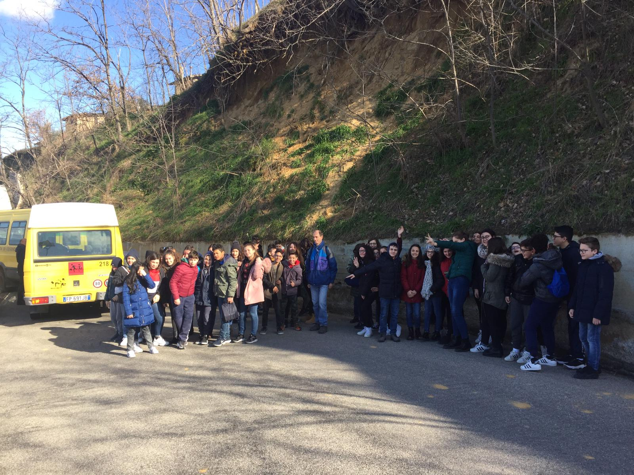
A geology teacher, from the University of Calabria, was waiting for us at Zumpano. Mr. Scarciglia gave us a brief overview of the geological and geomorphological features of the area and its evolution, also showing the students the scar of a landslide that had recently affected that soil.

Slide 4
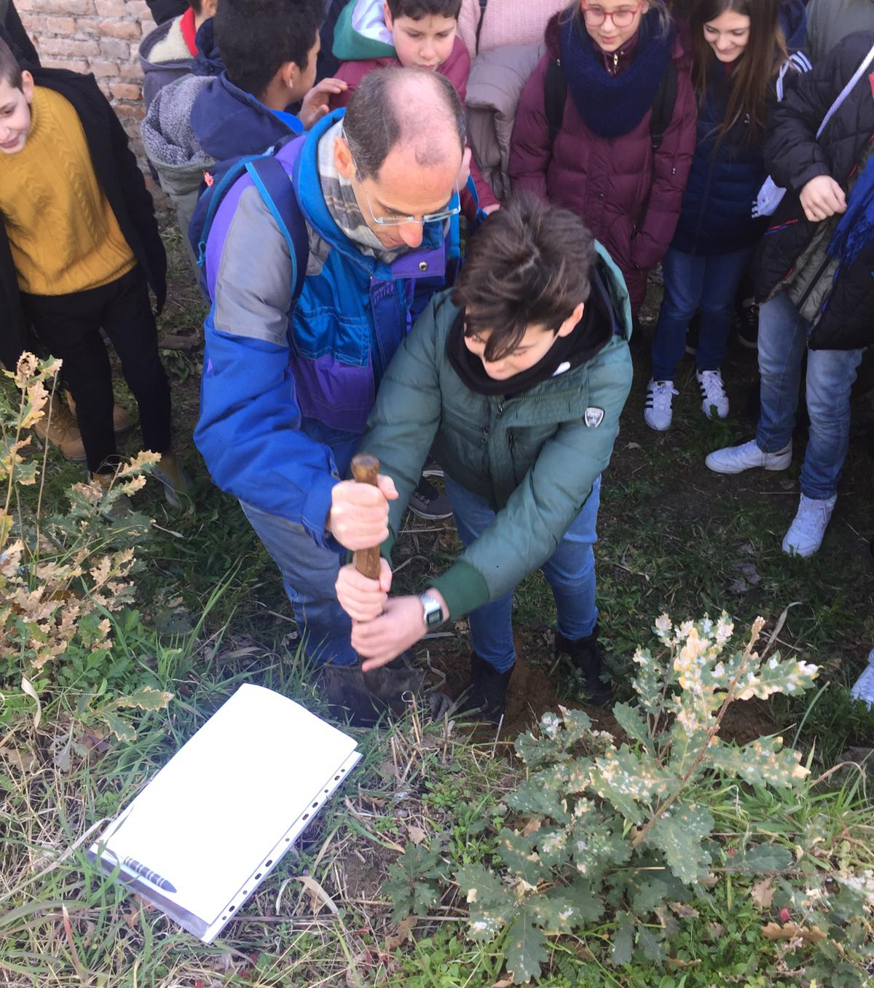
There, we were able to watch the various soil profiles from an existing escarpment.
So, we did not have to dig deep to take some soil samples from various layers.

Slide 5
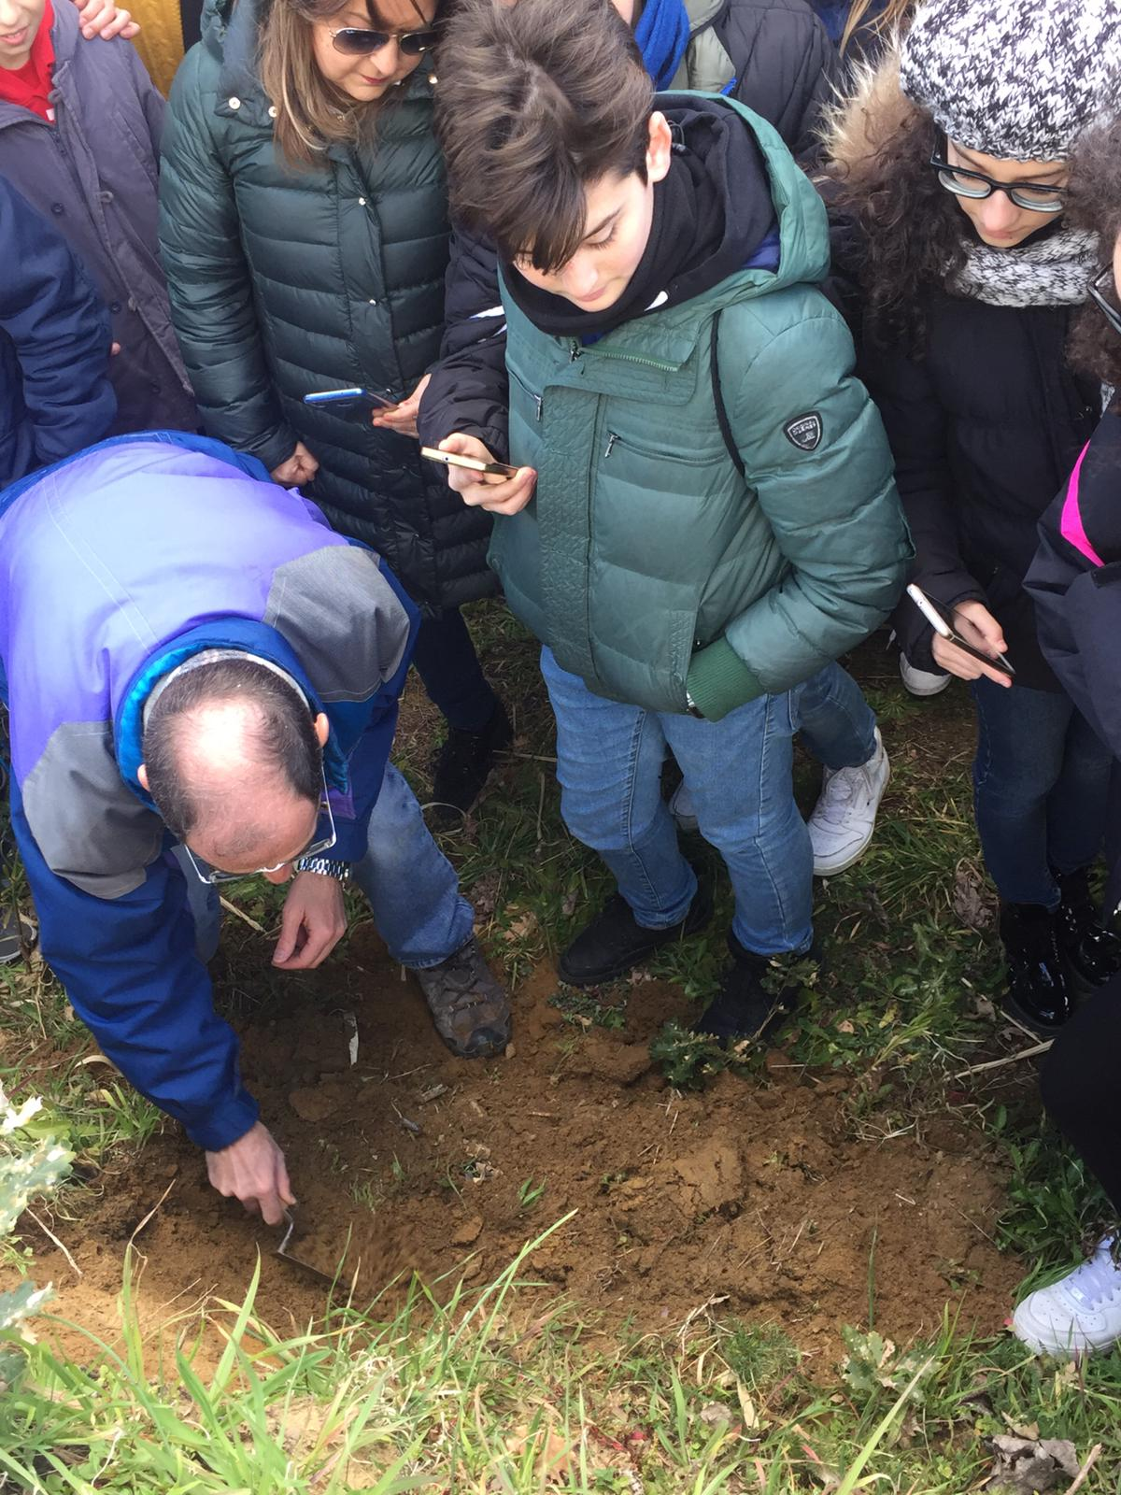
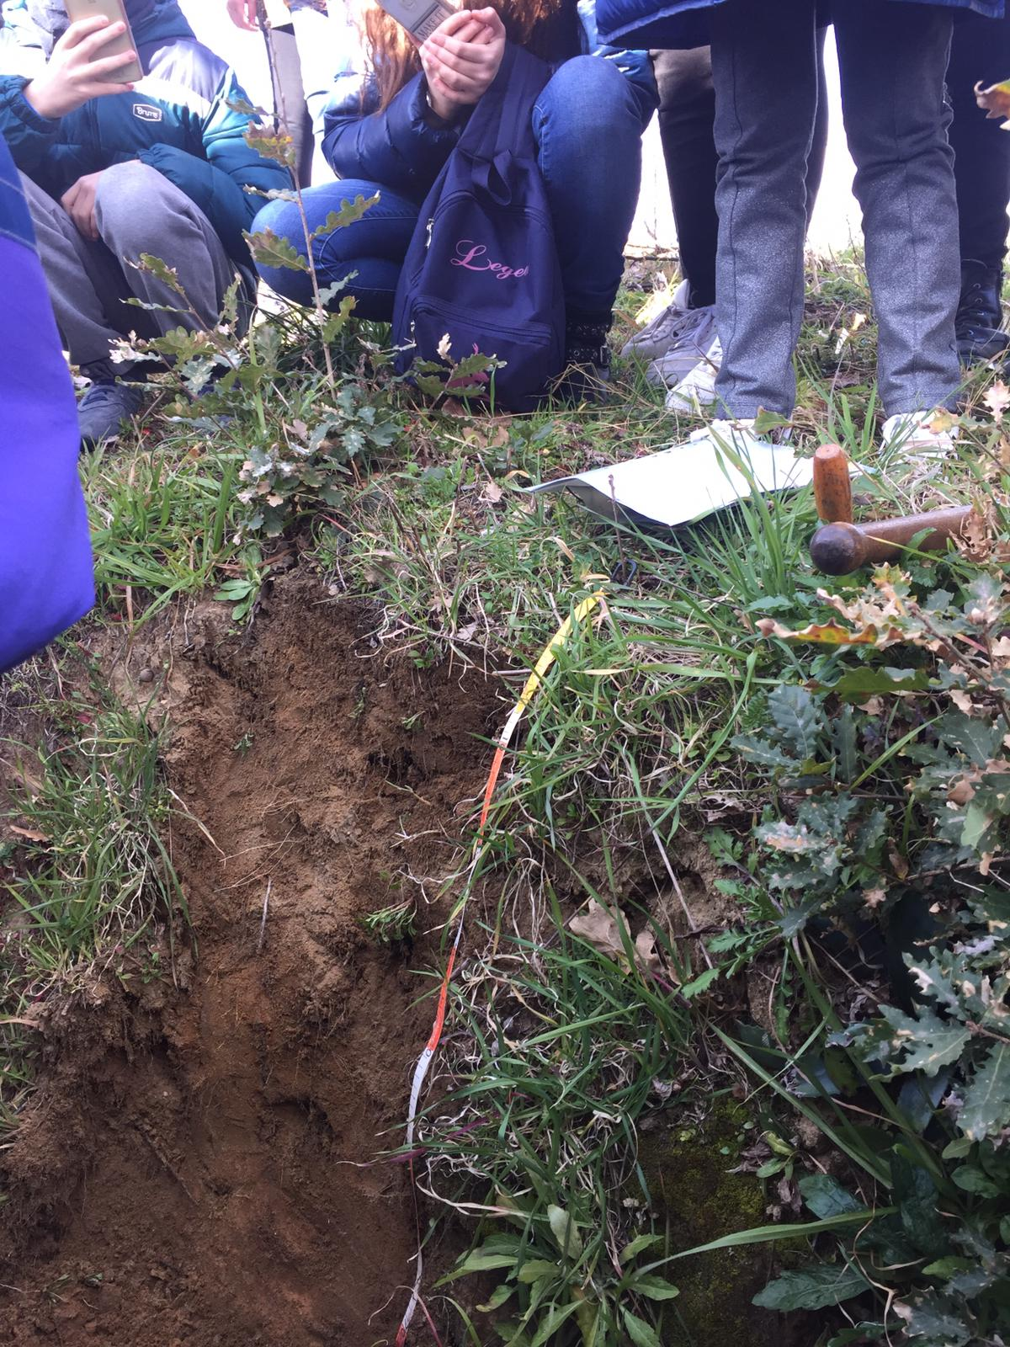

Slide 6
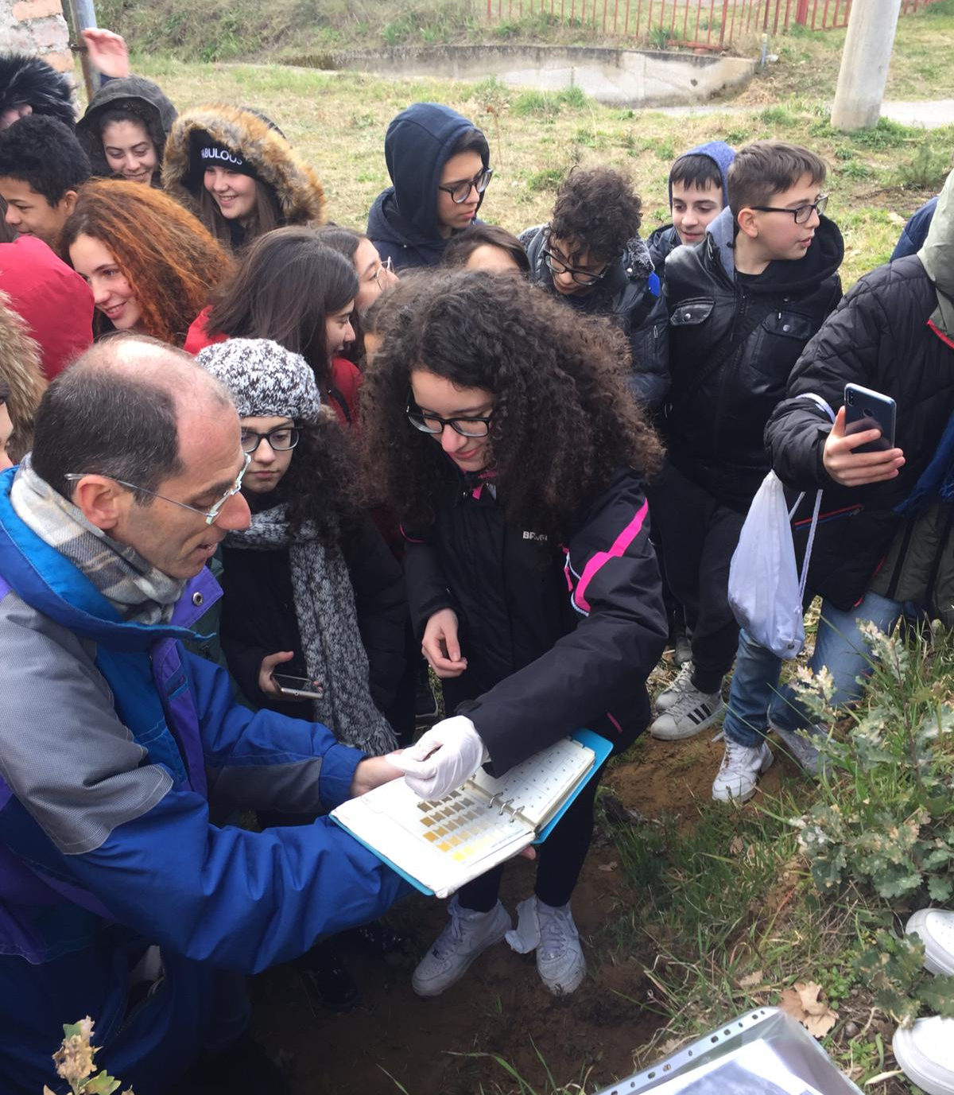
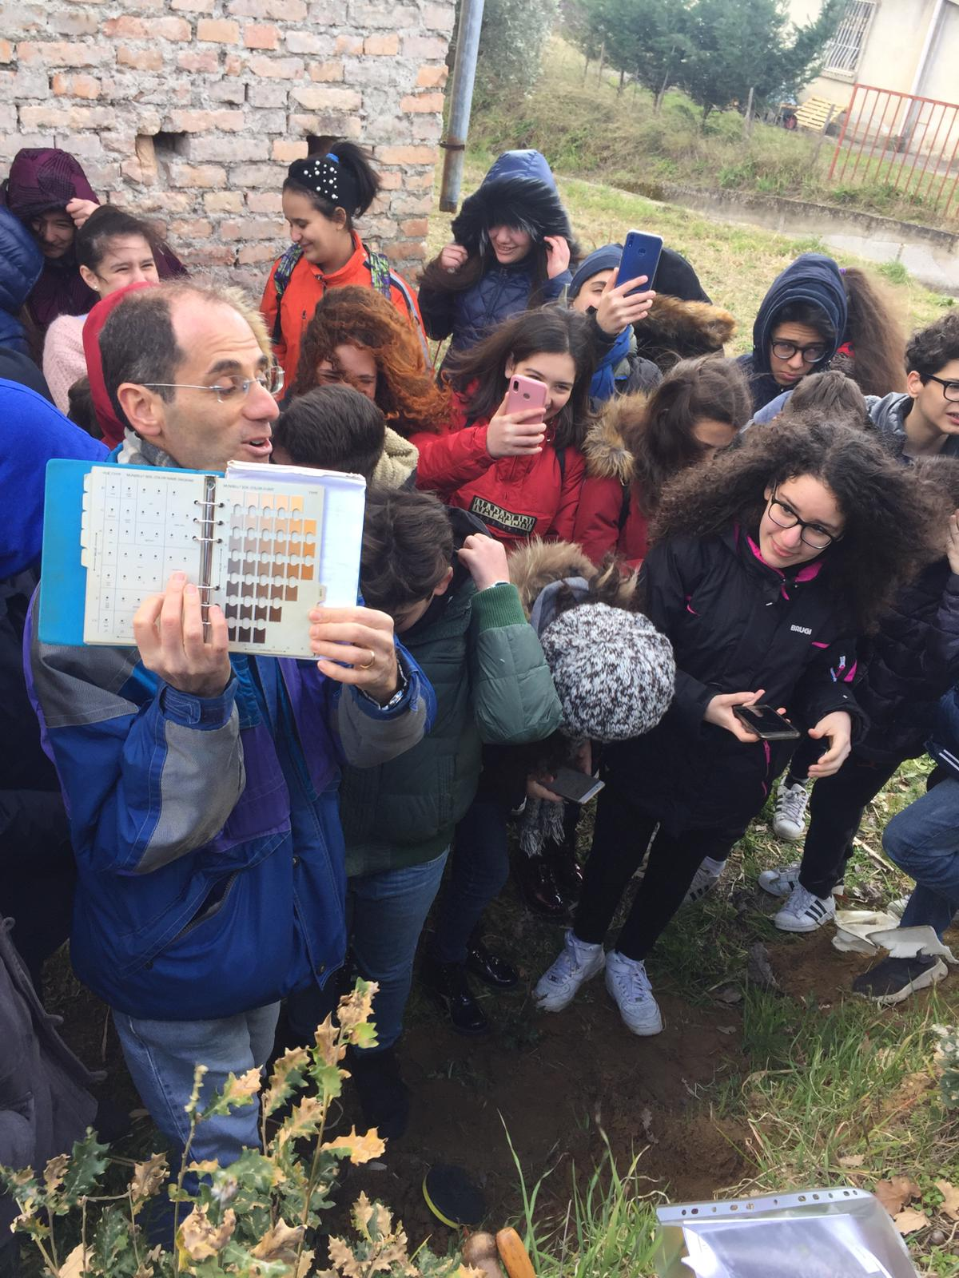
We used Mensell's table to classify the soil according to its colour. Then the teacher told us various other things about that soil.

Slide 7
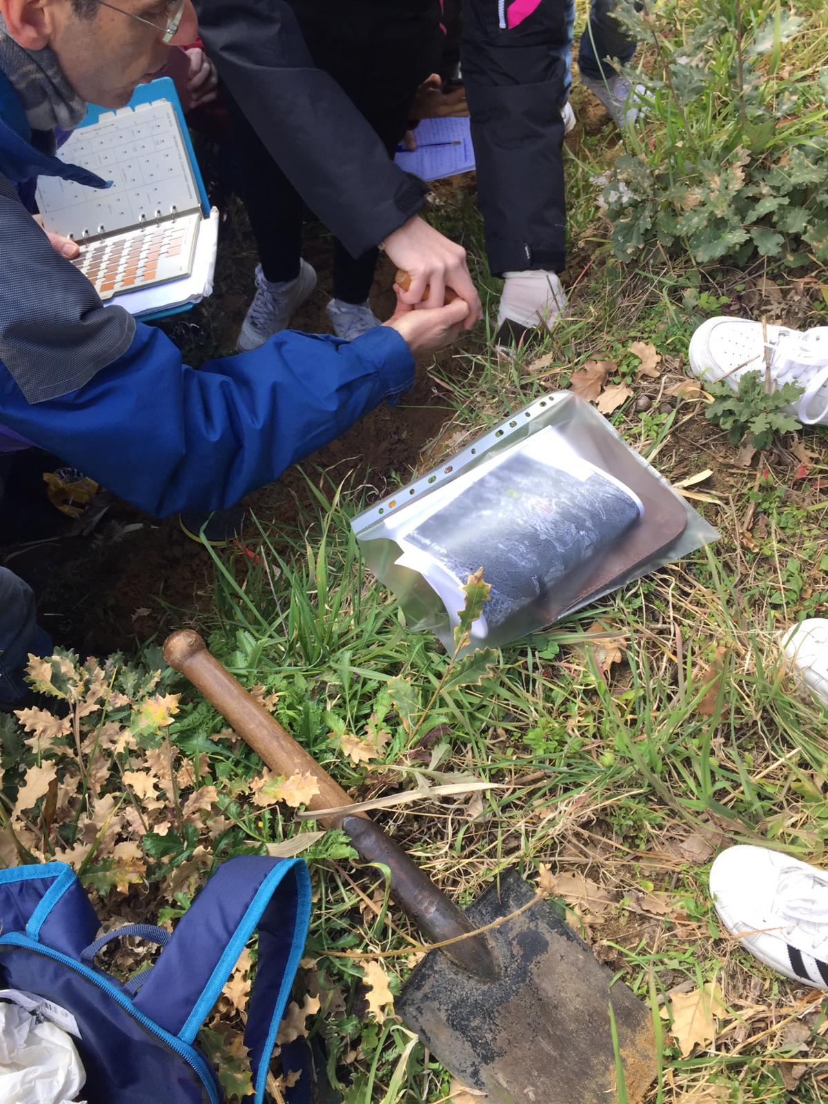

Slide 8
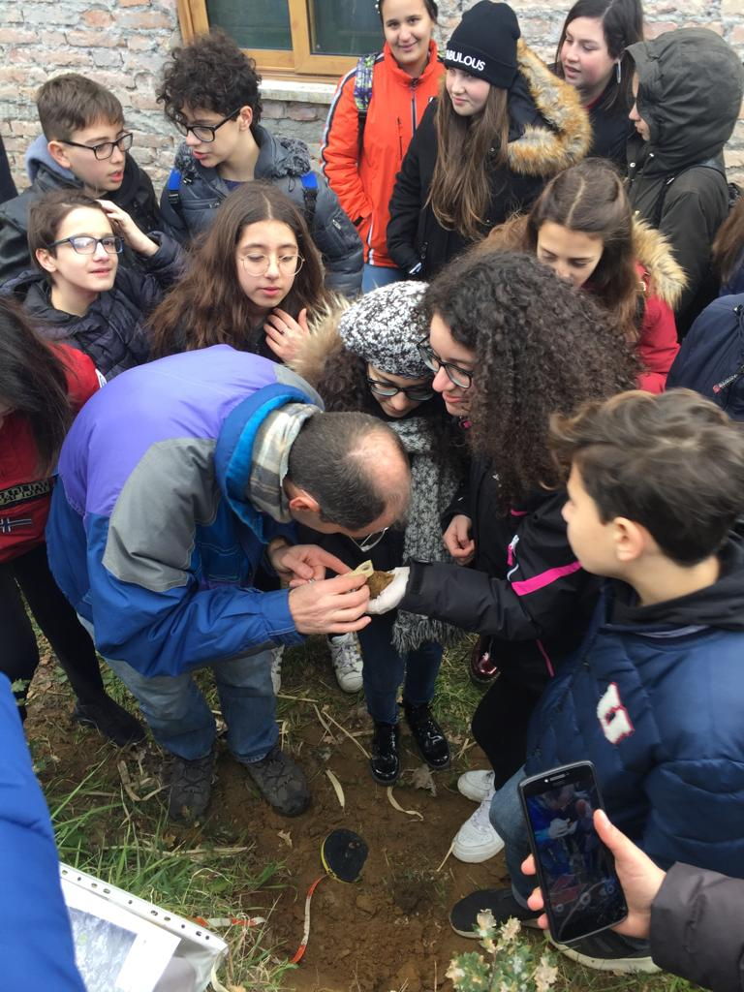
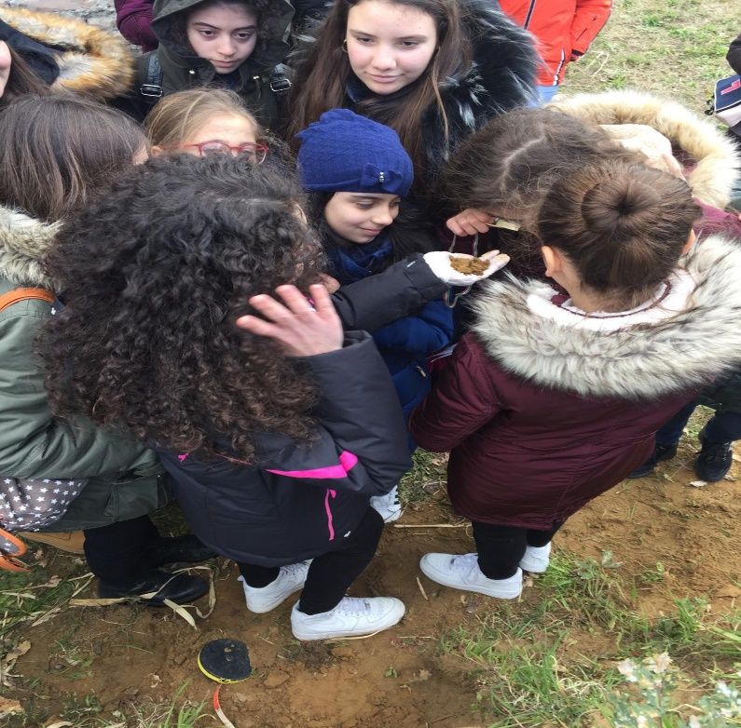
The silt granules were observed by the pupils through a magnifying glass, which made it possible to observe the shape, color and appearance in a better way, and to identify the minerals (quartz, feldspars and micas).

Slide 9
Then, we took some soil samples, which had to be taken to the University to be analyzed, within a Science laboratory, on the following days .

Slide 10
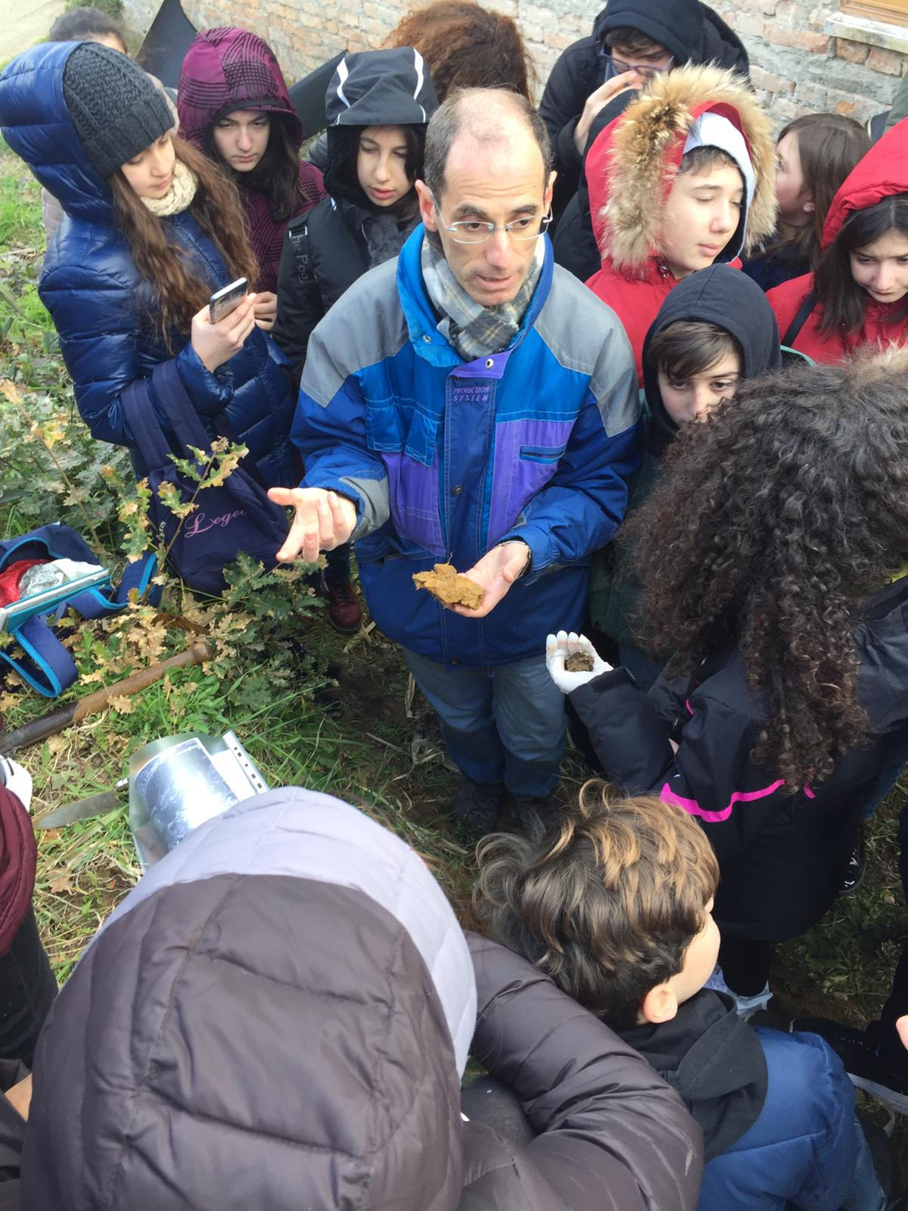
We noticed that the first three horizons were weakly humid, while the humidity of the deeper one was higher (moderately humid). Despite this, the soil was generally well drained, without the presence of stagnant water, conceivable as a temporary condition only in the lower horizon.

Slide 11
After all these interesting activities, we left around 11.30 and got back to school.

Slide 12
Thank you for watching
Vincenzo Fiorita
Vincenzo Rende

