Slide 1
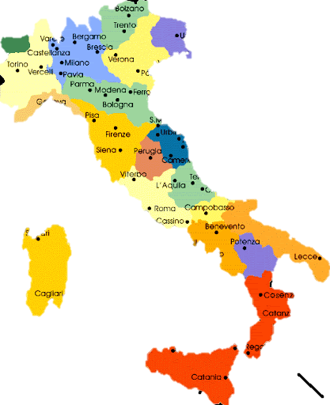
Italian school system
Art. 34 (from the Italian Constitution)
Schools are open to everyone. Primary education, given for at least eight years, is compulsory and free of charge. Capable and deserving pupils, including those without financial resources, have the right to the highest levels of education
Art. 33 (from the Italian Constitution)
The Republic guarantees the freedom of the arts and sciences, which can be taught freely. […] Entities and private persons have the right to set up schools and educational institutions, at no cost to the State. These schools are guaranteed full freedom and offer their pupils education and qualifications equal to pupils in state schools.

Slide 2
Schools in Italy

Slide 3
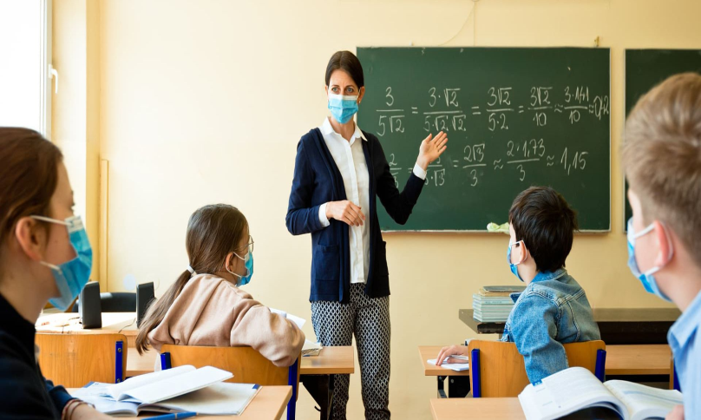
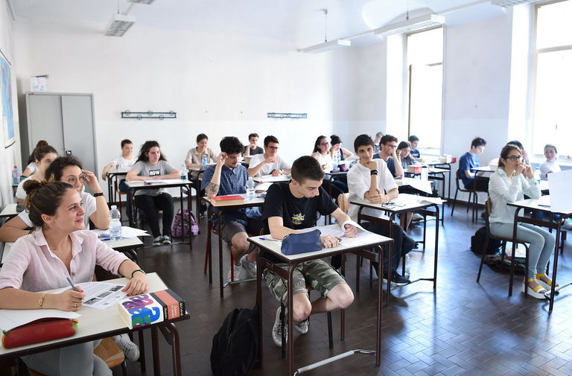
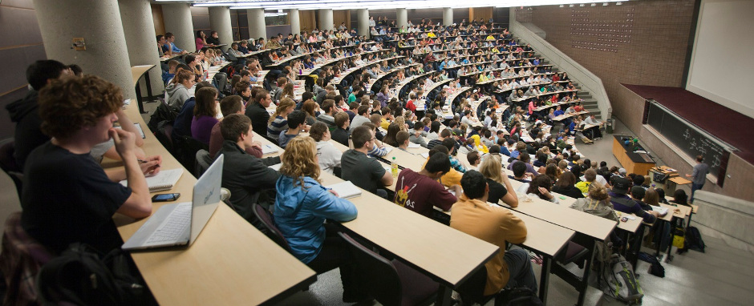
Education in italy
In Italy there are different degrees of Education:
- Nursery school (3-5);
- Primary school (6-10/11);
- Middle school (11-13)
- High school (13-18/19)
- University (18+)

Slide 4
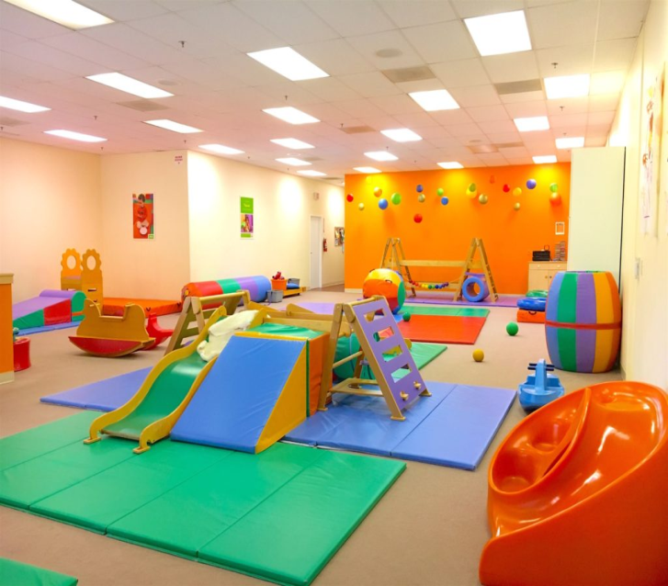
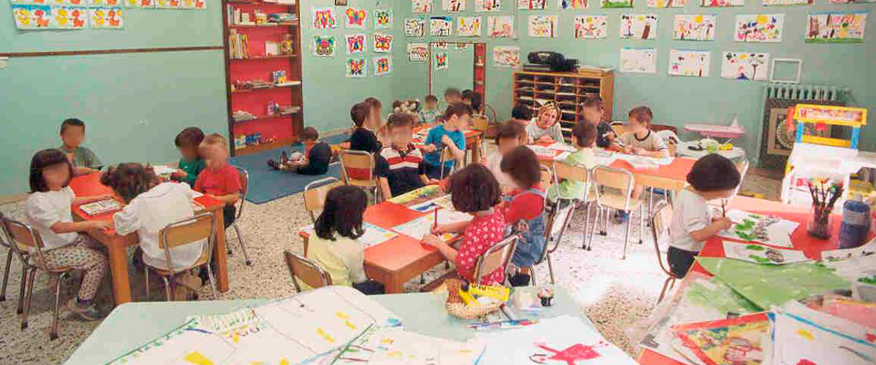
A TyPICAL DAY IN A NURSERY SCHOOL
Age 3 - 5
The nursery school prepare you to face the following schools. It is a preparation school to face primary school and, at the same time, babies start learning rules.
You usually draw, learn the vowels and the alphabet, sing songs or act in a drama.

Slide 5
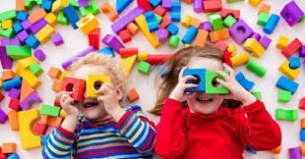
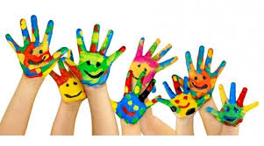
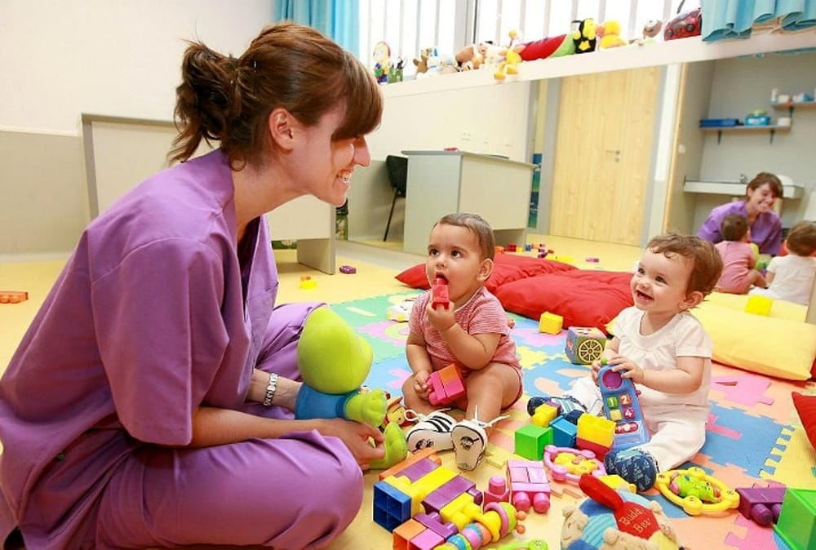
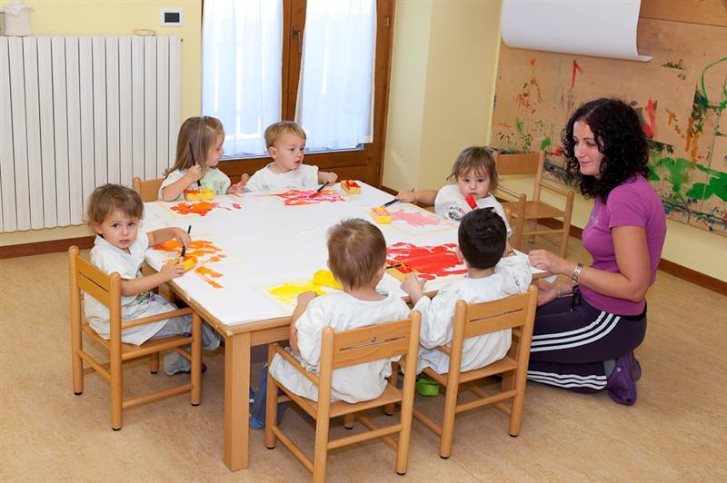
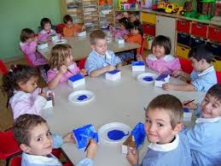
THE NURSERY
The nursery is a socio-educational service, aimed at encouraging the growth of children from 3 months to 3 years of age, offering opportunities, stimuli and interactions with other children.

Slide 6
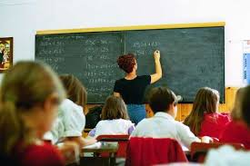
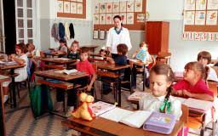
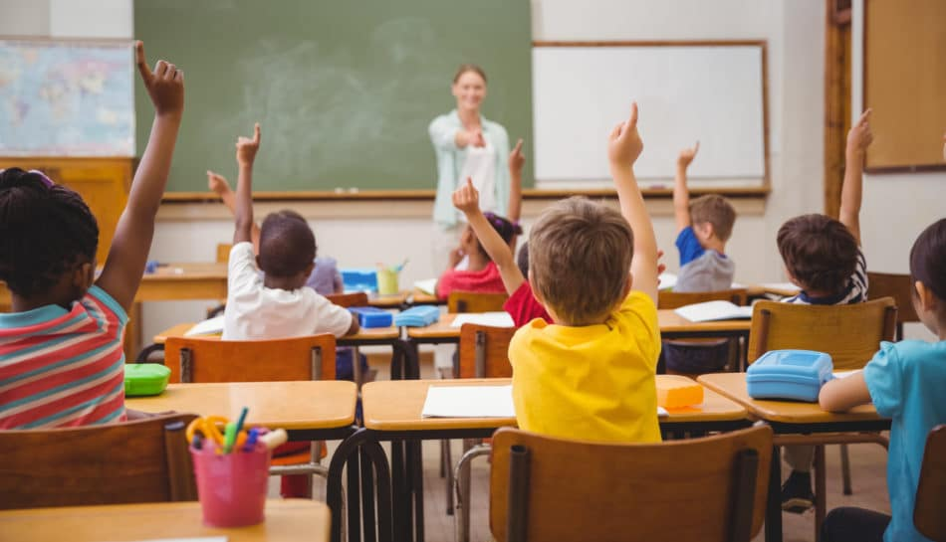
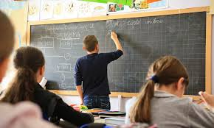
PRIMARY SCHOOL
Primary school represents the first level of the first cycle of compulsory education. It lasts five years: it begins at the age of 6 and ends at the age of 11.

Slide 7
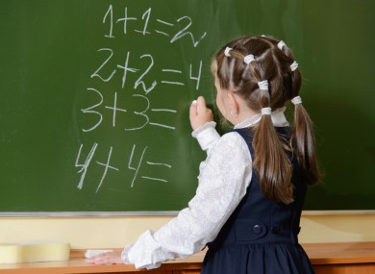
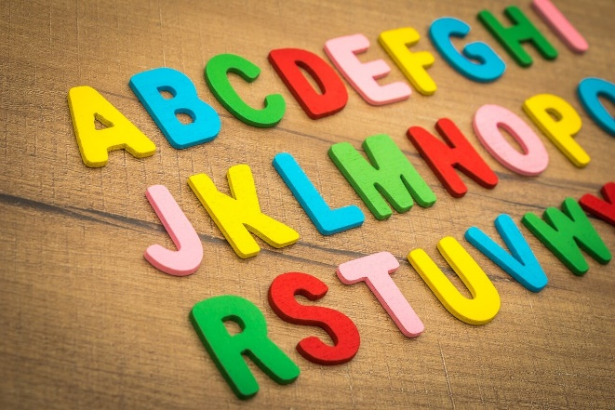
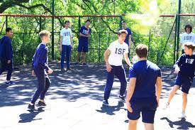
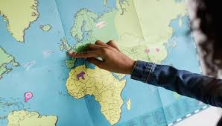
WHAT SUBJECTS ARE STUDIED?
The weekly timetable of lessons in a primary school can vary according to the prevalence of the choices of families from 24 to 27 hours, extending up to 30 hours based on the availability of the teachers.
The subjects studied in elementary school are:
Italian
History
Geography
Maths
Physical Education
Religion
Science
English
Music
Art
Technology

Slide 8
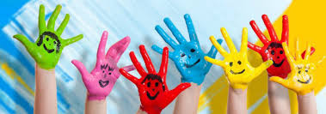
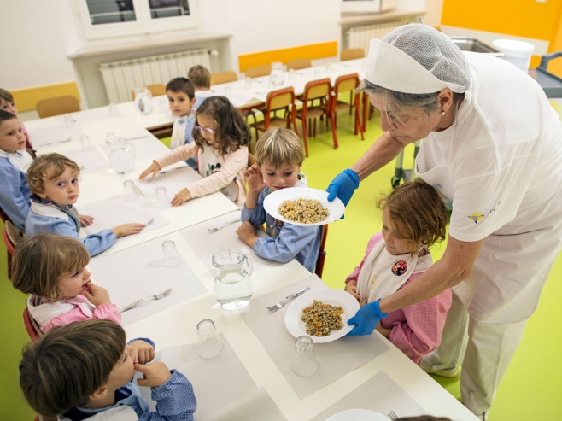
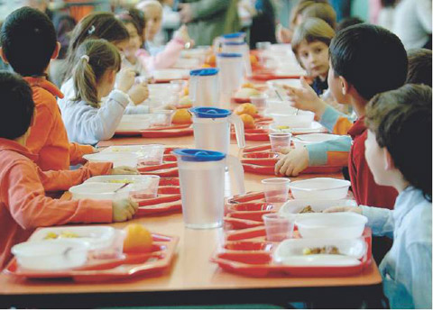
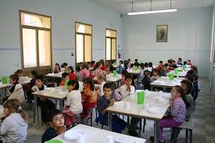
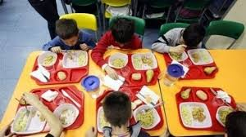
SCHOOL TIME
the current legislation provides that primary school can be organized according to different models:
a) the single teacher model, with 24 hours of teaching activity per week;
b) the extended time model which envisages 27 hours per week which can be extended up to 30 hours;
c) the so-called “full-time” model, characterized by 40 hours of school activities per week, including lunch time in the canteen. Today, full-time schooling is a great success.

Slide 9
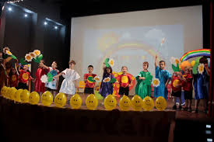
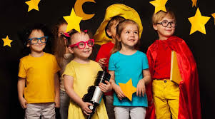
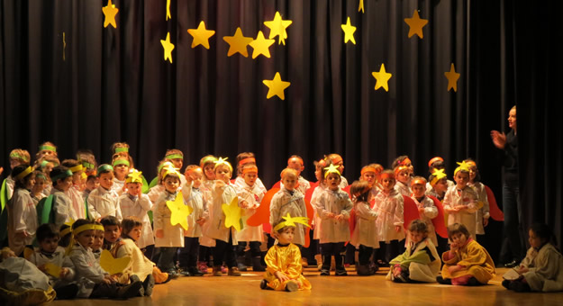
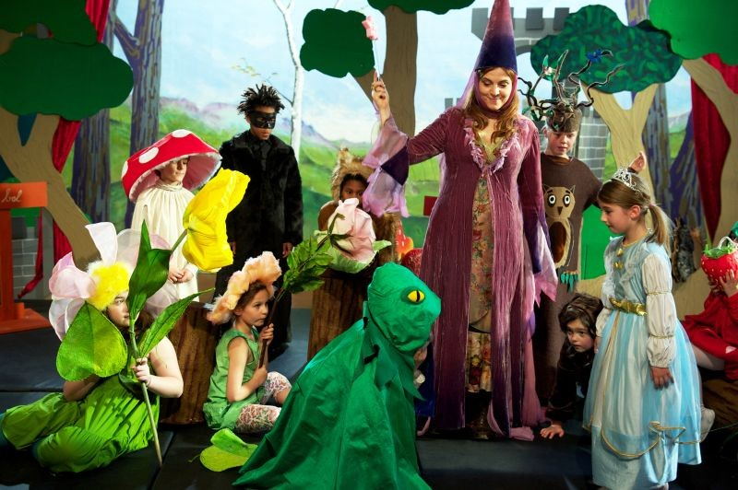
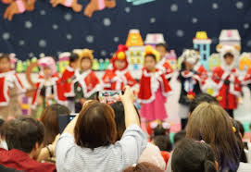
SCHOOL PLAYS
School plays are an emotional gym: it is a public event where children perform, speak in public, act in a play.
The activities can challenge you, but they can also help you to overcome shyness.

Slide 10
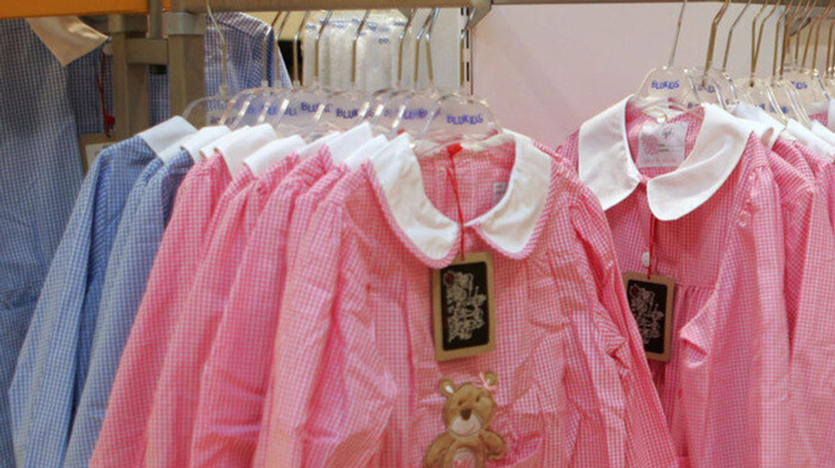
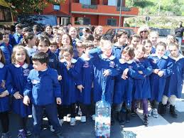
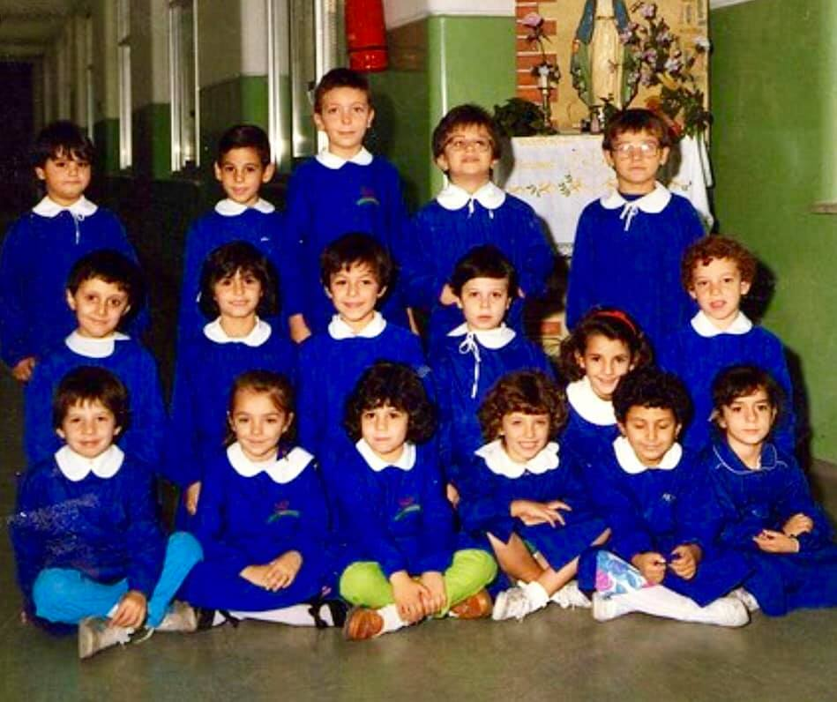
THE UNIFORM
The uniform is used to get rid of social differences.
It’s important who you are…. It isn’t important how you get dressed.
At the nursery school you can choose the color you prefer… white, pink, light blue, checkered. In the primary school, on the other hand, the chidren wear blue uniforms.

Slide 11
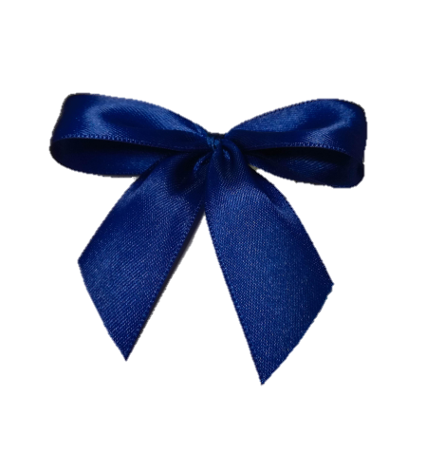
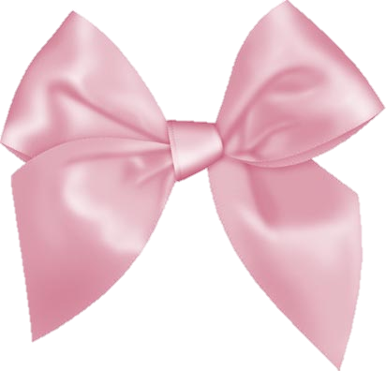
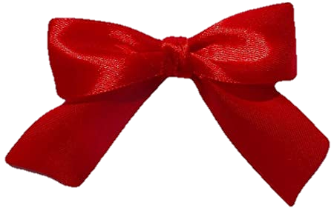
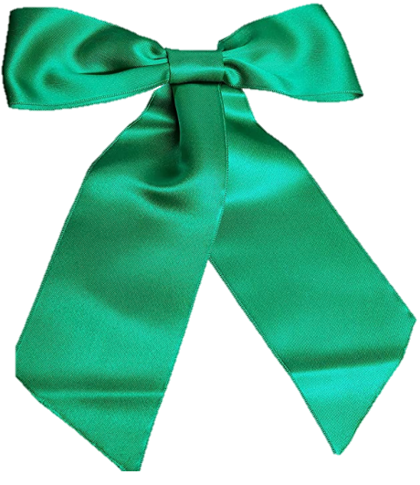
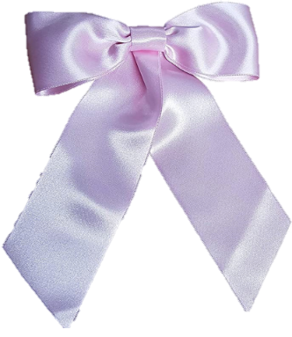
COLOURED RIBBONS
Every school year children use different coloured ribbons to make bows.
They are used to make bows:
First year – blue ribbon
Second year – pink ribbon
Third year – red ribbon
Fourth year – green ribbon
Fifth year – white ribbon

Slide 12
Welcome to the middle schools

Slide 13
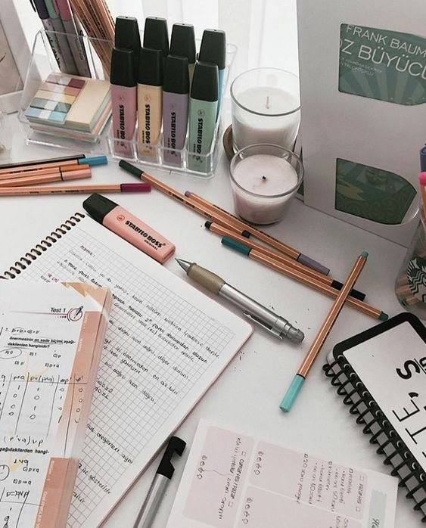
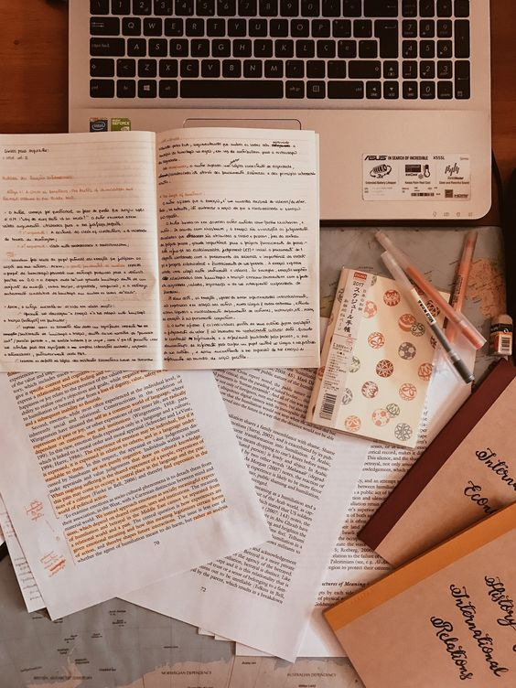
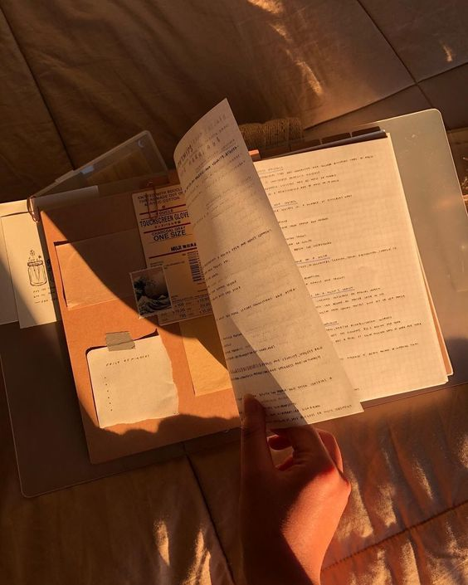
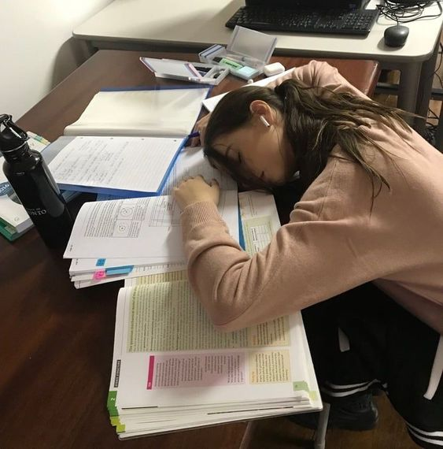
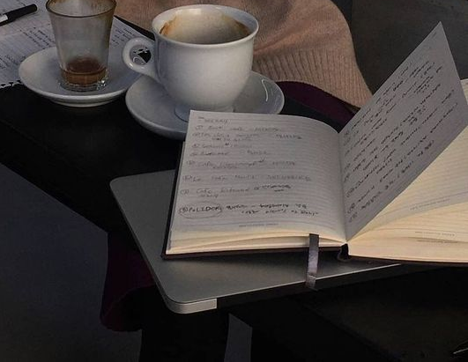
…generally…
Scuola Media or lower secondary school is mandatory, the students follow a three year program nominally from 11 to 14. At the end of the third year, students must take and pass an exam.

Slide 14
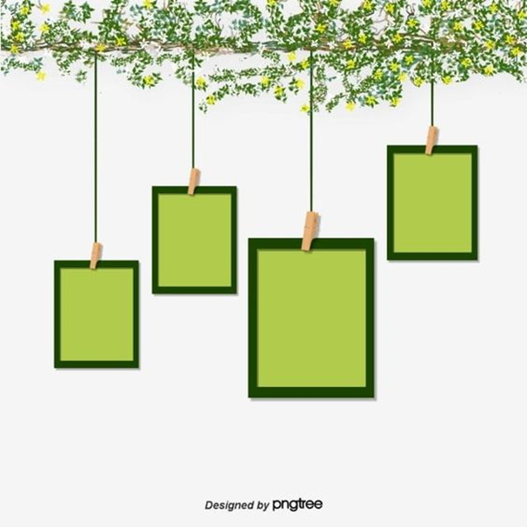
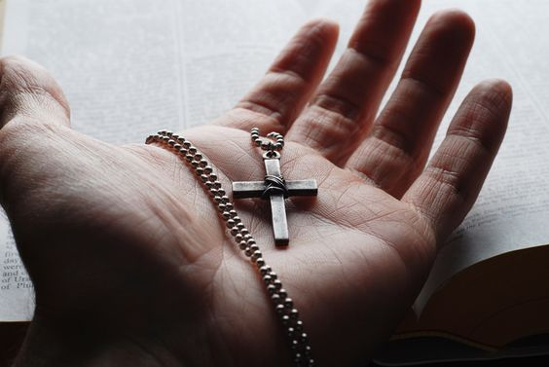
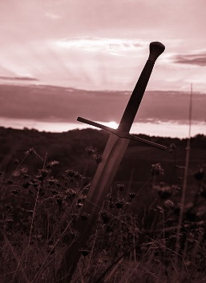
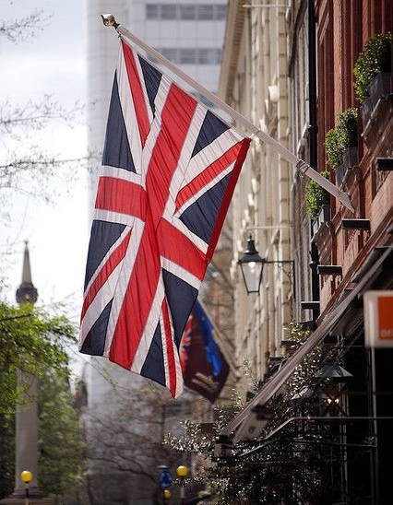
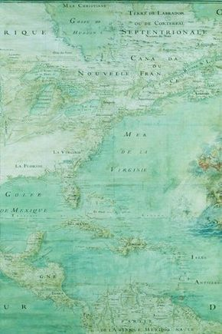
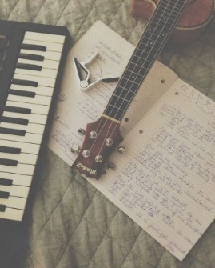
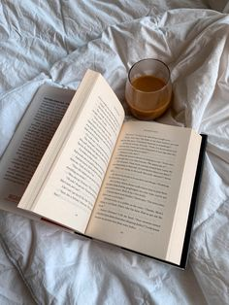
subjects
Martina Altomare

Slide 15
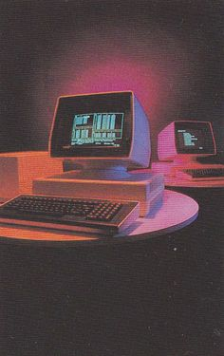
subjects
Martina Altomare

Slide 16
Favourite subjects in our class

Slide 17
Middle school years
The years of the middle schools in Italy are 3:
The first year,
The second year,
The third year.

Slide 18
Written and oral tests
Invalsi tests
Oral tests
Written tests
Italian
The oral exam consists of two moments:
maths
Italian
maths
english
english
Second language
•the presentation of a theme
What is it for?
•the teacher’s questions
The student can take the written and the oral tests

Slide 19
high school choices in our class

Slide 20
High school: what are they?
The upper secondary school system includes:
Classical High School
Scientific High School
Fine Arts High School
Foreign Languages High School
Music High School or Dance Academy
Human Sciences High School
Teacher Training High School
Technical High School
Vocational High Schools

Slide 21
High schools
After finishing the middle school, you attend the high school.
Two differents possibilities
education system
(5 years)
vocational education and training system
(3 years)
secondary school
Substantially
, high schools are divided into
technical institutes
Vocational institutes

Slide 22
Hospitality training institute
Professional
Institutes/
accountaing
Human sciences
Foreign language
sporty
turistic
artistic
Scientific
classic
The high schools we are going to discuss are

Slide 23
Scientific high school
The scientific high school is mainly concerned with strengthening science and mathematics subjects.
There are two courses
traditional
applied
sciences
Latin
differences
in-depht studies
sub-courses

Slide 24
Peculiarities
There are also EXTRACURRICULAR COURSES like
Cambridge English course
Erasmus projects
Many humanistic and scientific laboratories
Libraries

Slide 25
Foreign languages high school
The foreign languages high school is one of the secondary schools that can be accessed in Italy.
Physics
chemistry
Philosophy
The foreign languages that can be activated in public institutions are:
Italian language and literature
Latin language
History of art
History
Foreign languages
Mathematics
Earth sciences
Biology

Slide 26
Hospitality training institute high school
training course lasting between 3 and 5 years.
At the end of the study you recive a professional diploma
specific addresses:
Hall and sales services
Tourist reception
Food and wine

Slide 27
Classical
HIGH SCHOOLS
difficult
prestigious
but is it really so?
Yes!!

Slide 28
what did I choose?
easy

Slide 29
B
I
O
M
E
D
I
C
A
L
Meredith and Derek

Slide 30
human
Sciences high school

Slide 31
SPORTS HIGH SCHOOL
The student who gets a diploma from the Liceo Sportivo will have all the traditional skills of the scientific high school.
This high school, born a few years ago, was a real cultural revolution in the education of young people.

Slide 32
Accounting high school
Particular subject is economic
In Italy, Accounting is studied as Business Economics in the Commercial Technical Institutes.

Slide 33
tourist high school
the study plan includes both the teaching of the humanities and the scientific ones and specific subjects by message

Slide 34
THE UNIVERSITY
public or private
divided into faculties
degree courses

Slide 35
The university works for courses and exams,divided into session
Usally the lesson end within 3-4 months
At the end there are exam session where the professor
Will evaluted the student with a grade
18 / 30

Slide 36
Francesco petrarca
Dante alighieri
Cino da Pistoia
1158
Cecco d’Ascoli
Salimbene da Parma

Slide 37
ANCIENT AND BEAUTIFUL UNIVERSITIES IN ITALY
Universities among the oldest in the world
Ca ‘Foscari in Venice, in the Gothic palace on the Grand Canal, was declared an Italian Wonder as part of the project for the 150th anniversary of the Unification of Italy.
University of Bologna
Founded in 1088
Named Alma Mater Studiorum
University of Venice
Founded in 1972
Declared an Italian Wonder

Slide 38
THE UNIVERSITY OF CALABRIA
It was founded in 1972 and is located in Rende. In 2019, according to a ranking drawn up by a Censis, it is second among the largest Italian state universities.

