Slide 1
Gorlice region – traditional life based on the natural environment

Slide 2
GORLICE

Slide 3
The Carpathian Mountains are the highest in Poland. The Low Beskids (Beskid Niski) is the main range in Gorlice region.
Beskid Niski

Slide 4
Lackowa 997 m n.p.m. - the highest pick of the Beskid Niski in Poland

Slide 5
From Lackowa you can see the Tatras – the highest range in Poland.

Slide 6
Klimkówka Lake was created on Ropa river to protect people from flooding.

Slide 7
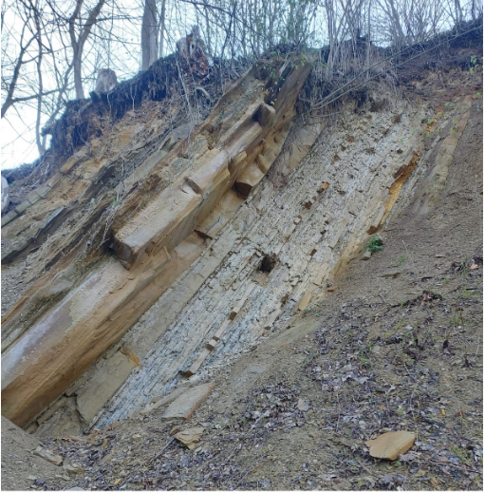
The Carpathian flysh – sandstone and shale are bedrocks for brown soil. It is a typical type of soil in Gorlice region.

Slide 8
Magurski National Park is an area protecting natural forest, animals and environment of low mountains in the borderland of Poland and Slovakia.

Slide 9
Magurski National Park – typical forest and sandstone rocks.

Slide 10
MPN in Folusz – natural beech forest in the spring.

Slide 11
Beaver lodges – you can see them on our rivers more and more often.

Slide 12
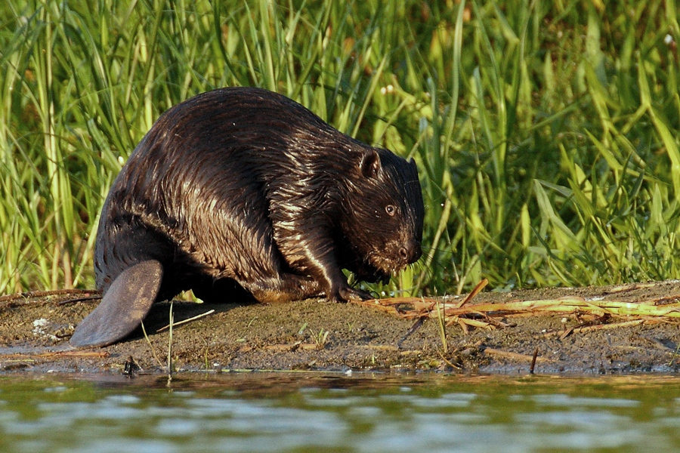
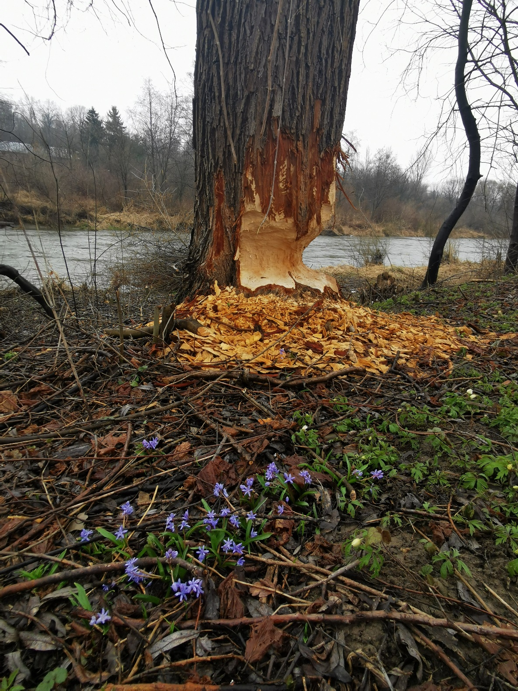
Autorstwa Klaudiusz Muchowski - https://picasaweb.google.com/114025505682426955097/Ssaki?authuser=0&amp;feat=directlink#5800552717512853698, CC BY-SA 3.0, https://commons.wikimedia.org/w/index.php?curid=22928968

Slide 13
The Beskid Niski is an area with infertile soil, mountain climate and difficult conditions for life and economy.

Slide 14
This part of the Carpathian Mountains is rarely populated.

Slide 15
The southern part of Poland is place of residence of Lemko people. They are the first inhabitants of the mountains and created their own culture – language, music and architecture.
Gorlice
Poland
Slovakia

Slide 16
Lemkowyna – landscape of Lemko territory, mailny beautiful valleys with only a few bulidings, for people who like silence and open space.

Slide 17
Czarne – the door is a symbol of old settlement, which was destroyed by communist authorities. That is way so many valleys are empty.

Slide 18
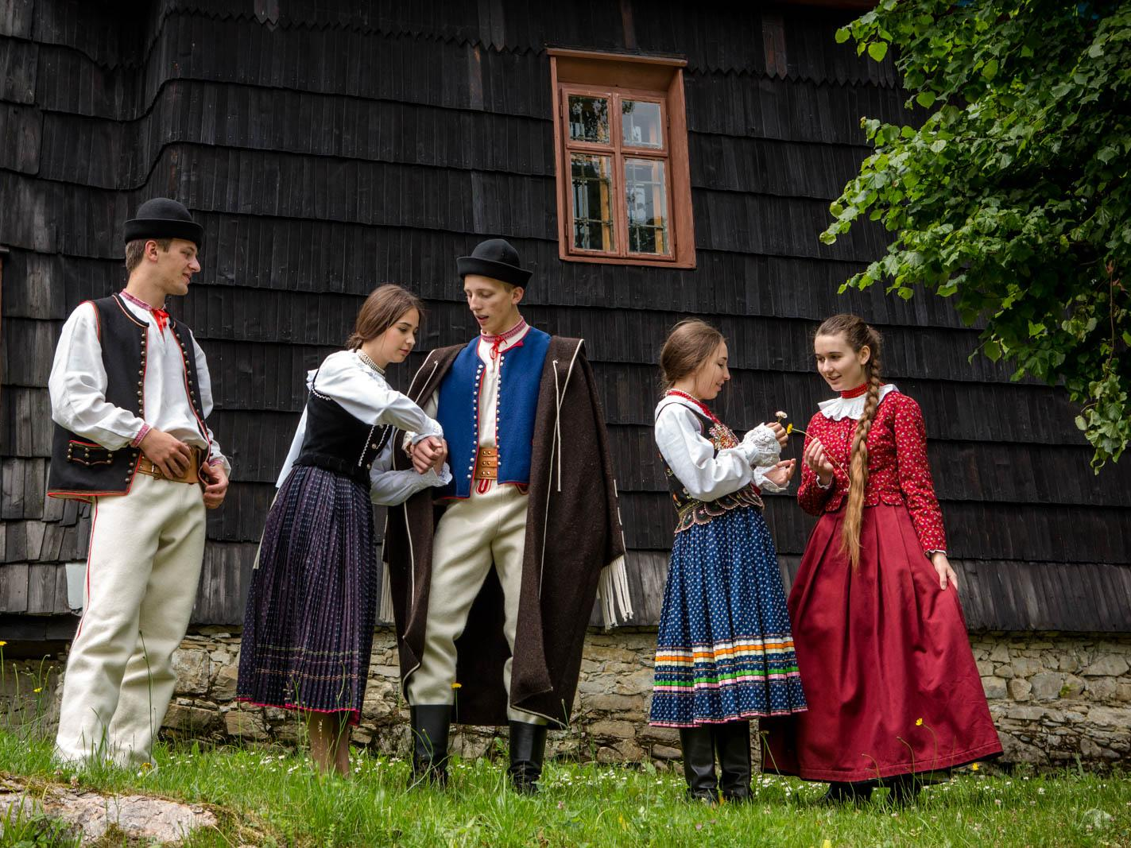
Traditional Lemko clothes
https://www.etnozagroda.pl

Slide 19
Krywulka – it is necklace made from beads in different colours.
https://www.uniwlud.pl/tag/krywulka/

Slide 20
Anna Maria Zygmunt, a fashion designer, creates collection of clothes which were inspired by traditional Lemko style.
Fot. Mateusz Gurgul

Slide 21
Vatra means bonfire and is a symbol of celebration of Lemko Culture. Every year in summer open air festiwal is organized in Zdynia.

Slide 22
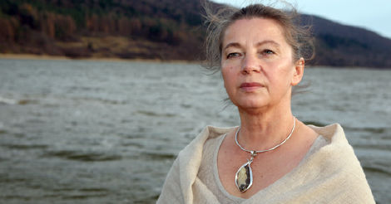
Julia Doszna famous Lemko singer
Fot. Press
https://www.youtube.com/watch?v=dhoYWQmojAo&list=PLCE1B81E0620B9012&t=7s

Slide 23
There are many wooden churches hidden in the valleys where Lemko people lived.

Slide 24
Some of them are listed on the UNESCO Heritage List.
Bartne – orthodox church dedicated to Saints Kosma and Damian

Slide 25
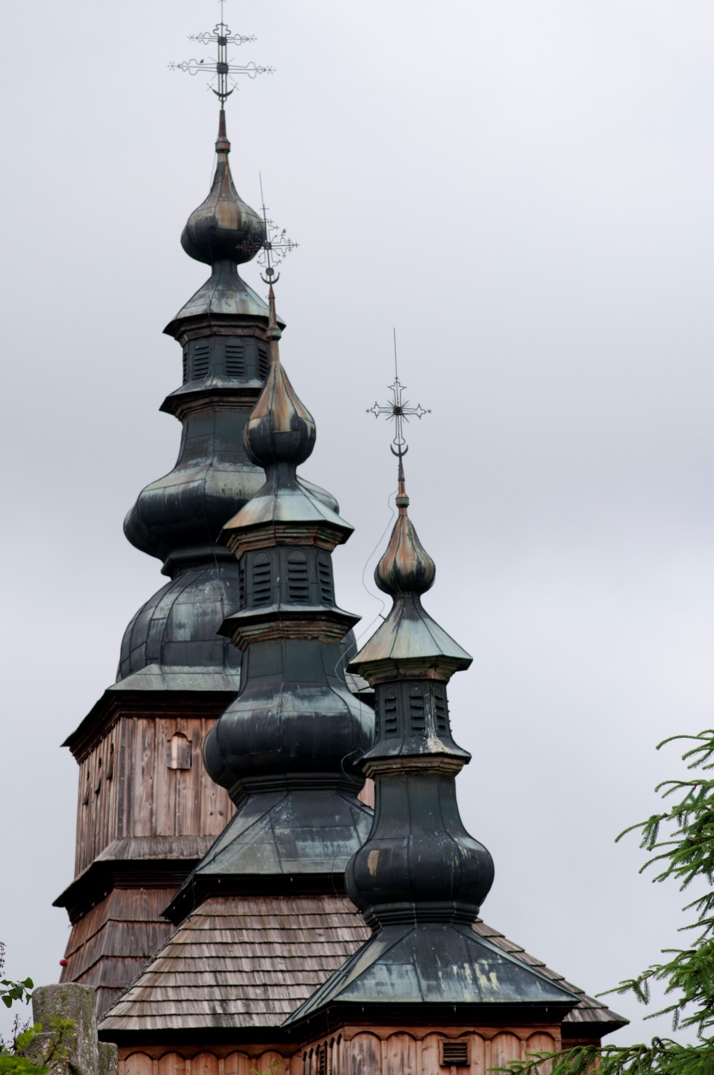
There is Wooden Architecture Trail in the Carphatian Mountains. The orthodox church in Owczary.

Slide 26
Kwiatoń – an orthodox wooden church dedicated to Saint Paraskewa.

Slide 27
Kwiatoń - Ikonostasis designed by Michał Bogdański in 1904 r. Source: Michał Oleksiuk

Slide 28
Świątkowa Wielka – traditional coloured wooden church.

Slide 29
Gładyszów – Greek orthodox church.

Slide 30
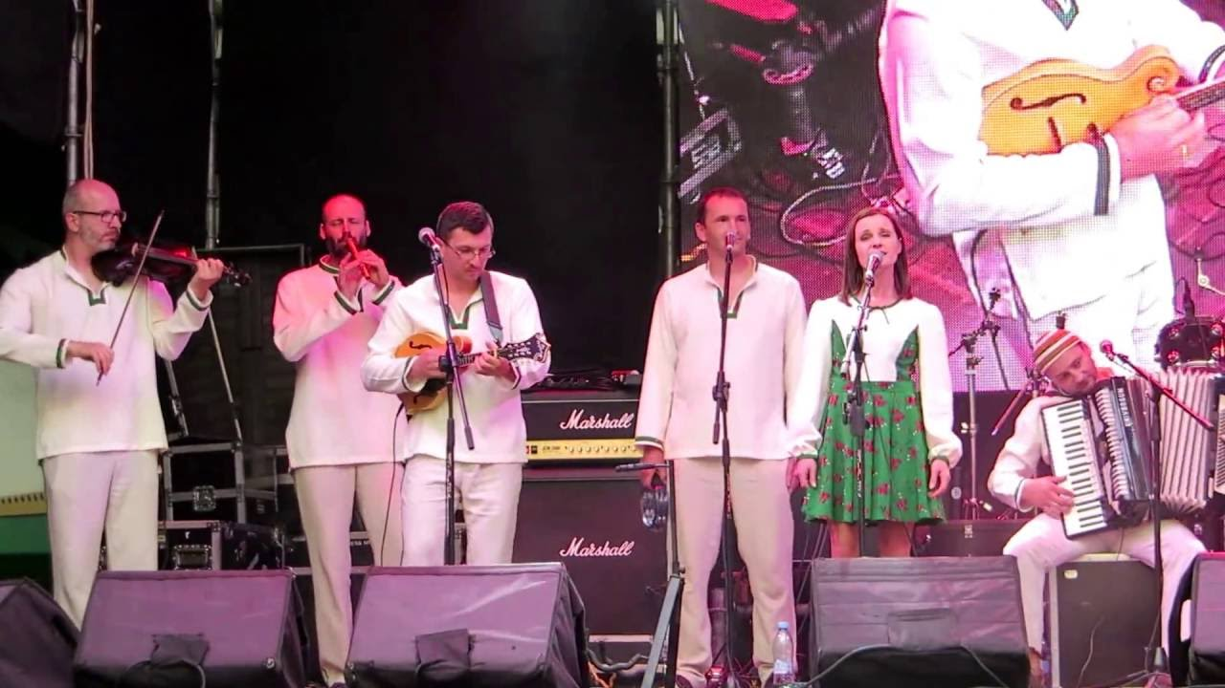
Song performed by the Lemko group "Serencza" ("Серенчa")
https://www.youtube.com/watch?v=uxrLw7C5_Pw

Slide 31
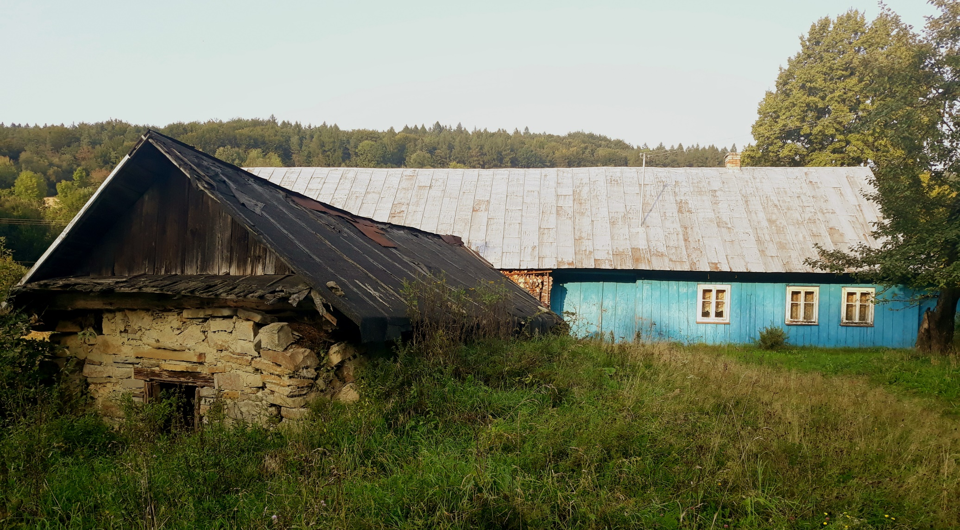
Wood and stones are natural resources used to build houses, churches, chapels or things for everyday use.

Slide 32
Traditional Lemko house is called chyża.

Slide 33
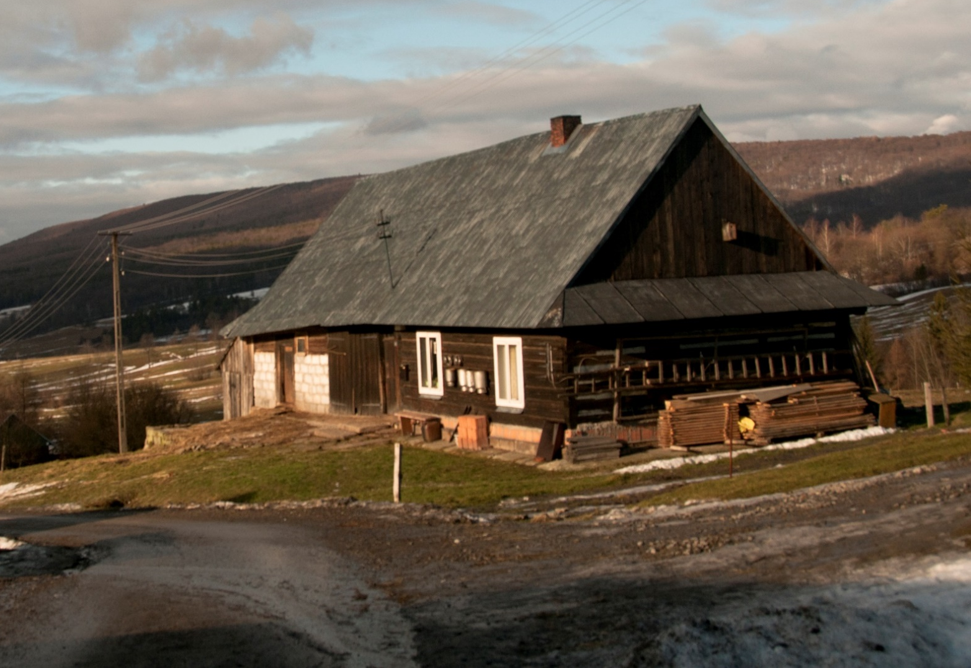
Typical old houses in our region. Nowadays many of them are renovated and popular for resting or agroturism.

Slide 34
Usually, people in villages have animals living around.

Slide 35
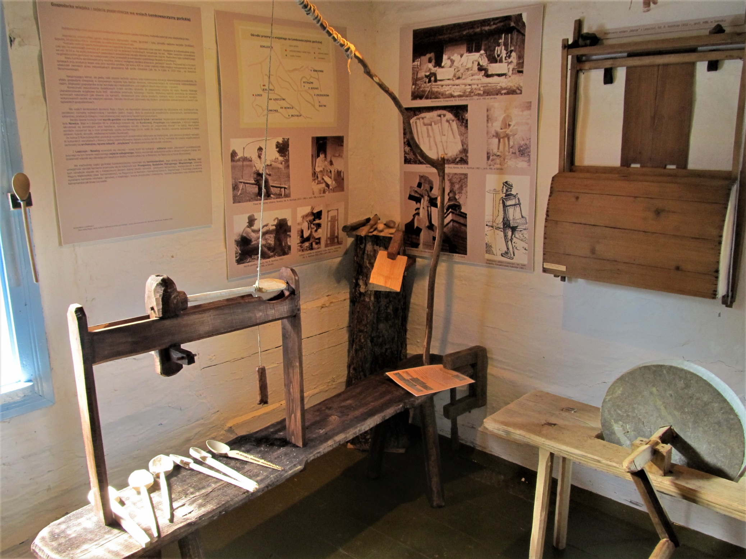
Nowica
Inhabitants of Carphatian villages made wooden spoons and other tools.

Slide 36
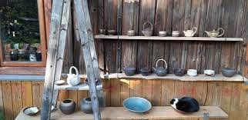
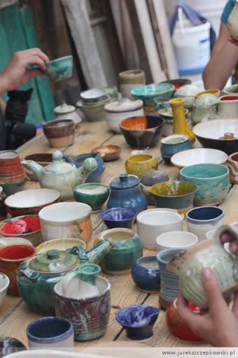
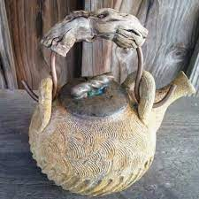
Ceramic bowls, plates and cups were commonly used in the past, but now art workshops are popular.
https://www.facebook.com/WarsztatyCeramiczneCzarne/videos/1033899513359903
https://www.facebook.com/WarsztatyCeramiczneCzarne/

Slide 37
The villages of Bodaki and Bartne – here specialized in using natural stones to build houses or sculptures.

Slide 38
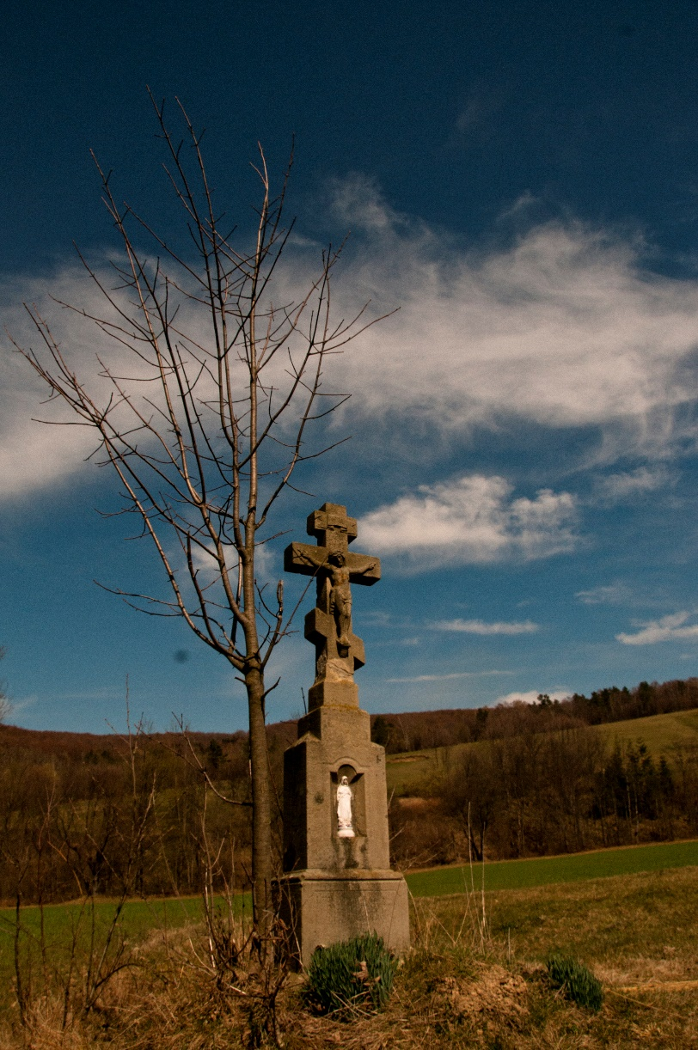
Chapel in Izby – as many others was made from local sandstone.

Slide 39
Nowadays sheep and cattle grazing is one of the main parts of agriculture in the Beskidy Mountains.

Slide 40
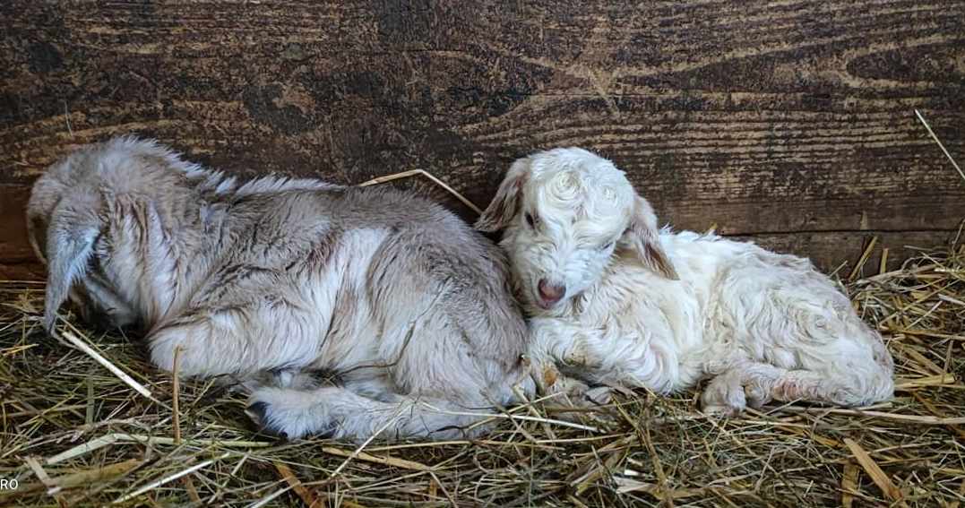
Banica Farmhouse – one of a few places where ecological goat cheese is made following an original recipe. https://www.facebook.com/ZagrodaBanickaKozieSery

Slide 41
Honey bee hives – natural environment is still good for insects. Honey is also a local product – very good quality.

Slide 42
Izby

Slide 43
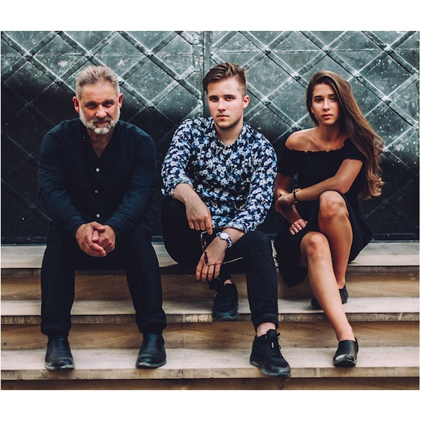
Kapela Maliszów The Familly Band
https://www.youtube.com/watch?v=WTxtoPE9Tn8

Slide 44
The village Krzywa – winter in the Beskid Niski Mountains.

Slide 45
Cemetery of the I World War
Długie
Ożenna

Slide 46
Cemetery on Rotunda peak – one of the most interesting objects, designed by Slovak Dusan Jurkovic.

Slide 47
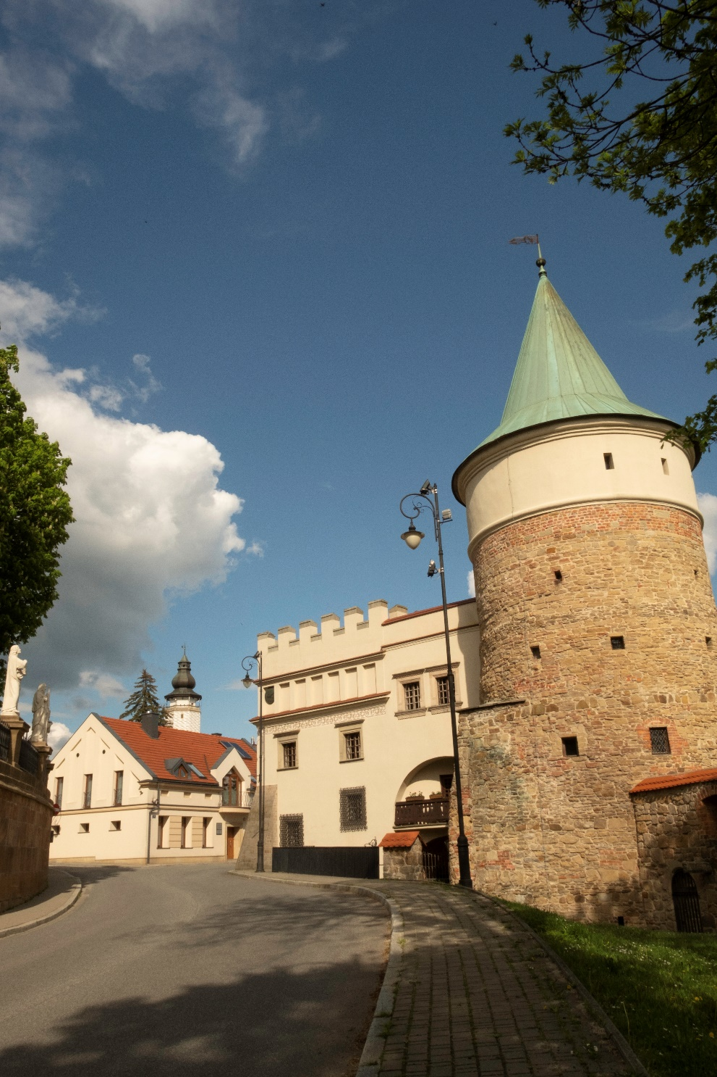
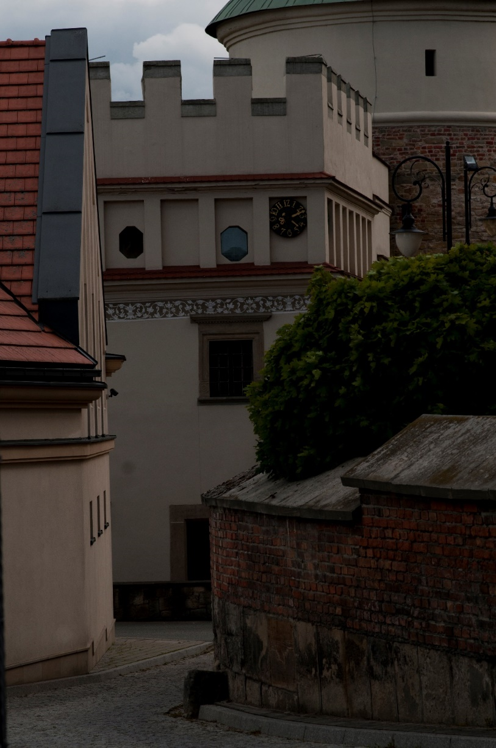
Biecz – medieval town called small Cracow

Slide 48
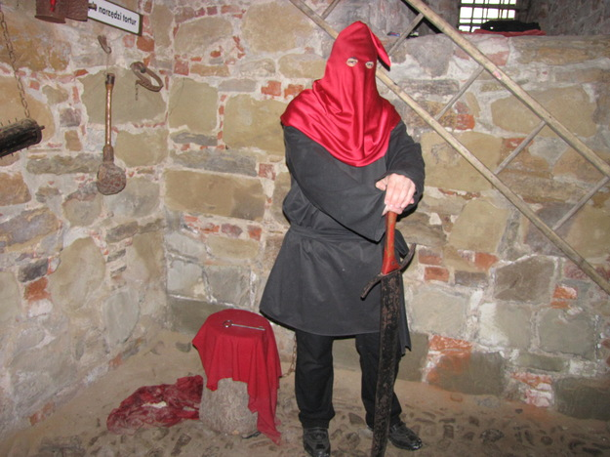
One of the most specific professions which Biecz was famous for was an executioner ☺.

Slide 49
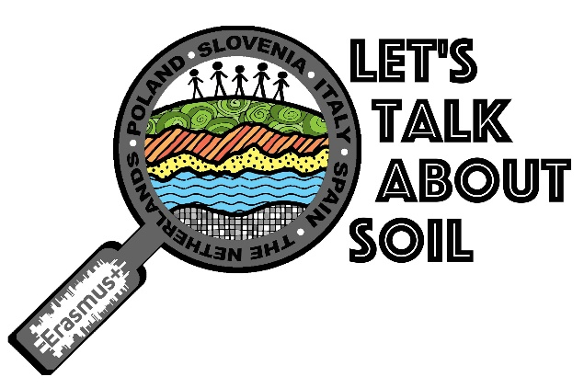
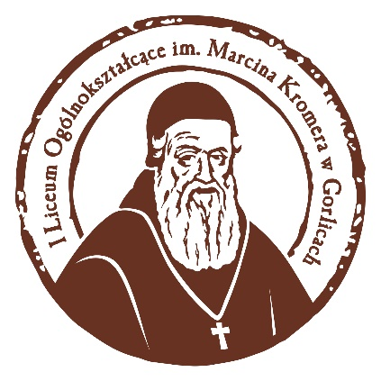
https://www.youtube.com/watch?v=OGrxQ4MlD9c

