Slide 1
ISTITUTO COMPRENSIVO
COSENZA III
VIA NEGRONI
ERASMUS PROJECT KA229
LET’S TALK ABOUT SOIL

Slide 2
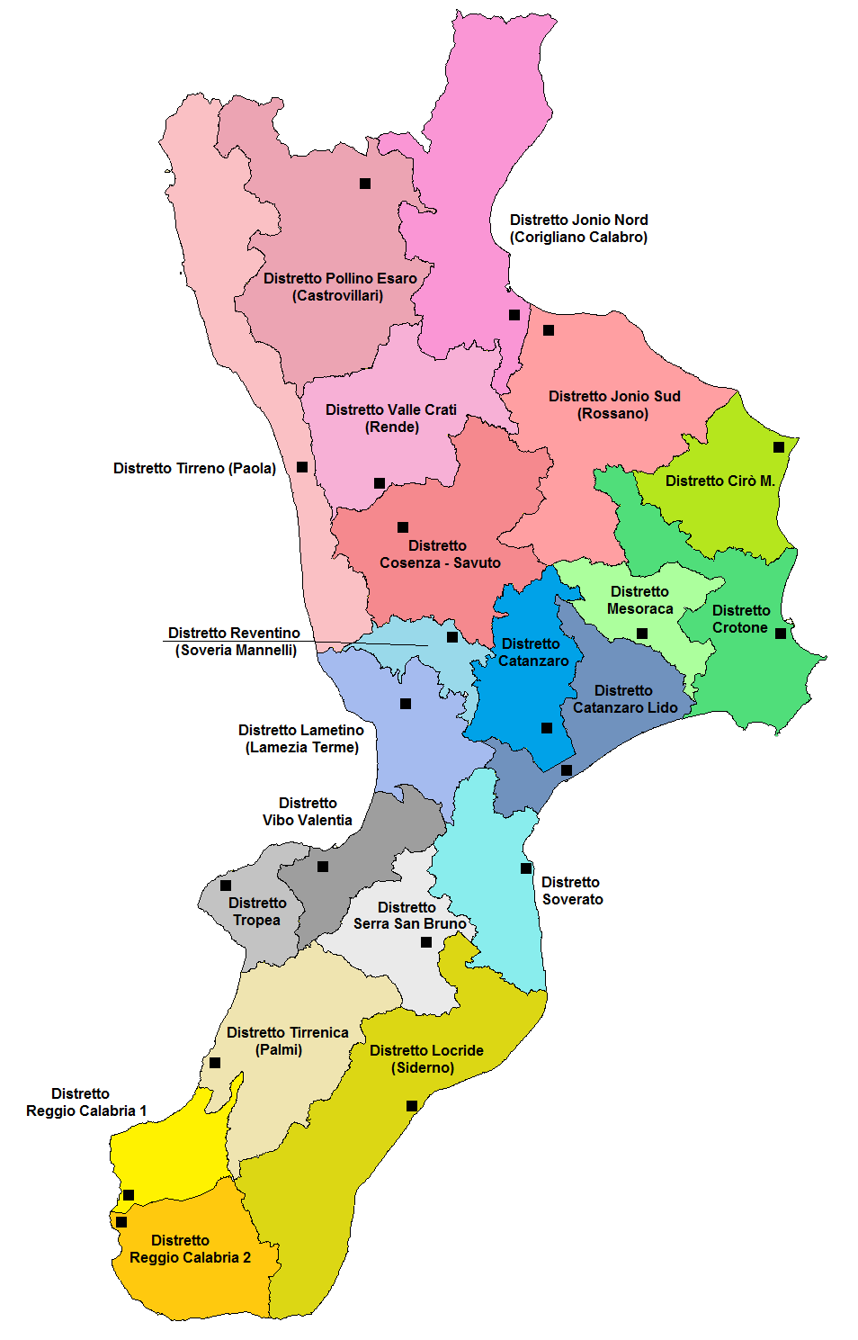
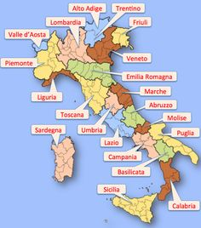
I
T
A
L
I
A
C
A
L
A
B
R
I
A
Calabria is in the south of Italy. The soil is rich in calcareous rocks and it includes alluvial and coastal plains. The climate is mediterranean. The rainiest months are from October to January, while the driest months are from June to September.
Unfortunately, Calabria is a sismic land and it has often been hit by numerous earthquakes.

Slide 3
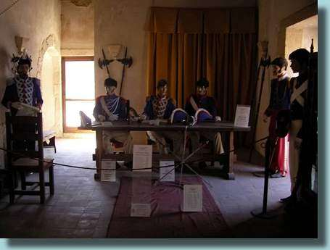
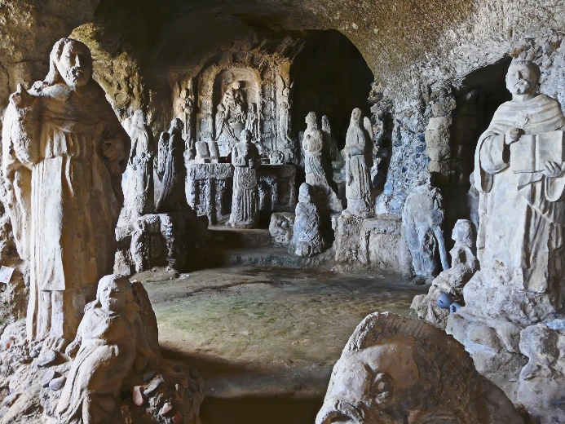
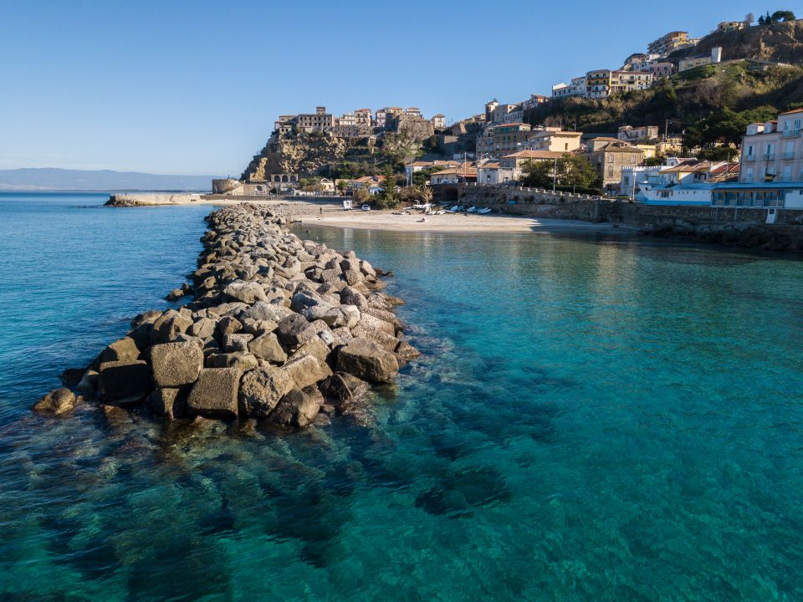
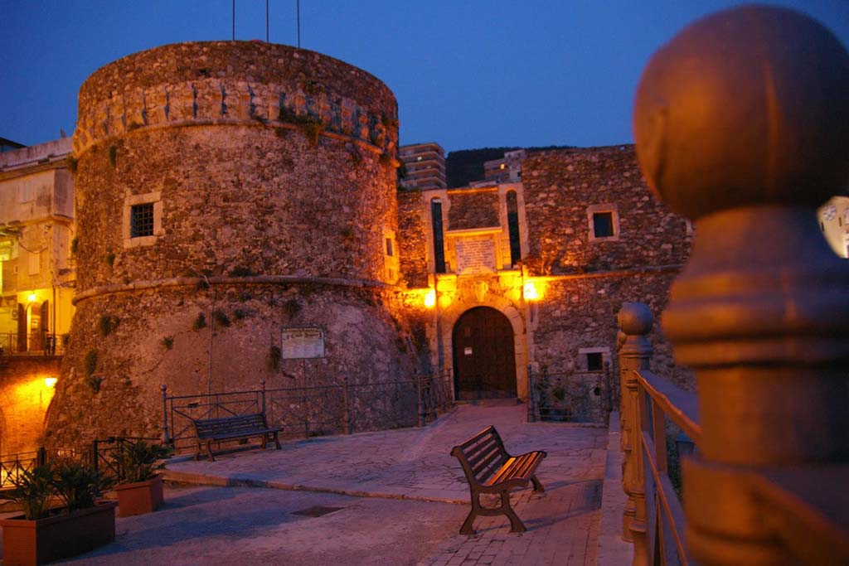
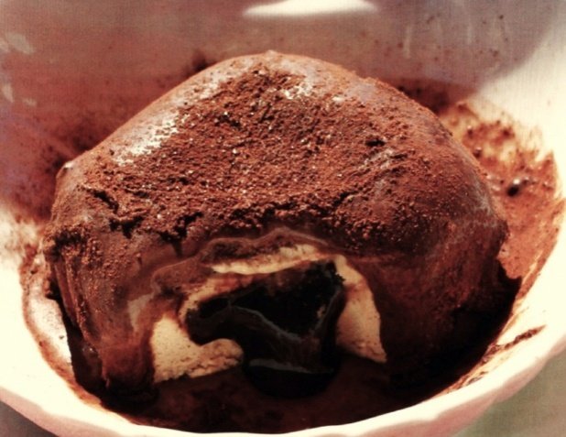
P i z z o
Tourists that come to Calabria love our coasts because they’re amazing. There are two types of coasts: the flat and sandy coasts on the Ionian sea and the rocky ones on the Tyrrhenian sea.

Slide 4
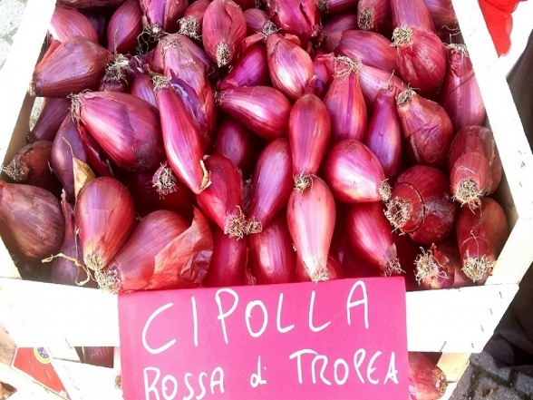
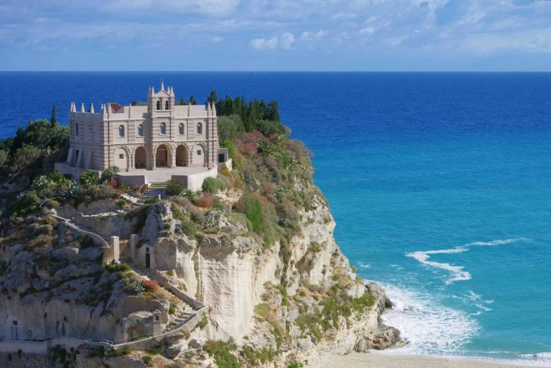
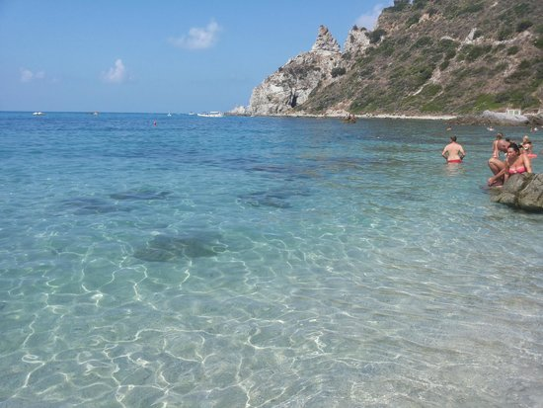
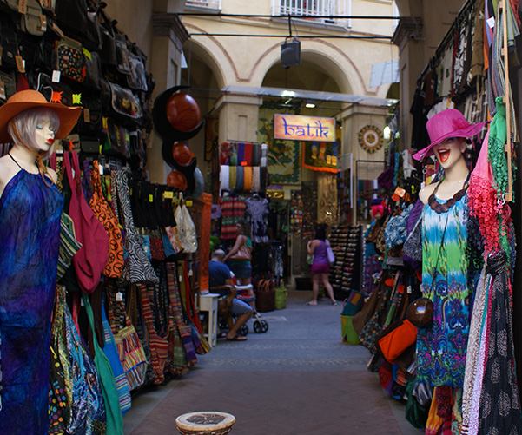
Tropea
Calabria is rich in fertile land that allows the breeding of different types of animals. The typical breeding animals are sheep, cattle, horses, goats. In addition there are also fish farms. In Calabria it is possible to taste different sausages, salami (‘nduja from Spilinga, for example), the famous red onions from Tropea, mushrooms, chestnuts, some legumes, chili peppers, Sila’s potatoes, tomatoes, olives, oil, mandarines, oranges, cedars and bergamots.

Slide 5
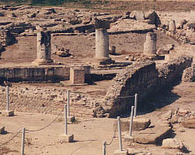
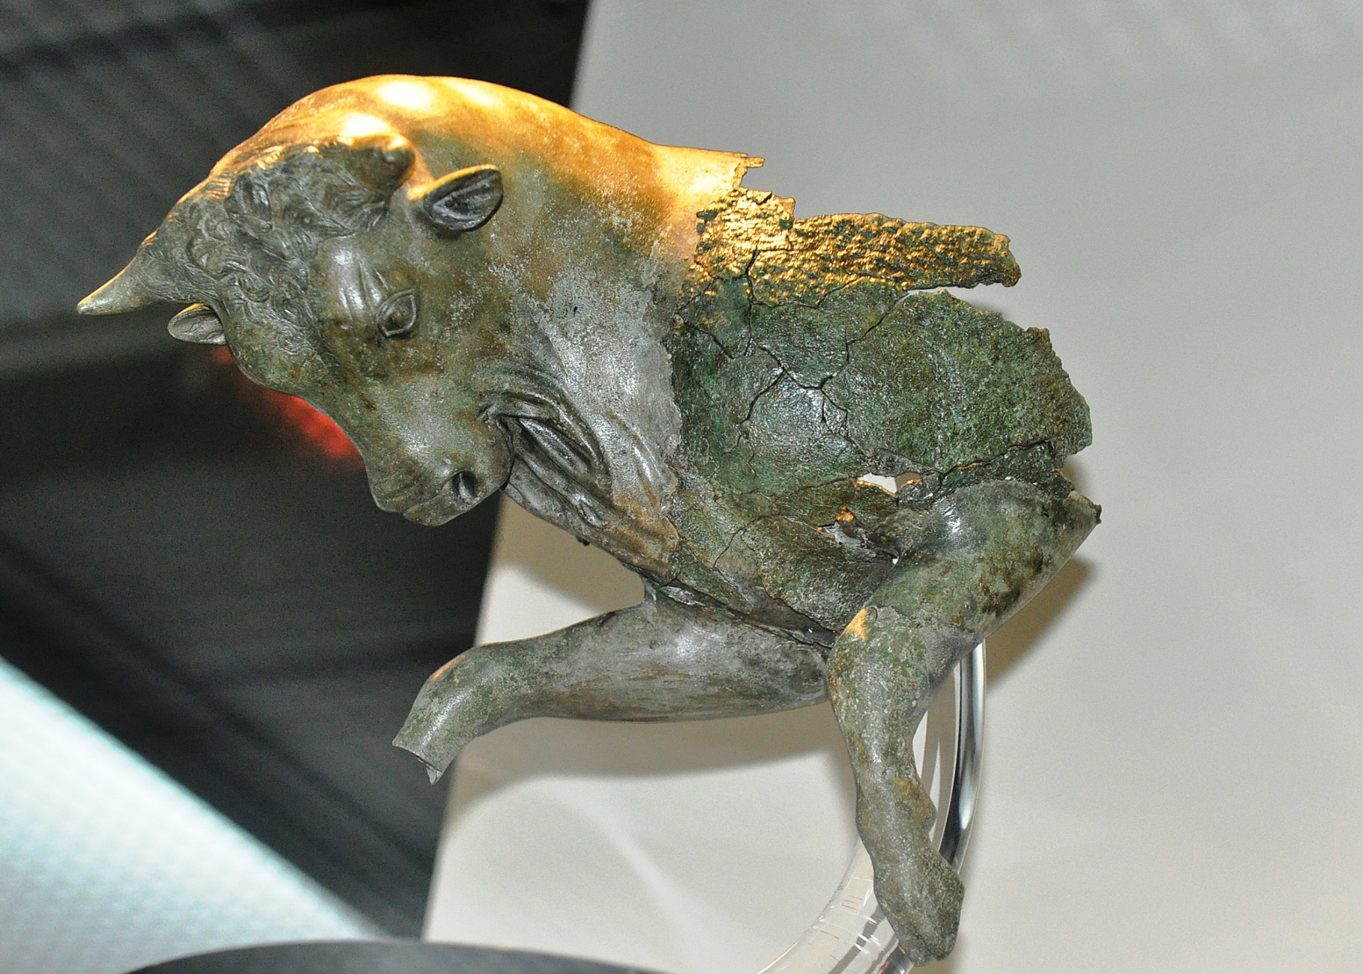
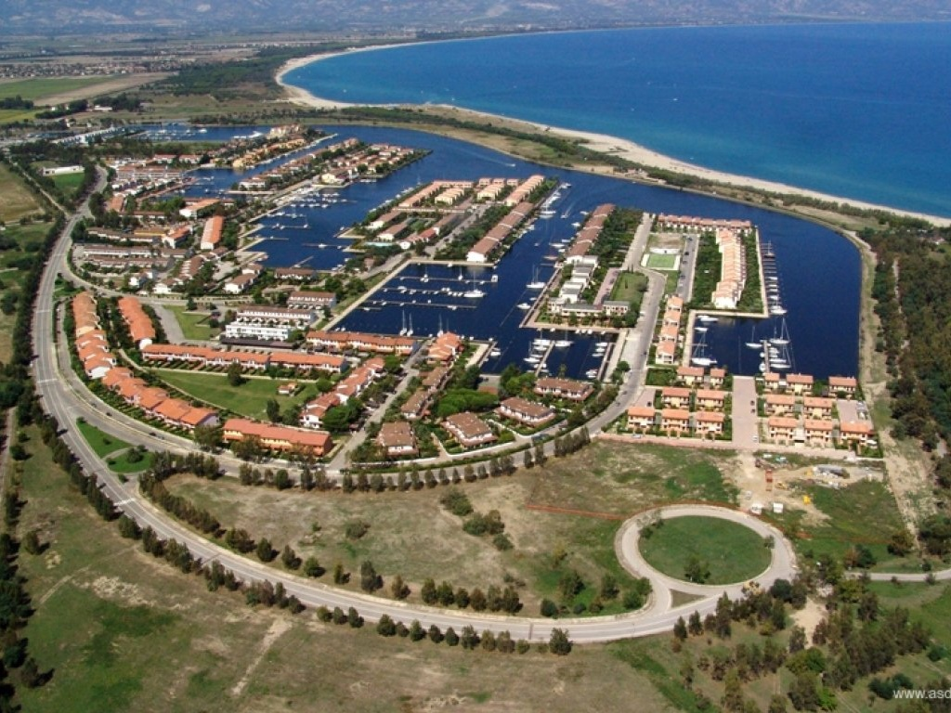
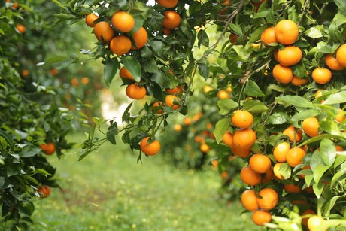
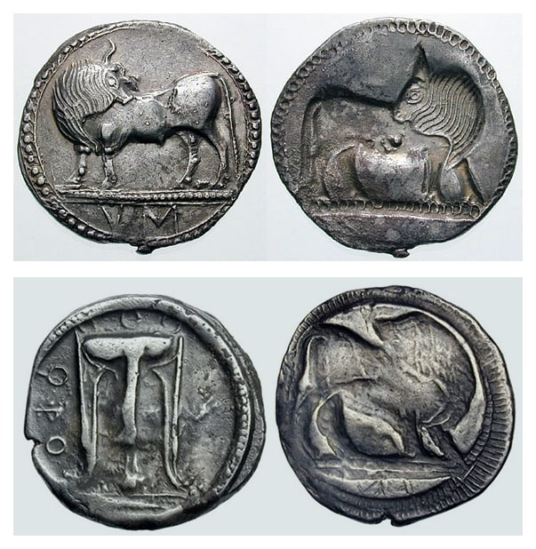
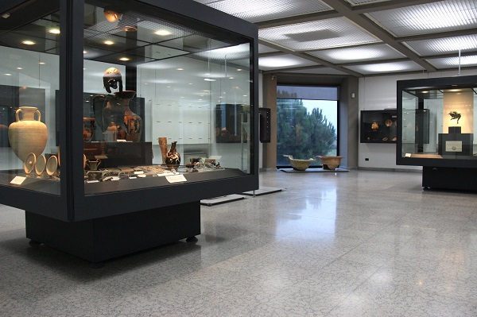
SIBARI
Sibari is near Cassano allo Ionio in Calabria. It was one of the most important cities (poleis) of Magna Grecia on the Ionian sea, overlooking the Gulf of Taranto. The archaeological sites of the Ancient Greek cities of Sybaris and Thurii, which can be found a few kilometers to the south-east of the town are famous. In the 1980s and 1990s beach tourism developed in the town. The local agriculture produces citrus fruits, olives and rice.

Slide 6
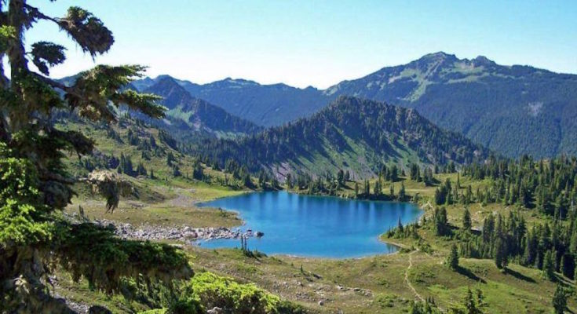
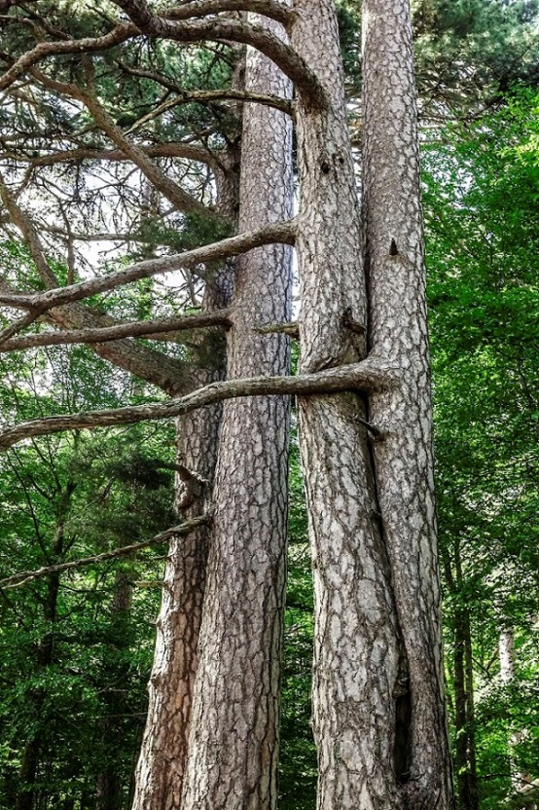
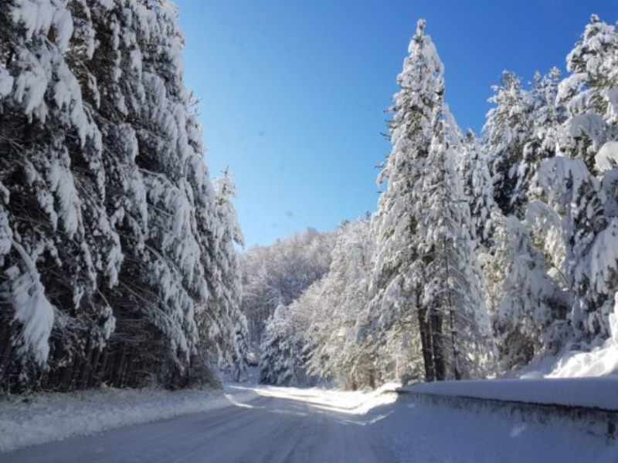
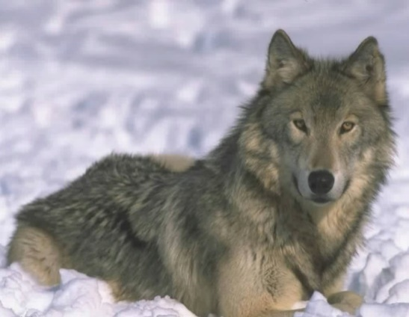
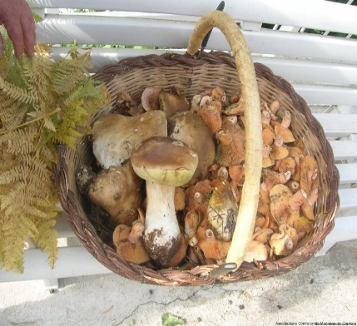
SILA
In winter it is often possible to ski in Sila, since it snows a lot! . In autumn Sila is rich in mushrooms and chestnuts, which are often exported because they are typical products. Sila is a natural reserve where the wolves, which are at risk of extinction, live.
In Calabria there are a lot of mountains, as Pollino chain (in the north) and Aspromonte mountain massif.

Slide 7
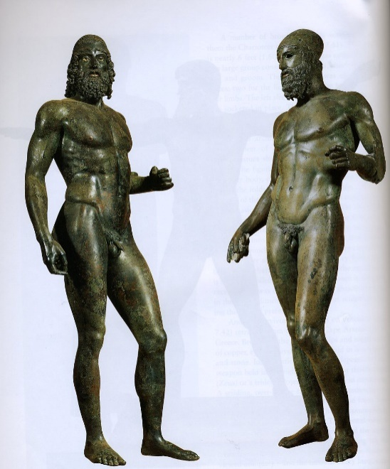
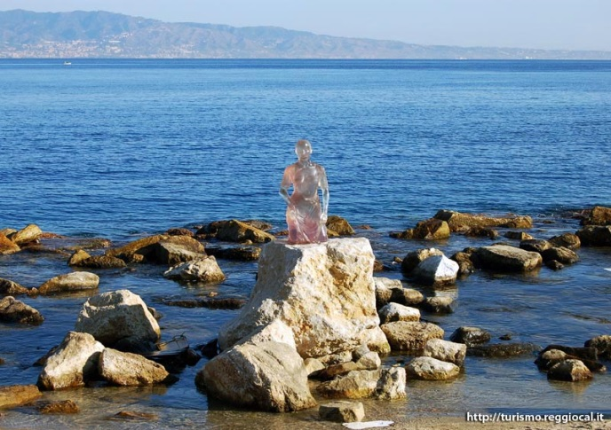
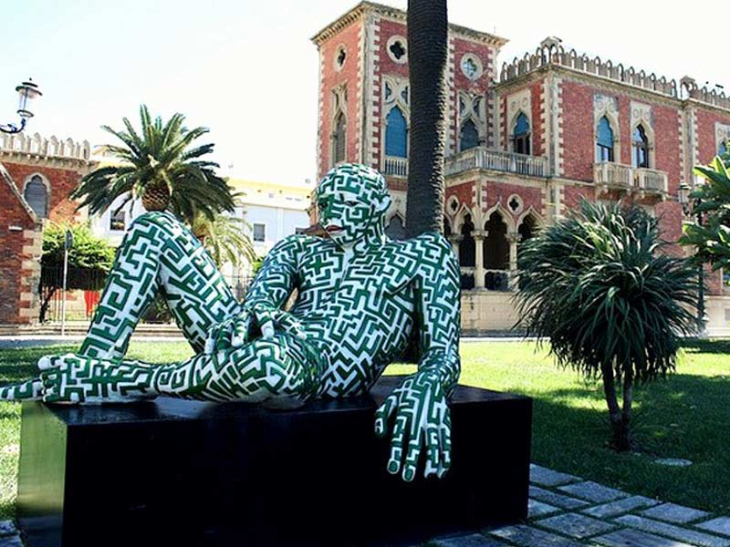
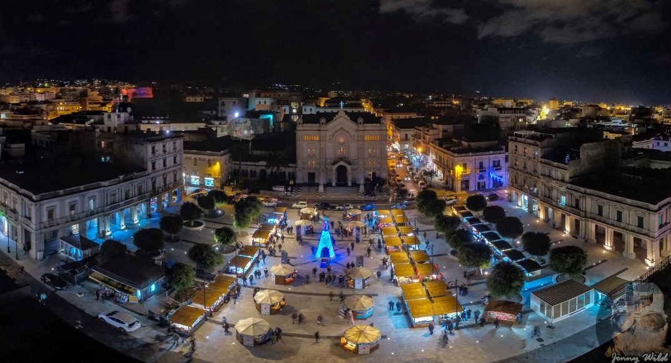
Reggio Calabria
In Reggio Calabria there is an important museum where it is possible to admire the Riace Bronzes, two statues of greek origin, datable to the 500 B.C., that we received in an exceptional state of conservation. The statues were found in 1972, in the depths of the sea, near Riace Marina, in the province of Reggio Calabria. The hypothesis on the origin and on the authors of the statues are different, but there are not yet elements that allow to attribute with certainty the works to specific sculptors. The seafront is named after Italo Falcomatà, who was major of the city. It is about 1.7 km long and it occupies the coastal area between the port and the fortress. Walking along the seafront is a unique experience since you can admire the Sicilian coasts standing opposite you!

Slide 8
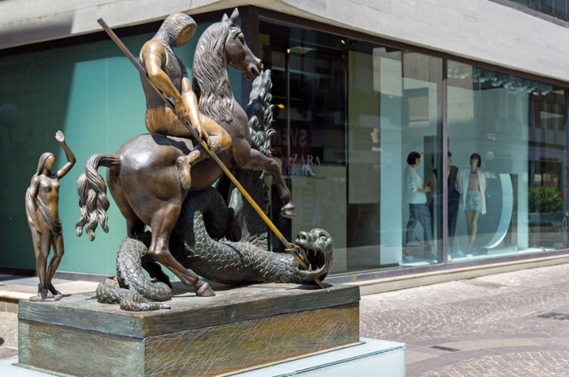
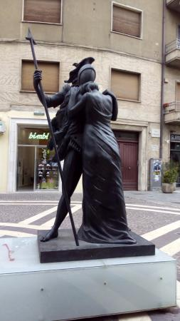
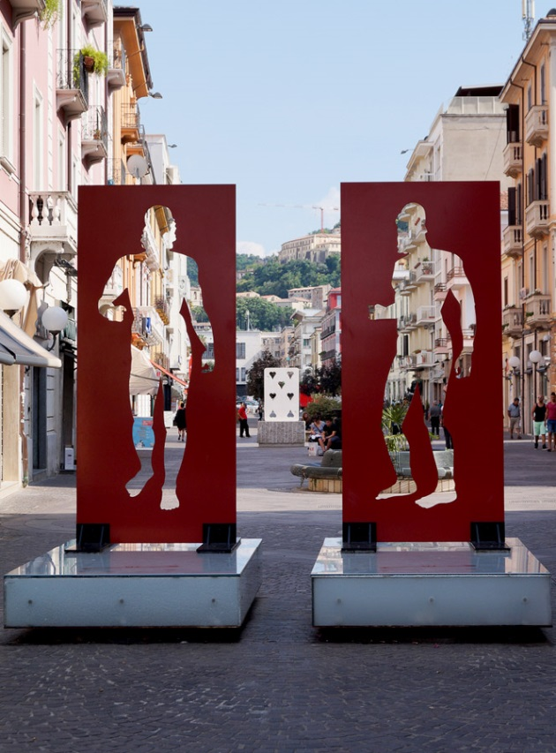
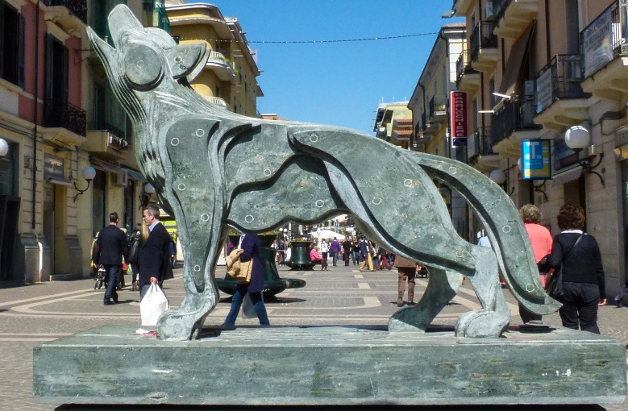
Cosenza
Cosenza is a city of art. Along Corso Mazzini we can go shopping while looking at artworks by internationally known artists. The photos are examples of what Bilotti open-air museum is. The works of art were all given to the municipality of Cosenza by the businessman Carlo Bilotti. The most important square in Cosenza is Piazza Bilotti, whose project was due to the architect Pietro Caruso. It is a modern architecture, whose shape is rectangular. In it there are 12 statues representing «warrior philosophers».

Slide 9
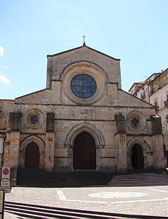
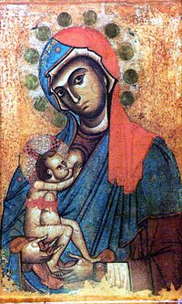
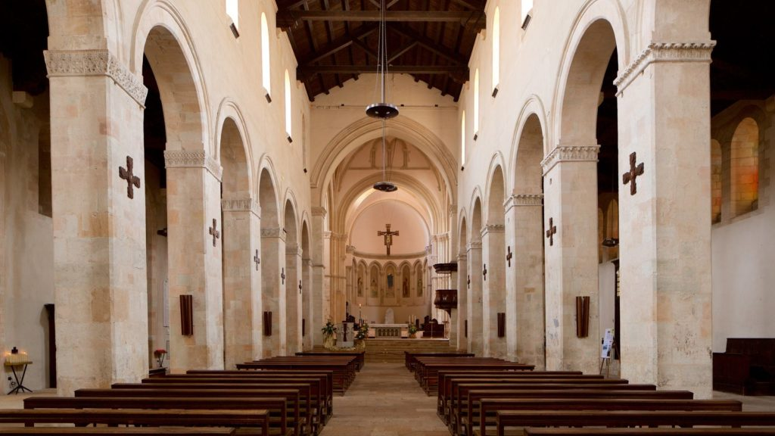
Cosenza
There are a lot of monuments that characterize the city. The cathedral was built around the middle of the eleventh century and it became sacred in 1222. The church is located in the heart of old Cosenza, at Duomo Square and has several architectural styles. The full name is Cathedral of Santa Maria Assunta and it is the sanctuary of the patron of the city, Madonna del Pilerio, who saved the people from a horrible plague and an earthquake.
On 12th October, 2011, the Cathedral was recognized a UNESCO heritage site.
Saint Domenico’s church and Saint Francesco from Assisi’s church in Cosenza, Saint Francesco from Paola’s sanctuary in Paola, Joachim of Fiore’s abbey in San Giovanni in Fiore are astonishing examples of the artistic treasure Calabria owns!

Slide 10
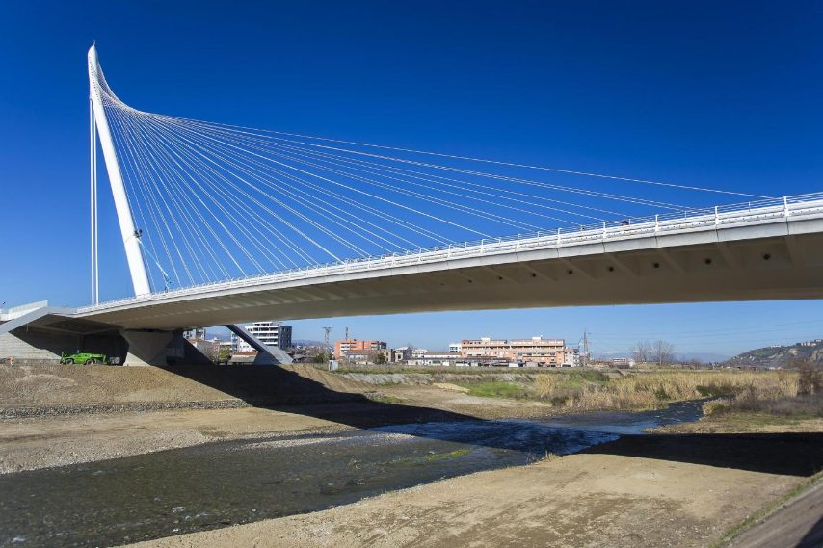
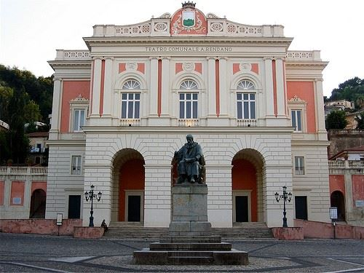
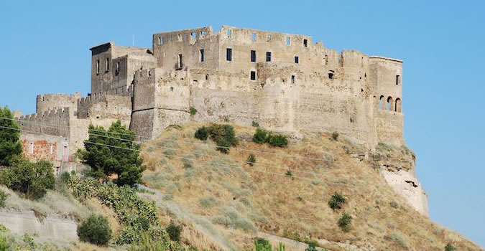
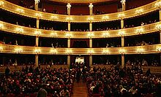
Cosenza
Rendano theatre was built in the 1700s. It’s a famous theatre and its shows attract a lot of people every year.
The Norman-Swabian castle is very old and it’s the most important among the monuments in Cosenza. It was restored after the earthquake in 1184. It rises on one of the highest points of the city, the Pancrazio hill at 383 metres above the level of the sea. Cosenza has got seven hills, Triglio,Mussano, Venneri, Gramazio, Guarassano, Torrevetere and Pancrazio, of course!
Calatrava bridge is in the south-east side of Cosenza and it connects two parts of the city divided by the river Crati. The bridge is named after the architect-engineer Santiago Calatrava and it is the highest cable-stayed bridge in Europe. It was inaugurated on 2018, 26th Jan.

Slide 11
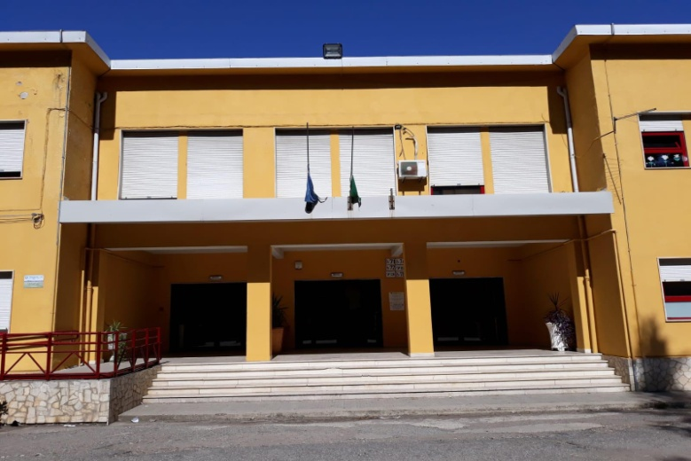
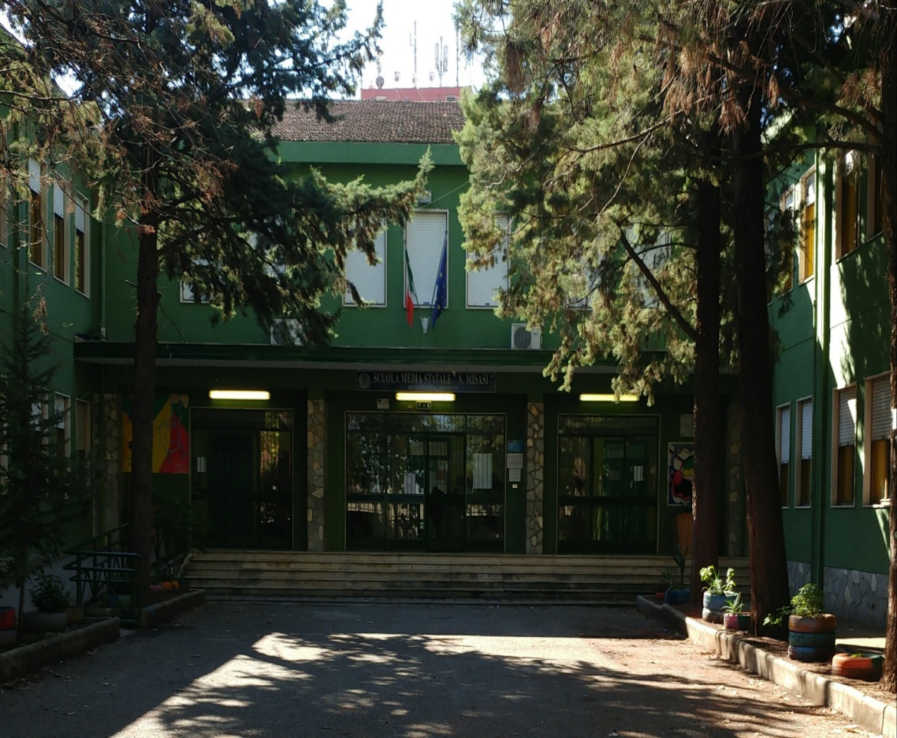
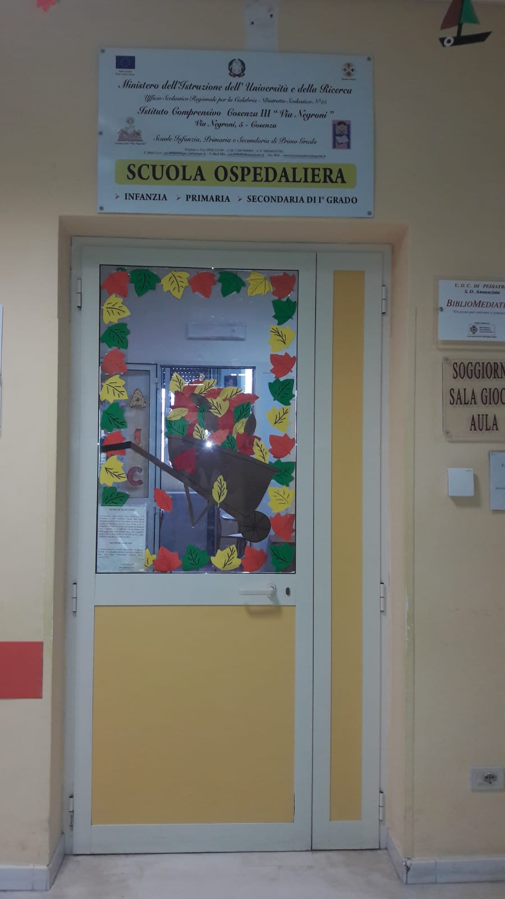
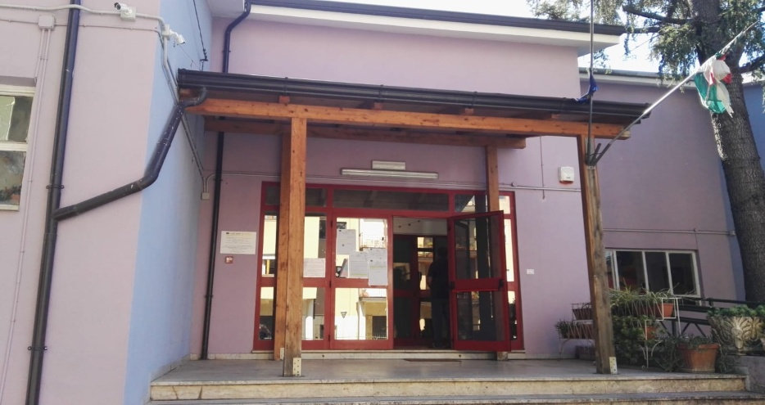
I.C. COSENZA III

Slide 12
Istituto Comprensivo Cosenza III is composed of a Nursery school, a Primary school and a Secondary school plus a hospital school and it’s located in Cosenza.
We are students from the Secondary school. The building has got a green facade and it’s quite big. It has got two floors. There is a main hall at the entrance. On both floors there are some classes, some administrative offices and some toilets. Students can practice sports or Physical Education in two gyms. In the school there are three laboratories: the Science lab, the language lab and the ICT lab. Every year the school takes part to lots of competitions. Last year some students won prices for robotics. Moreover, our school organizes interesting trips around Calabria, Italy or even abroad every year.

Slide 13
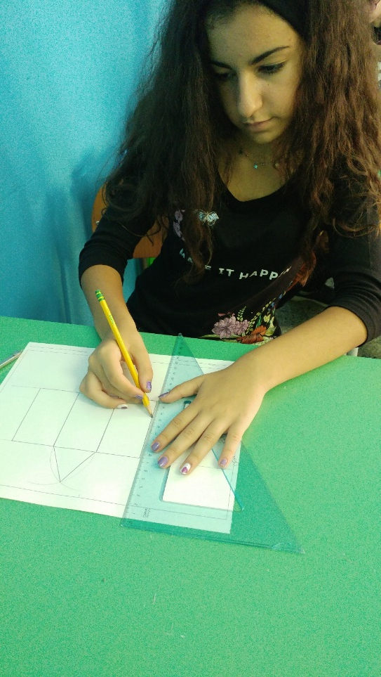
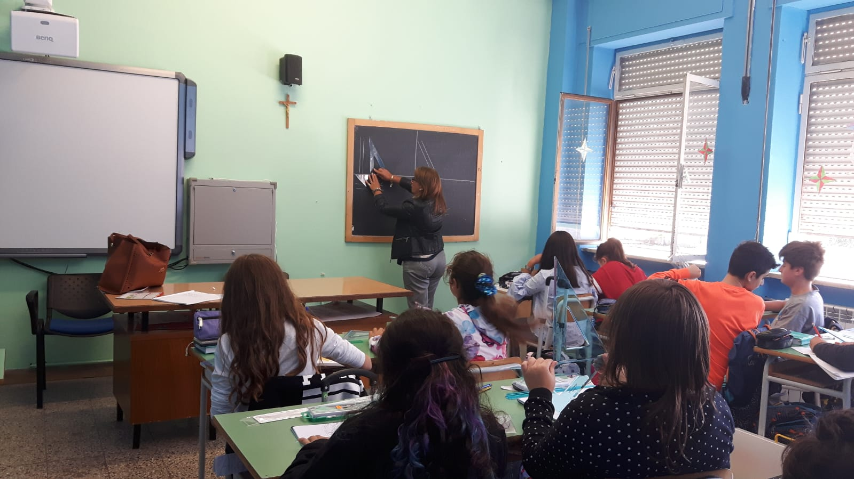
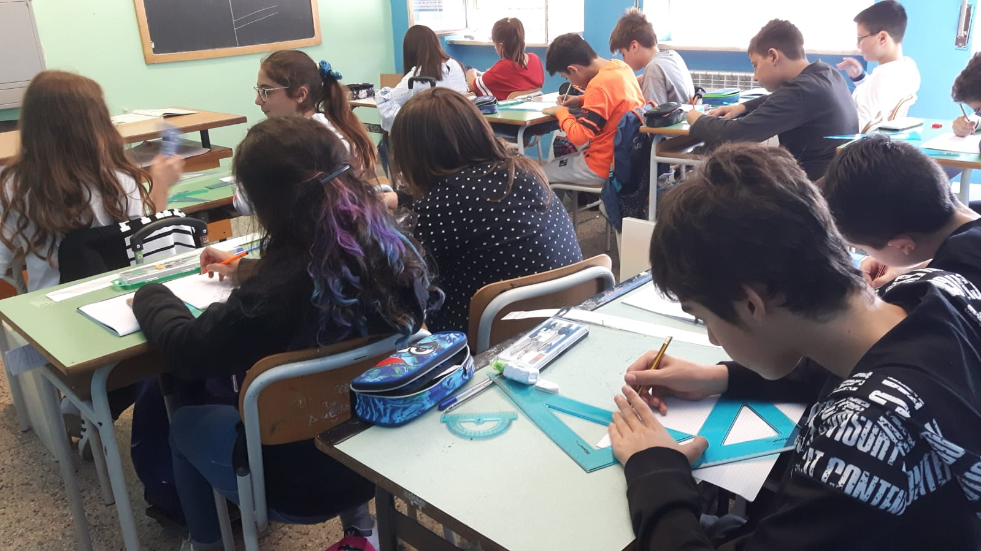
Technology
Rulers, goniometers, compasses, pencils, rubbers and, above all, commitment are needed to realize a good work!

Slide 14
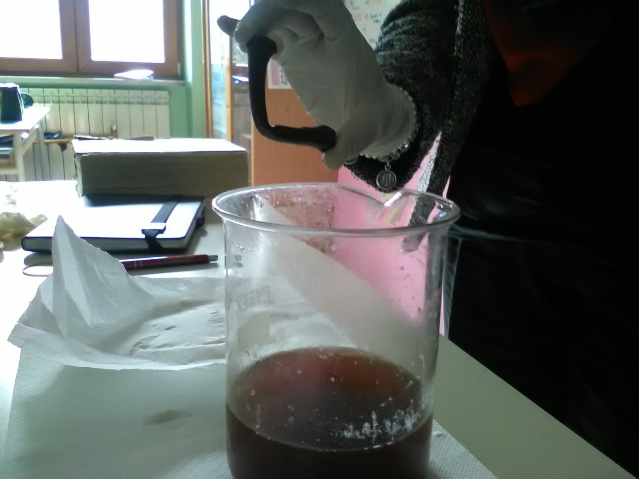
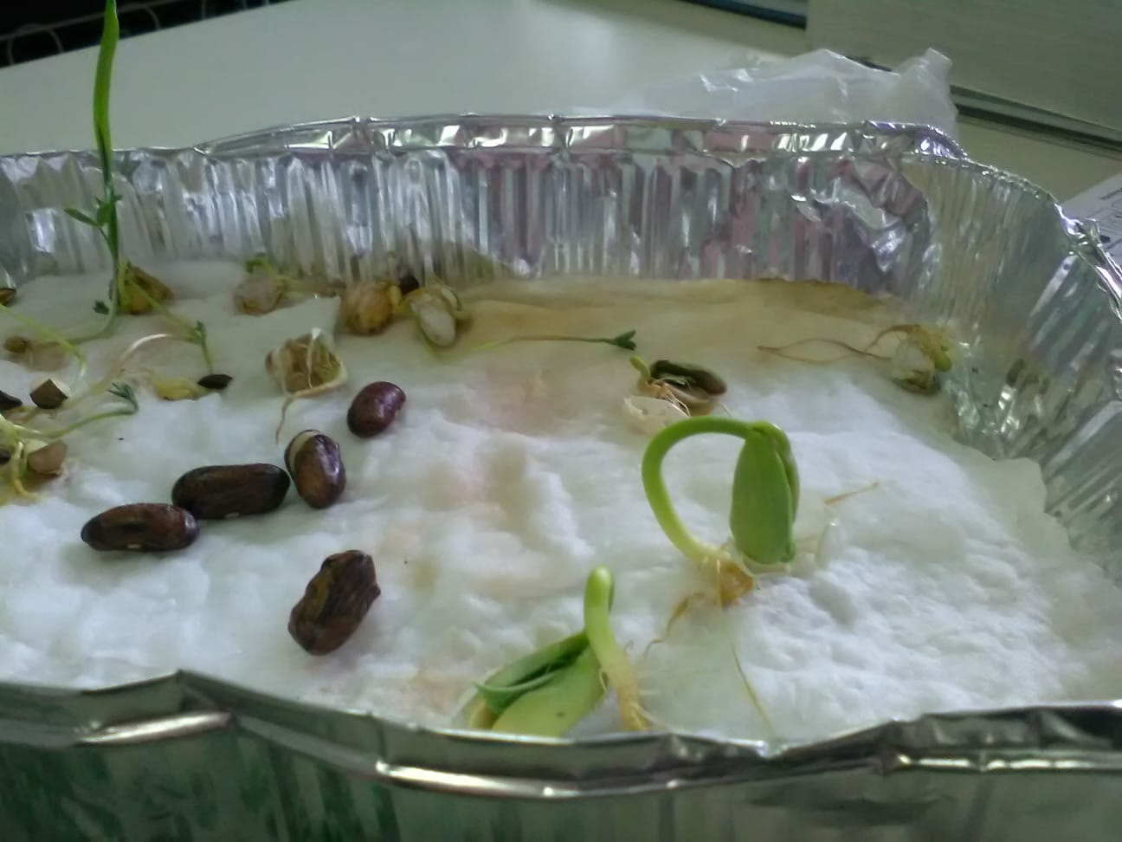
Science
GERMINATOR
DEMINERALIZATION OF A CHICKEN BONE
The student is doing a Science experiment: vinegar and sodium bicarbonate to simulate a volcanic eruption!

Slide 15
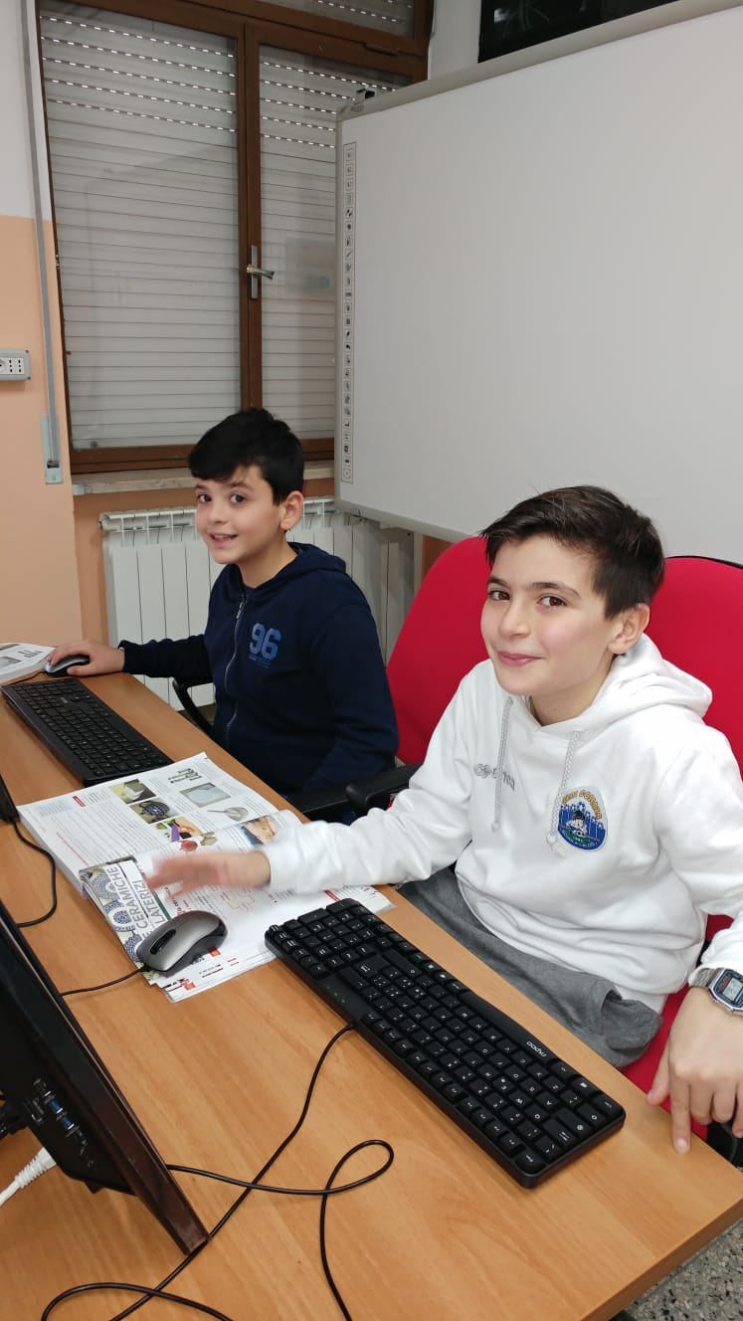
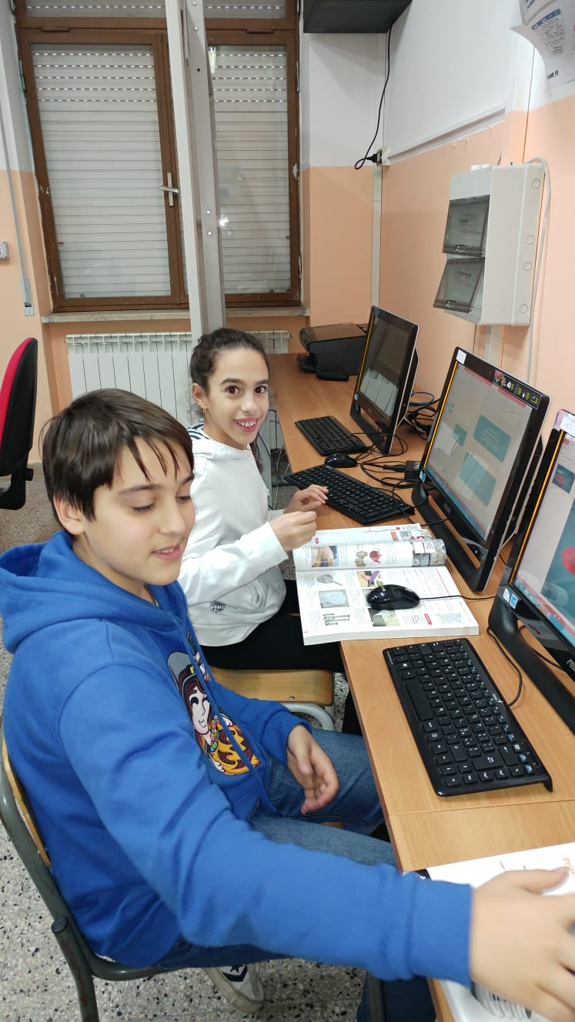
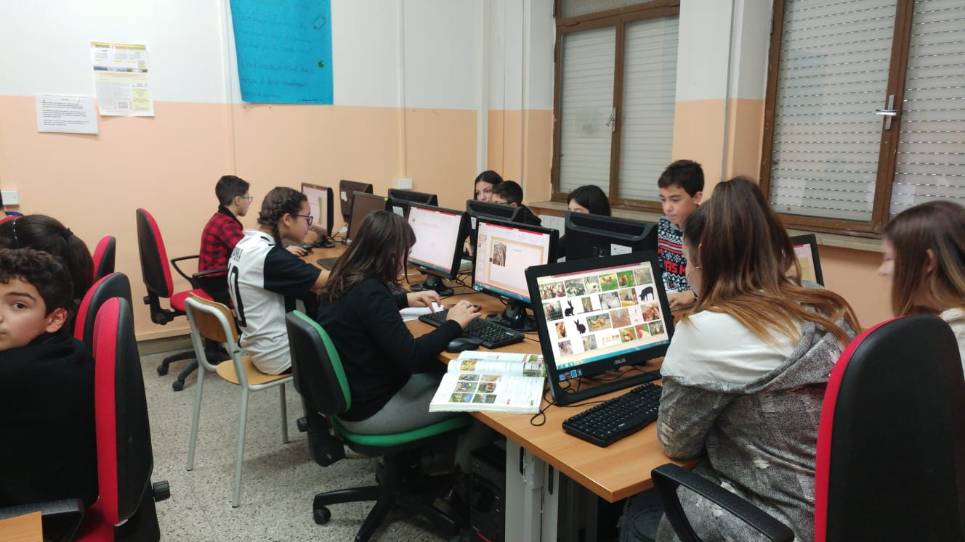
ICT
The students are in the ICT lab, having fun while learning!

Slide 16
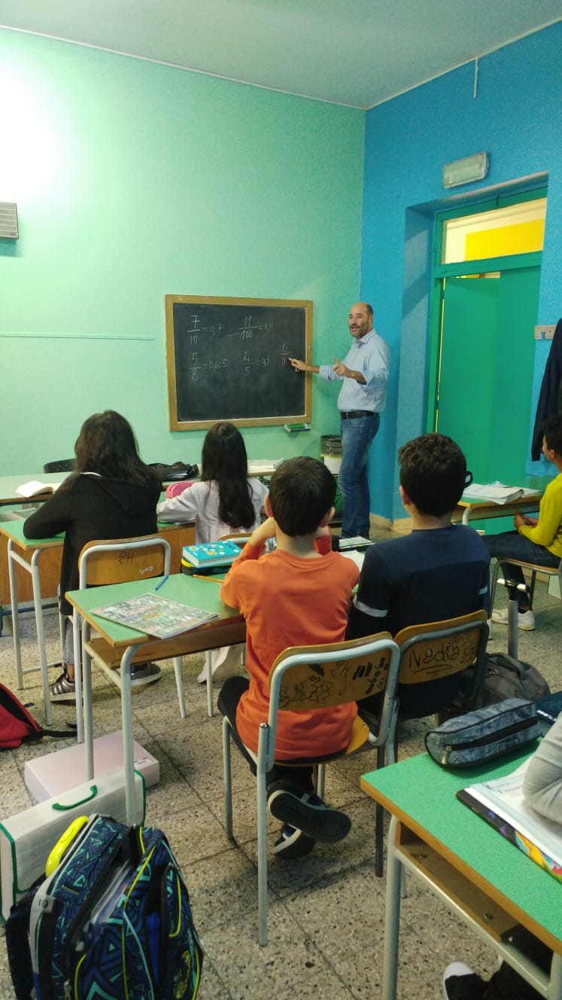
MATHS
Students are listening to their teacher and they’re learning some important Math rules.

Slide 17
OUTDOOR SPORTS...

Slide 18
…AND INDOOR ACTIVITIES
IN OUR COMFORTABLE
GYM!

Slide 19
LANGUAGE LAB
Some students are listening to a foreign language recording.

Slide 20
SOME STUDENTS AND THEIR ART…

Slide 21
… WORKS

Slide 22
We are really proud of our school… studying Music, Art,
History, Geography, Science, Math, Spanish or French, English, Italian, Latin, Citizenship, I.C.T. or P.E. makes us grow up «faster, higher, stronger» !

Slide 23
Playing a musical instrument: the keyboard

Slide 24
Learning Latin means discovering the origins of the Italian language

Slide 25
Cooperative learning

Slide 26
The last but not the least, our mascot NEGRONAU, the little robot which let us win prizes!

Slide 27
THANKS

