Slide 1
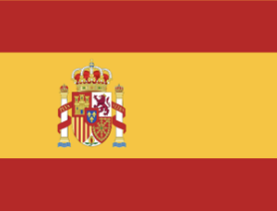
THE ITALIAN MEETING…

Slide 2
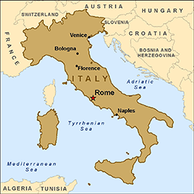
CALABRIA
is in the south of Italy,
at the end of the "boot".

Slide 3
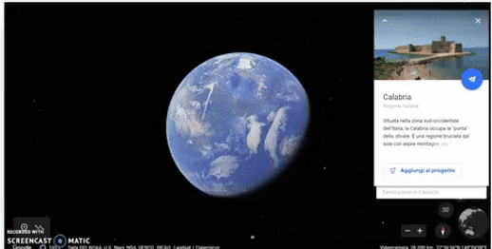
WELCOME TO ITALY, WELCOME TO COSENZA!

Slide 4
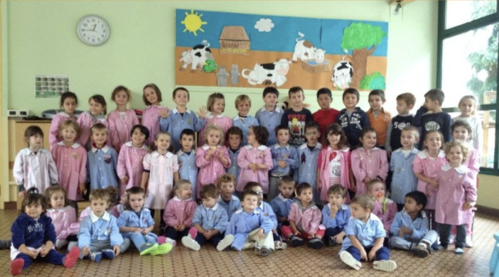
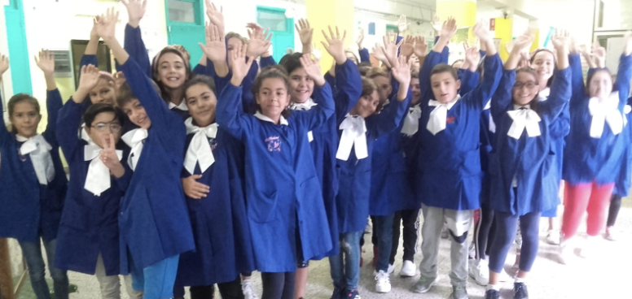
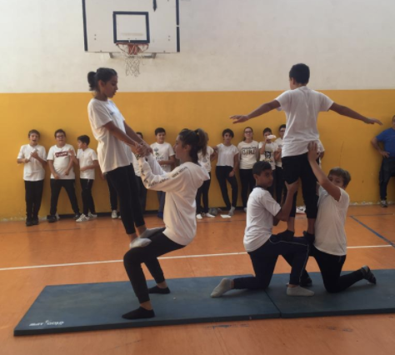
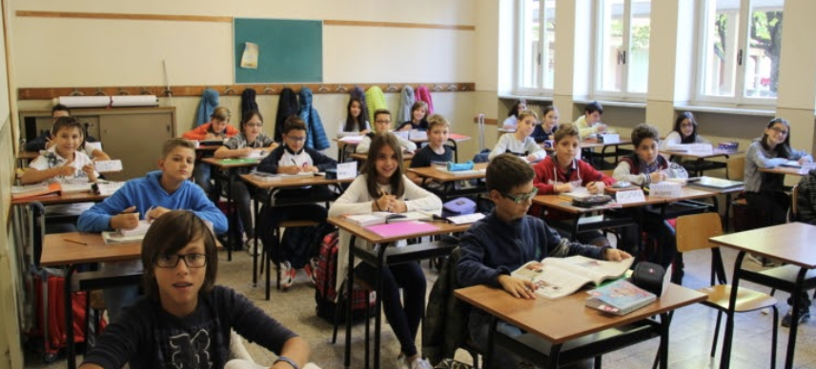

Slide 5
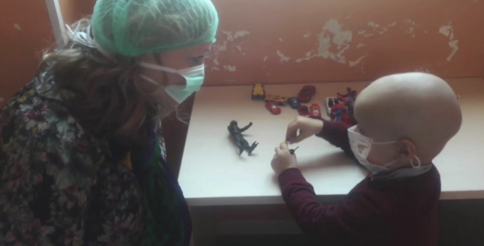
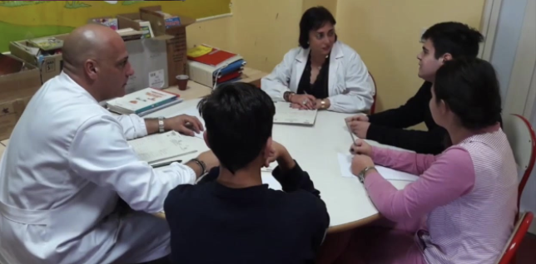
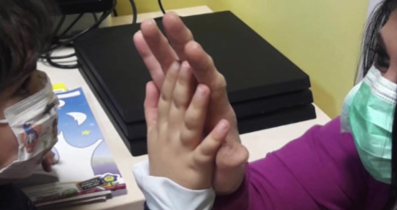
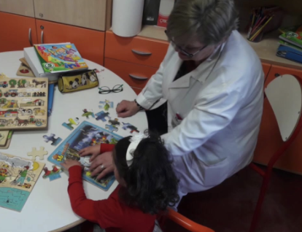
School in hospital…

Slide 6
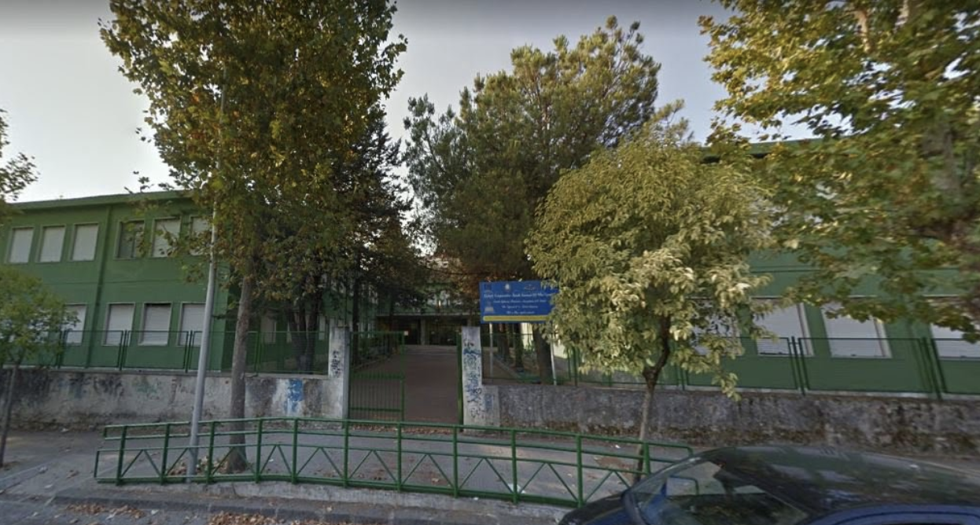
Our School: I.C. Cosenza III – Via Negroni
Frontal view of our school

Slide 7
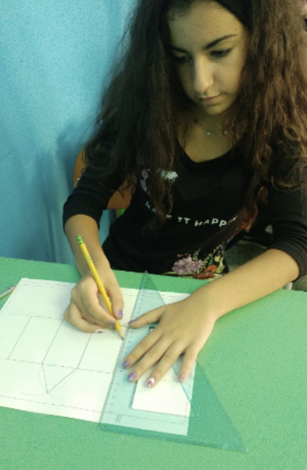
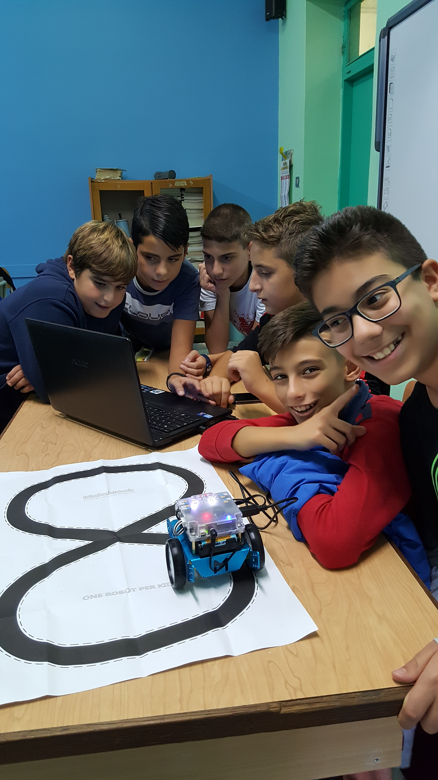
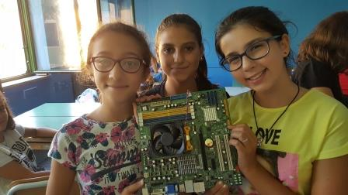
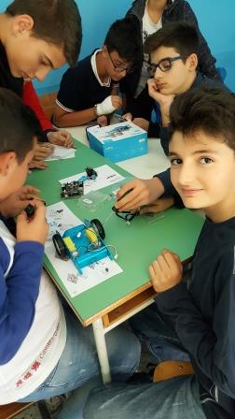
Technology…

Slide 8
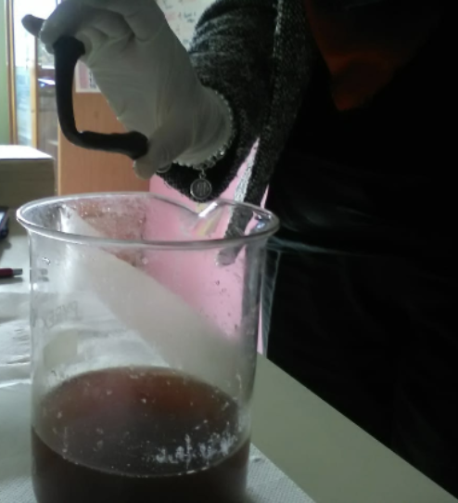
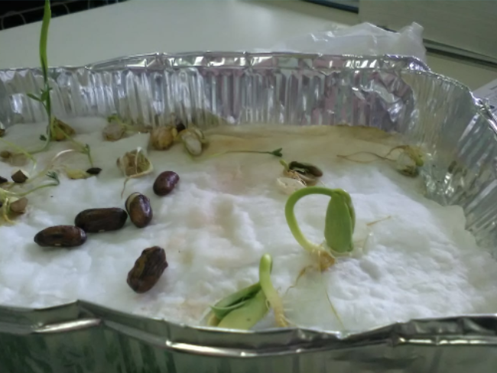
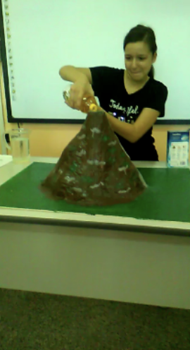
Science…
Students carry out science experiments…
Demineralization of a chicken bone
Different kind of germination
Simulation of volcano eruption
…covid 19 didn't stop our desire to experiment!

Slide 9
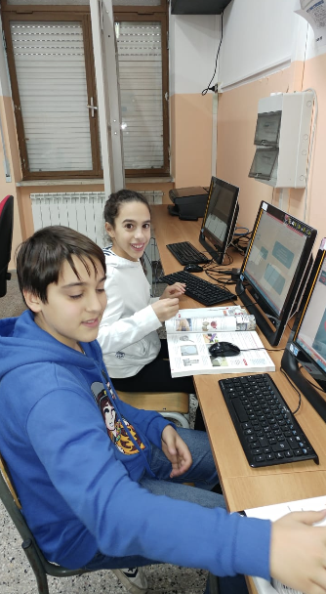
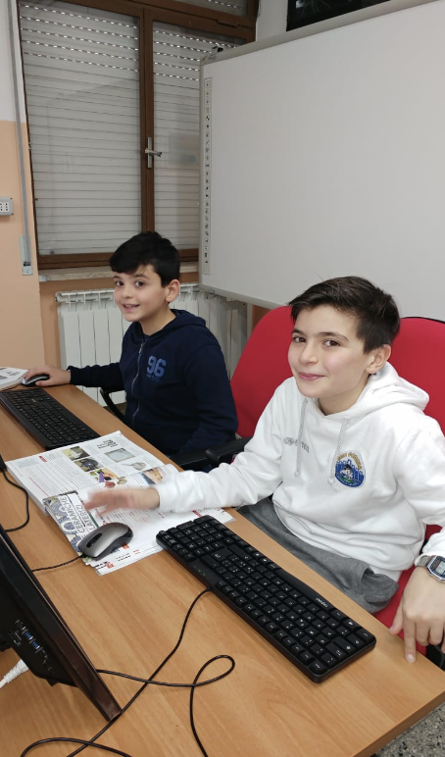
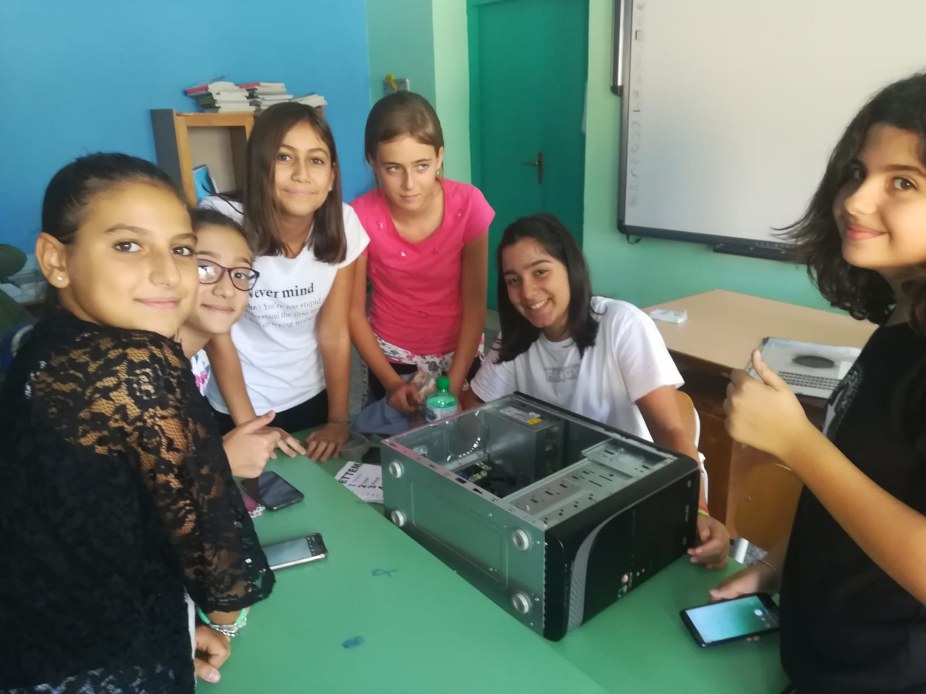
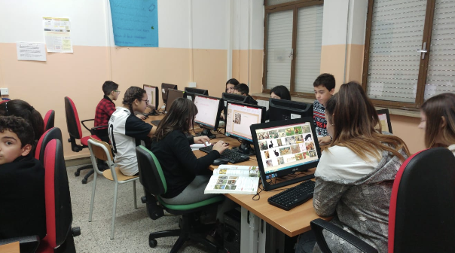
ICT
The students are in the ICT lab, having fun while learning!

Slide 10
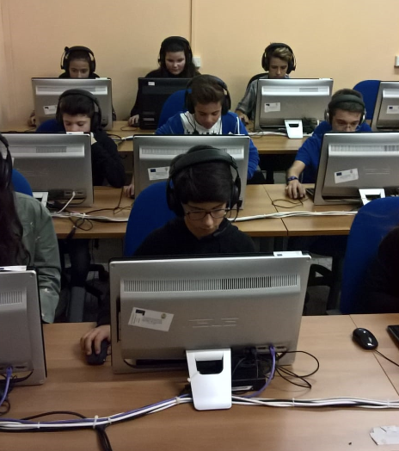
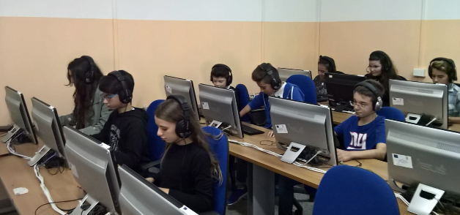
…languages lab…
Some students who are listening to a foreign language recording

Slide 11
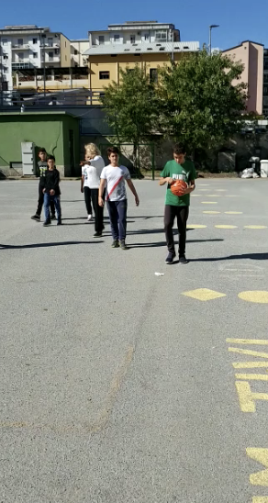
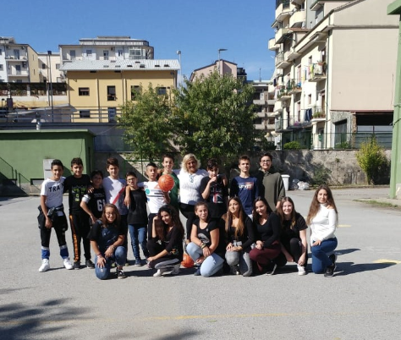
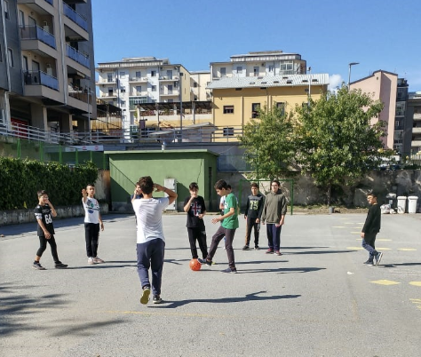
Outdoor sports…

Slide 12
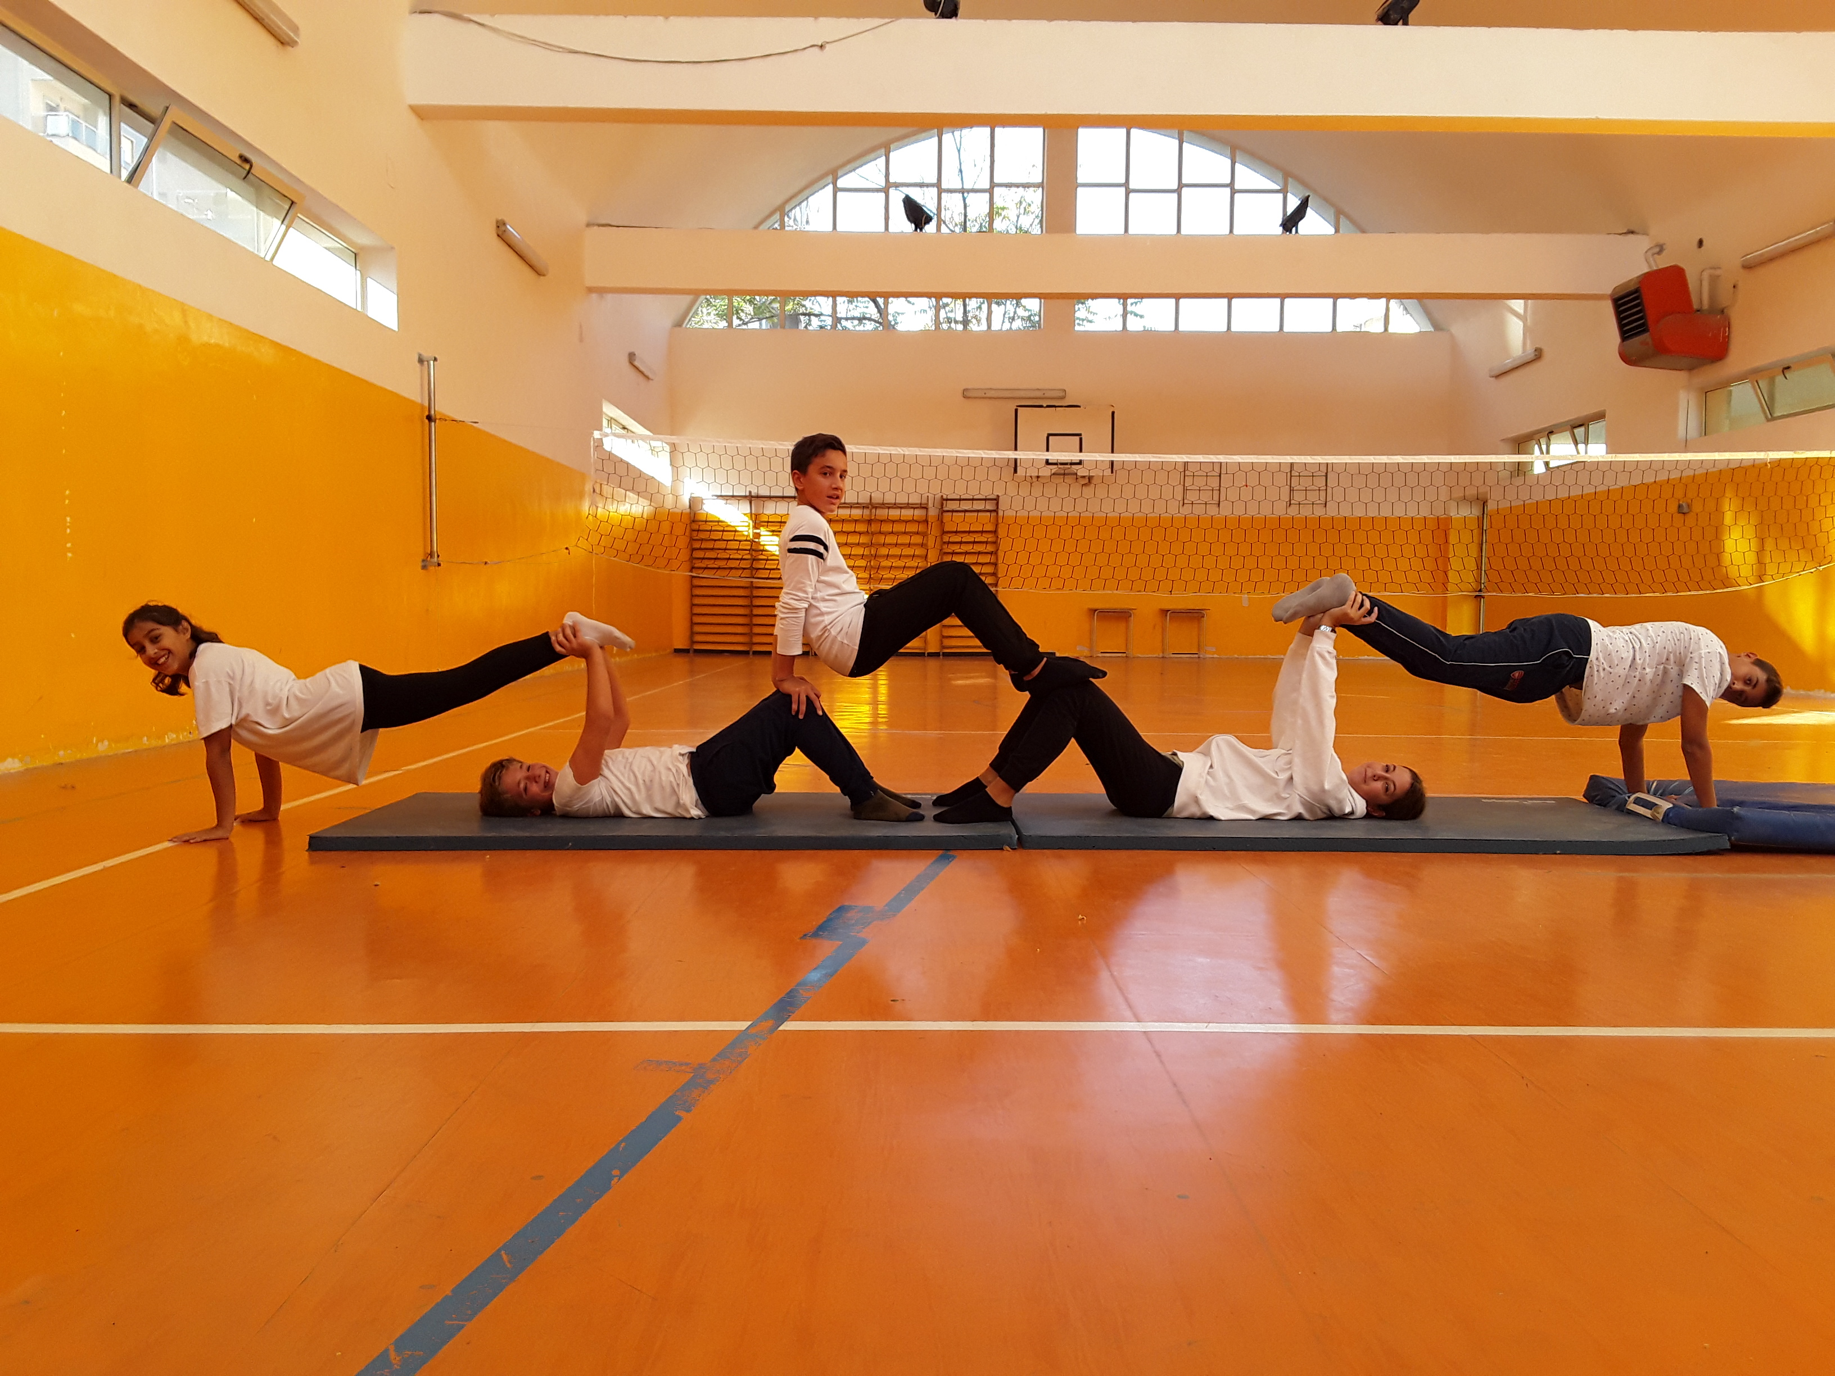
…and indoor activities in our comfortable gym!

Slide 13
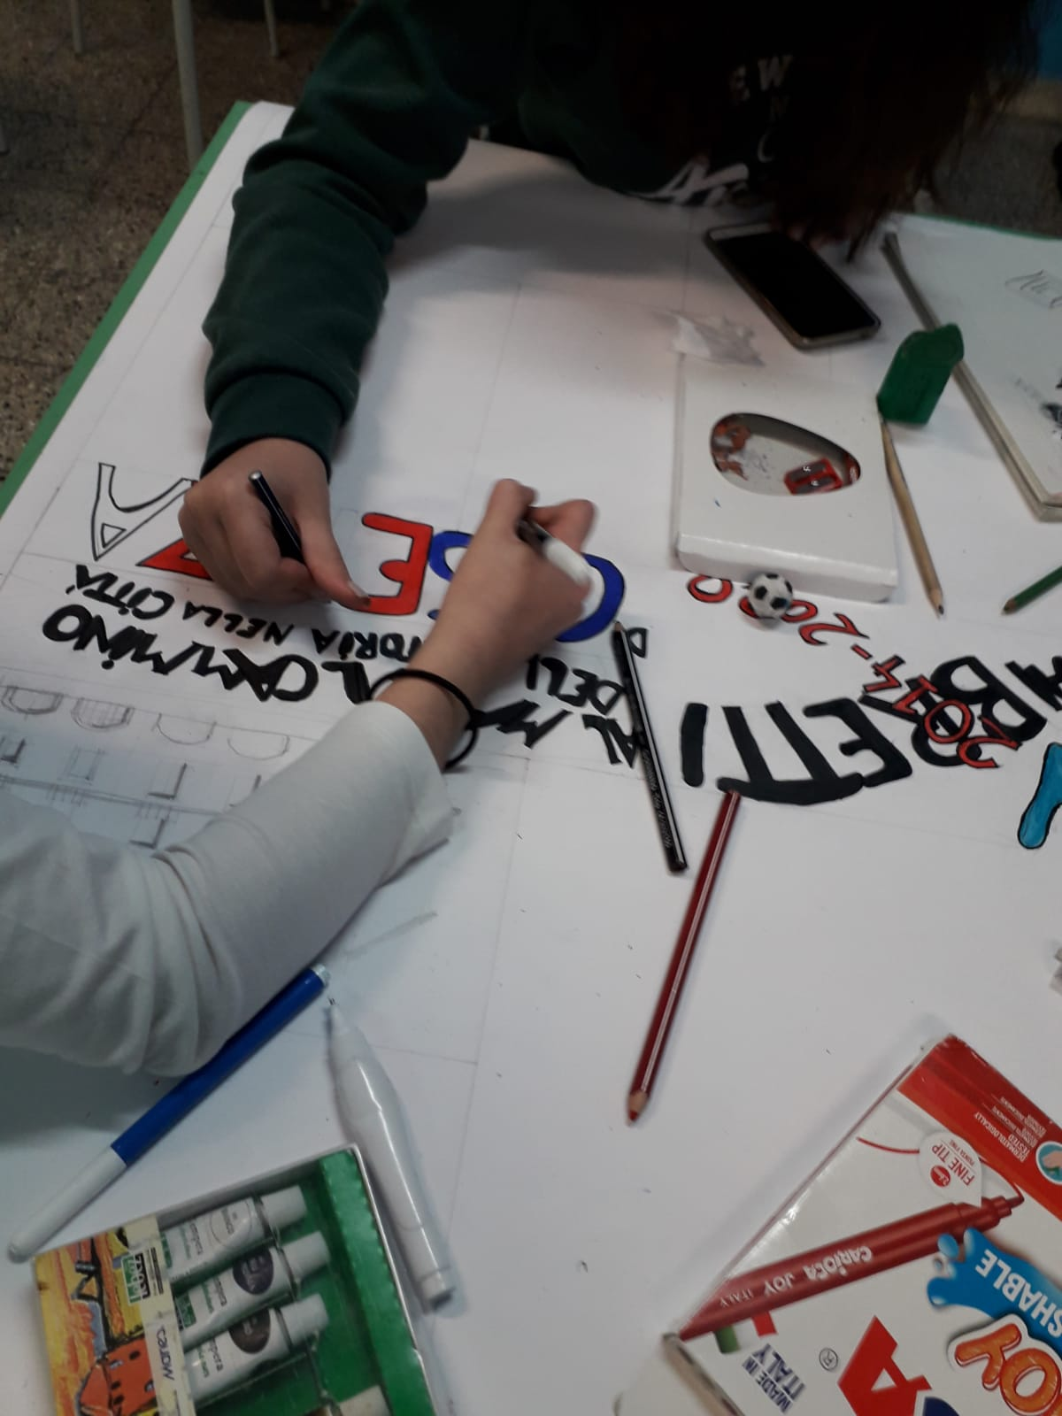
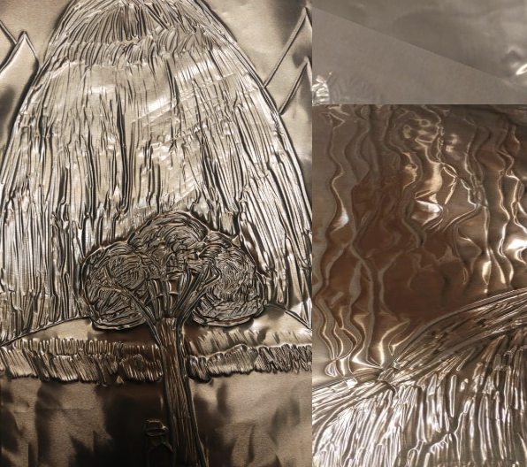
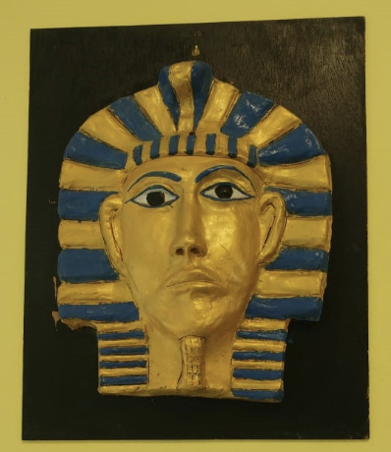
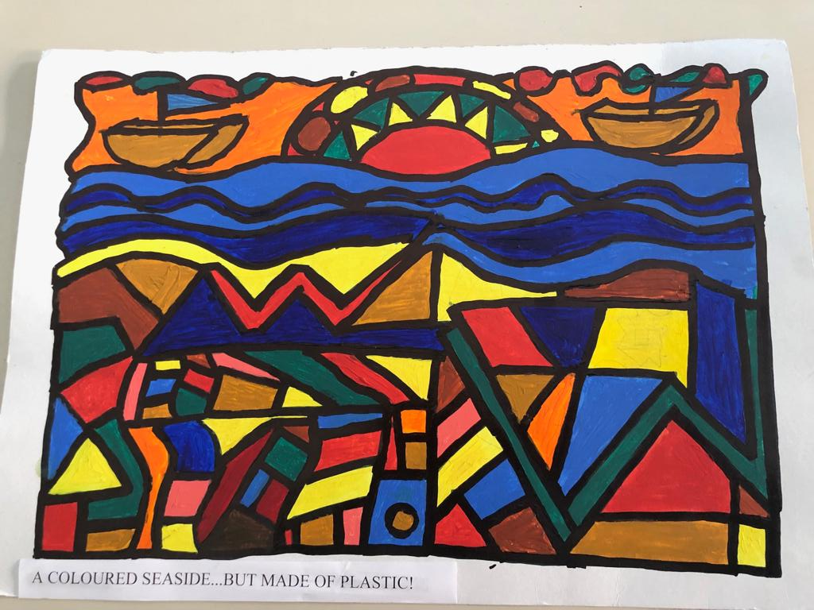
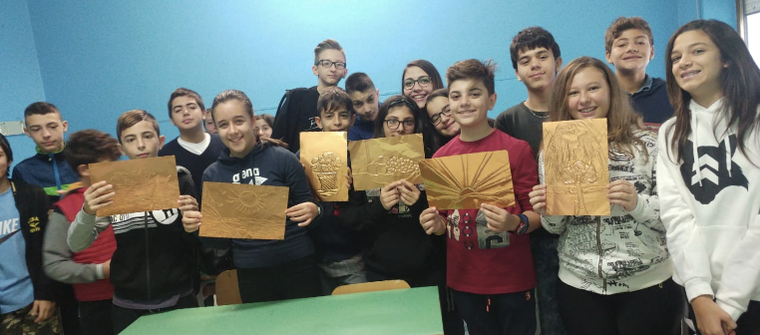
Some students and their artworks…

Slide 14
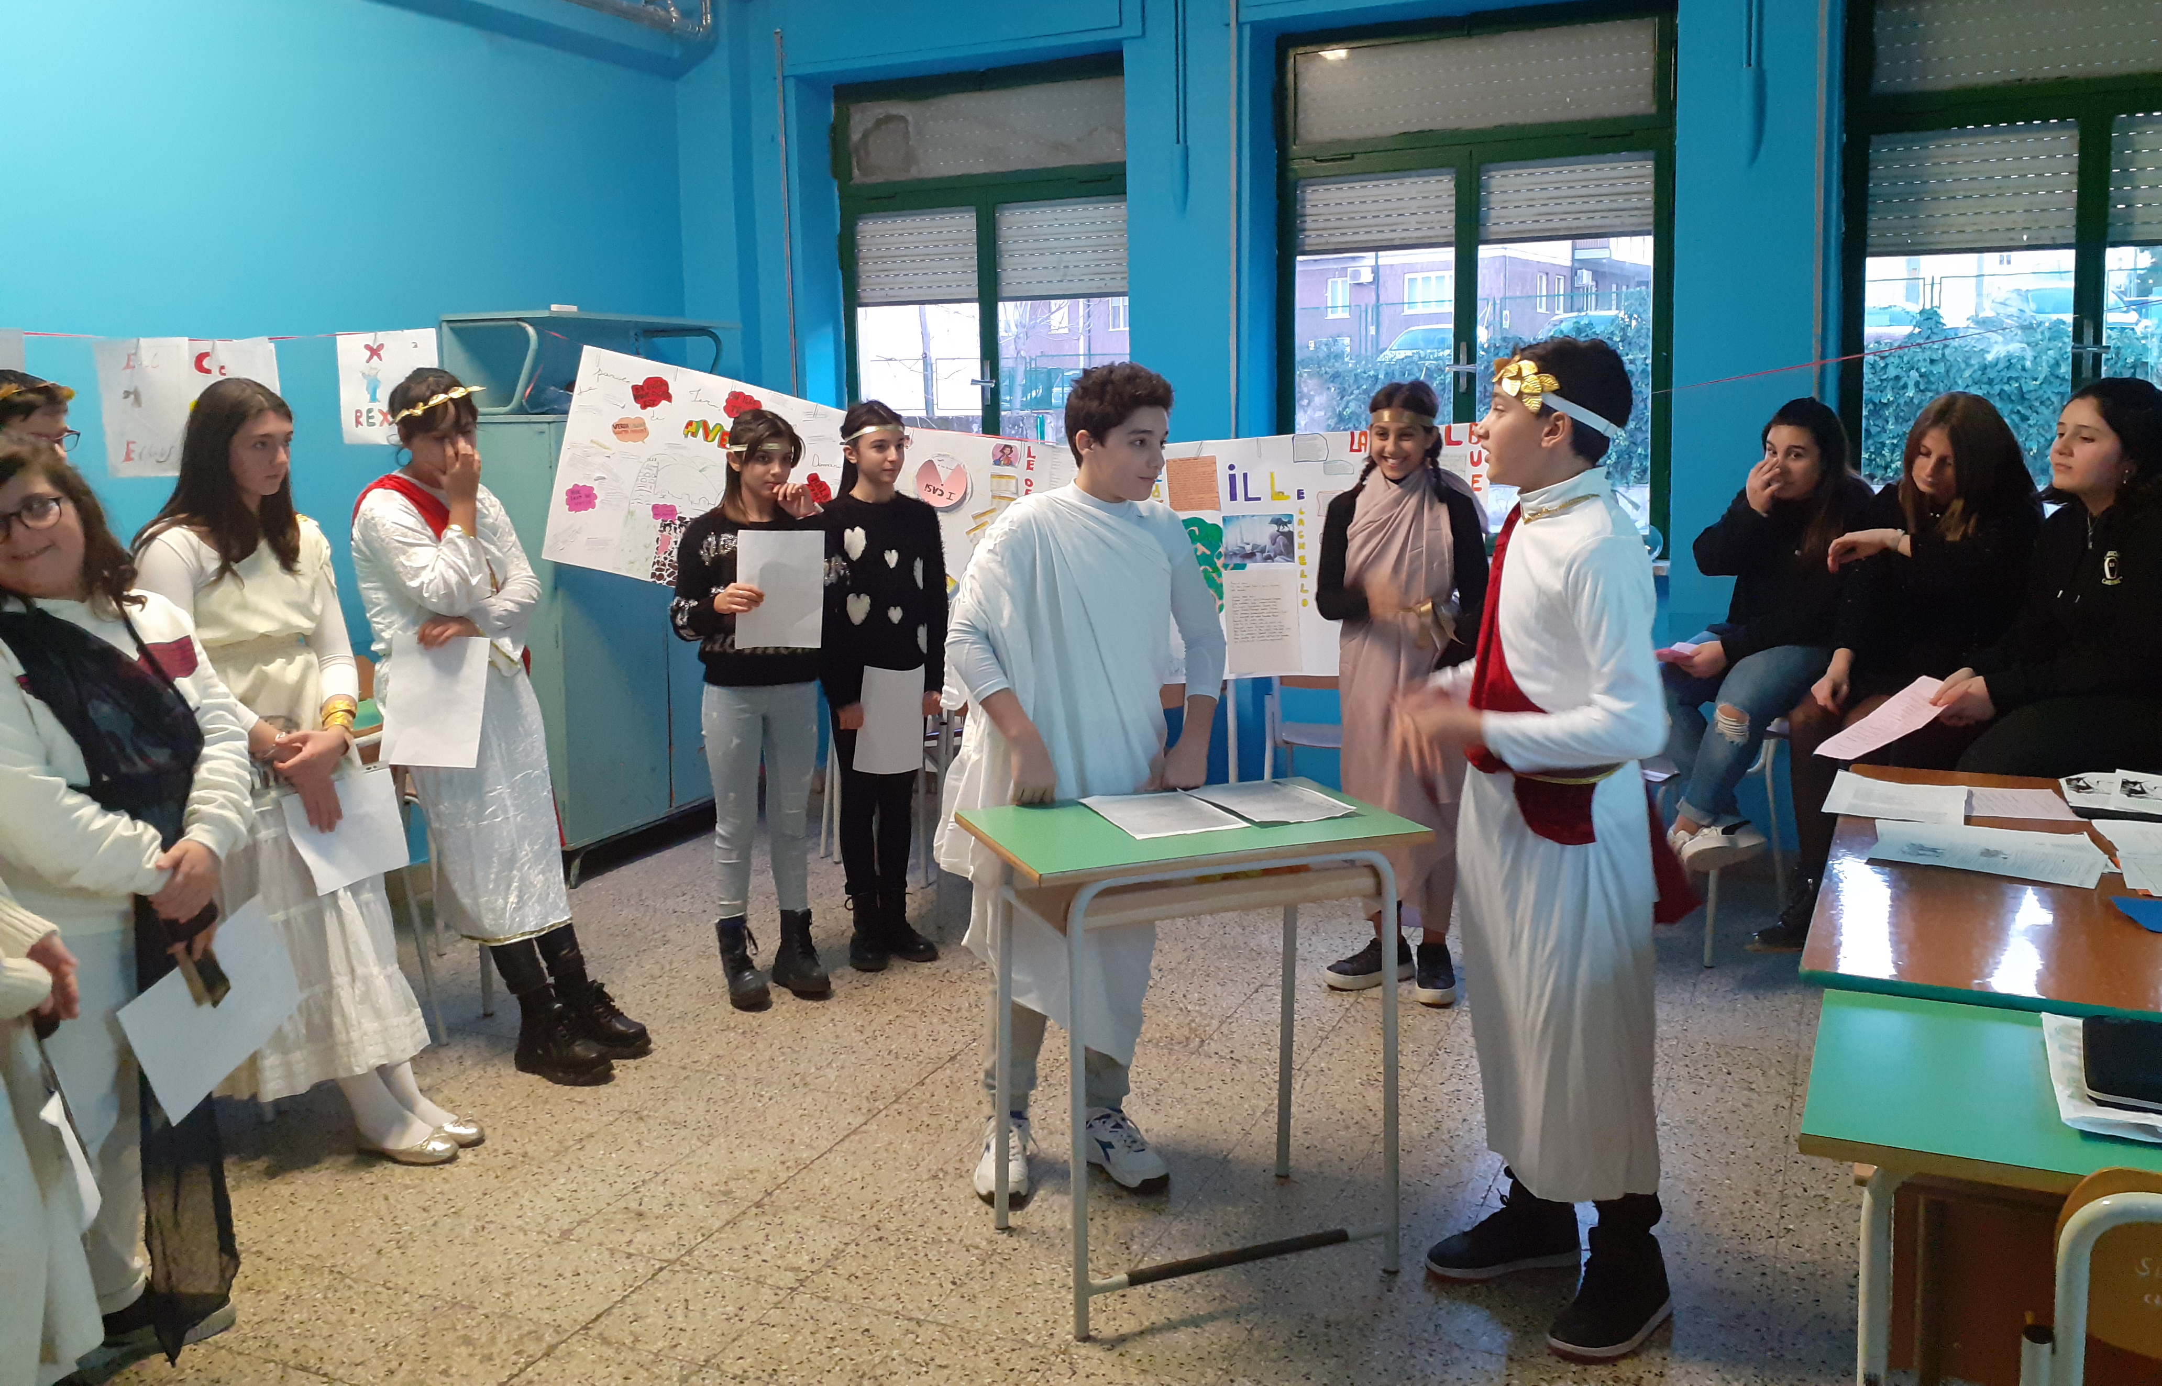
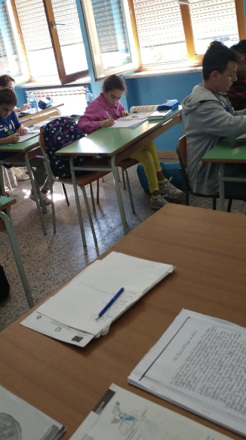
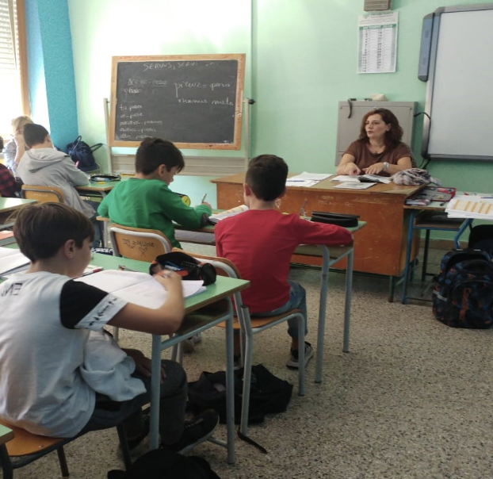
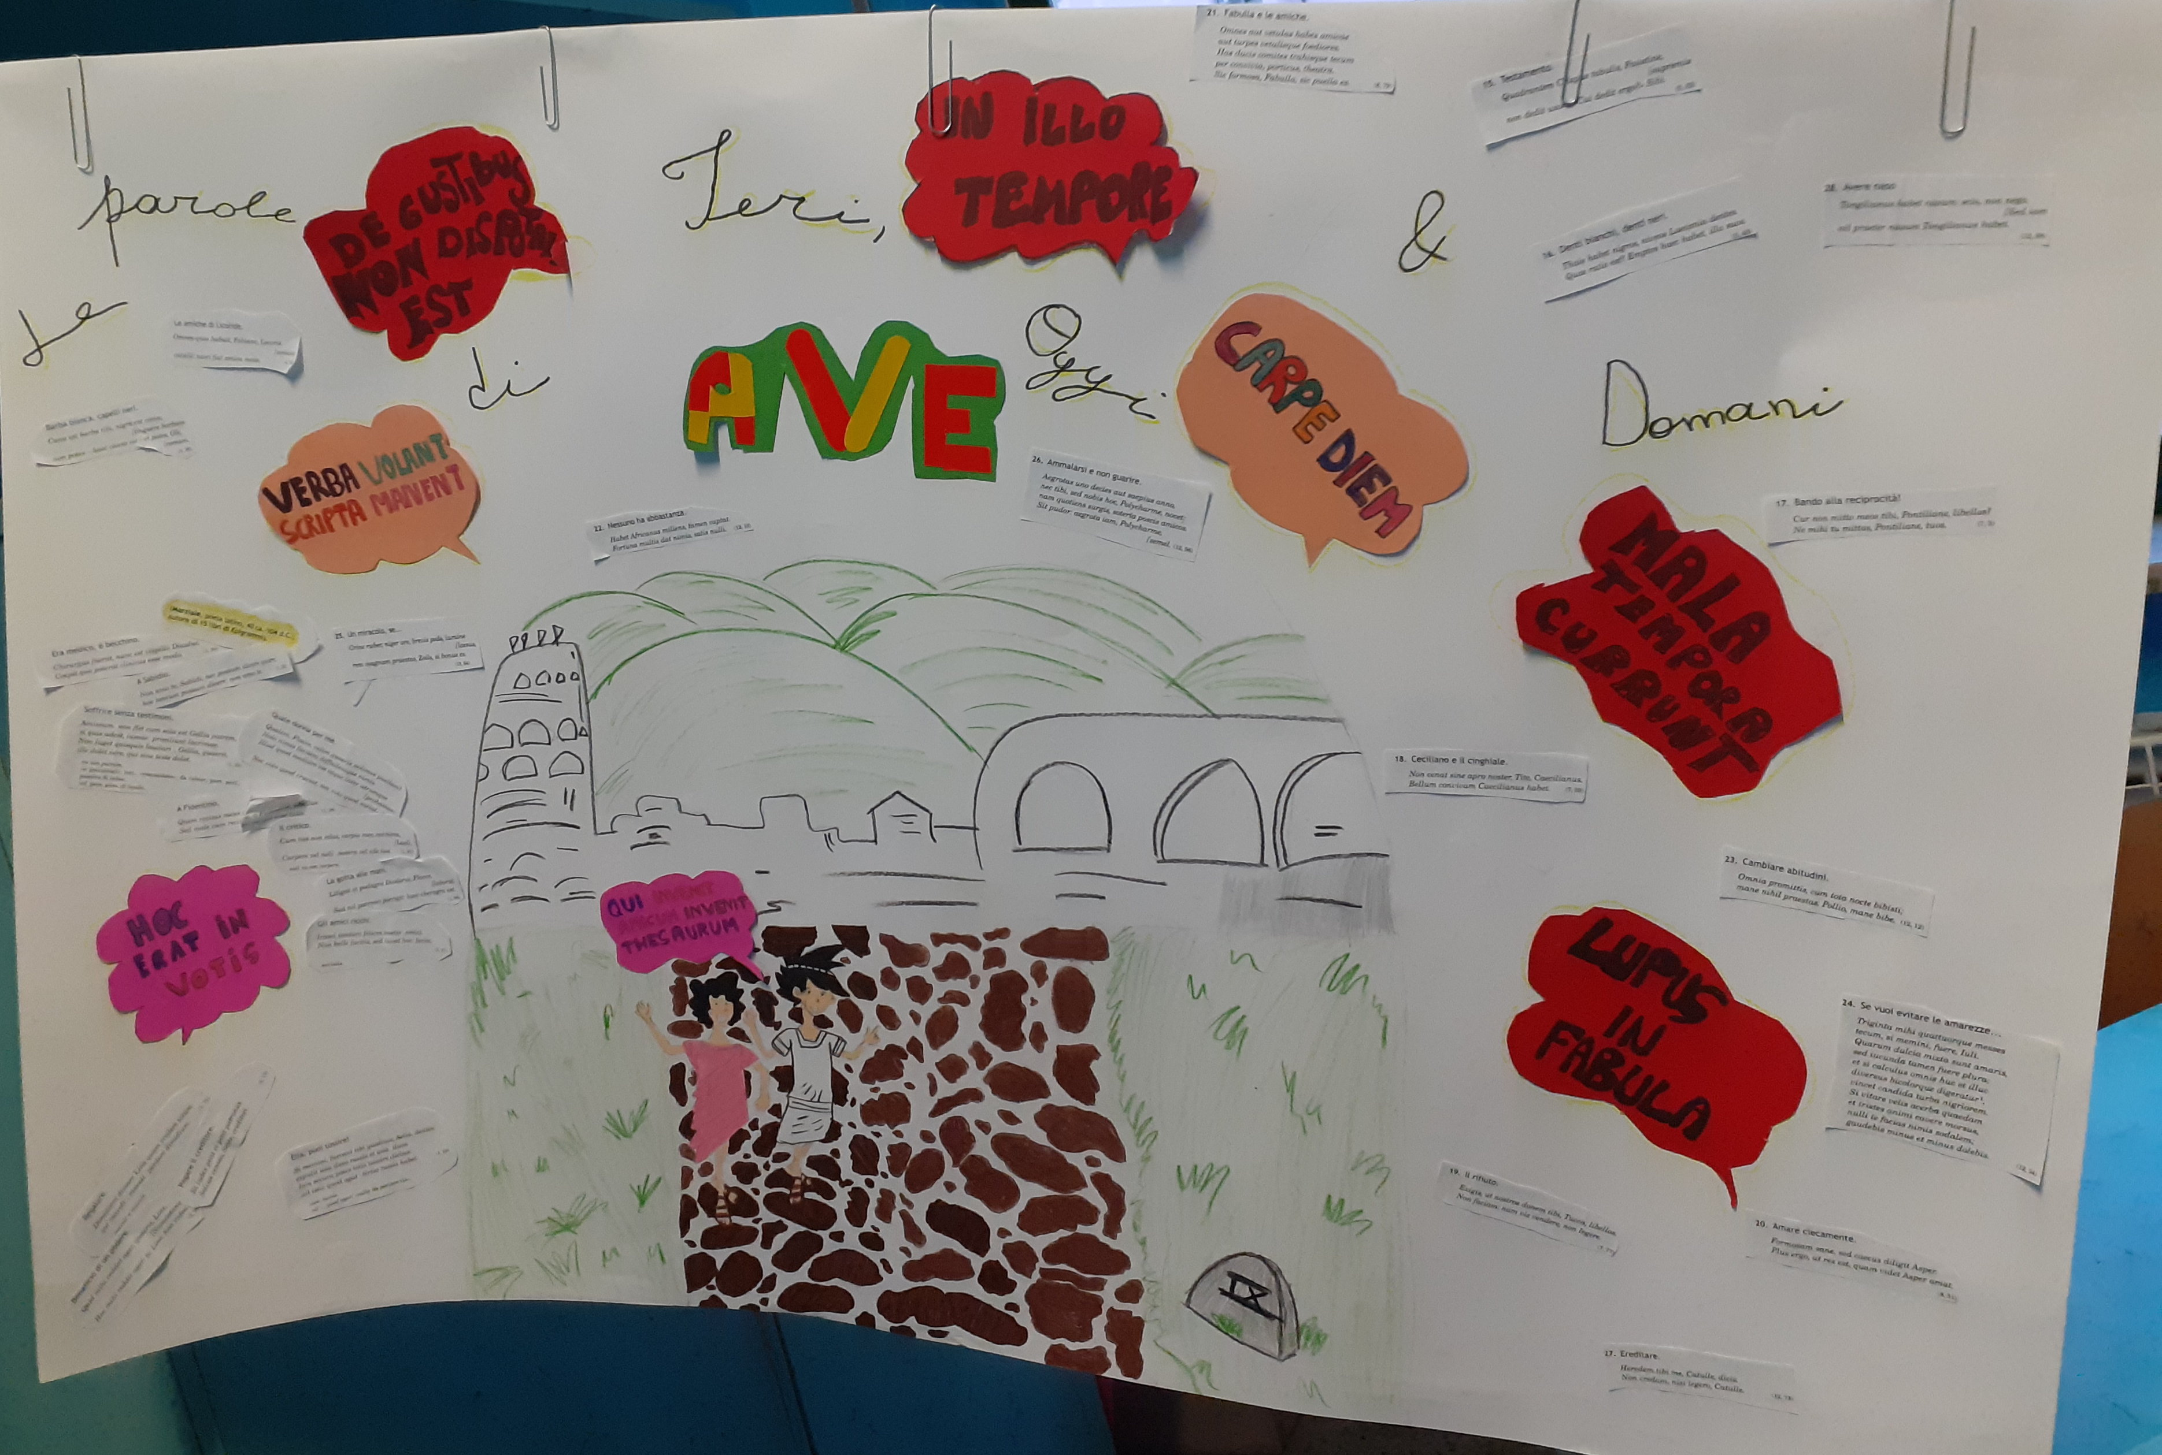
Learning Latin means discovering the origins of
the Italian language

Slide 15
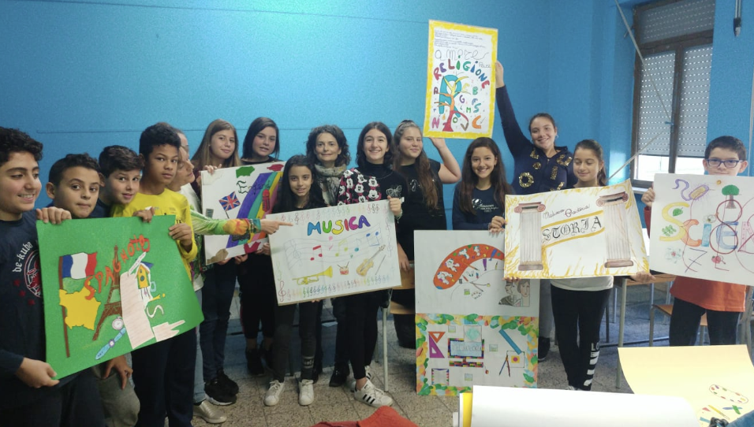
We are really proud of our school… studying all those subjects makes us grow up...
«faster, higher,
stronger»!

Slide 16
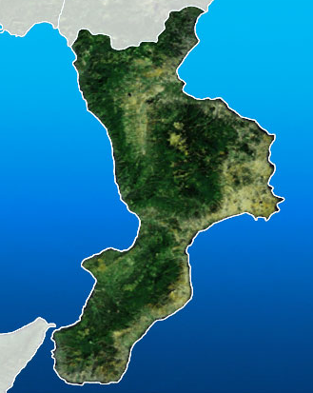
THE MEETING PROGRAMME
Most important places in Cosenza:
-Cosenza’s cathedral;
-the Rendano theatre;
-the Norman-Swabian castle;
-our University;
-the open air museum (MAB);
-the most important squares.
Most popular places among teenagers:
-Cosenza’s football stadium;
-Bilotti Square for concerts;
-Mazzini Street;
-Metropolis (shopping centre).

Slide 17
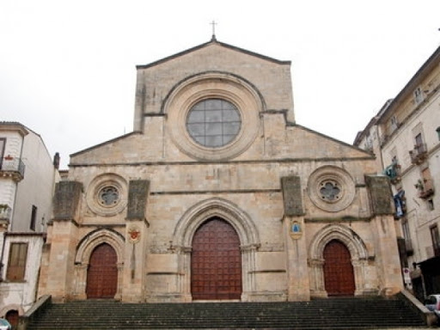
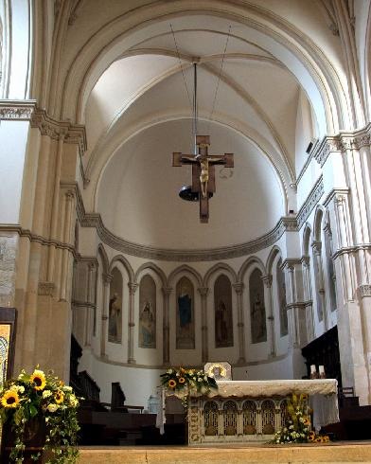
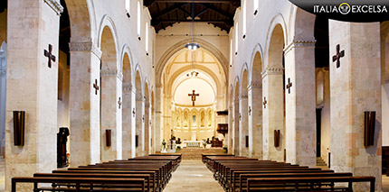
THE CATHEDRAL
Inaugurated in 1222 by Frederick II of Swabia, now Unesco heritage

Slide 18
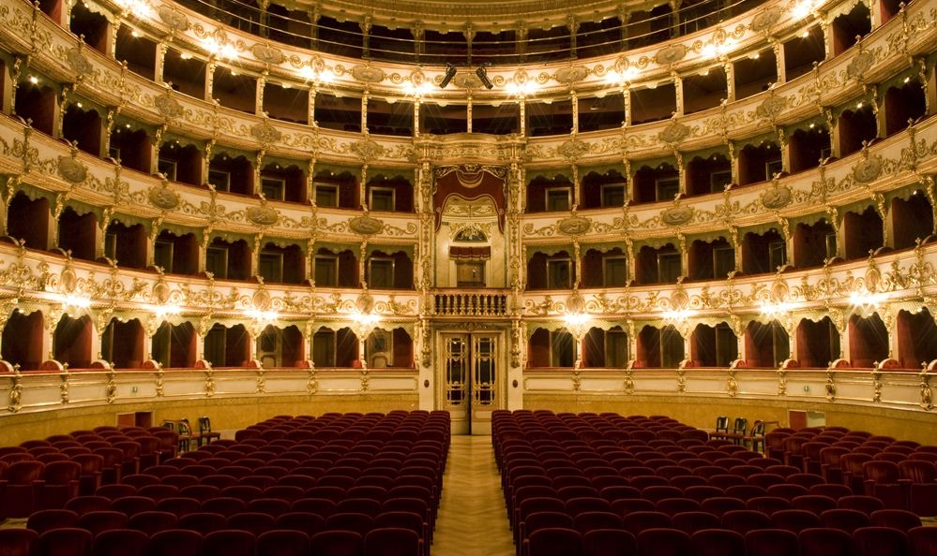
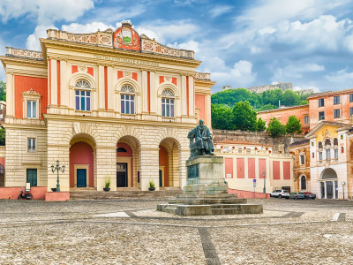
1909 Historical Theatre
ALFONSO RENDANO THEATRE

Slide 19
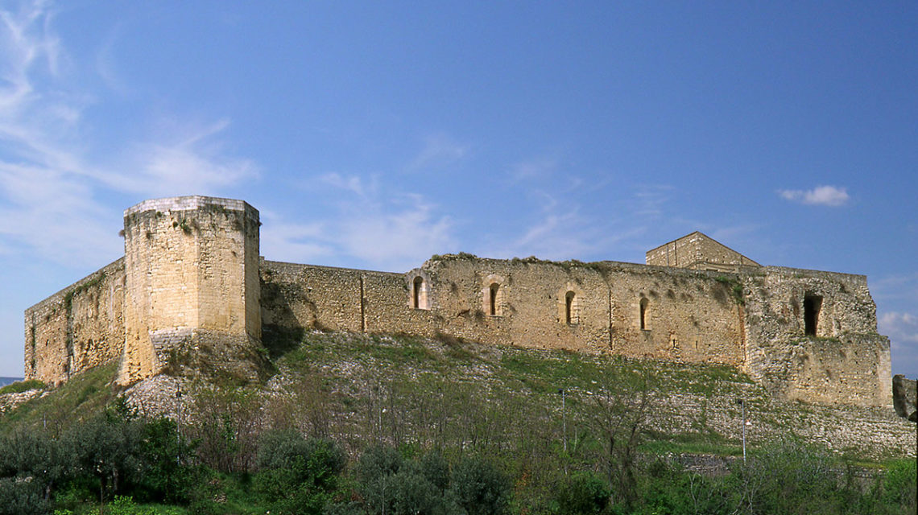
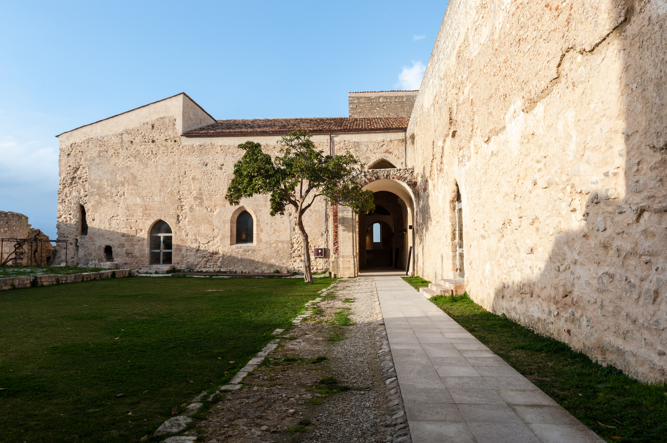
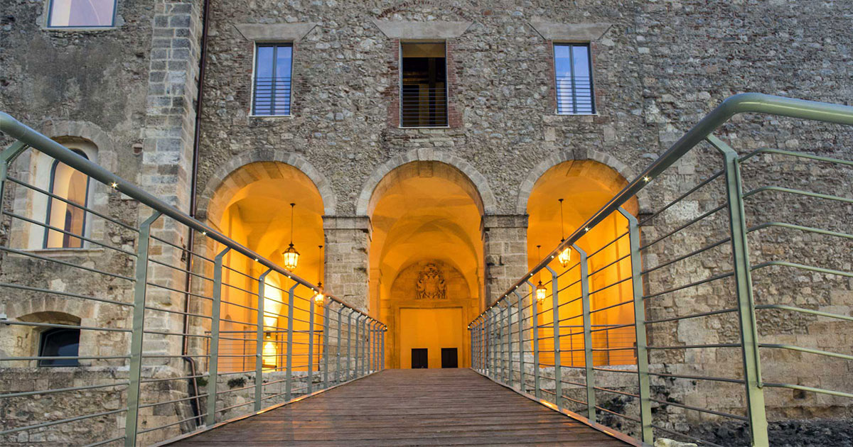
THE
NORMAN SWABIAN CASTLE

Slide 20
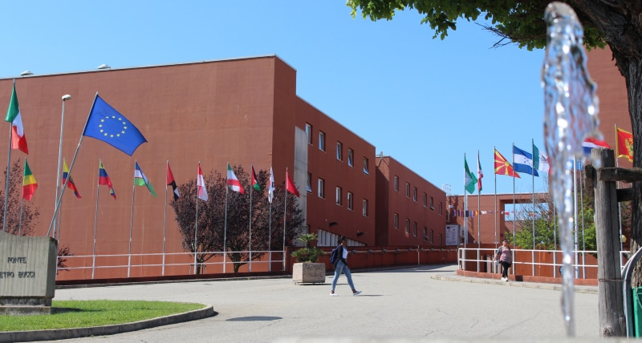
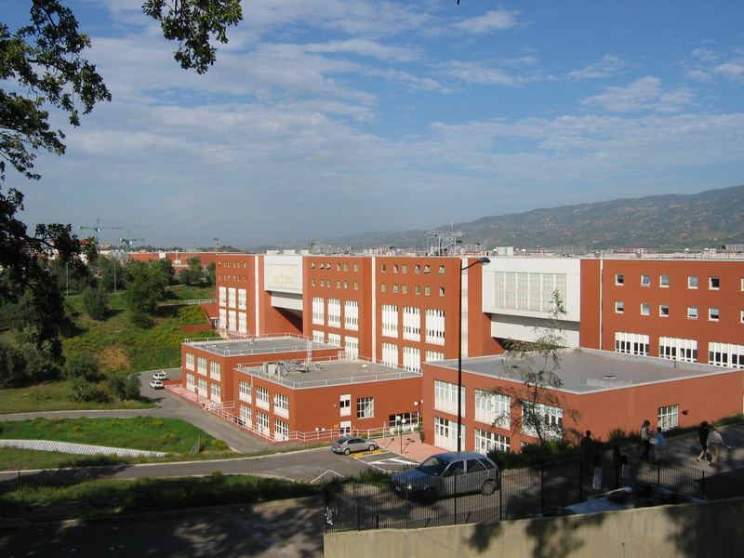
OUR UNIVERSITY

Slide 21
IMPORTANT SQUARES
Bilotti Square
XI September Square
Kennedy Square

Slide 22
CONCERTS IN BILOTTI SQUARE
Mahmood’s concert
Alvaro Soler’s concert

Slide 23
MAZZINI STREET

Slide 24
A park near Mazzini Street
A famous bar where all teenagers meet
A popular pub

Slide 25
FOOTBALL STADIUM – San vito / Marulla

Slide 26
METROPOLIS SHOPPING CENTRE

Slide 27
OTHER BEAUTIFUL CALABRIAN PLACES:
-Sila National Park
-Sibari
-Morano
-Crotone
-Reggio Calabria
-Vibo Valentia
-Rossano
-Scilla

Slide 28
SILA NATIONAL PARK

Slide 29
SILA ADVENTURE PARK

Slide 30
SIBARI
ancient greek colony

Slide 31
MORANO

Slide 32
CROTONE

Slide 33
REGGIO CALABRIA

Slide 34
RIACE’S BRONZES

Slide 35
VIBO VALENTIA

Slide 36
ROSSANO
Codex purpureus
(6th century)

Slide 37
SCILLA

Slide 38
and now…
…other interesting places to visit in Calabria!

Slide 39
ARCHAEOLOGICAL SITE OF LAOS

Slide 40
BRANCALEONE VETUS ARCHAEOLOGICAL PARK

Slide 41
CATANZARO BIODIVERSITY PARK

Slide 42
ROMITO CAVE near PAPASIDERO and LAO RIVER
Palaeolithic rock engravings
(around 11.000 years ago)

Slide 43
RAFTING ON LAO RIVER

