Slide 1
What is EarthKam?

Slide 2
Sally Ride EarthKam is a NASA educational program that makes it possible for students and teachers to learn about Earth from the perpective of space (the International Space Station).
During EarthKam missions students around the world request images of specific locations on Earth.
The program was started by Dr Sally Ride, America’s first woman in space.

Slide 3
1. Enter the page

Slide 4
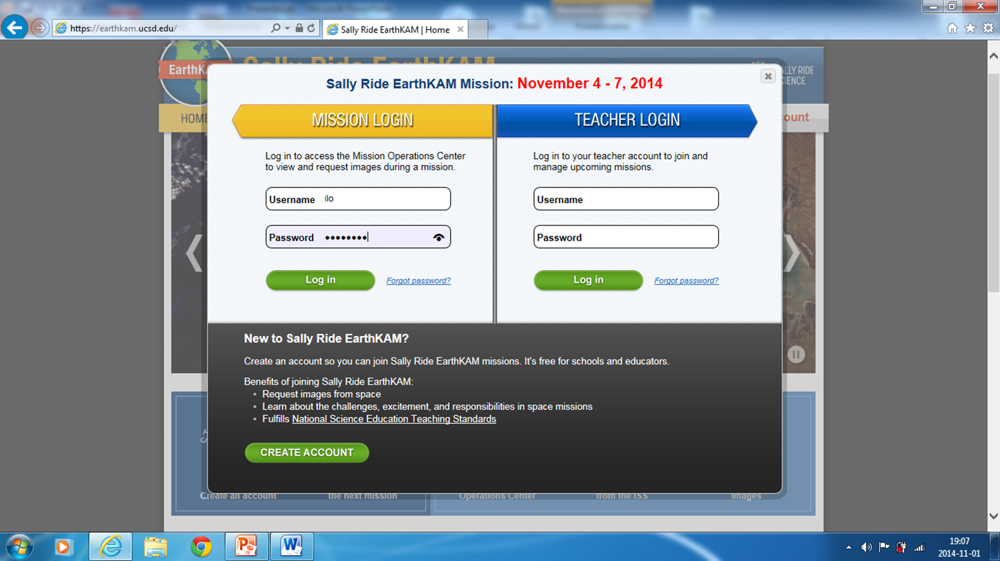
2. Click on the login and type in the box Login…… (given by the teacher) Password……

Slide 5
3. After you log in, you get such a screen and the numbers of the available orbits.

Slide 6
4. Click on the make image request and you’ll get this:

Slide 7
5. CD Procedure Tick the chosen orbit; there are 12 to choose from. You can only take pictures on the day orbits are red. Tick a place you want to photograph on a red line; a small circle appears. You can make it bigger to have a better quality of the picture. Follow the next slide as an example.

Slide 9
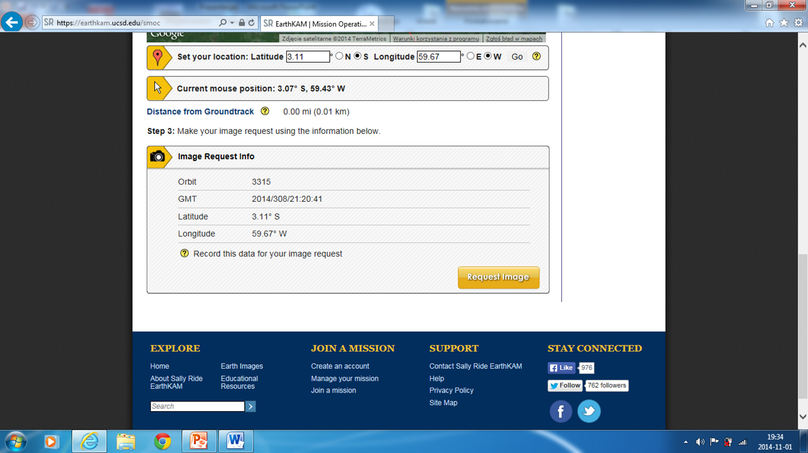
6. If you have chosen the best place on the orbit,there appears 0,01 km in the Distance from Groundtrack . If you switch the picture from satellite to a map, you get either a satelite view or a map with the names of all the objects. When you are sure about the place to be photographed, click on the request image.

Slide 10
7. Write your codeword in the window - each person gets seven codes (one for a picture)

Slide 11
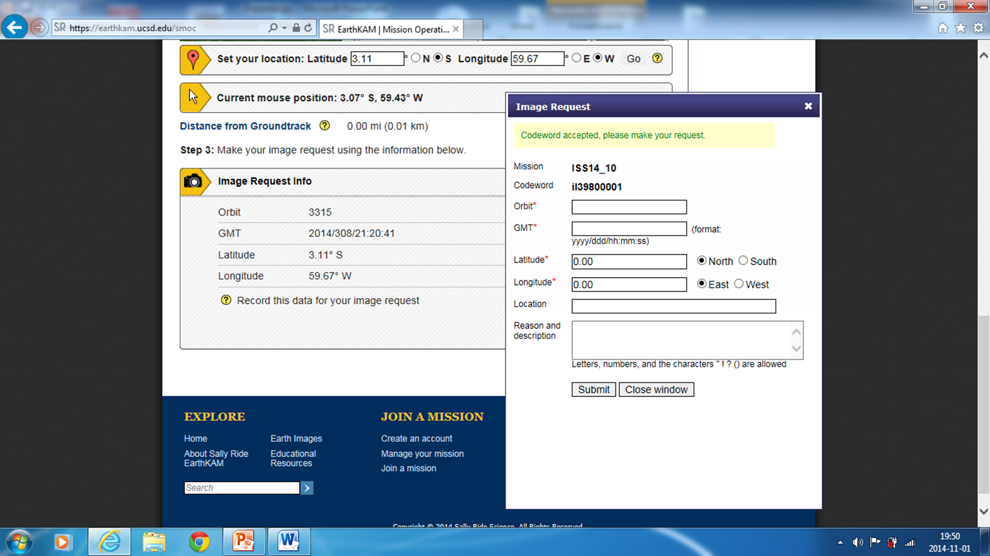
8. If you haven’t made any mistakes, there appears the window like the one here. In case of an error, there appears a notice giving directions how to correct it. Then you click submit, choose the small window and start the procedure from the beginning.

Slide 14
Here are our pictures from the previous EarthKam missions.

Slide 23
The End
This presentation has been made by:
Wiktor Kretowicz
within the framework of Erasmus+ project
Let’s talk about soil

