Slide 1
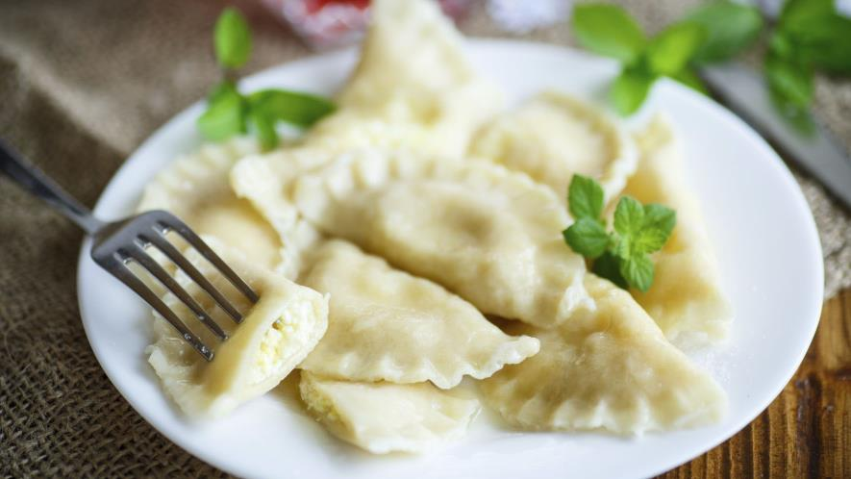
DUMPLINGS

Slide 2
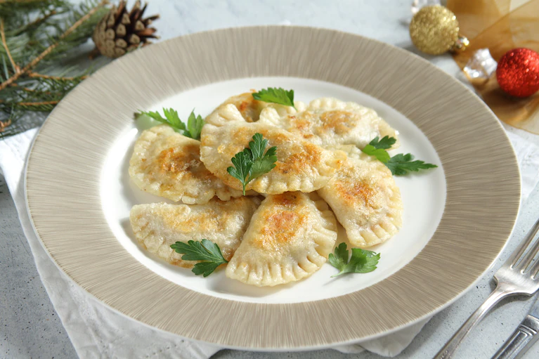
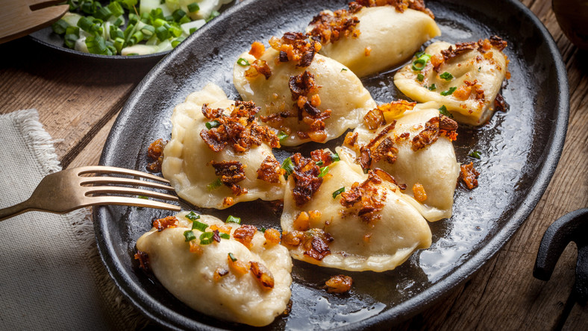
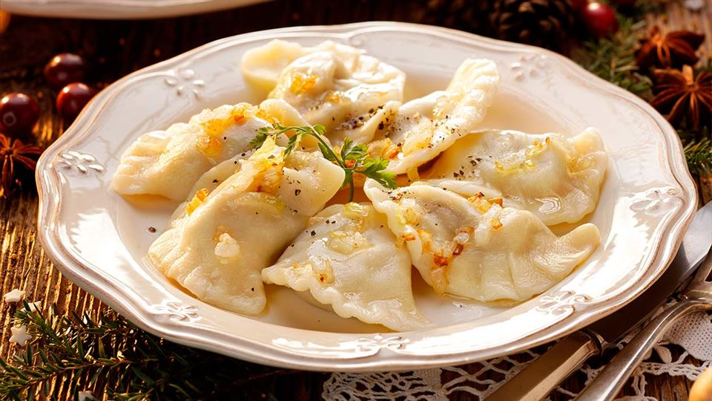
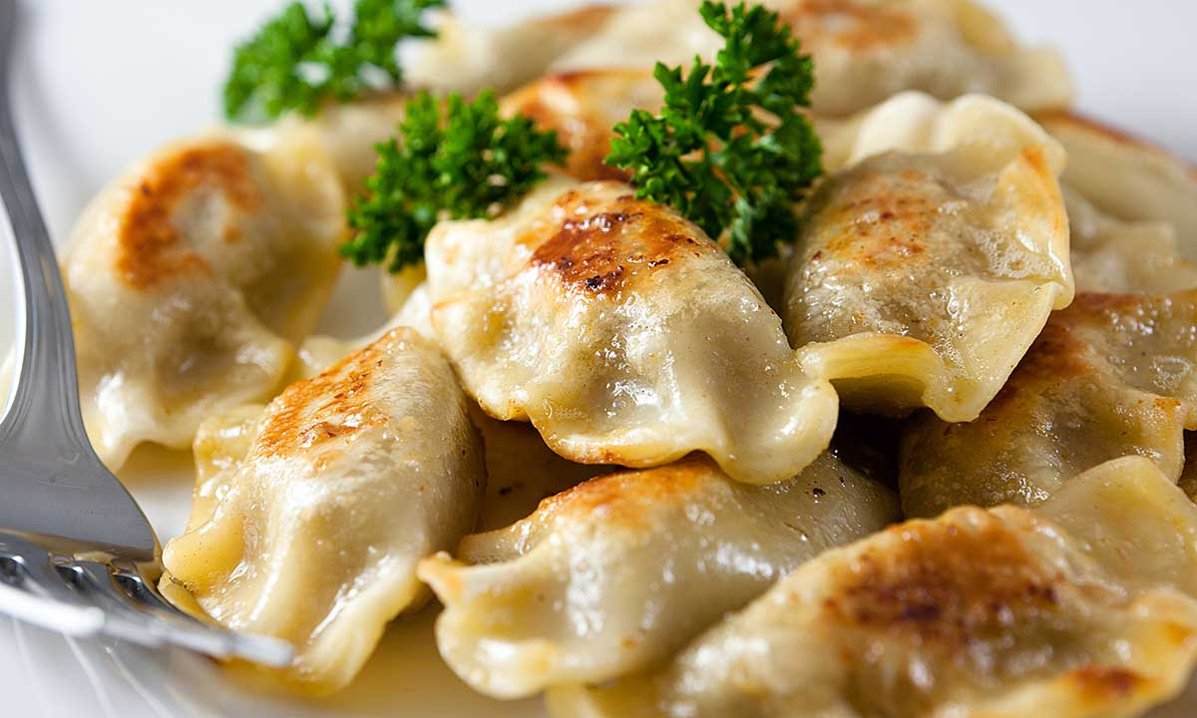
It might seem that pierogi have always been present in Polish cuisine. This is not contrary to the truth
Dumplings are a laborious flour dish. These are pieces of thinly rolled pasta with salty or sweet stuffing, shaped like a triangle or a semicircle and boiled in water
It is believed that they appeared on Polish tables as early as the 13th century thanks to Jacek Odrowąż, who brought them from Kiev.

Slide 3
TYPES OF DUMPLINGS
PIEROGI RUSKIE Filled with onions, cottage cheese and potatoes are often the object of interest of foreigners and a favorite dish of Polish people
DUMPLINGS WITH CABBAGE AND MUSHROOMS. They are eaten not only every day, but also at Christmas, because they are one of the 12 dishes we eat on Christmas Eve - they cannot be missing on the festive table.
DUMPLINGS WITH MEAT. Filled with beef or - less often - poultry, they are not only delicious, but also very filling.
One cannot forget about dumplings with sweet filling. They can be stuffed with, among others, cottage cheese or fruit - strawberries, raspberries, blueberries, plums, apples, cherries ...

Slide 4
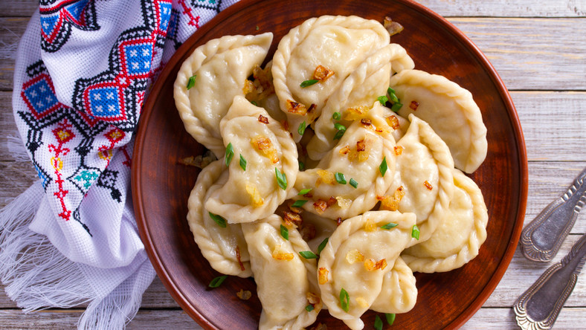
HOW TO EAT DUMPLINGS?

Slide 5
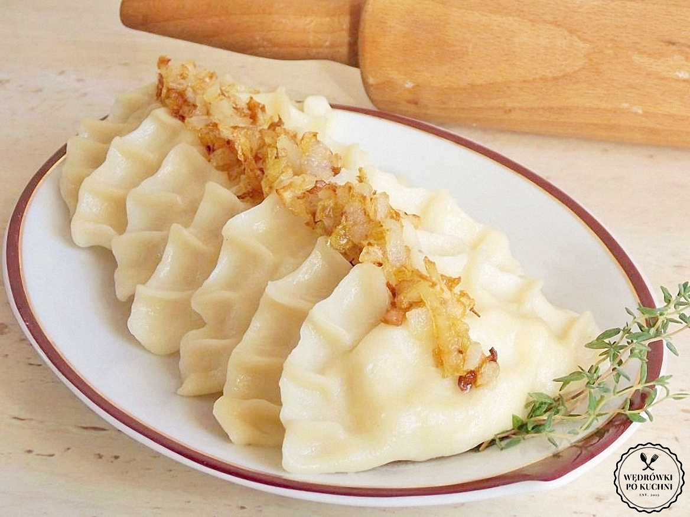
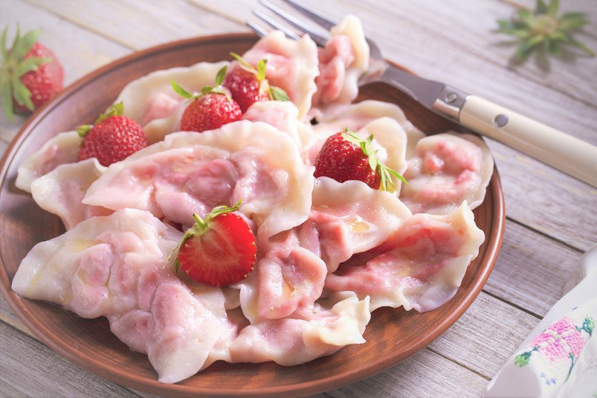
Dumplings can be served in many ways!
Depending on the filling, cooked dumplings can be served with, for example, sauces made of cream and spices.
Dumplings with meat can be served in an oriental style - with the addition of soy sauce.
Russian dumplings will go well with, for example, chives or sun-dried tomatoes - for a better taste, you can pour melted butter over them at the end.
Sweet dumplings - a good idea is to serve them with a sauce made of cream with the addition of cinnamon, vanilla, cardamom or almonds.

Slide 6
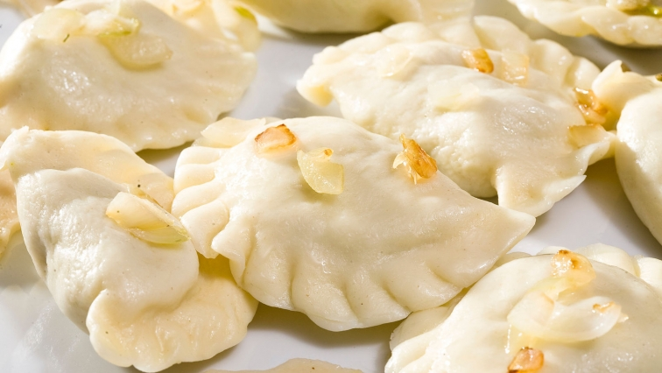
HOW TO PREPARE DUMPLINGS

Slide 7
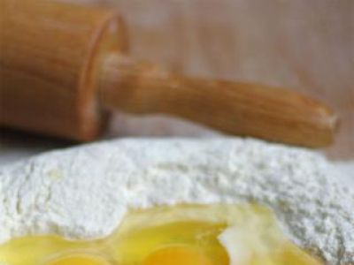
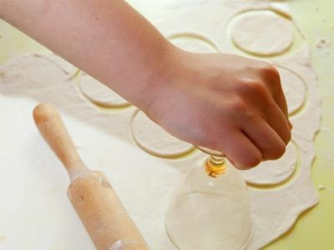
1. DOUGH
Ingredients:
2 cups of flour
1 egg
1 tablespoon of oil
salt
boiled water
Preparation:
In a bowl sift the flour and salt.
Crack the egg.
Mix together water and oil and slowly pour it into a bowl with flour and mix it (with your hands).
Knead the elastic dough.
Cover the bowl with a clean cloth and leave it in 5 minutes.
Knead the dough again and roll it until 1,5mm thick and cut it with glass ( circle shape).

Slide 8
2. STUFFING - INGREDIENTS
CABBAGE AND MUSHROOMS
POTATO AND COTTAGE CHEESE
75 decagrams of potatoes
25 decagrams of cottage cheese
2 onions
2 tablespoons of butter
salt
pepper
10 decagrams of bacon
60 decagrams of sour cabbage
5 decagrams of dried mushrooms
1 egg
2 onions
2 tablespoons of oil
salt, pepper

Slide 9
STUFFING - PREPARATION
CABBAGE AND MUSHROOMS
POTATO AND COTTAGE CHEESE
Peel and chop the onion. Fry it in butter
Peel the potatoes, boil and mince them. Add the onion.
Mince the cottage cheese and mix it with your potatoes
Add salt and pepper
Boil the mushrooms
Add cabbage to the mushroom
Mince the cabbage and mushrooms
Chop the onion and fry it in oil
Add it to the cabbage and mushrooms
Add an egg
Add salt and pepper and mix everything together

Slide 10
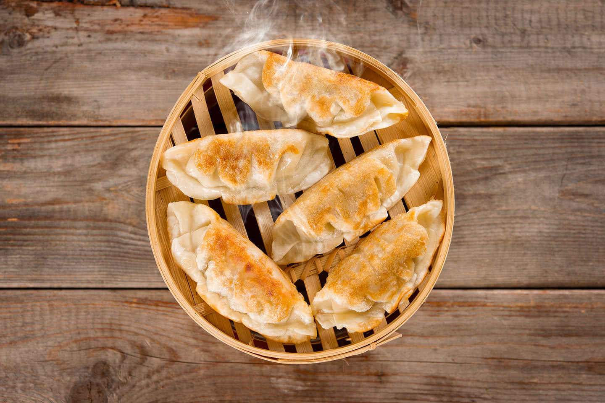
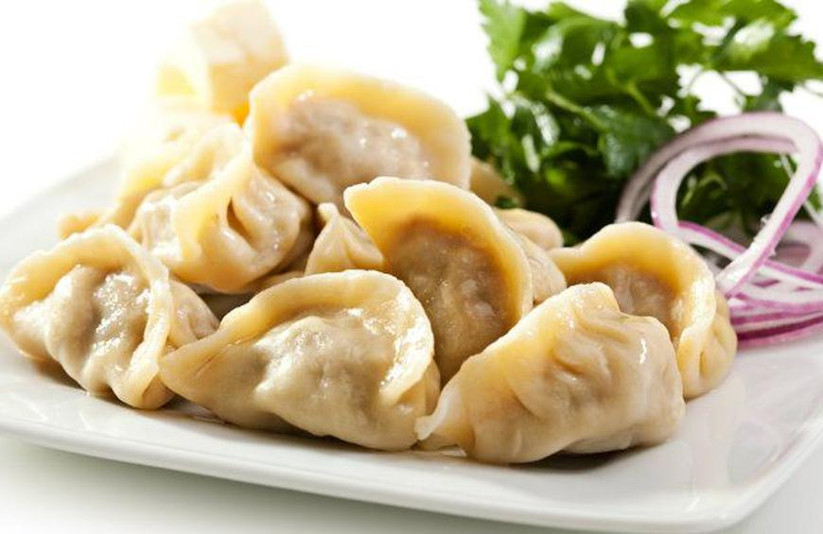
HOW TO MAKE DUMPLINGS - VIDEO
https://www.youtube.com/watch?v=GNKfgHyaQ8M&list=LL&index=8

Slide 11
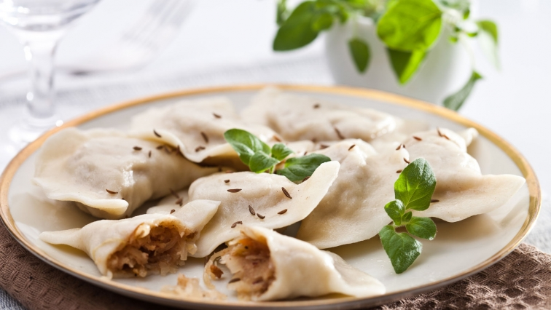
Thank you for your attention

Slide 12
Presentation submitted by Aleksandra Laskoś and Julia Cetnarowska within the framework of Erasmus+ project ‘Let’s Talk About Soil’
SOURCES
https://prostehistorie.com.pl/blog/mowisz-polska-myslisz-pierogi/
https://www.kwestiasmaku.com/przepis/ciasto-na-pierogi
https://pl.wikipedia.org/wiki/Pierogi
https://gotujmy.pl/pierogi-krok-po-kroku,artykuly-kulinarne-abc-artykul,13791.html
https://context.reverso.net/t%C5%82umaczenie/polski-angielski/w+wi%C4%99kszo%C5%9Bci
https://www.google.com/search?q=pierogi+zdj%C4%99cia&oq=pierogi+zdj%C4%99cia&aqs=chrome..69i57j0i22i30l5.4840j0j7&sourceid=chrome&ie=UTF-8

