Slide 1


COSENZA: PAST AND PRESENT

Slide 2
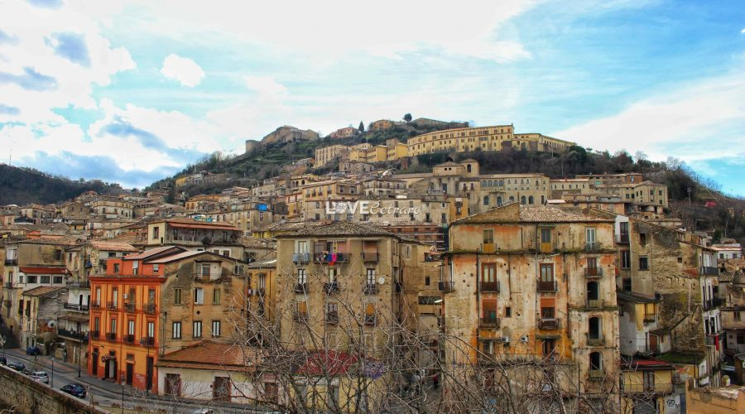
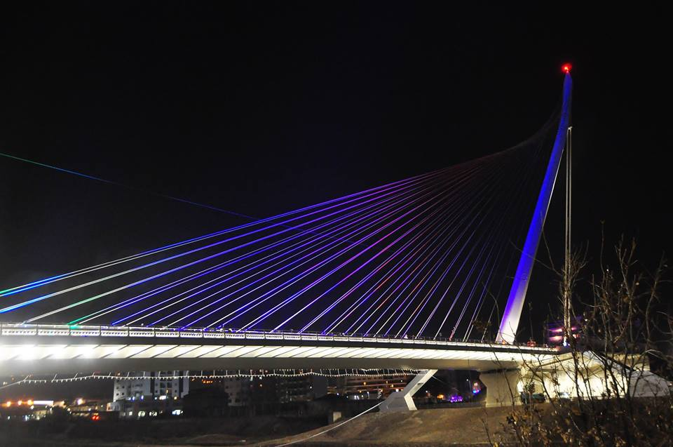
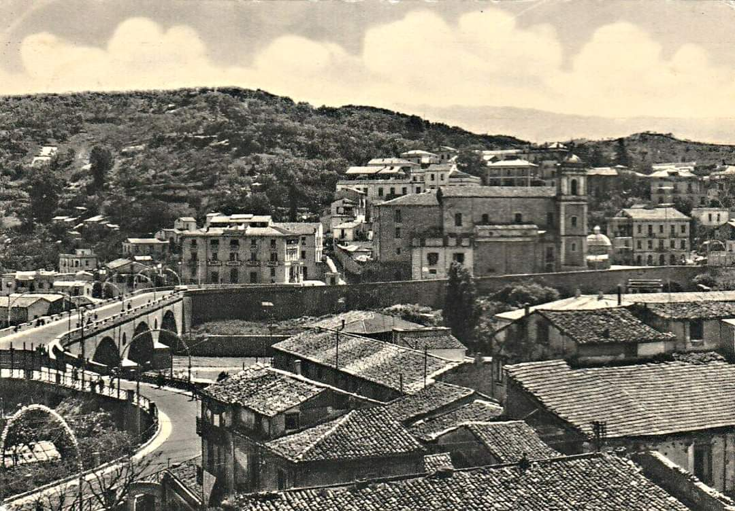
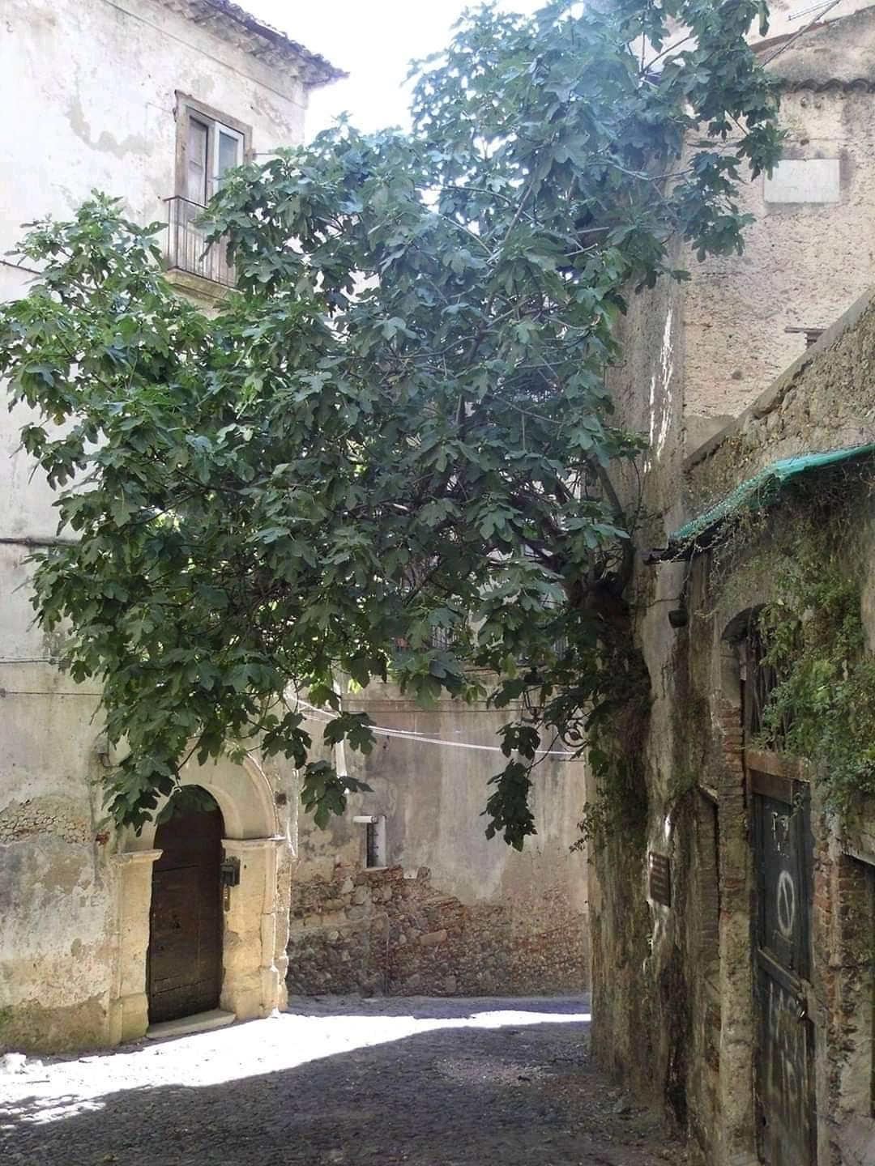
COSENZA YESTERDAY
COSENZA TODAY

Slide 3
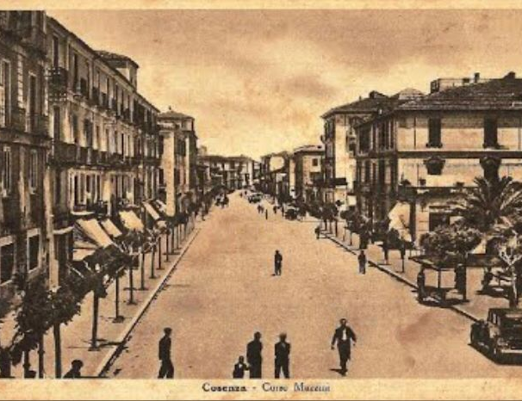
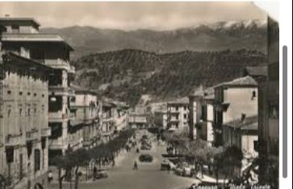
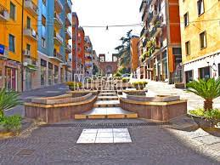
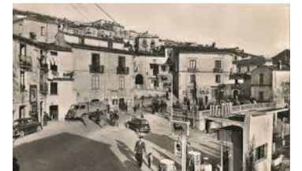
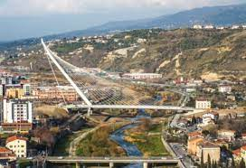
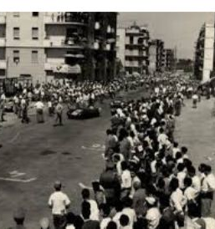
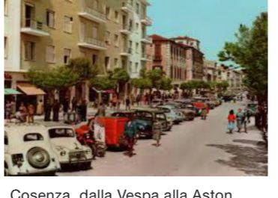
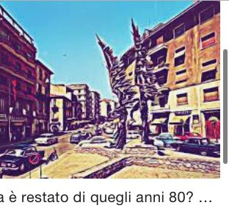

Slide 4
Cosenza
KennedySquare
Historical Centre
Bernardino Telesio
Calatrava Bridge
Giuseppe Mazzini Street
The Planetary
Bilotti Square
and

Slide 5
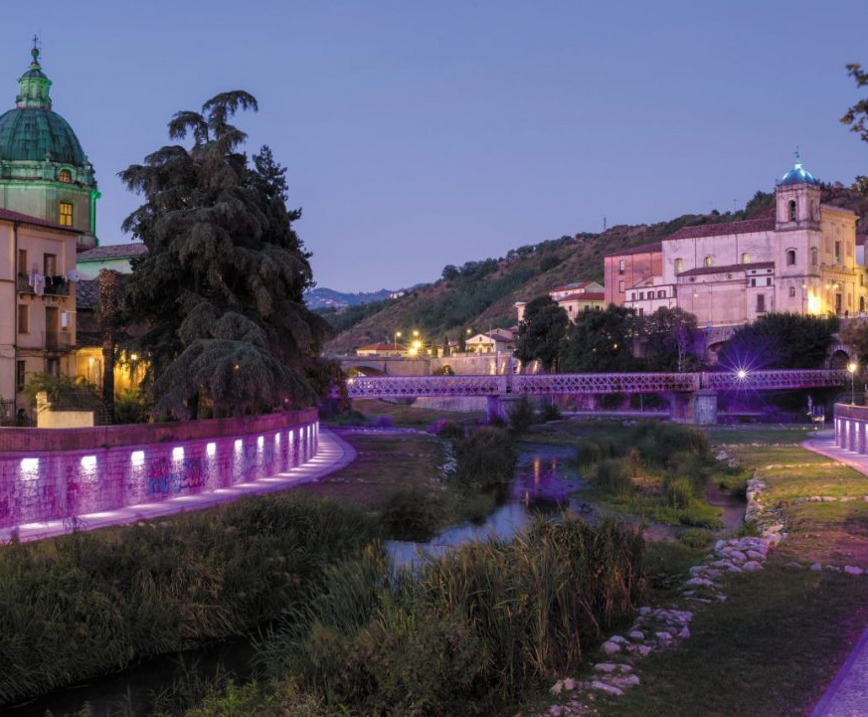
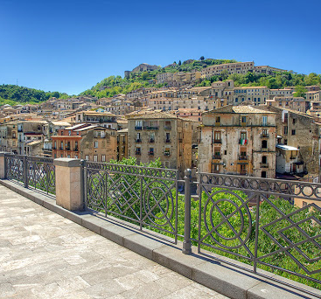
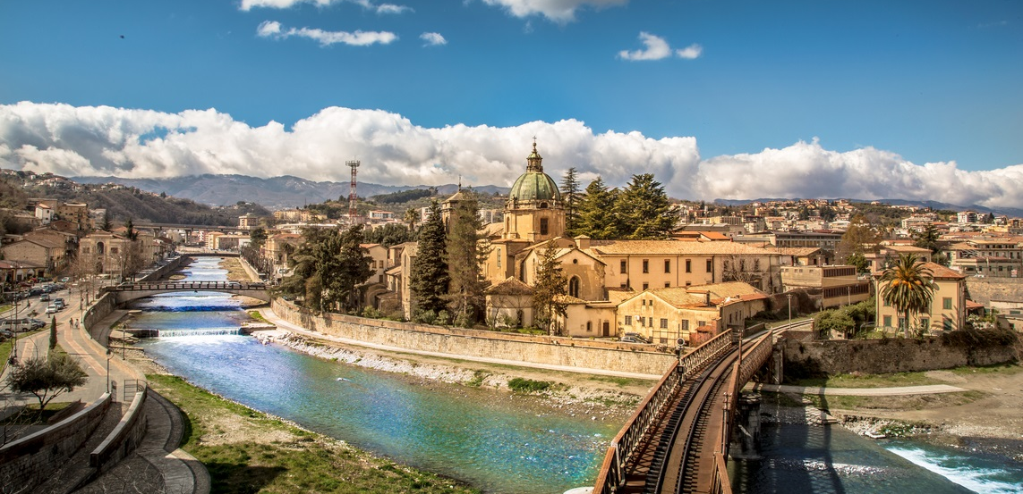
COSENZA: ITS PAST
Cosenza, also known as the City of the Bruzi, is the oldest city in Calabria located on seven hills in the valley of river Crathis. First it was dominated by the Romans and then by the Byzantines, who called it Constantia. After that, the Saracens and the Lombards competed for its dominion. So, it was razed to the ground in 957 and it was rebuilt in 988. In 1057, Robert Guiscard started the Norman invasion of Calabria. The town soon rebelled against his rule. Cosenza was disputed by the Normans and by the Swabians. The Swabian Emperor Frederick II promoted construction and economic activities. Subsequently, Cosenza was disputed by the Angevins and the Crown of Aragon. In 1432 King Louis III of Anjou settled in the castle of Cosenza with his wife Margaret of Savoy. When he died untimely, in 1434, he was buried in the Cathedral. Cosenza was the home of the great philosopher Bernardino Telesio who, together with Aulo Giano Parrasio, was among those scholars who gave importance to Cosenza, becoming the Athens of Italy.
☺

Slide 6
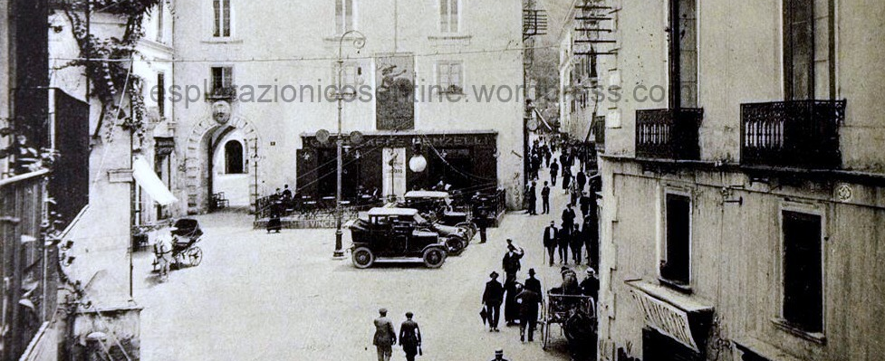
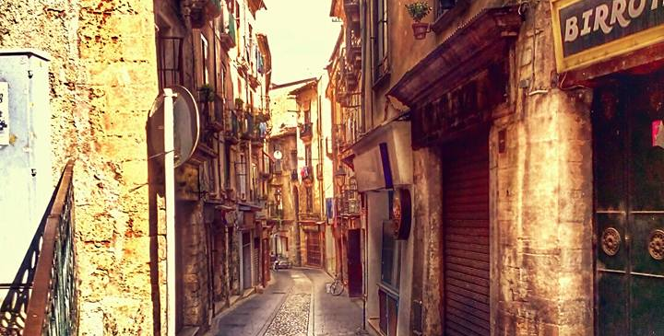
The historical centre dates back to very ancient times. It was founded in the fourth century B.C. by the Bruzi, but the name «COSENTIA» was given by the Romans. The name Cosenza is younger.
COSENZA: THE HISTORICAL CENTRE IN THE 1920s AND 2021
☺

Slide 7
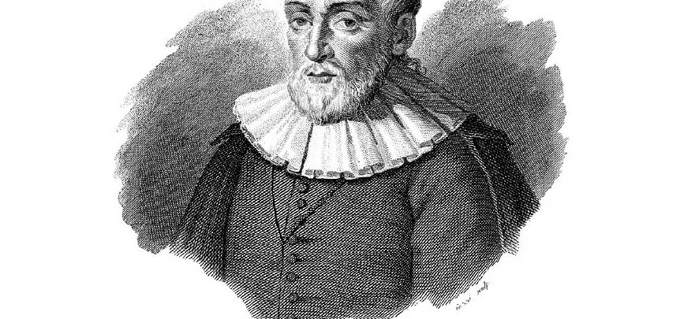
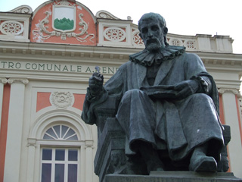
Bernardino Telesio
A statue, made by the sculptor Achille Orsi in 1914, is dedicated to the famous philosopher and naturalist Bernardino Telesio, who lived in the sixteenth century. It is located in Piazza 15 Marzo, the space that Cosenza dedicated to the memory of the Risorgimento uprisings of 1844 and overlooked by the Rendano Theatre and the Government Palace. The bronze statue depicts the philosopher in a meditative attitude, holding a book and a pen. The base on which it rests is in granite and has two bas-reliefs on the sides, in bronze, depicting stories from the life of the philosopher, including the representation of his activity as a philosophy teacher and his arrest during the sacking of Rome in 1527. ☺

Slide 8
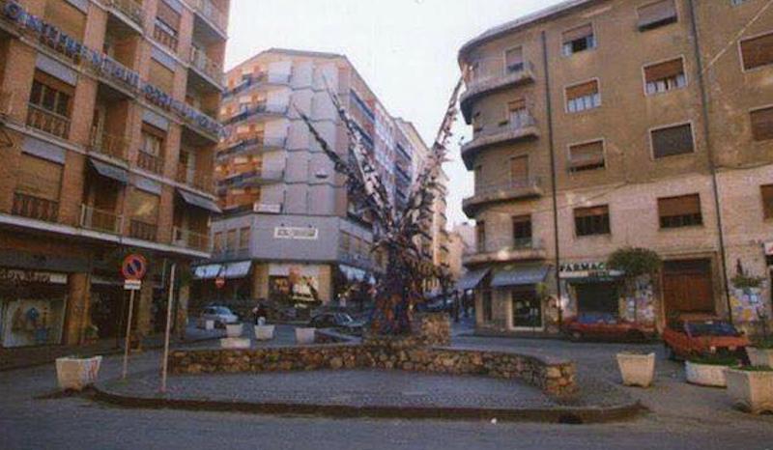
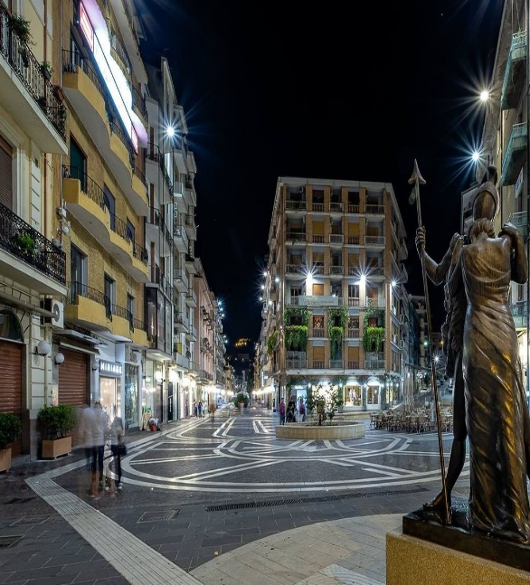
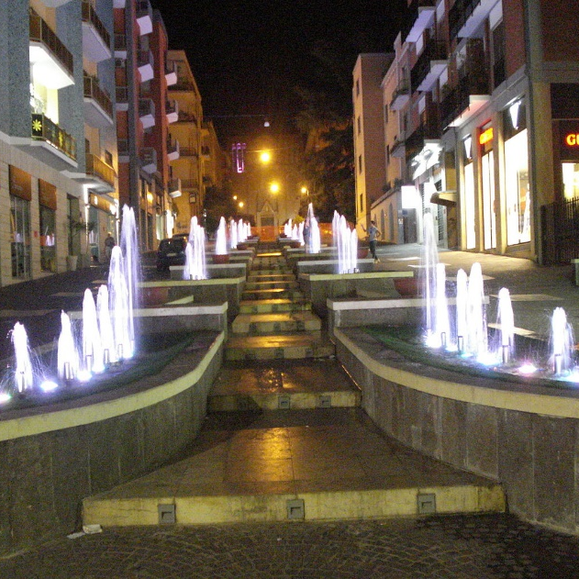
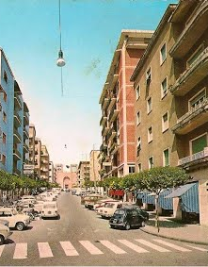
GIUSEPPE MAZZINI STREET
Once Giuseppe Mazzini street was different from today. People drove their cars along the street and there weren’t many shops. Around 2002-2003, the mayor Giacomo Mancini, changed it in a beautiful pedestrian area as well as an important outdoor shopping center. It also became the seat of the famous Open-Air Museum Bilotti☺

Slide 9
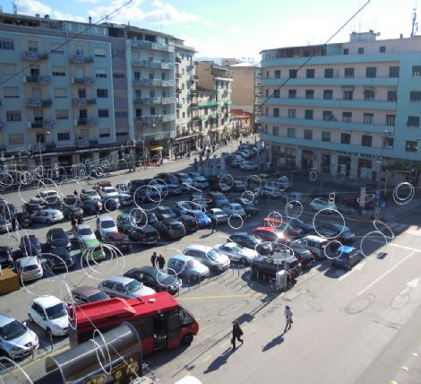
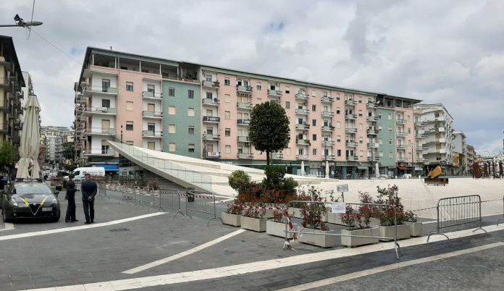
BILOTTI SQUARE IN 2010 AND 2021
Since 2013 Piazza Bilotti has started to change. In the past it was possible to park outdoors, while today there is an underground car park and a square with two points, where you can walk. ☺

Slide 10
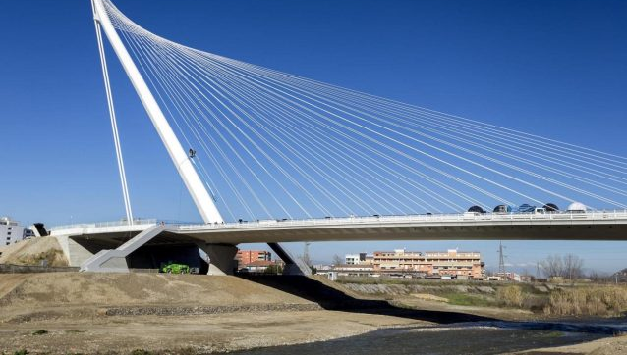
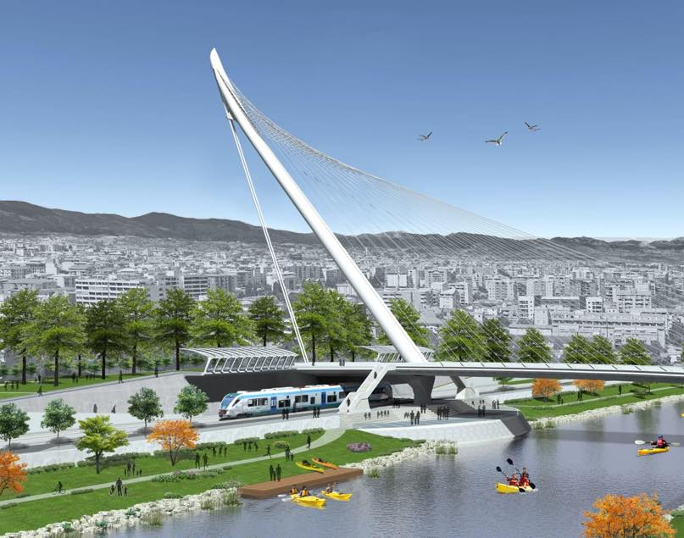
CALATRAVA BRIDGE
It was designed by the Spanish naturalized Swiss architect, Santiago Calatrava and inaugurated on January 26, 2018. The bridge is named after the Patron Saint of Calabria San Francesco from Paola but it is called Calatrava Bridge. The bridge has a length of 140 meters, the steel pylon is 104 meters high and weighs 800 tons, the width is 24 meters, there are two carriageways for vehicular transit in both directions and one for pedestrian traffic. The credit for the construction of the work goes to the mayor Mario Occhiuto in office since 2011 who unlocks the construction site with some variants in progress and reaches the inauguration on 26 January 2018 in the presence of the architect Calatrava after a process of bureaucratic delays that lasted 18 years old. The decisive step was taken on 23 July 2017 when the antenna or pylon was installed, the imposing structural element that supports the steel cables that support the road deck. ☺

Slide 11
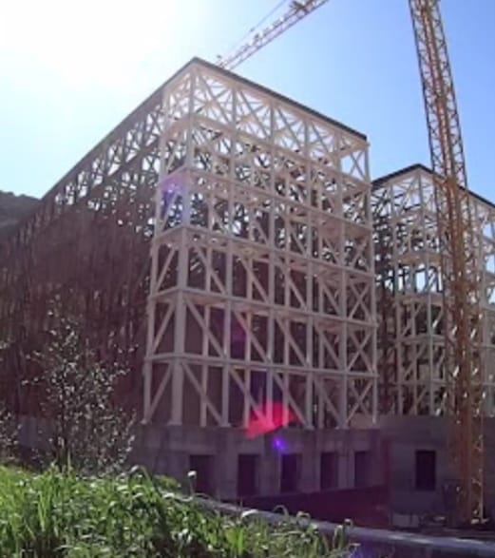
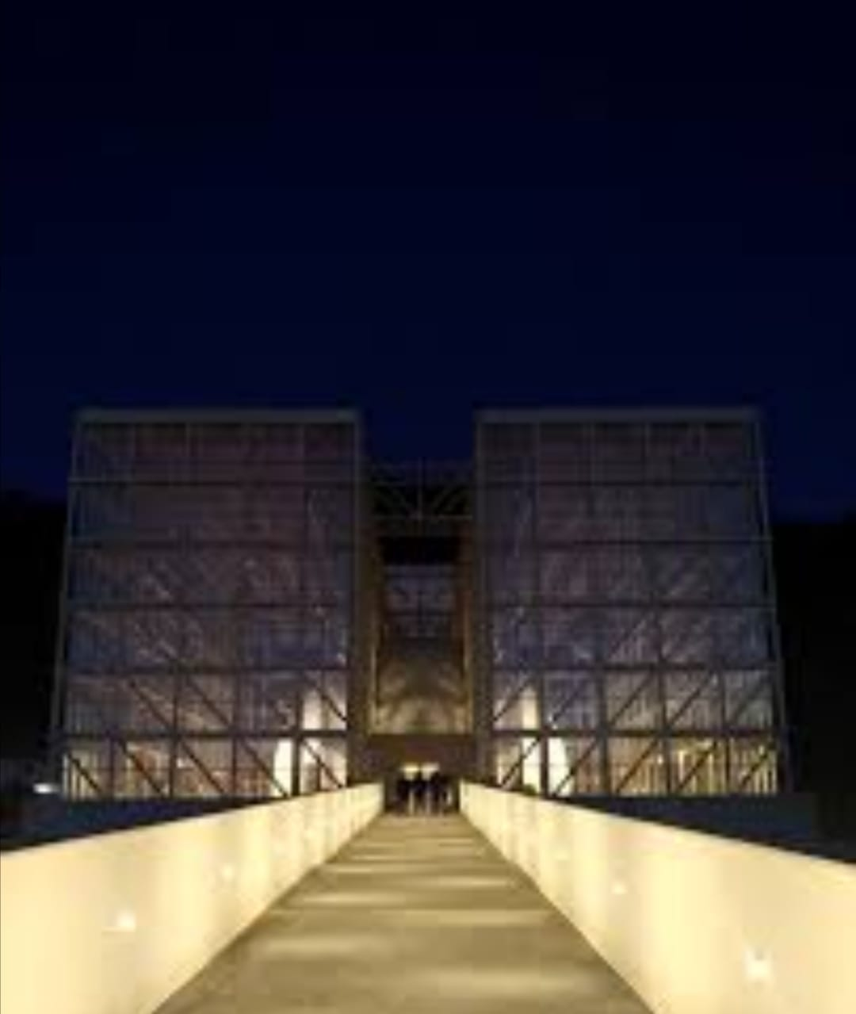
THE PLANETARY
IN 2000 AND 2021.
It was founded by Carlo Olmo.
It took 19 years to build it.
Inside it, we can admire the solar system, the planets and the stars.☺

Slide 12
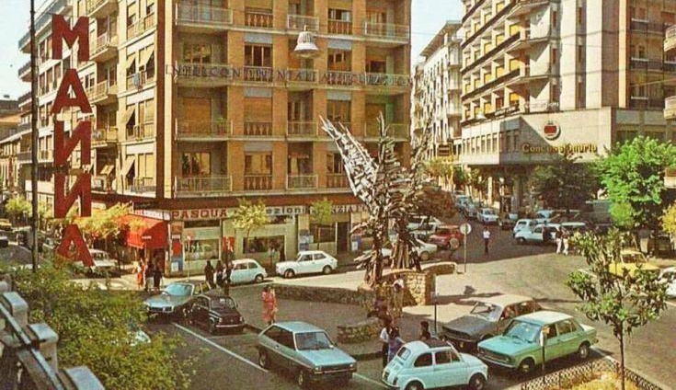
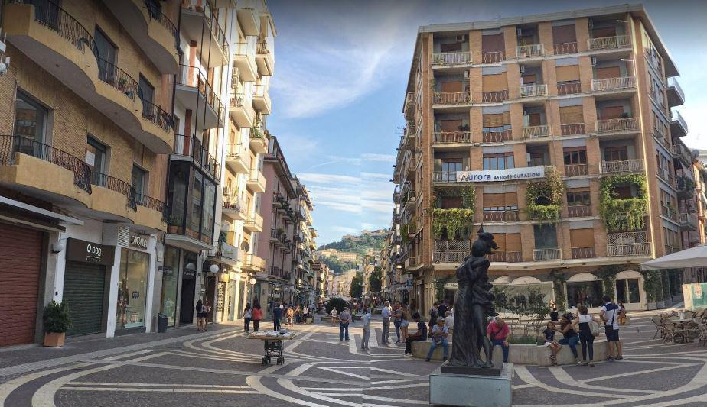
KENNEDY SQUARE YESTERDAY AND TODAY
Kennedy Square was the meeting place of the young people in the 80s and it is approximately at the northern end part of Mazzini Street. ☺

Slide 13

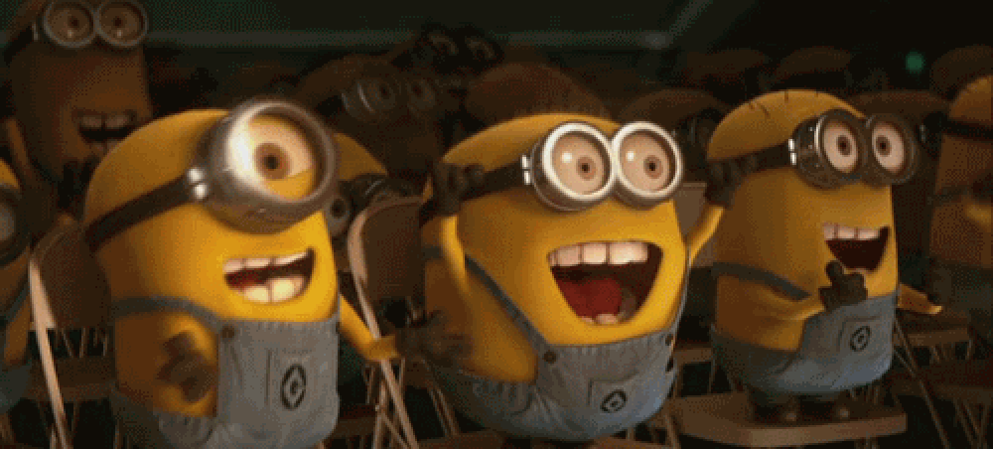

THANK YOU FOR WATCHING!!! ☺
Bernardo Federica
De Rose Sara
Giordano Stefano Pio
Guzzo Maria
Marino Giulia
Mitidieri Salvatore
Munno Alessandra
Spizzirri Giuseppe
Tocci Emmanuela

