Slide 1
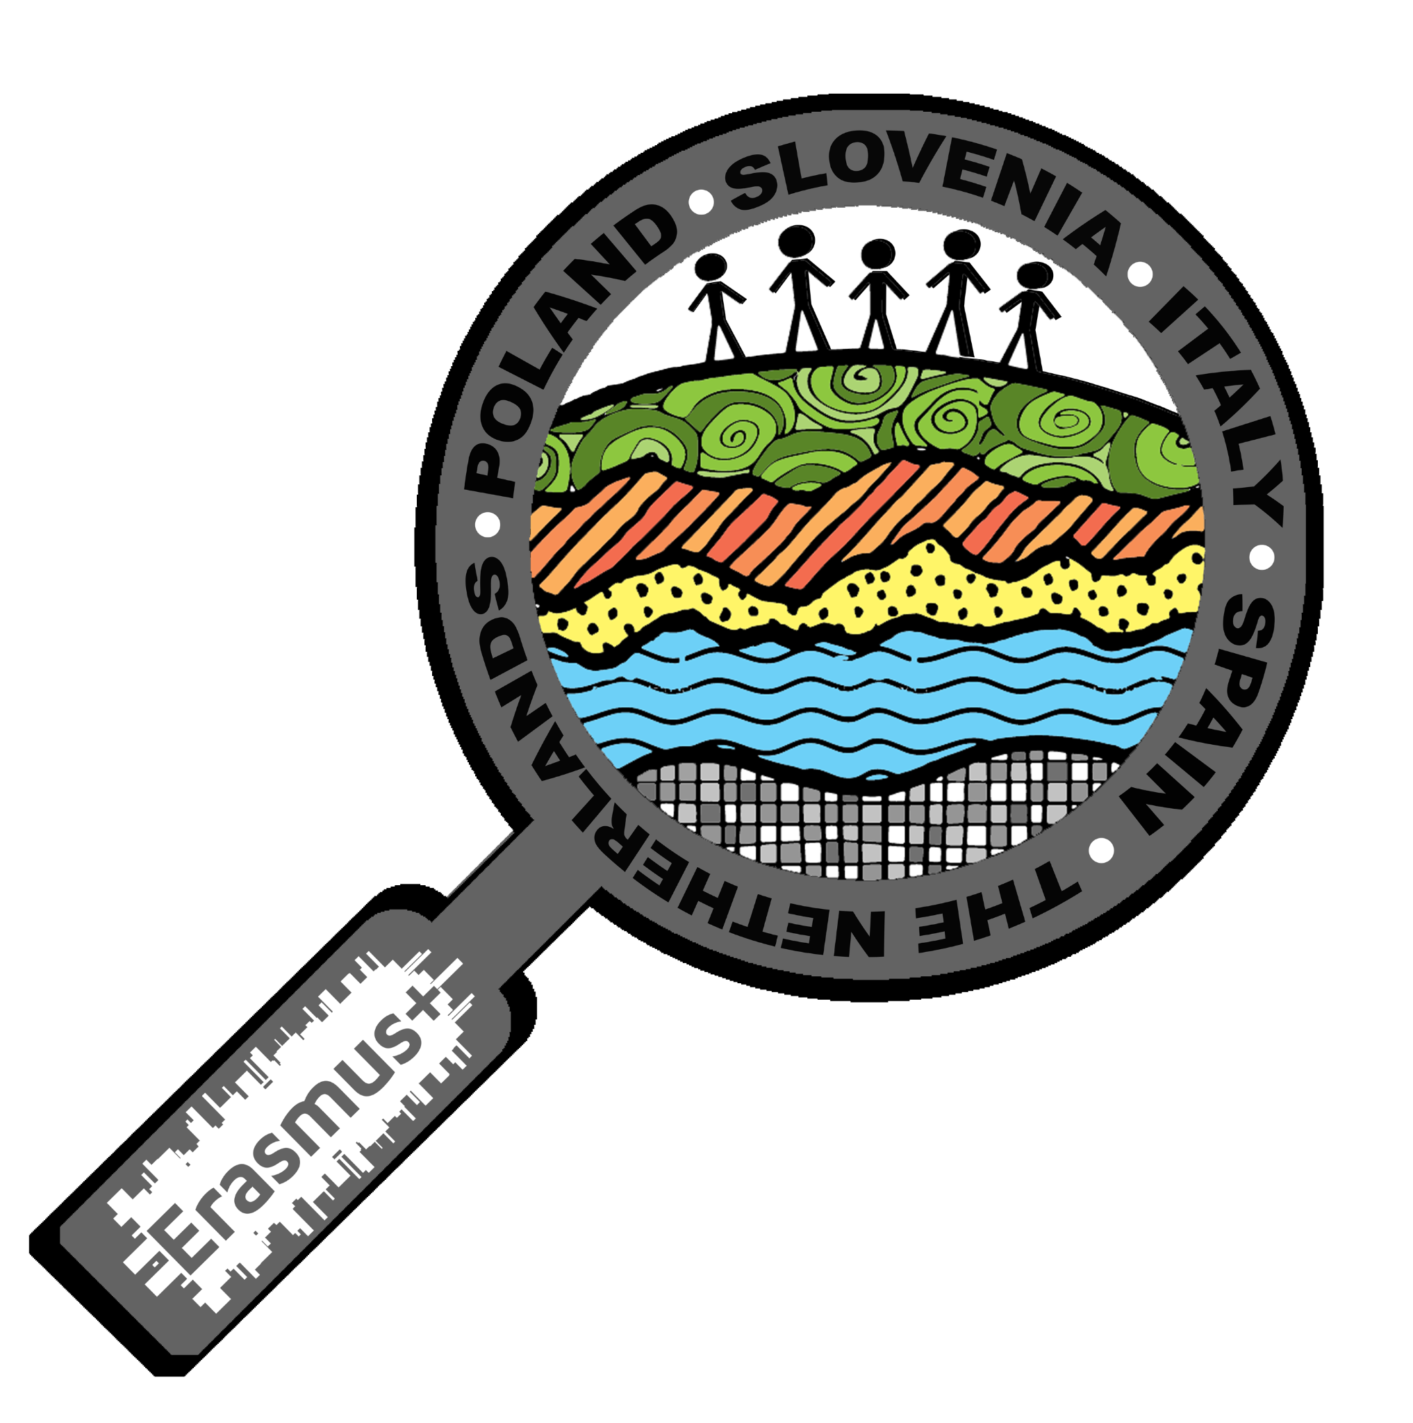
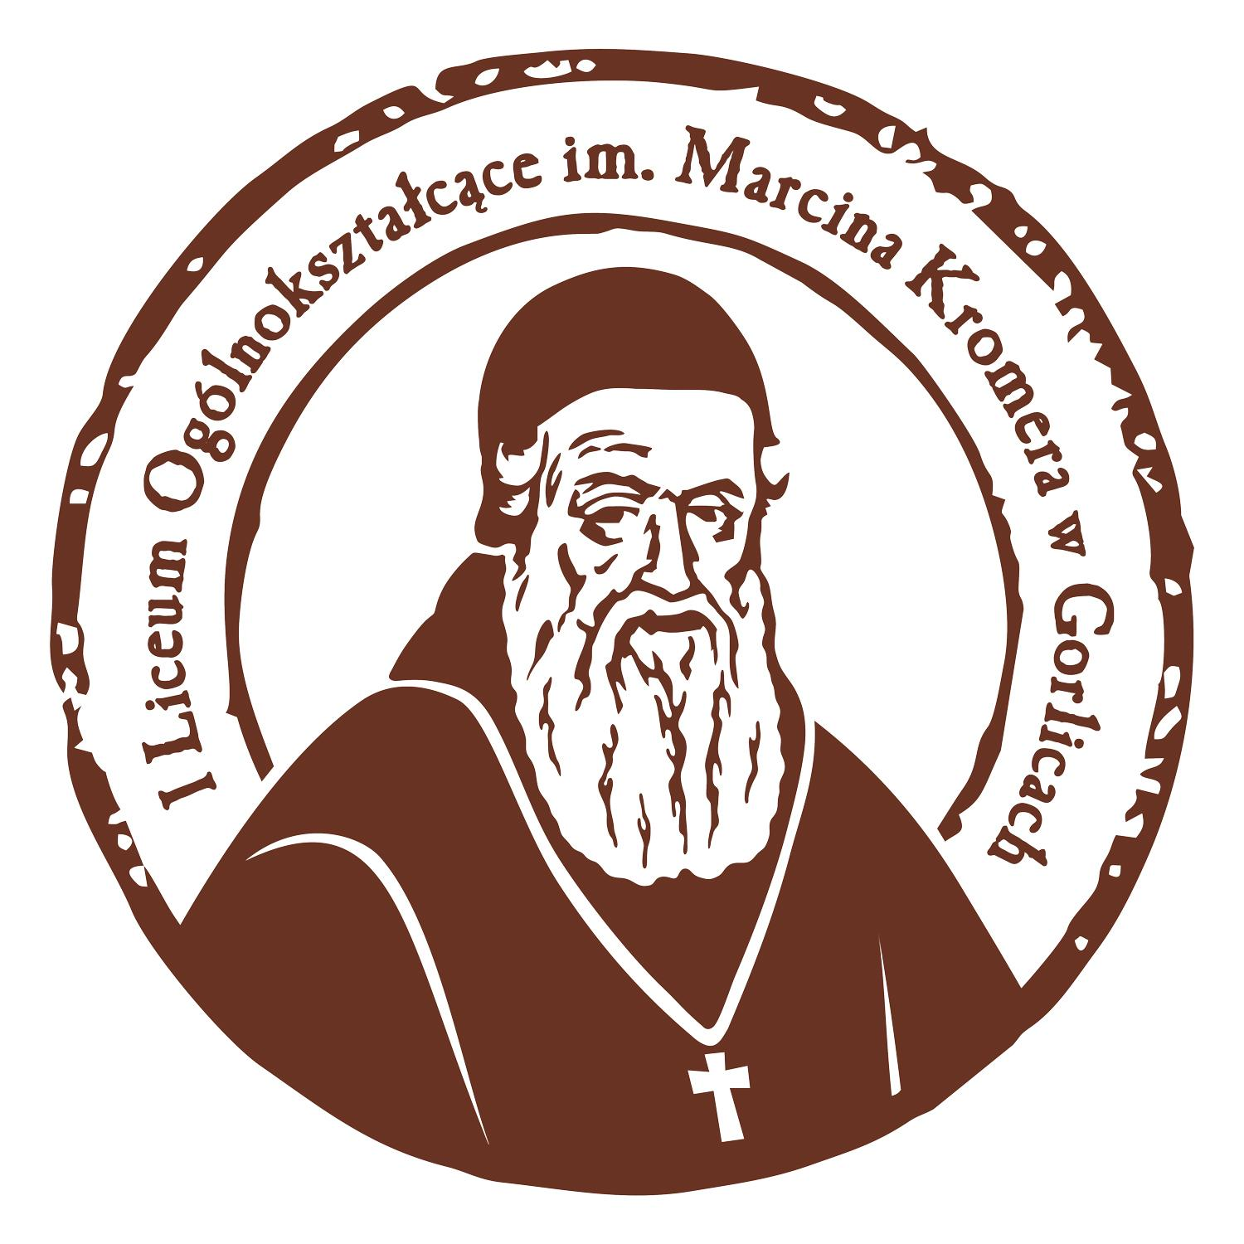
Gorlice and its area
presentation made by:
Marcelina Jędrzejowska
Agnieszka Król
within the framework of Erasmus+ project ‘Let’s Talk About Soil’

Slide 2
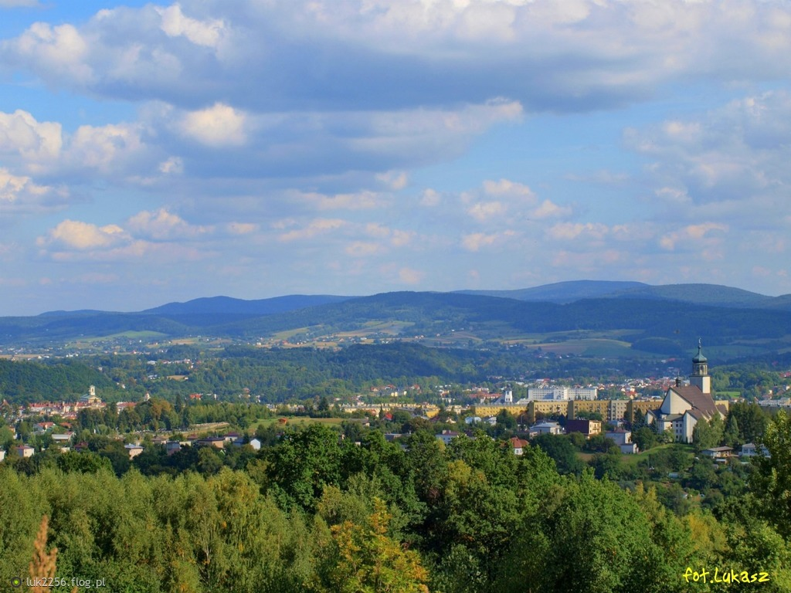
GORLICE

Slide 3
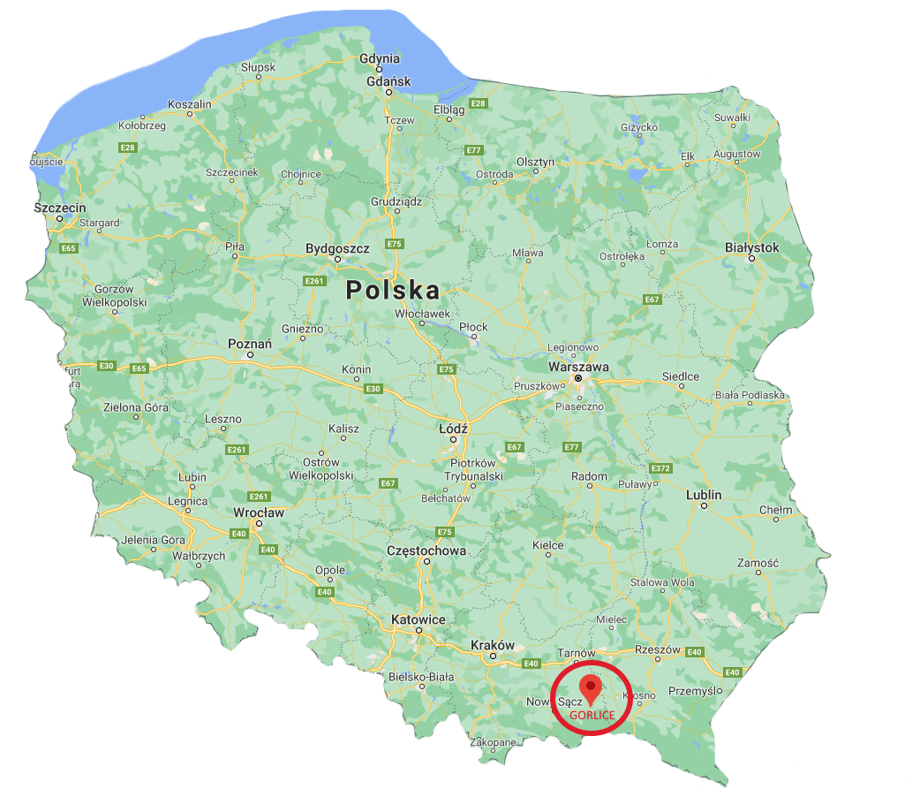
Gorlice is a town located in the southern part of Poland.

Slide 4
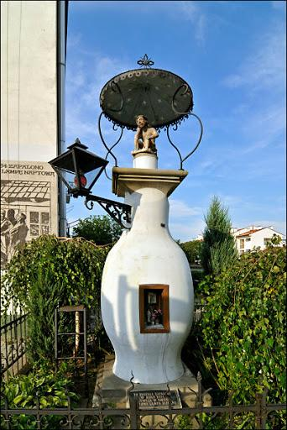
Oil lamp
The first street oil lamp was created in Gorlice in 1854. It was created by Ignacy Łukasiewicz.

Slide 5
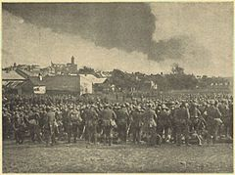
Battle of Gorlice
Battle during World War I. The position fights at Gorlice lasted almost half a year, but the decisive clash was started by an unexpected attack by German and Austro-Hungarian troops on May 2, 1915.
When? | 2–12 May 1915
Where? | Galicia, Gorlice, Jasło and Krosno (between the rivers Biała and Wisłoka)
Territory | Austria-Hungary, Galicia (now Poland)
Reason | Need to dissuad the Russians from Galicia
Effect | Won by Austria-Hungary and Germany

Slide 6
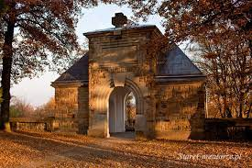
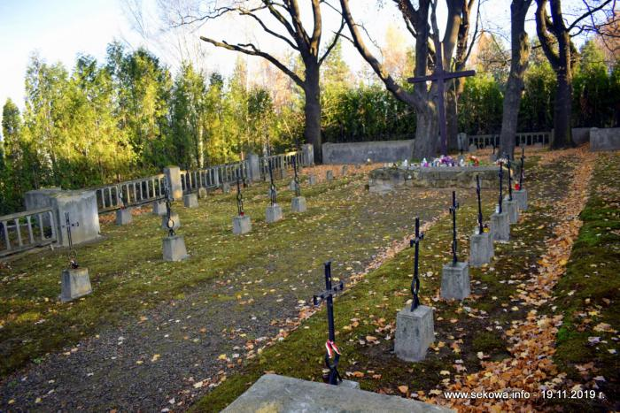
World War I Cemetery No. 91
World War I Cemetery No. 87
Austrian, German and Russian soldiers are buried in this cemetery, although there are also Polish surnames.
Austro-Hungarian, German and Russian soldiers are buried there. Recently, the President of Poland and Slovenia visited this place.

Slide 7
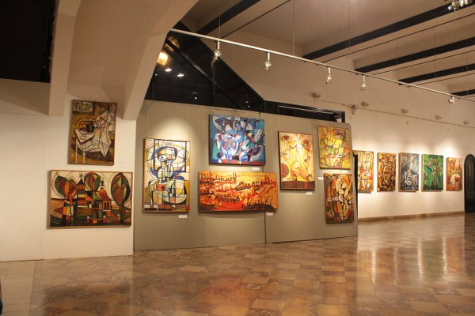
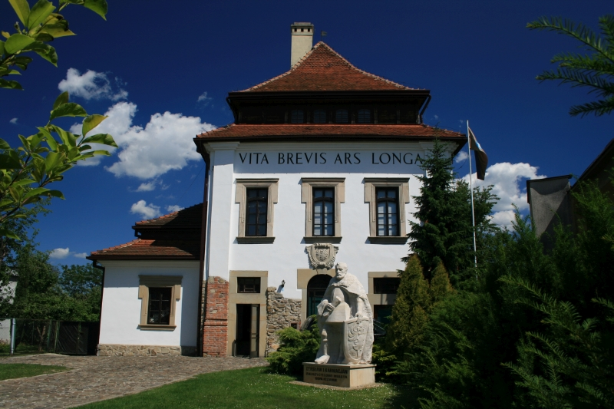
Manor of Karwacjanie and Gładysze
Karwacjanie were the first inhabitants of the manor and the founders of Gorlice in the 14th century. Currently, this building houses an art gallery and holds classical music concerts.

Slide 8
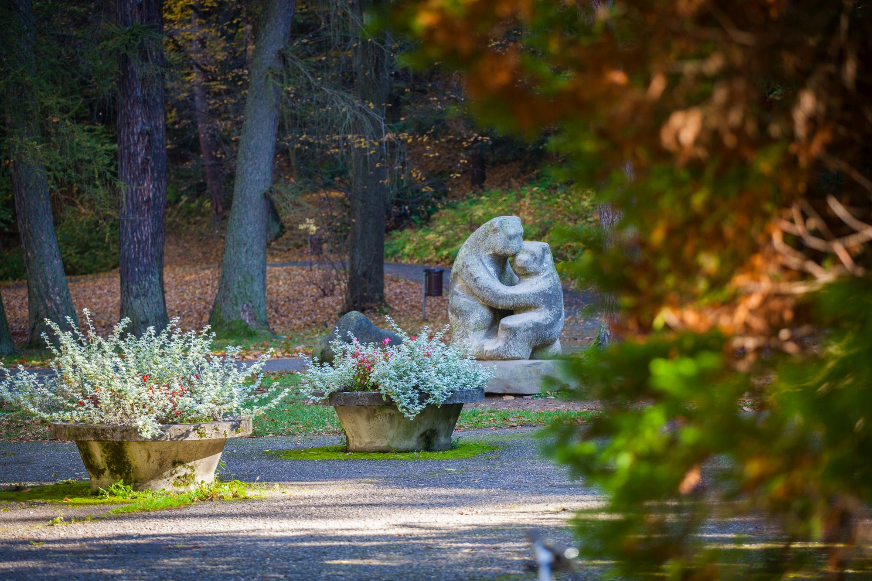
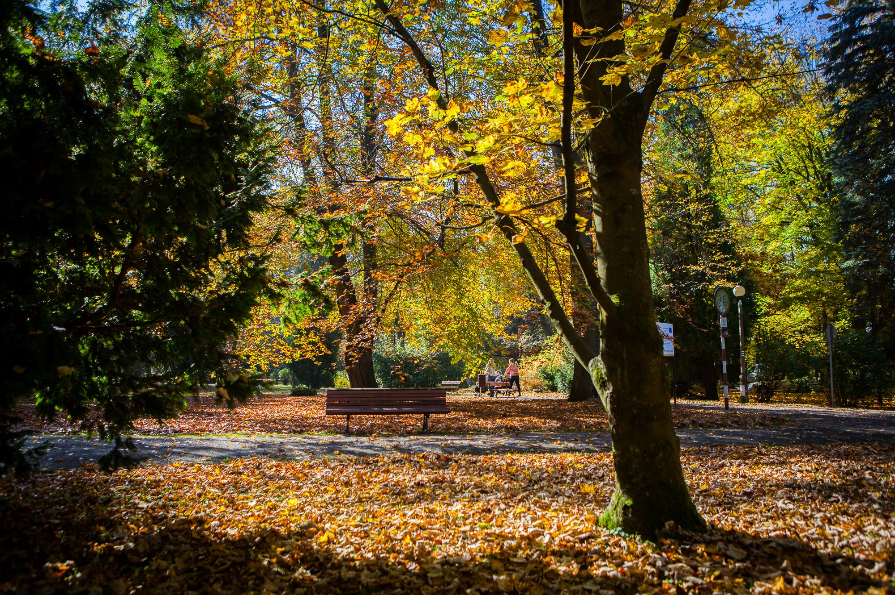
Park in Gorlice
The park covers a large area, as much as 20 hectares of land.
In the center of the park, there is a stone sculpture of two bears hugging each other, which was created in honor of the bears that, according to a local legend, freed the town from a curse.

Slide 9
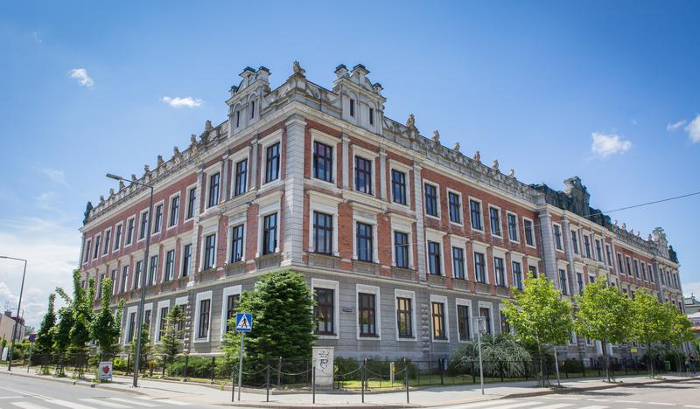
The history of the oldest secondary school in the Gorlice poviat dates back to 1906, when it was established by Franz Joseph. The school has about 800 students. The school has many faculties, including linguistic and media studies, biological and chemical, mathematical and physical, psychological and social, humanistic and many others. Sport in our school has been at a high level for many years, especially basketball and football. Now the school is being renovated.
Marcin Kromer Secondary School

Slide 10
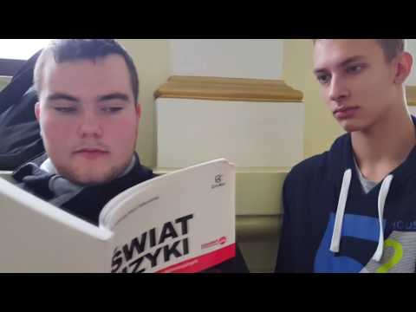
Recording from inside the school

Slide 11
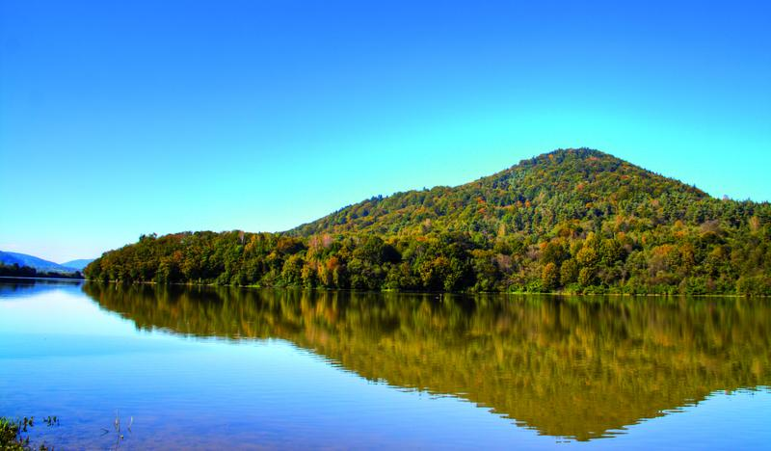
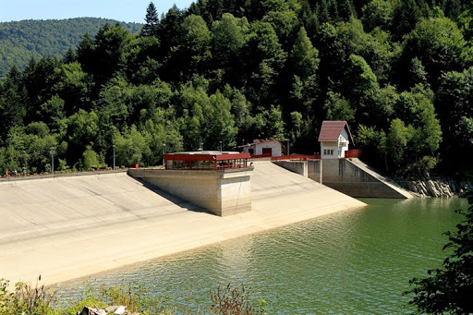
Klimkówka lake
The lake, hidden among the wild ranges of the Low Beskids, was created thanks to a dam separating the Ropa river. Klimkówka is an ideal solution for warm days.

Slide 12
SZYMBARK

Slide 13
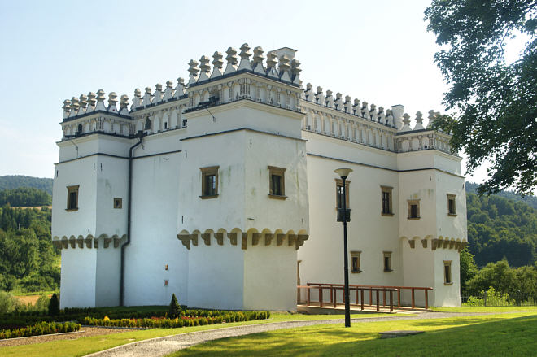
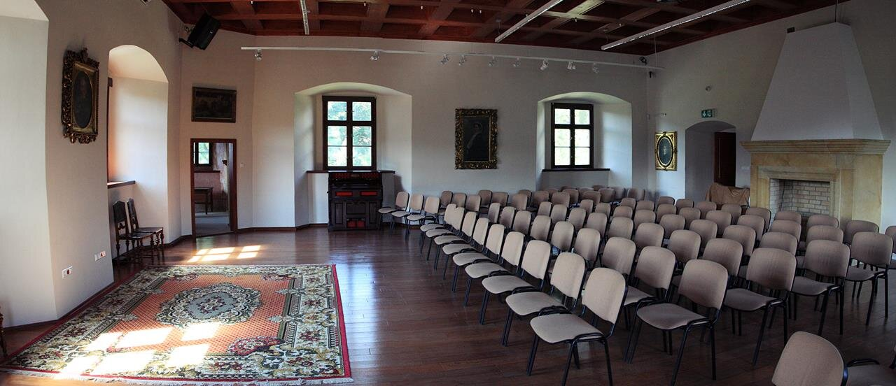
Castellum in Szymbark
The former seat of the Gładysz family is a very valuable monument of Renaissance architecture in Poland. Currently, exhibitions are organized there and the place is intended for tourists.

Slide 14
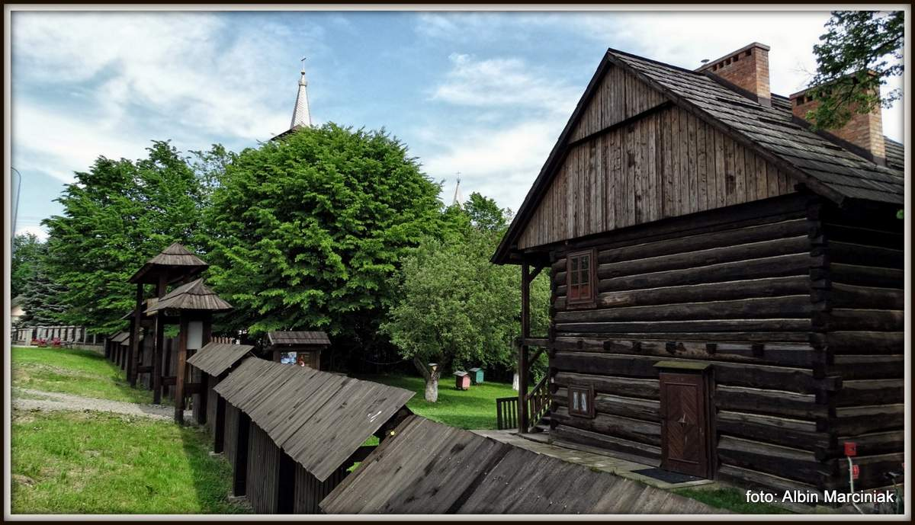
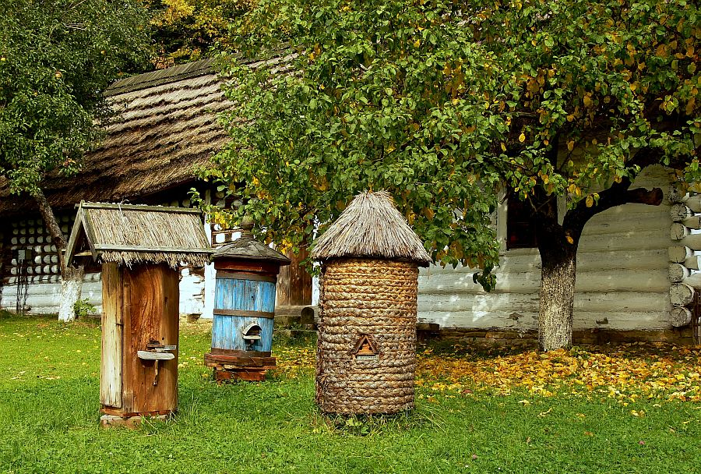
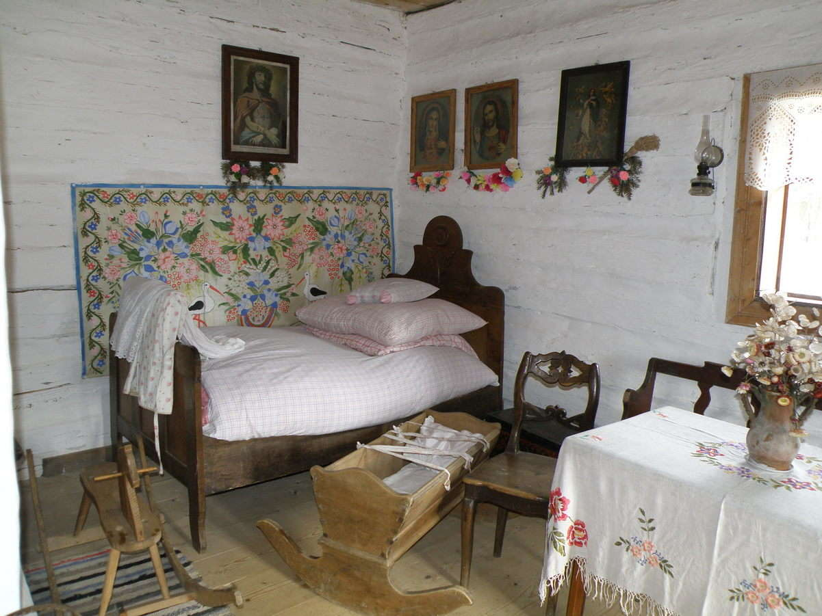
Szymbark - open-air museum of the Pogórze countryside
There are original farm buildings from the 19th / 20th century in the open-air museum. School trips and bonfires are organized there.

Slide 15
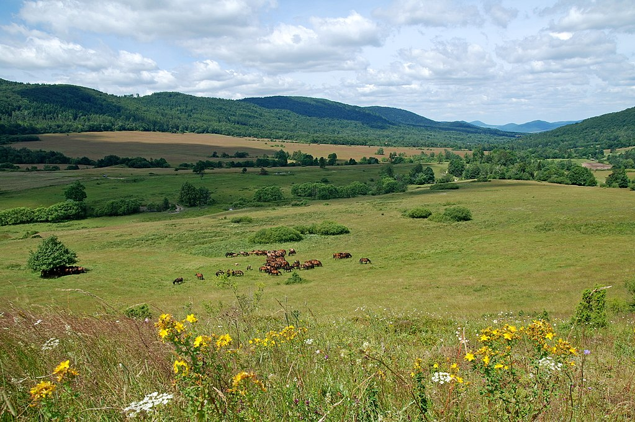
REGIETÓW

Slide 16
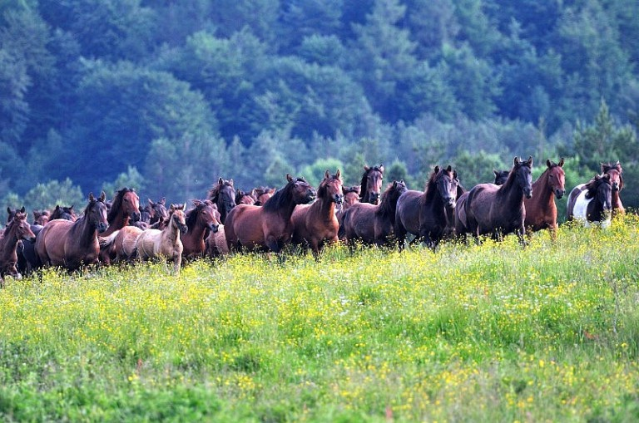
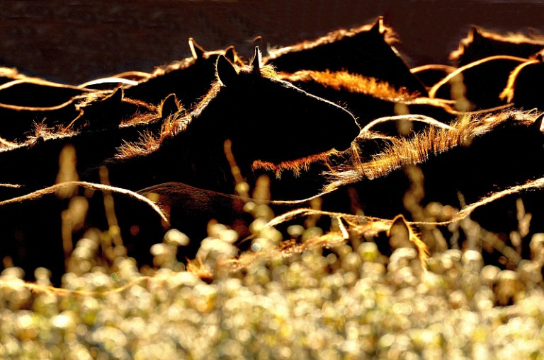
This village is famous primarily for horse studs. Currently the "Gładyszów" Hucul Horse Stud is the largest stud of this breed in Europe.
Hucul horses breeding

Slide 17
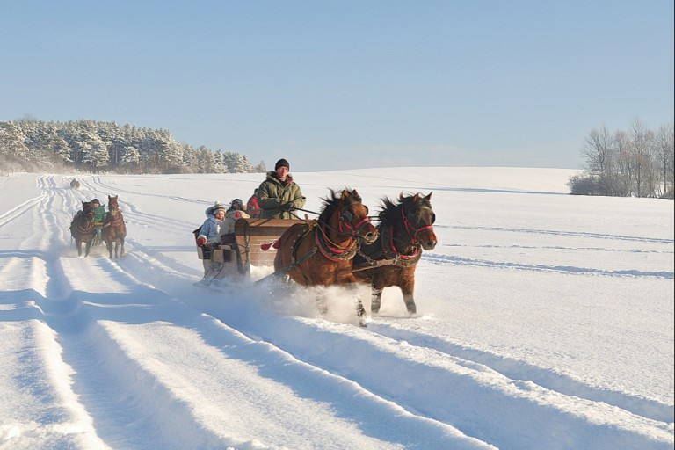
In winter, the stud also offers a sleigh ride "The Magical Land of Lemkos and Pogórzans" in Regietów.

Slide 18
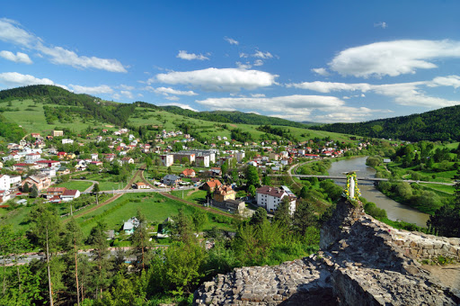
KRYNICA

Slide 19
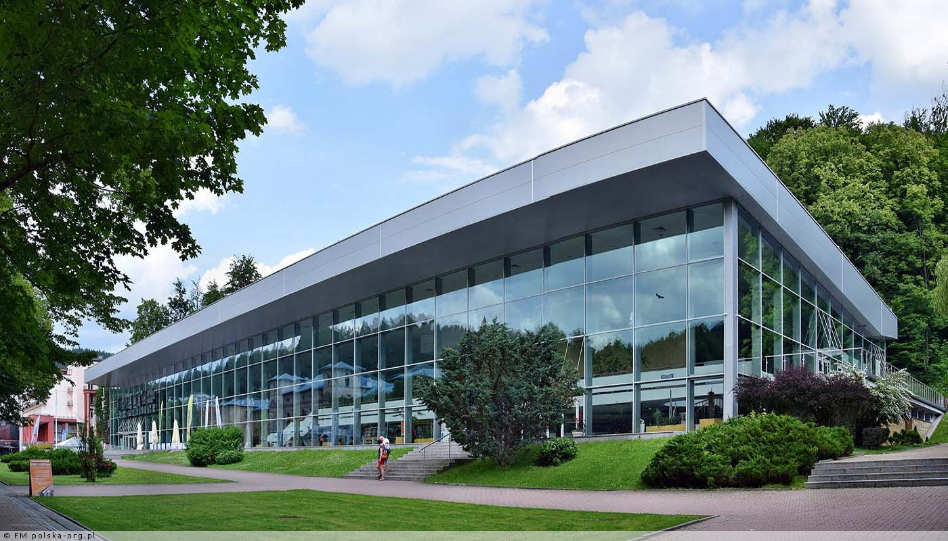
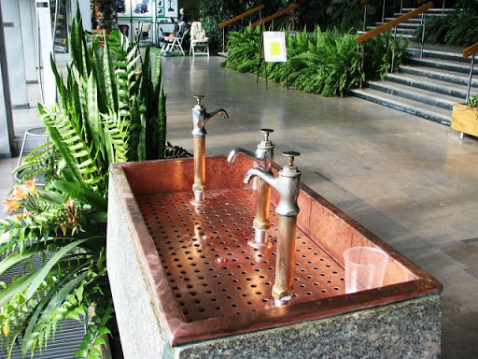
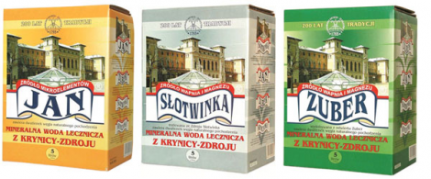
Mineral waters
The healing and mineral waters are the greatest treasures of the Krynica region. Their healing properties have been known for centuries. There is a pump room for healing waters in the centre of the town.

Slide 20
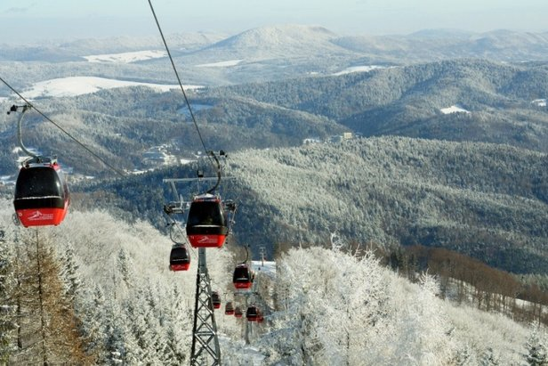
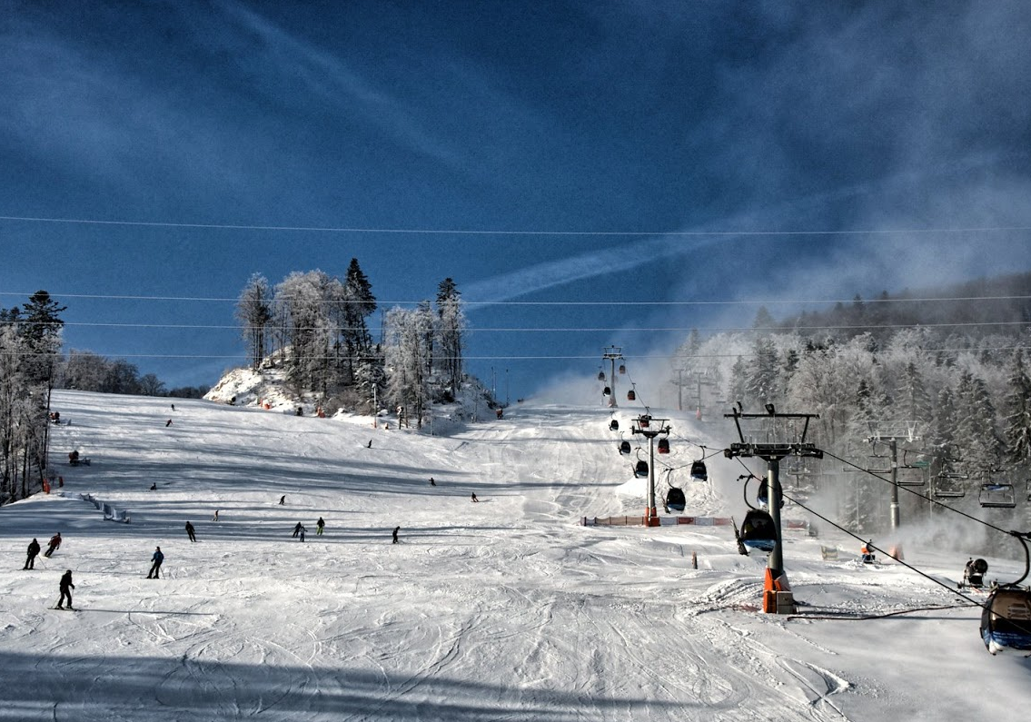
Jaworzyna Krynicka
There is a ski station in Jaworzyna Krynicka.
A modern gondola can take you up to the height of 1114 m.

Slide 21
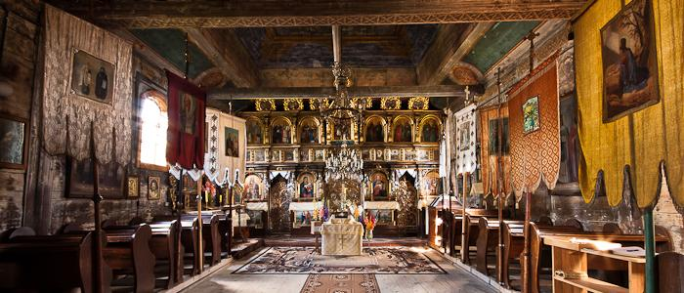
Wooden architecture trail

Slide 22
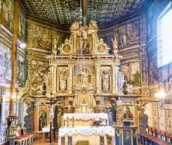
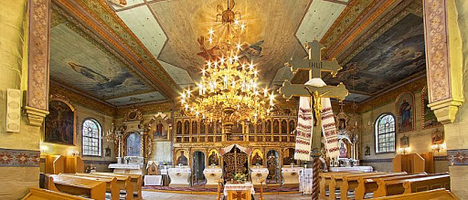
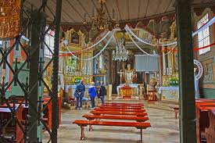
In our area there is the Wooden Architecture Trail entered on the UNESCO list. There are 252 historic churches and Orthodox churches.

Slide 23
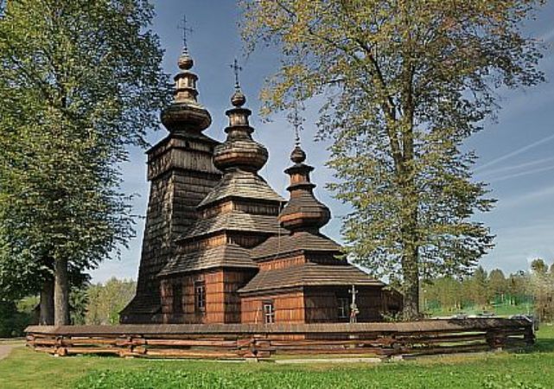
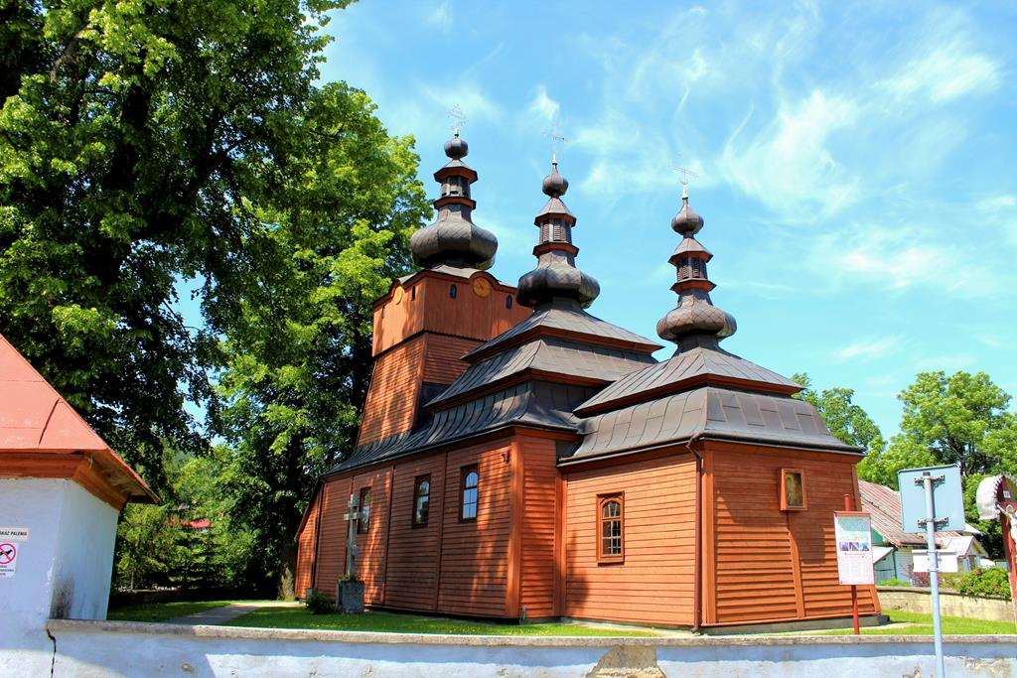
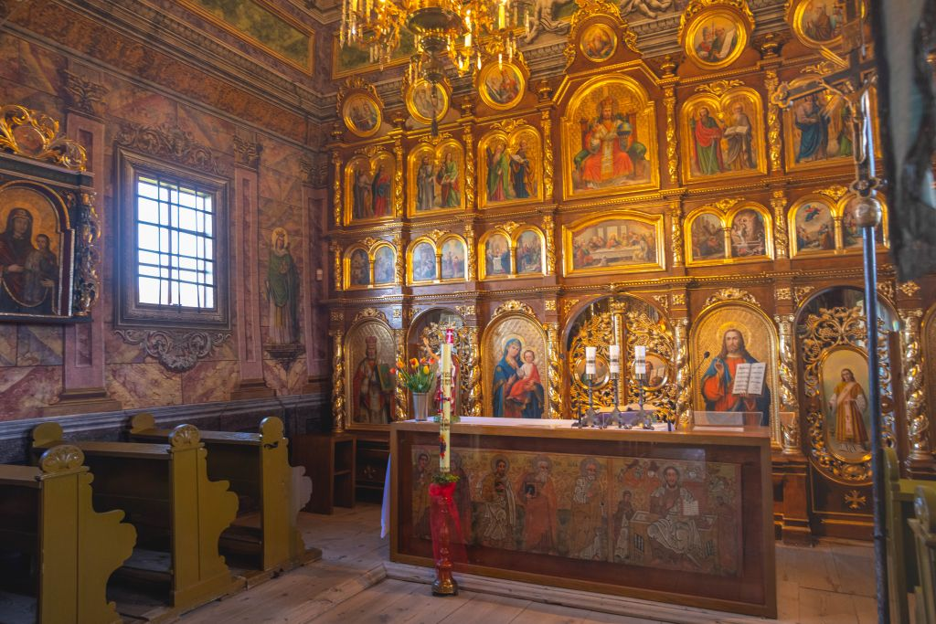
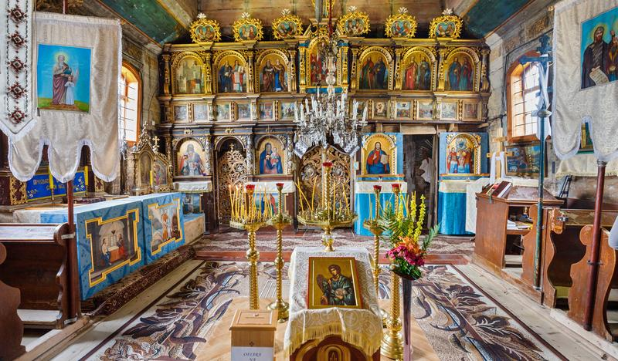
Church of St. Michael the Archangel in Wysowa
Greek Catholic Church of St. Paraskewia in Kwiatoń
Building in the neo-gothic style
Classic example of Łemkov orthodox architecture

Slide 24
Sources
https://www.google.com/search?q=panorama+Gorlice&sxsrf=ALeKk00JdB5JrHZeUeBtSry0K7Hshqj-uA:1610984440018&source=lnms&tbm=isch&sa=X&ved=2ahUKEwjPoKTa6KXuAhURi8MKHZF8AQUQ_AUoAnoECAMQBA&biw=1600&bih=735#imgrc=QbZtqTEK8m3ueM&imgdii=3d_2uCCbKb8jQM
https://pl.wikipedia.org/wiki/Bitwa_pod_Gorlicami
https://muzeum.gorlice.pl/oddzialy-muzeum/galeria-sztuki-dwor-karwacjanow/galeria-sztuki-dwor-karwacjanow
https://www.gorlice.pl/pl/353/0/gorlickie-legendy.html
http://www.parki.org.pl/parki-miejskie/park-miejski-im-wojciecha-biechonskiego-w-gor
https://www.gorlice.pl/pl/345/0/cmentarze-z-i-wojny-swiatowej.html
https://bip.malopolska.pl/iloimkwgorlicach
https://visitmalopolska.pl/pl_PL/obiekt/-/poi/liceum-ogolnoksztalcace-im-m-kromera-gorlice
https://visitmalopolska.pl/pl_PL/obiekt/-/poi/jezioro-klimkowka
https://pl.wikipedia.org/wiki/Pa%C5%82ac_w_Zag%C3%B3rzanach
https://gorlice24.pl/pl/19_wiadomosci_z_regionu/652_gmina_gorlice/7169_zagorzany-zespol-palacowo-zamkowy-szuka-nowego-wla-ciciela.html
https://mapio.net/a/114503638/
http://www.zamkipolskie.com/szymb/szymb.html
https://klubpodroznikow.com/relacje/polska/skanseny/2166-skansen-w-szymbarku
https://pl.wikipedia.org/wiki/Regiet%C3%B3w
http://www.huculy.com.pl/
http://www.krynica.pl/Muszyna-a131.html
https://www.onthesnow.co.uk/lesser-poland/krynica-jaworzyna-krynicka/ski-resort.html
https://www.twojakrynica.pl/uzdrowisko/wody-mineralne-lecznicze-krynicy/
https://www.krynica.net/blog/na-stokach-narciarskich-ma-byc-bezpieczniej/
http://www.pttkgorlice.pl/o-nas/szlaki-turystyczne/#szlaki
https://www.gorlice.pl/pl/325/0/szlak-architektury-drewnianej.html
http://www.drewniana.malopolska.pl/?page=obiekty&id=94
https://pl.wikipedia.org/wiki/Ignacy_%C5%81ukasiewicz
http://eugeniuszgerlach.blogspot.com/2012/01/eugeniusz-gerlach-wystawa-malarstwa.html
http://www.polskaniezwykla.pl/web/place/44820,klimkowka-zapora-na-klimkowce.htm

Slide 25
THANK YOU FOR WATCHING

