Slide 1
Agrotourism in Poland
GORLICE DISTRICT

Slide 2
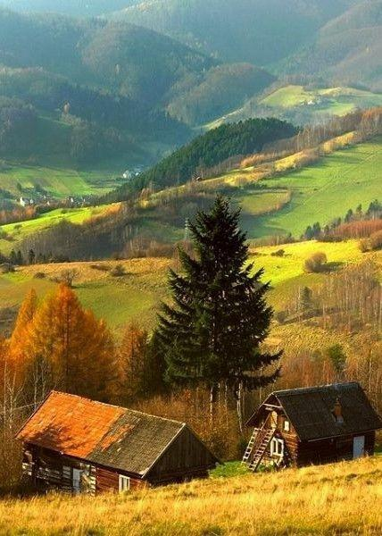
AGROTOURISM IN OUR REGION
This type of recreation is very popular in our country. Many people living in cities prefer to go to the countryside to experience a moment of silence

Slide 3
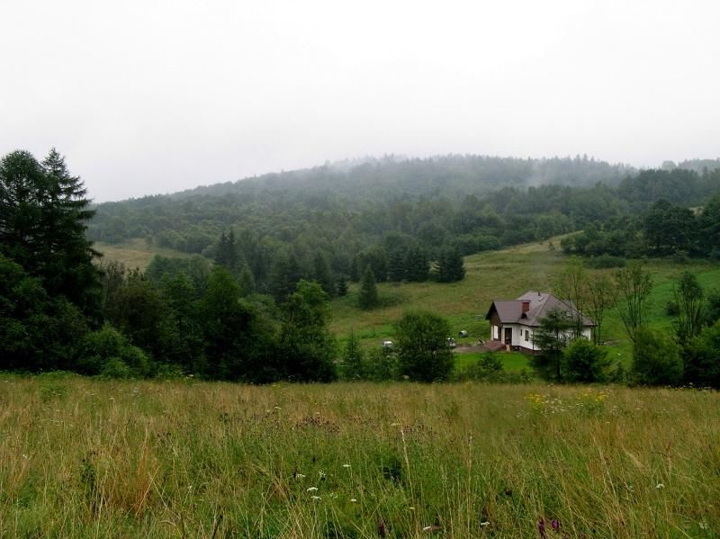
AGROTOURISM IN OUR REGION
BUCZYNOWA DOLINA

Slide 4
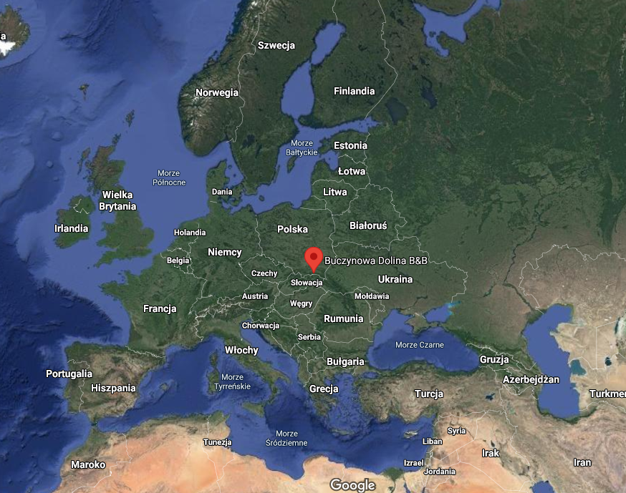
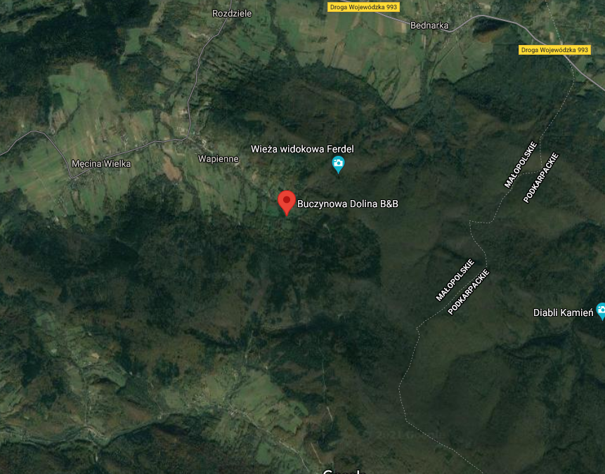
LOCATION

Slide 5
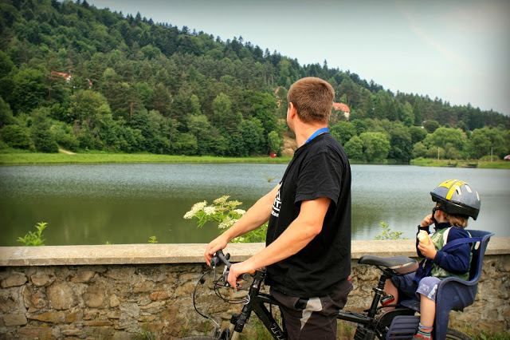
BUCZYNOWA DOLINA
Buczynowa Dolina is located near the Magura National Park. Hiking trails start right behind the house, so you can go hiking, biking, trekking poles, or Nordic-walking.

Slide 6
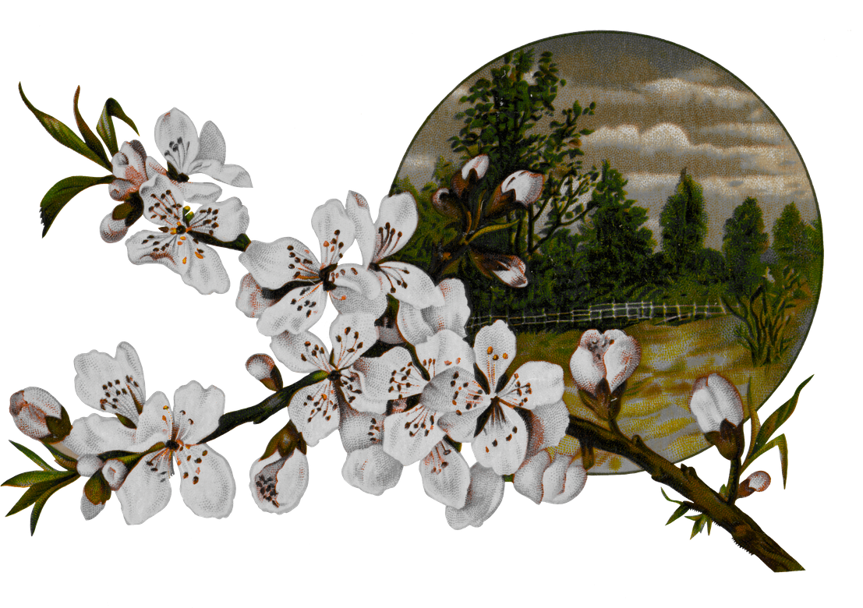
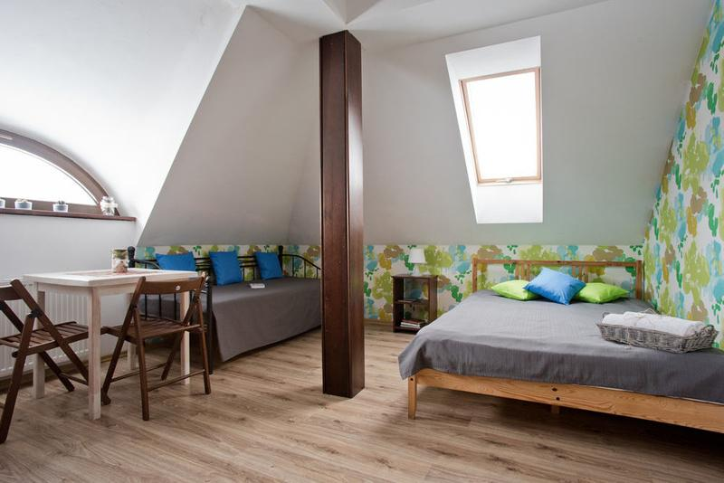
ROOMS AND SERVICE
ROOMS
Buczynowa Dolina offers up to 7 large rooms. In each room you will find comfortable beds, table and chairs, closet and of course bathroom
SERVICE
There will always be a staff member waiting to welcome you at the door, show you around and make sure you have the best possible rest

Slide 7
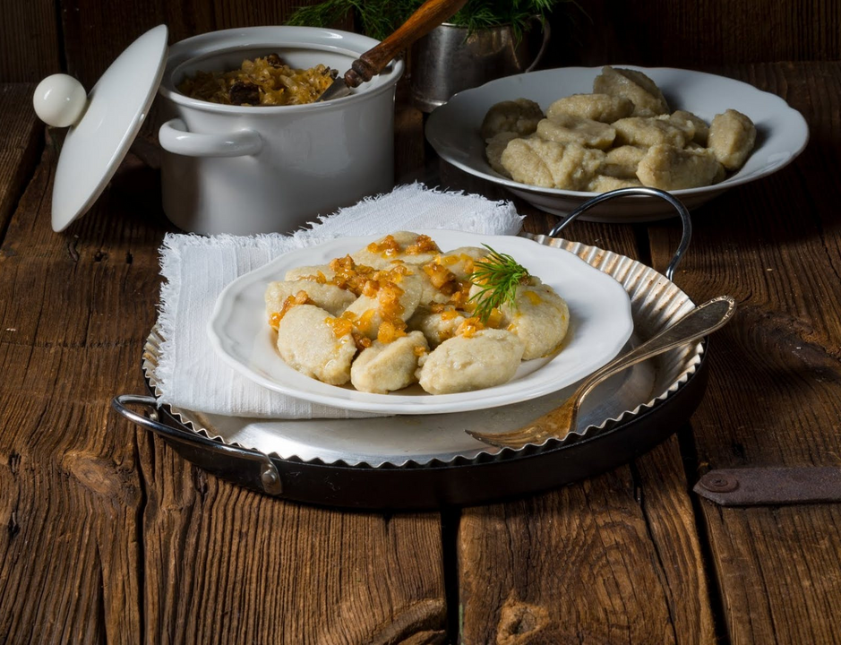
FOOD
DURING YOUR STAY YOU CAN TRY MANY REGIONAL DISHES

Slide 8
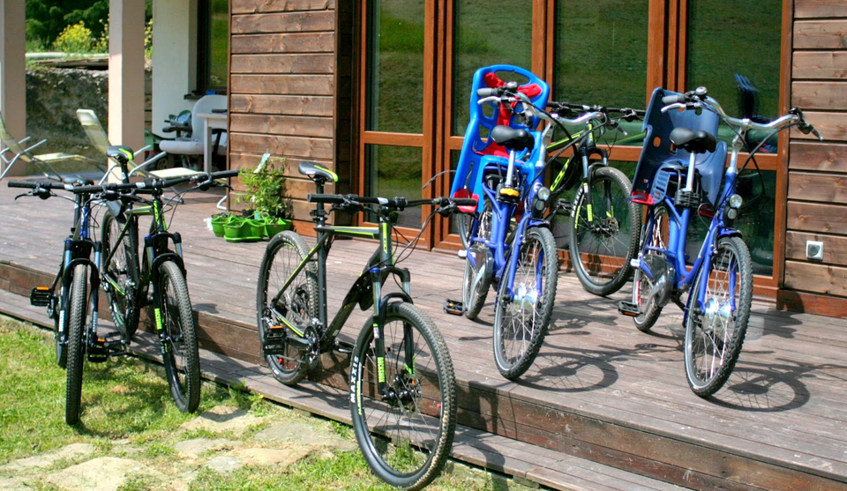
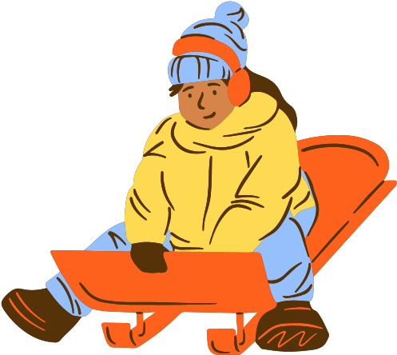
ACTIVE RECREATION
In the area of the complex it is possible to rent bicycles, sledges, cross-country skis and deck chairs

Slide 9
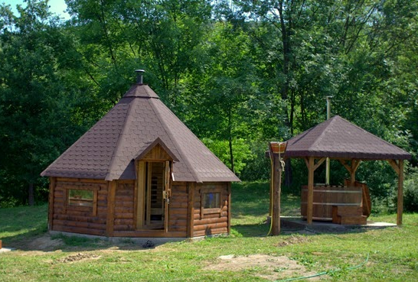
BUCZYNOWA SPA
RIGHT NEXT TO THE VILLAGE THERE IS A SMALL SPA COMPLEX
At the local spa you can enjoy a massage or sauna

Slide 10
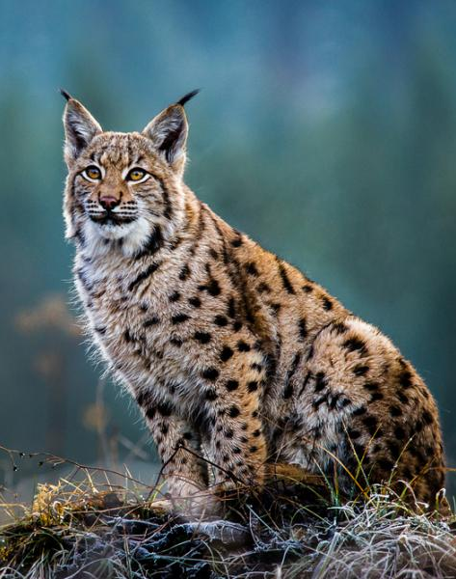
MAGURA NATIONAL PARK
The complex is very close to the national park area, the staff offers a wide range of maps of the trails leading through the park. During the visit to the park we can meet a rare lynx.

Slide 11
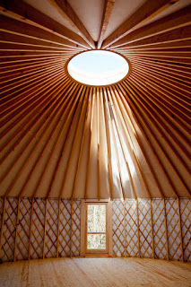
WORKSHOP LOCATION
There is a Yurt, a workshop space where you can attend various classes such as yoga, dance, massage, or conduct your own workshops

Slide 12
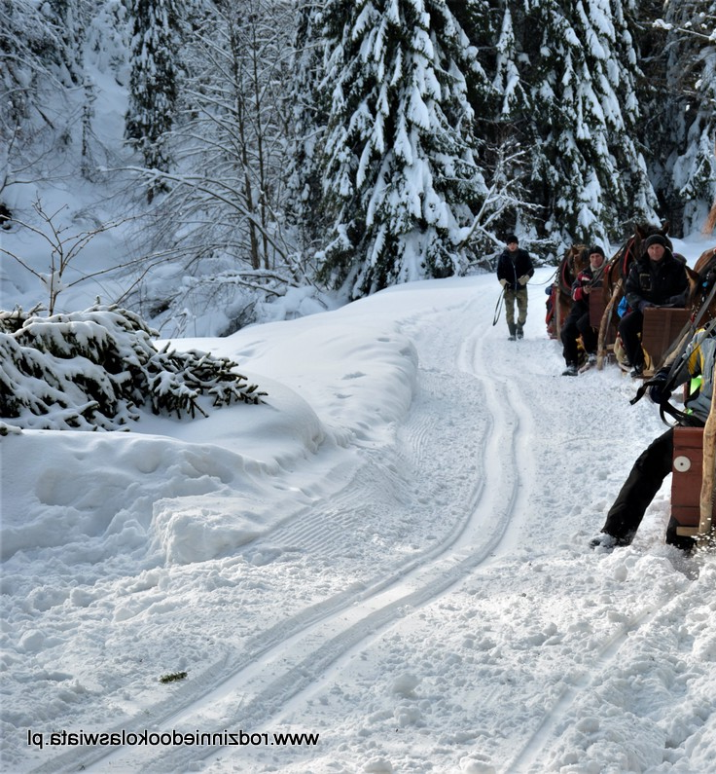
SEASONAL OFFERS
While booking your stay, you can take advantage of seasonal packages that include additional attractions, for example in winter you can go on a sleigh ride and in summer go to the lake

Slide 13
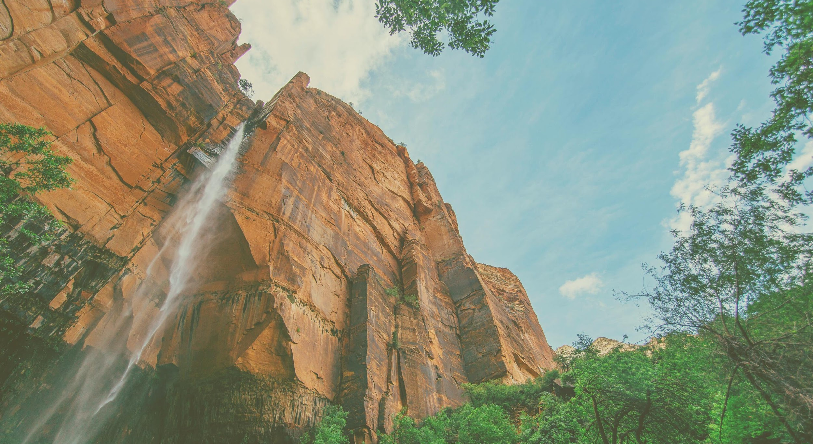
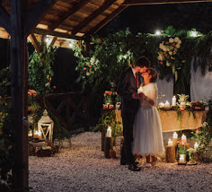
ADDITIONAL SERVICES
Intimate weddings and various celebrations is a specialty of Buczynowa Dolina. Within the complex you can have a wedding party and the wedding itself in a climatic church.

