Slide 1
Agritourism in the Beskid Niski Mountains

Slide 2
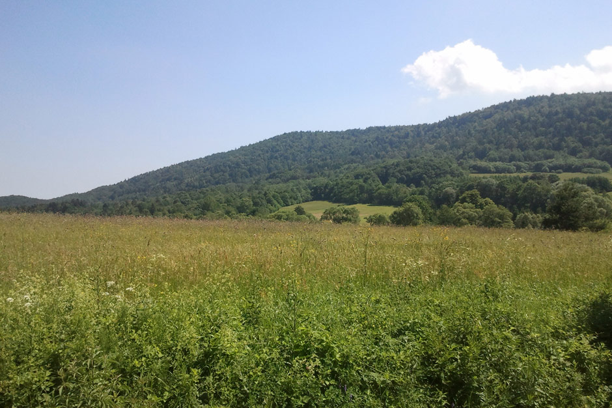
Beskid Niski Mountains

Slide 3
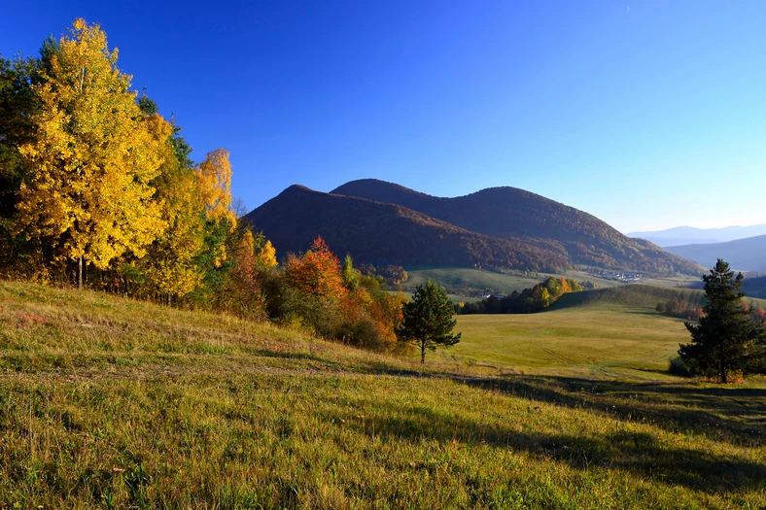
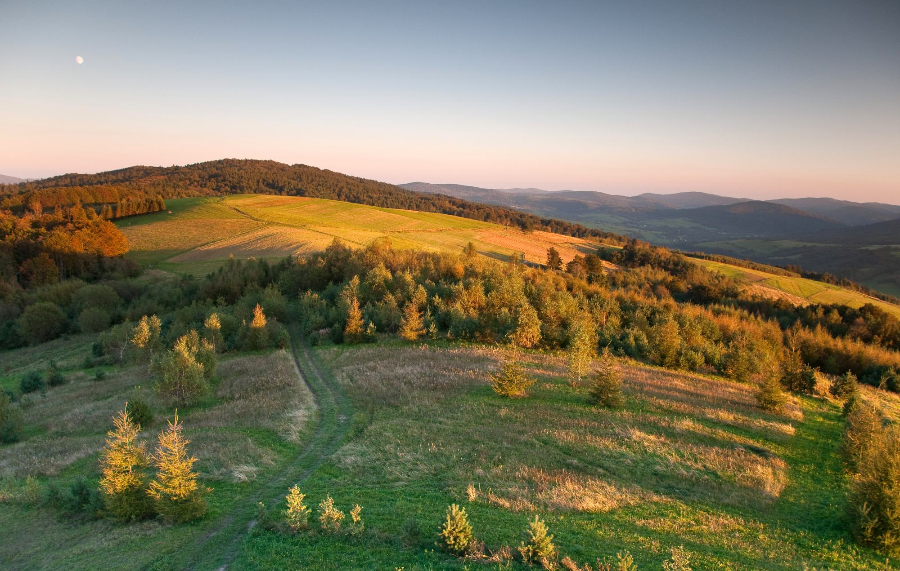
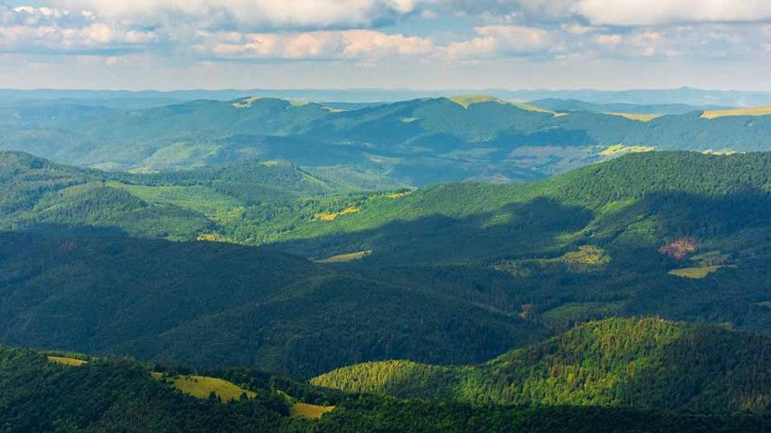
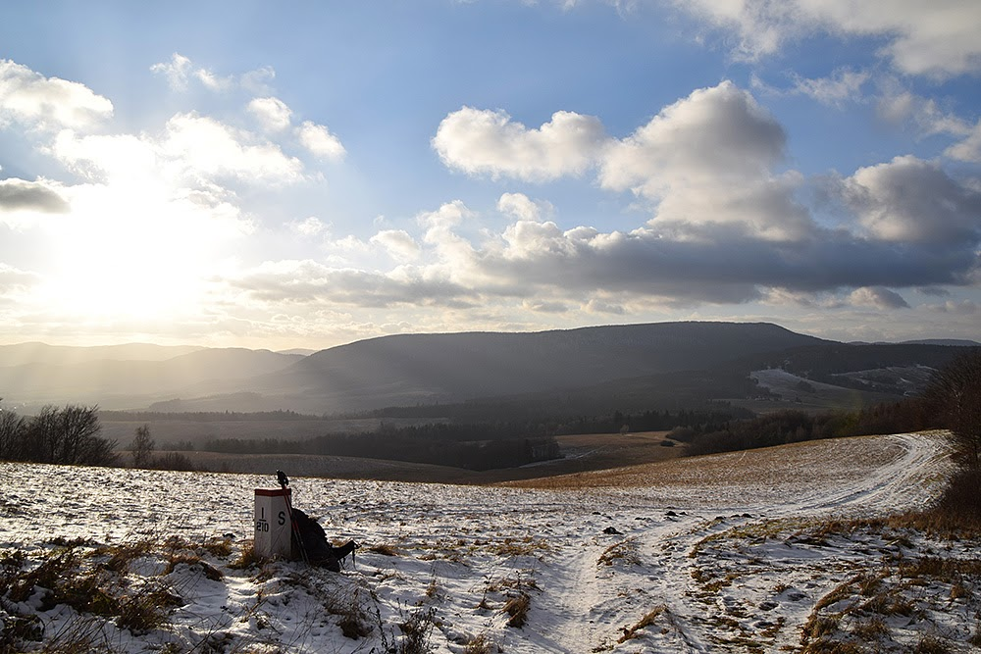

Slide 4
The landscape of the Beskid Niski Mountains is a unique harmony of the beautiful, wild nature and historical heritage of various cultures. It’s still an undiscovered part of the country.

Slide 5
”Skrawek Nieba” “A piece of heaven”

Slide 6
”Skrawek Nieba”
“A piece of heaven”
”A piece of heaven’’ is located in the very heart of Beskid Niski and provides a comfortable relaxation for families. This intimate place is situated in a picturesque village of Łosie near Klimkówka Lake and the Magurski National Park. It’s a place for all those who want to get away from the hustle and bustle of the city as well as lovers of untouched nature, home made food, the warmth of a fireplace, peace and quiet.

Slide 7
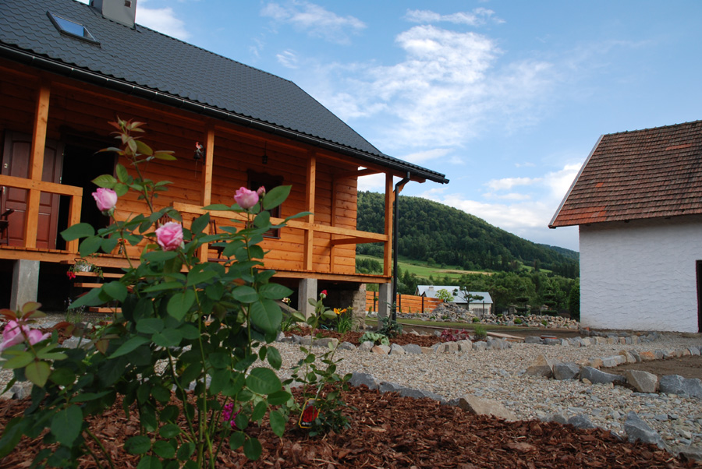
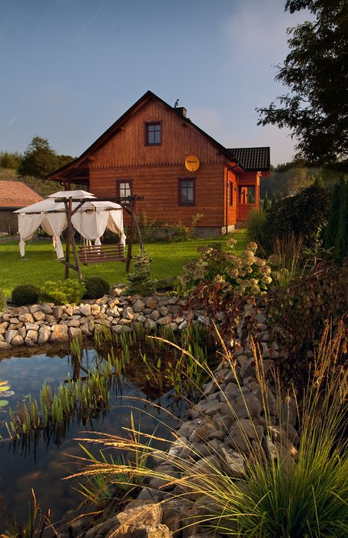
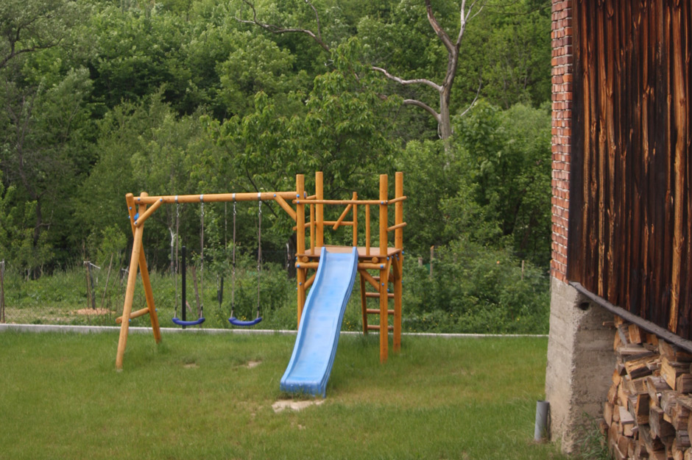

Slide 8
Accommodation offer
The house is located on a fenced property in a beautiful garden with a pond. There is also a playground for children, a bonfire place, a vegetable and herbal garden as well as a parking lot.

Slide 9
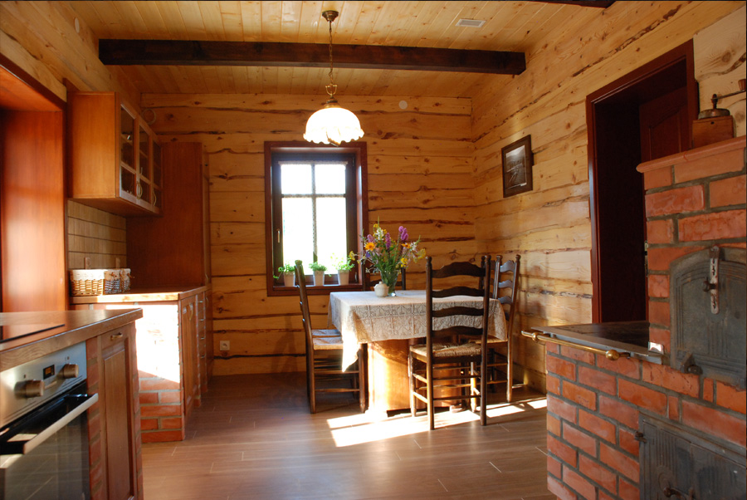
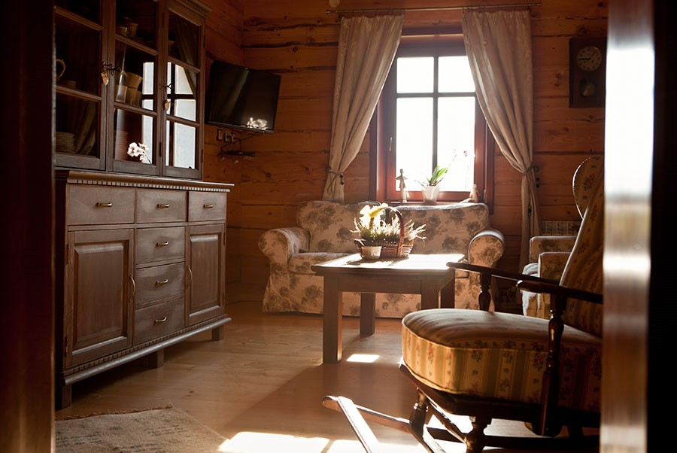
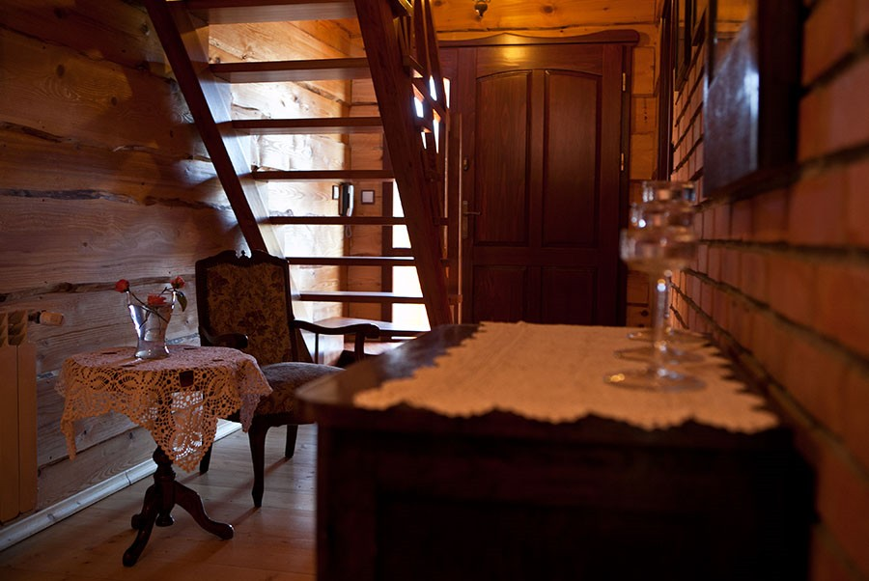
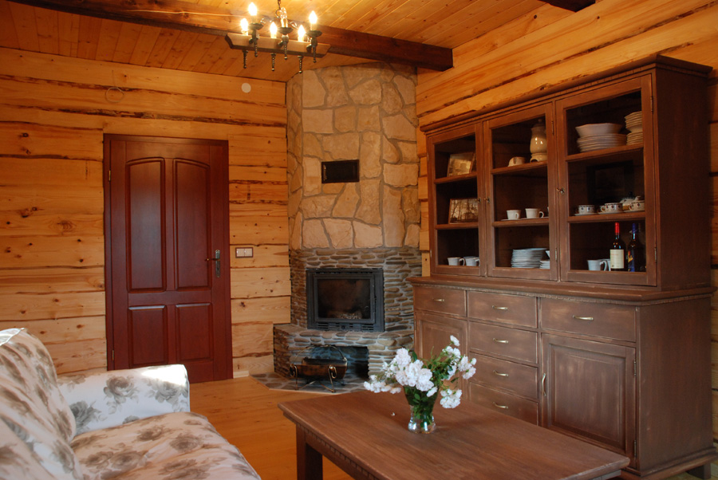

Slide 10
The farm offers comfortable double, triple and four-bed rooms, all of them with bathrooms. There is also a living room with a fireplace, a bookcase and a TV set. You can also use the kitchen with a dining room and a roofed porch.

Slide 11
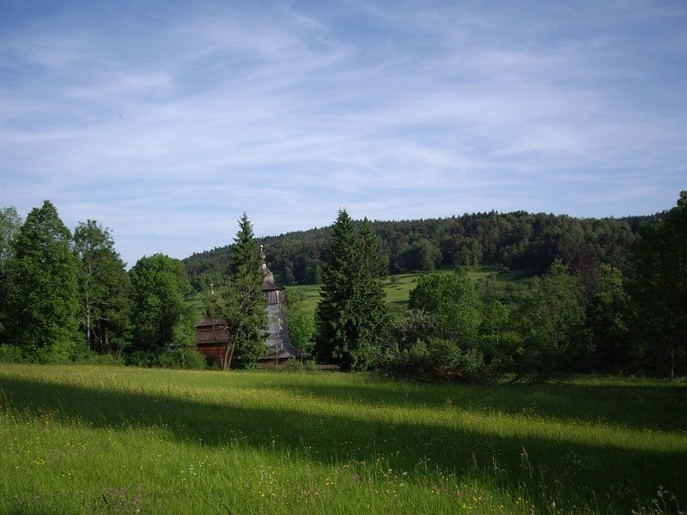
Agritourism Wołowiec 8

Slide 12
About Wołowiec 8
There are sets of beehives and you can help to take care of them.
There’s also a volleyball court.
You can cook over the fire at the cozy fireplace. For example, you could try cooking lamb from the Wołowiec eco-friendly farm.
There’s an enormous bathtub, in which you can relax.
You can truly feel like you are part of nature in Wołowiec 8. For example, you can learn how to look after the animals living on the farm.

Slide 13
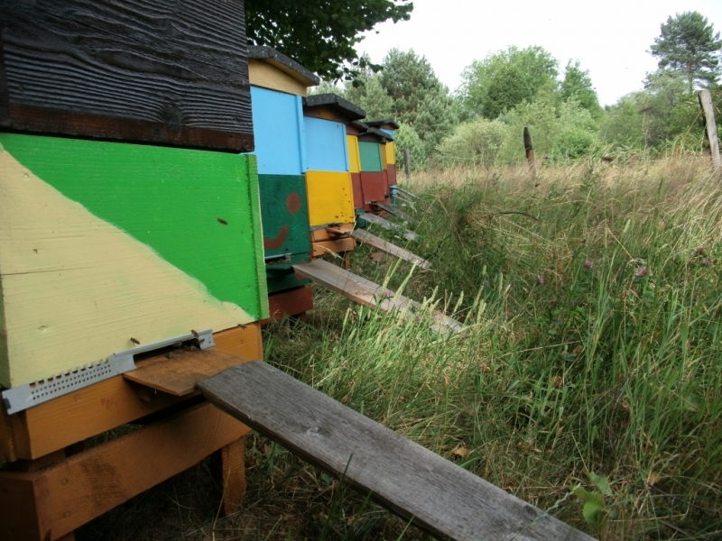
Beehives

Slide 14
Animal’s enclosure

Slide 15
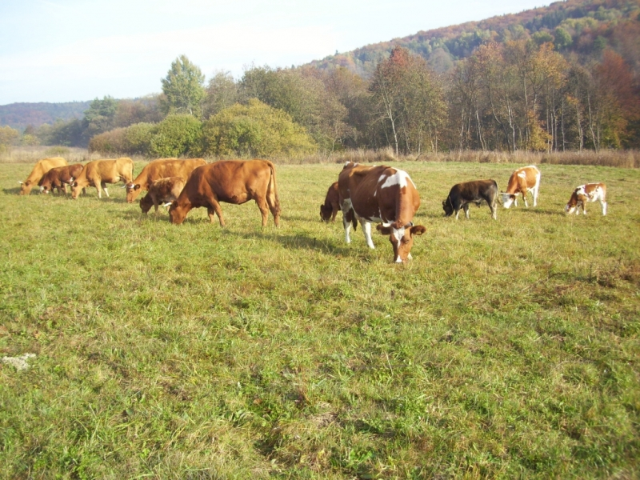

Slide 16
The fireplace

Slide 17
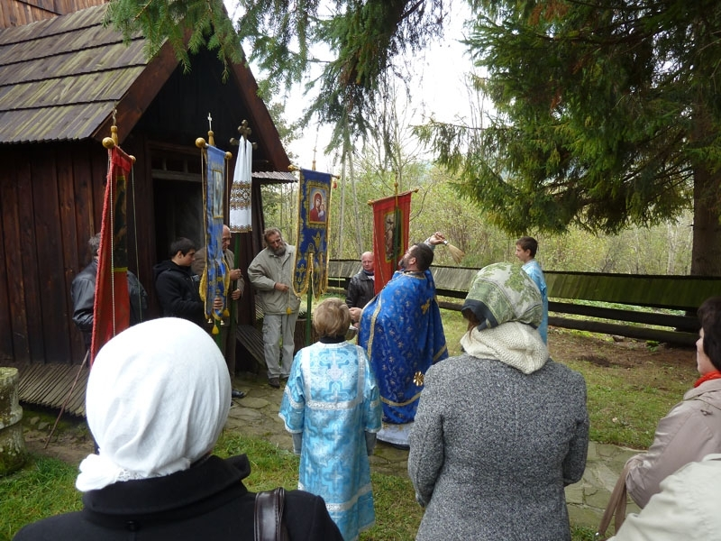
Hosts of Wołowiec 8.
Their family has lived in Wołowiec for generations. They receive visitors for the whole year and they always offer some traditional food for their guests. Hosts are Lemkos, which means that they are an ethnic minority and they will be glad to tell you about them. They guarantee that your leisure time spent at the farm will be quiet and peaceful.

Slide 18
What accommodation is offered?
You can rent from a double room up to a 4-bed room.
Kids under 5 can stay a night for free, while the adults have to pay from 40 to 50 zł per day and if you bring a dog or a cat with you, you have to pay additional 10 zł.
You can negotiate the price if you want to stay for a longer period.
The rustic look of the rooms can make you feel as if you were travelling in time.

Slide 19
Inside of a house

Slide 20
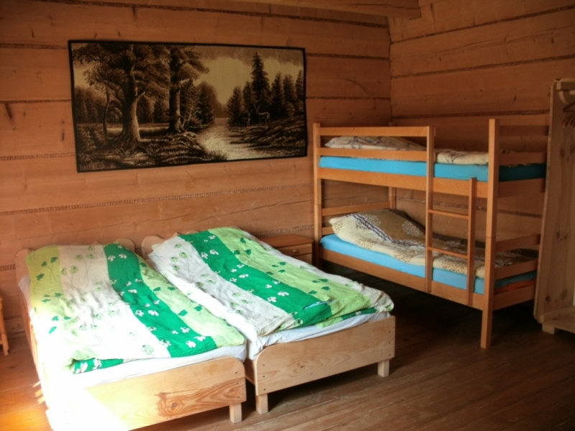

Slide 21
The nearby area
There are a lot of places worth visiting in the area of those two farms:

Slide 22
Nowica

Slide 23
The farm is only 7 kilometers from the village of Nowica near Magura Małastowska. What makes this village so unique is its location, original old buildings, a total lack of telephone connection or any trade infrastructure. You will feel there like in a real open air museum pulled away from the hustle and bustle of civilization. In May there are organized one of its kind theatrical meetings “Innowica”.

Slide 24
Magura Ski Station

Slide 25
“A piece of heaven” is a perfect starting point for skiers. The Magura Ski station is 15 kilometers from there. It is equipped with a chair lift and a 1400-meter-long slope. The slope is lit, artificially snow-covered and groomed. The station has a parking lot, equipment rent and catering facilities.

Slide 26
The Hucul Pony Stud Farm in Regietów

Slide 27
The Hucul Pony Stud Farm in Regietów, which is only 20 kilometers from the farm is the biggest in the country. It offers many attractions for the horse riding enthusiasts, such as participating in horse rides along the marked riding trails or traditional sleigh rides. Horses from the stud took part in many films, for example “Ogniem i mieczem” (With fire and with sword”).

Slide 28
The Klimkówka Lake

Slide 29
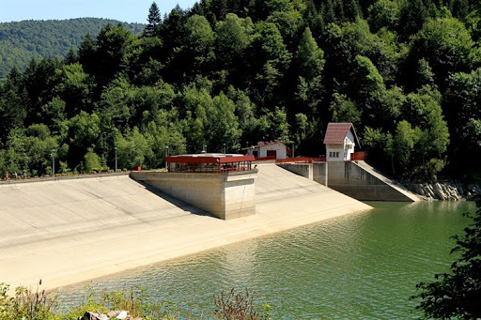

Slide 30
Klimkówka is an artificial lake created as a result of the accumulation of the Ropa river by the dam. Part of the Klimkówka reservoir and the dam is in the village of Łosie.The amazing landscapes make Klimkówka Lake a very attractive place. There are a few places where you can hire water equipment, campsites, parking places and catering facilities.

Slide 31
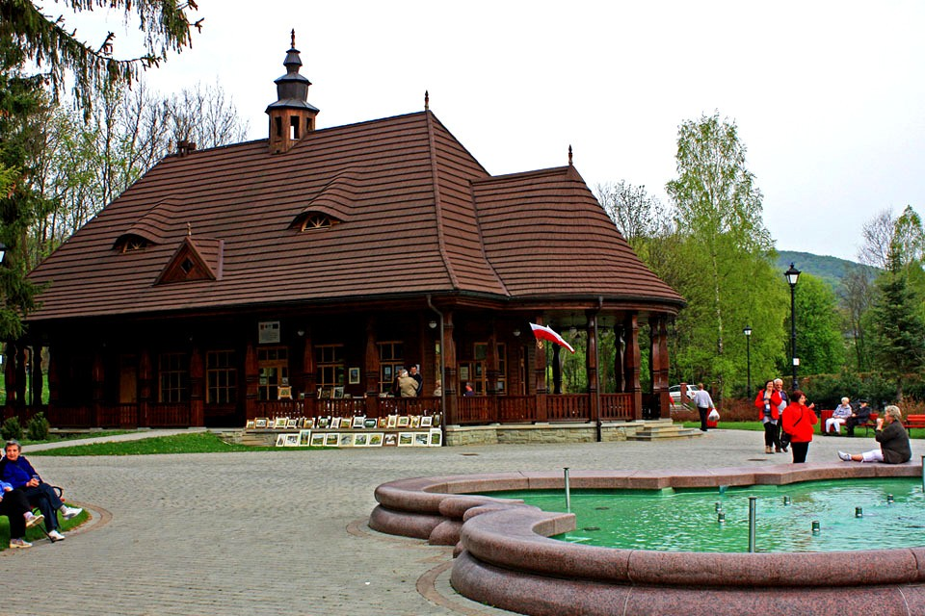
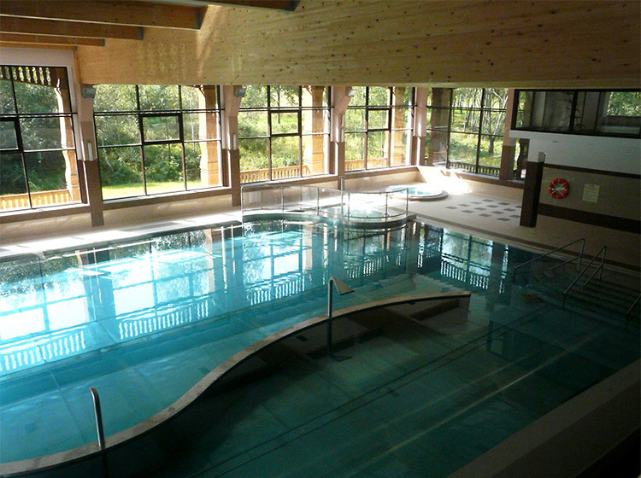
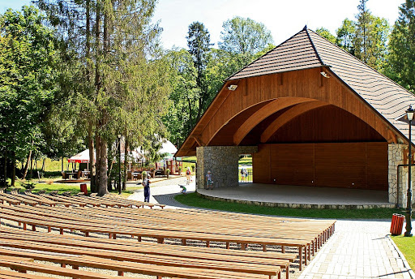

Slide 32
Wysowa Zdrój
It takes 20 kilometres to relax in Wysowa Zdrój: a well-maintained and beautifully situated spa, known for its mineral therapeutic waters. One of the most favorite places for a walk in Wysowa is its beautiful park, where you can find an amphitheatre and the stylish mineral water pump room reconstructed in 2005. The most recent attraction is a water park.

Slide 33
Thanks for watching
submitted by Hanna Karp and Oskar Górowski within the framework of Erasmus+ project ‘Let’s Talk About Soil’.

