Slide 1






LET'S INTRODUCE…

Slide 2
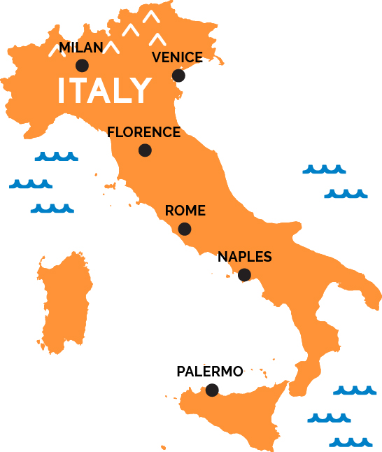
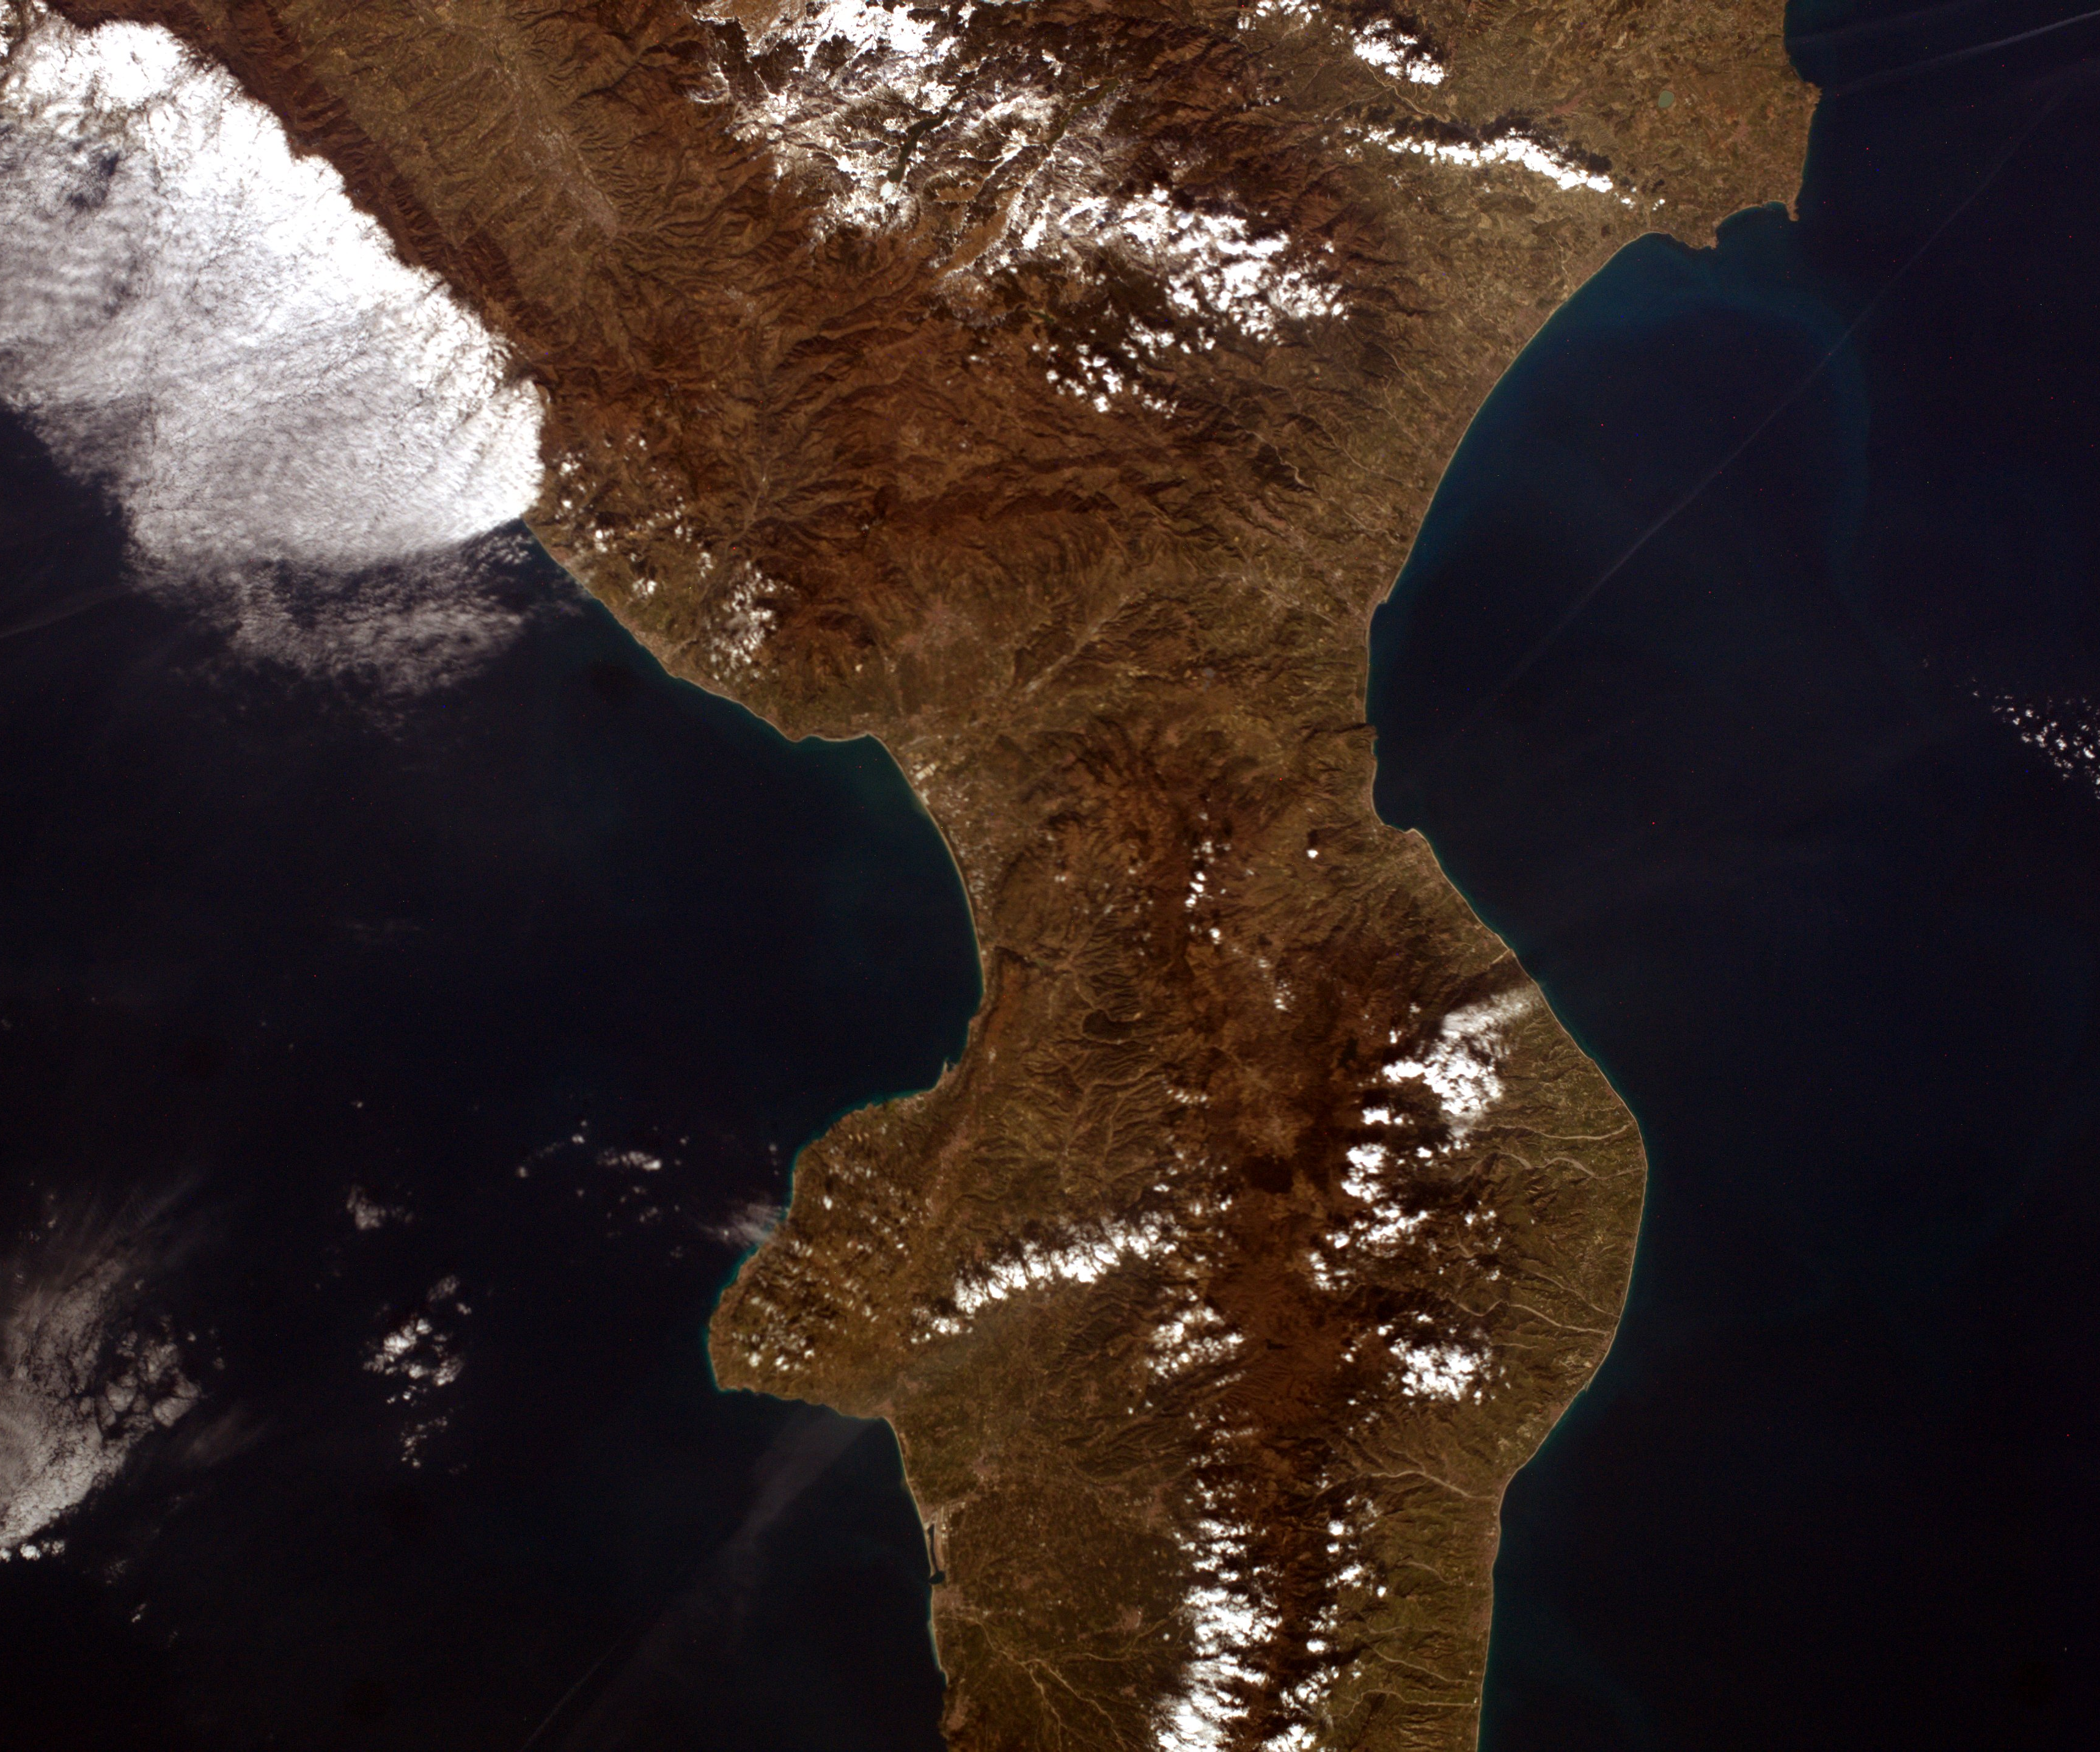
COSENZA
Heartkam recent picture of Calabria

Slide 3
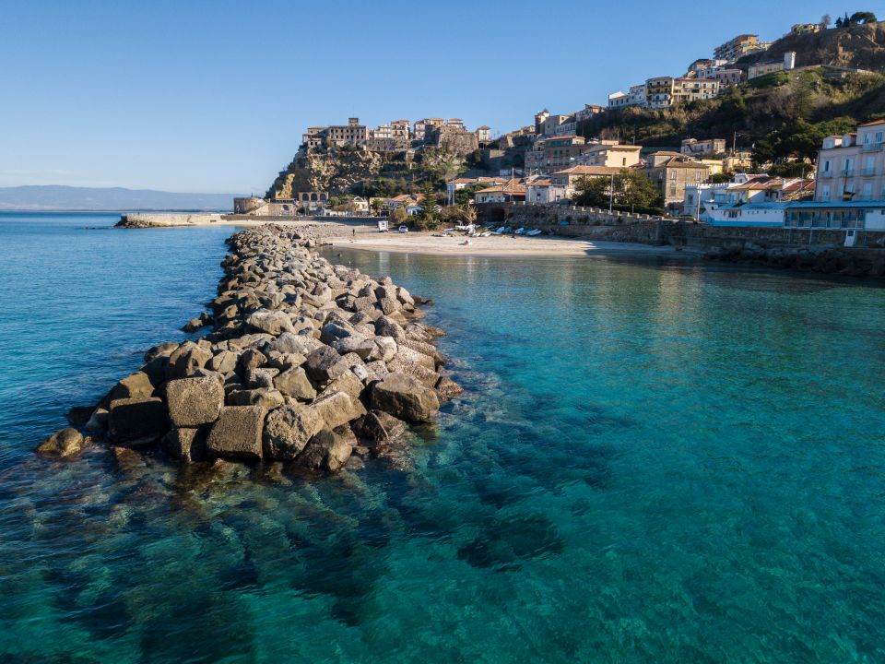
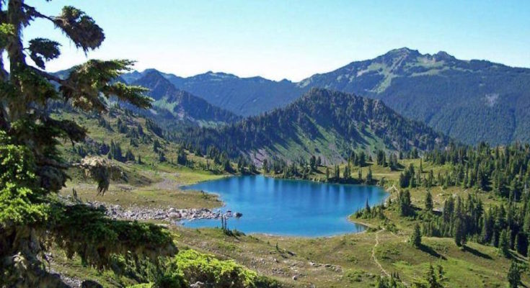
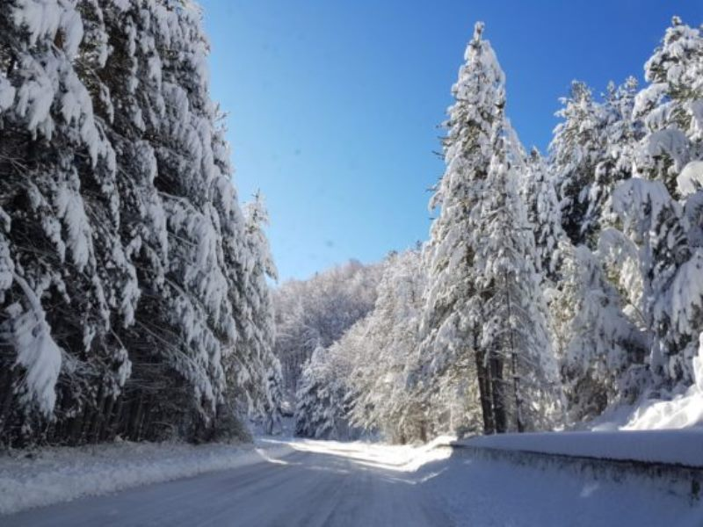
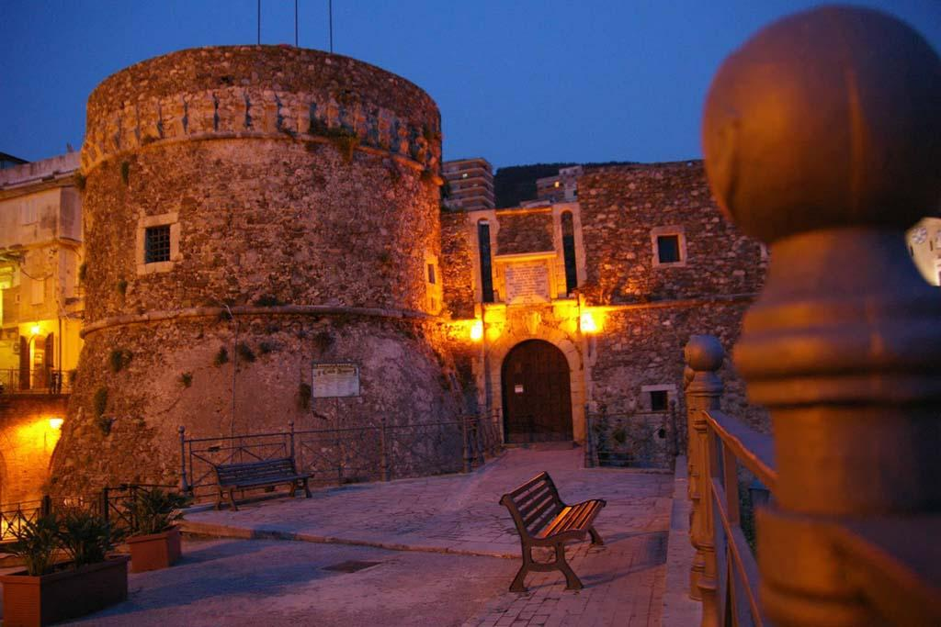
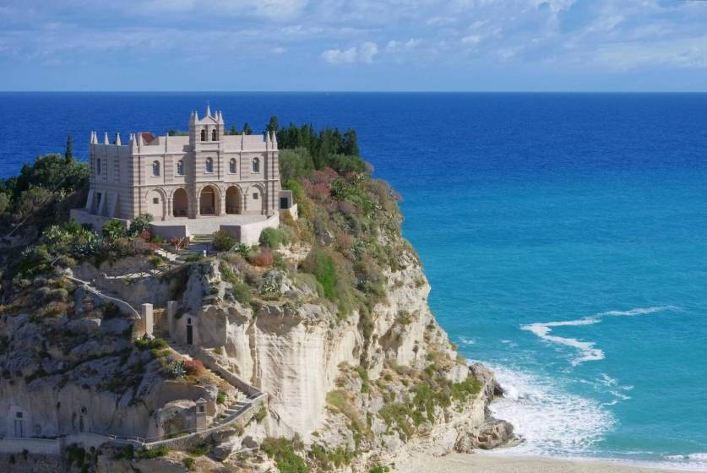
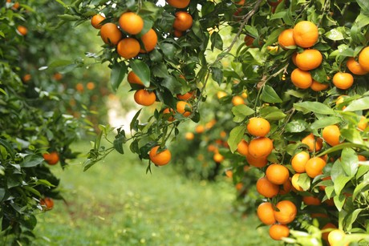
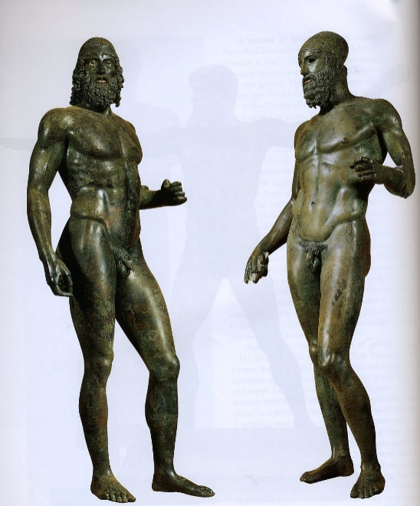
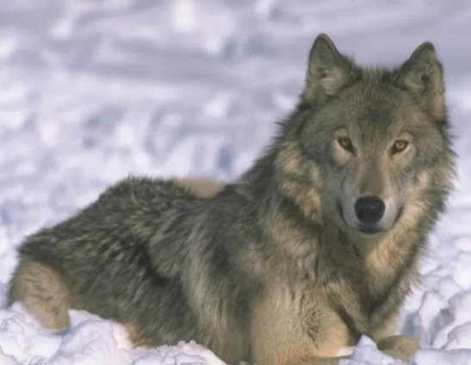

Slide 4
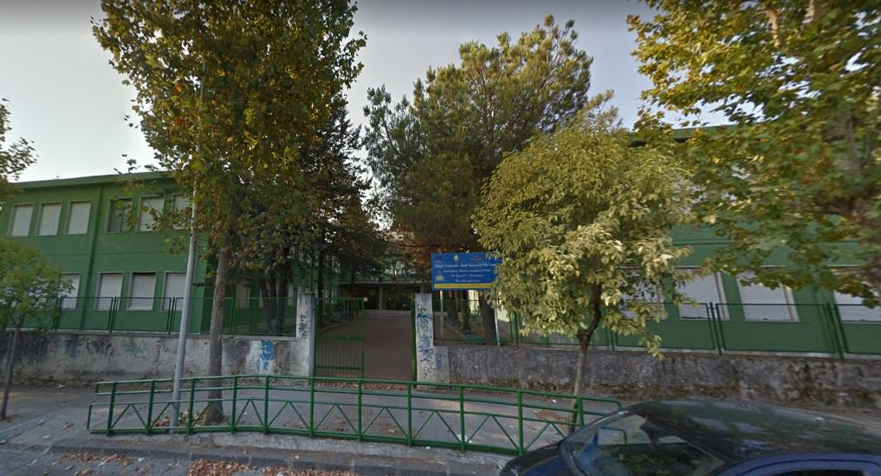
Our School: I.C. Cosenza III – Via Negroni

Slide 5
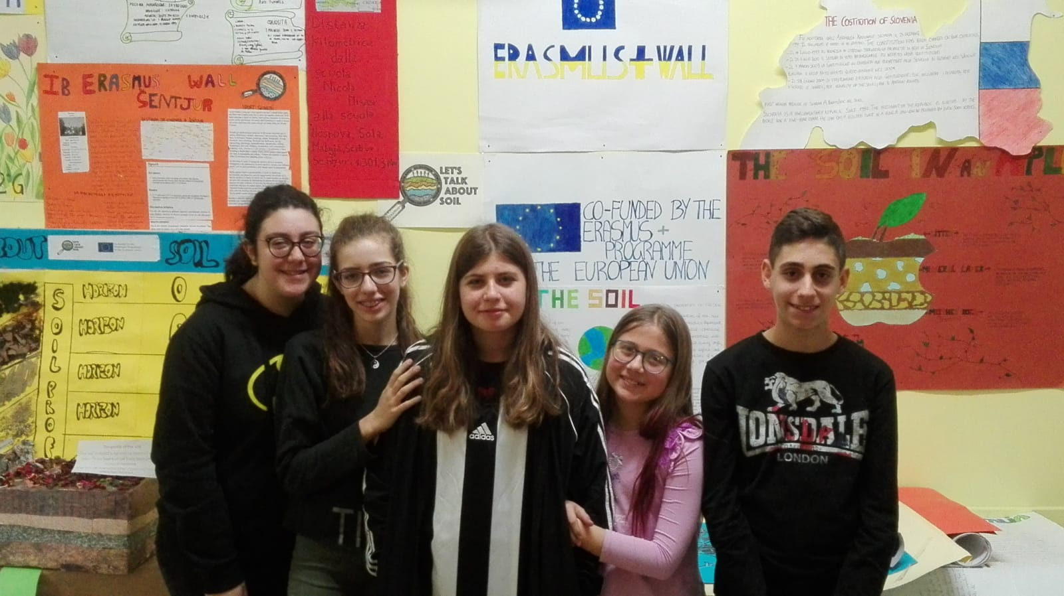
OUR AMAZING GROUP
ANTONIA
VINCENZO
ALESSIA
CLAUDIA
MARIANNA

Slide 6
SOIL LOSS AND PROTECTION OF ARABLE LAND

Slide 7
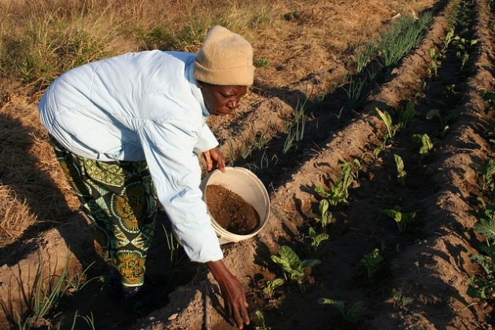
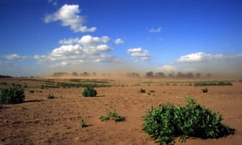
In Europe more than 20 million acres of soil were degraded…
theguardian.com
reliefweb.int
…every year we lose 24 billion tones of arable land!

Slide 8
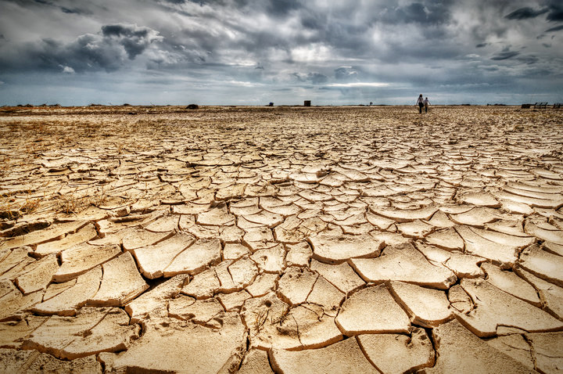

Enviromental factors of
Soil deterioration process:
Orography
Vegetable
cover
Aridity
Rain erosivity
Territory
morphology
Drought
tpi.it

Slide 9
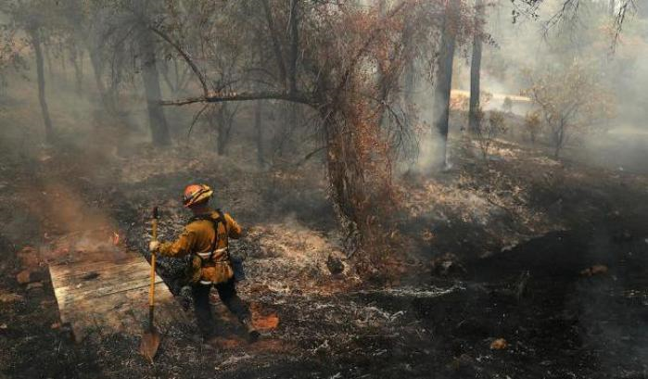
Anthropic factors of
Soil deterioration process:
Exploitation of water resources
Deforestation
Fire
Urbanization
Mismanagement of lands
Meteoweb.eu

Slide 10
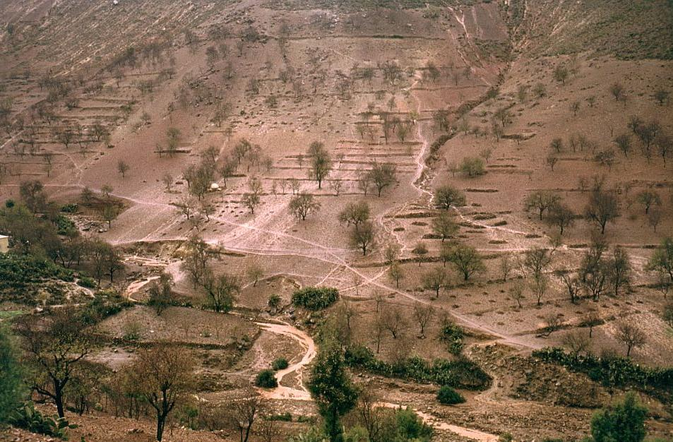
http://www.kwaad.net

Slide 11
Causes of soil degradation
Compaction
Salinization
Loss of organic substance
Contamination

Slide 12
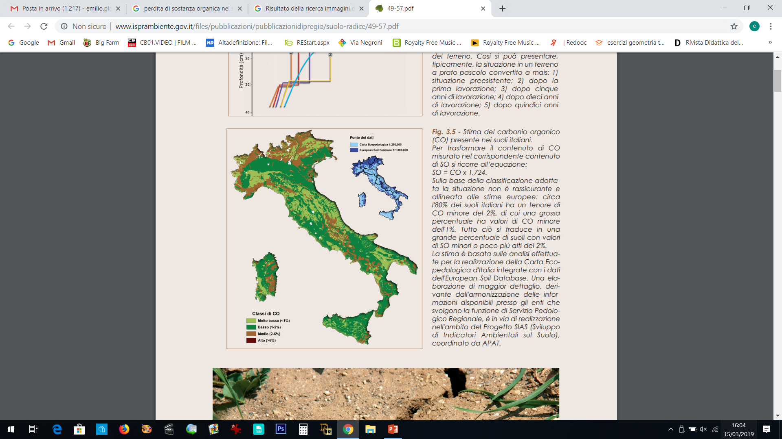
Situation in Italy...
Loss of organic substance
www.isprambiente.gov.it

Slide 13
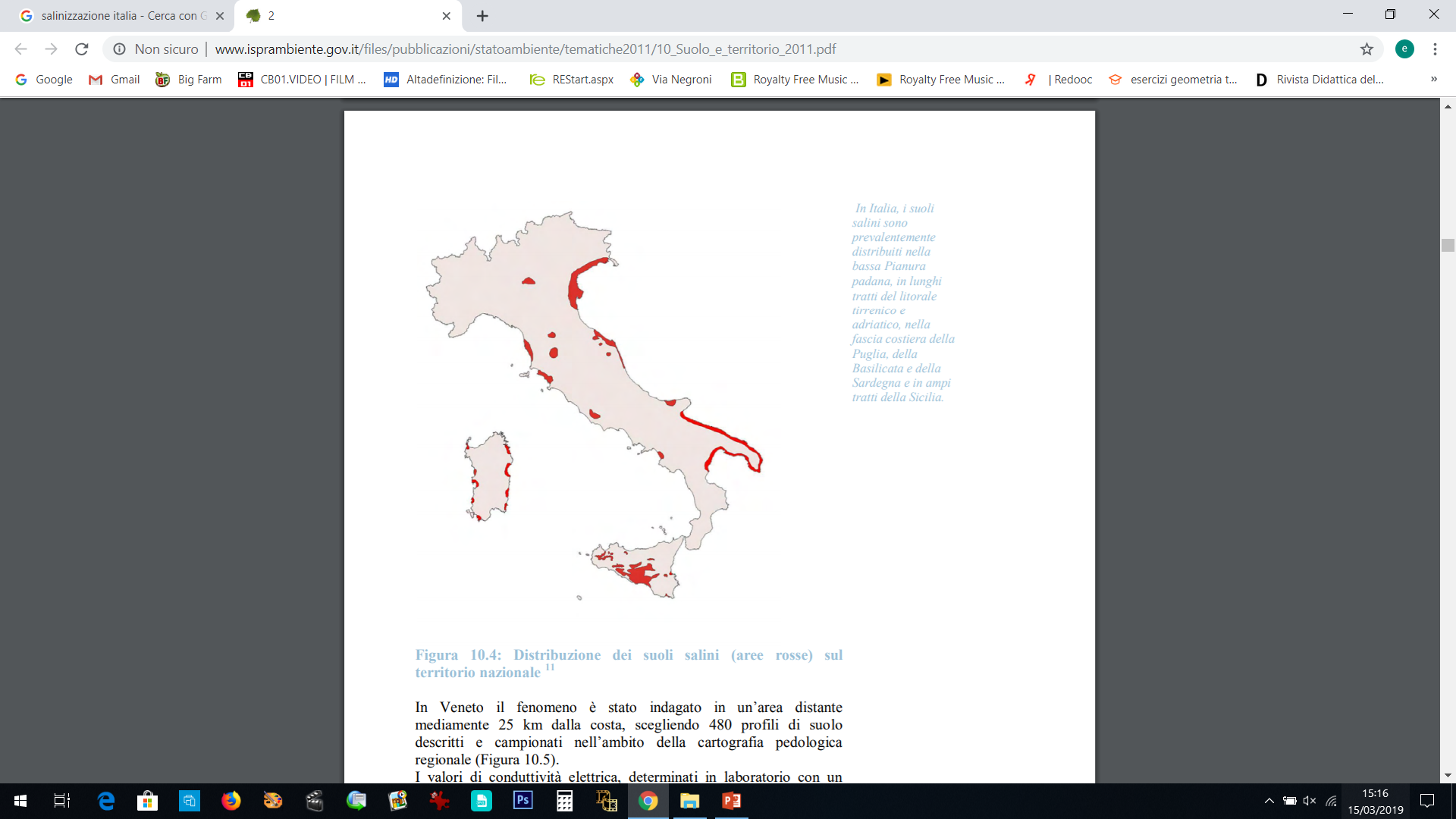
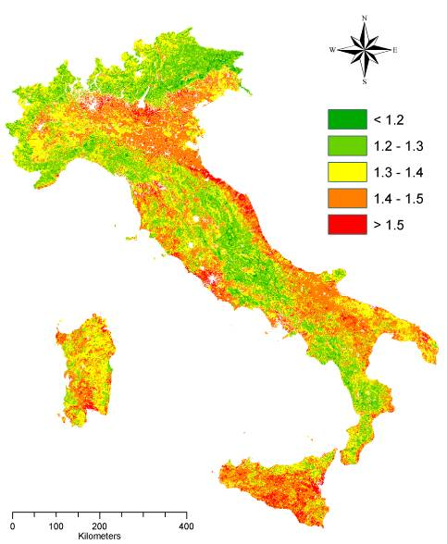
Soil salinity
Desertification
www.isprambiente.gov.it

Slide 14
…and in our region
Erosion is the main cause of soil degradation in Calabria
www.isprambiente.gov.it

Slide 15
In Calabria the speed with which the soil is consumed is 4 times that of the European average!
www.isprambiente.gov.it

Slide 16
SECOND PEDOLOGICAL WORKSHOP

Slide 17
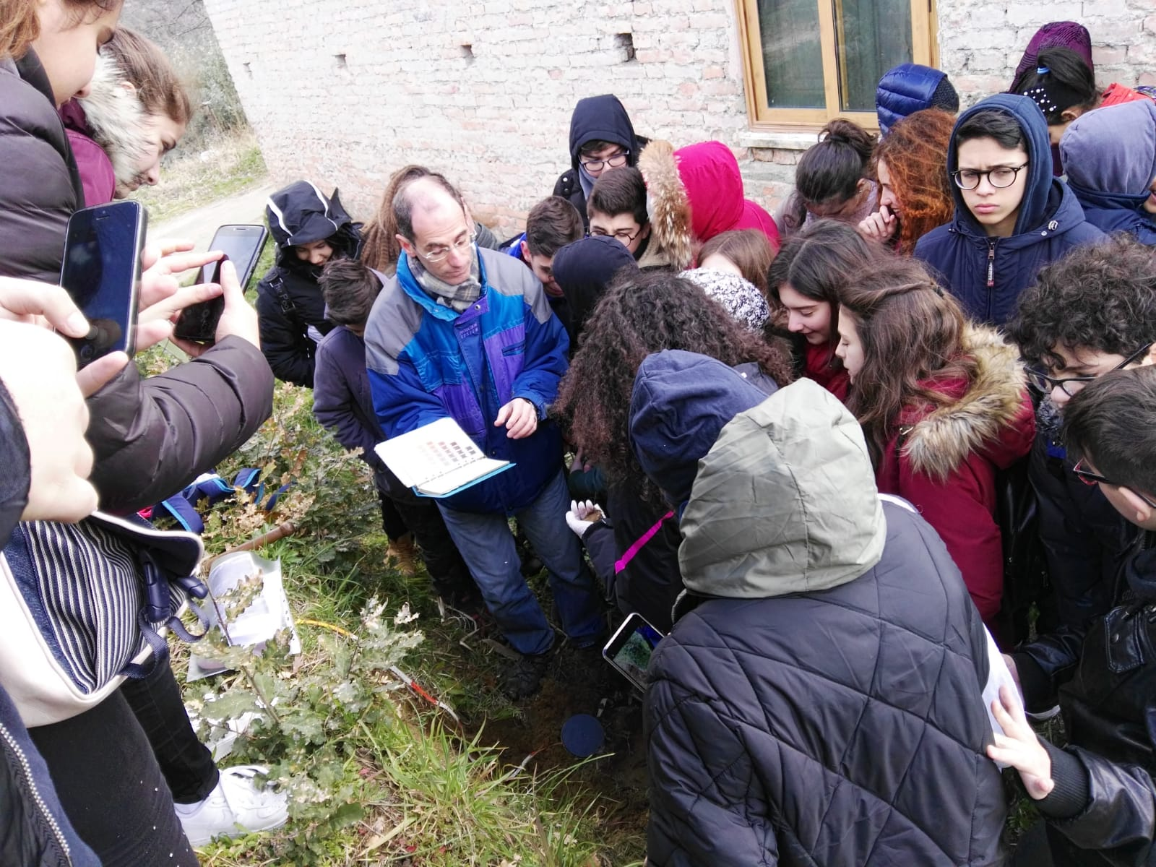
On Monday, 25th February, we went to Zumpano to look at a soil profile. A professor of geology from the University of Calabria was waiting for us.

Slide 18
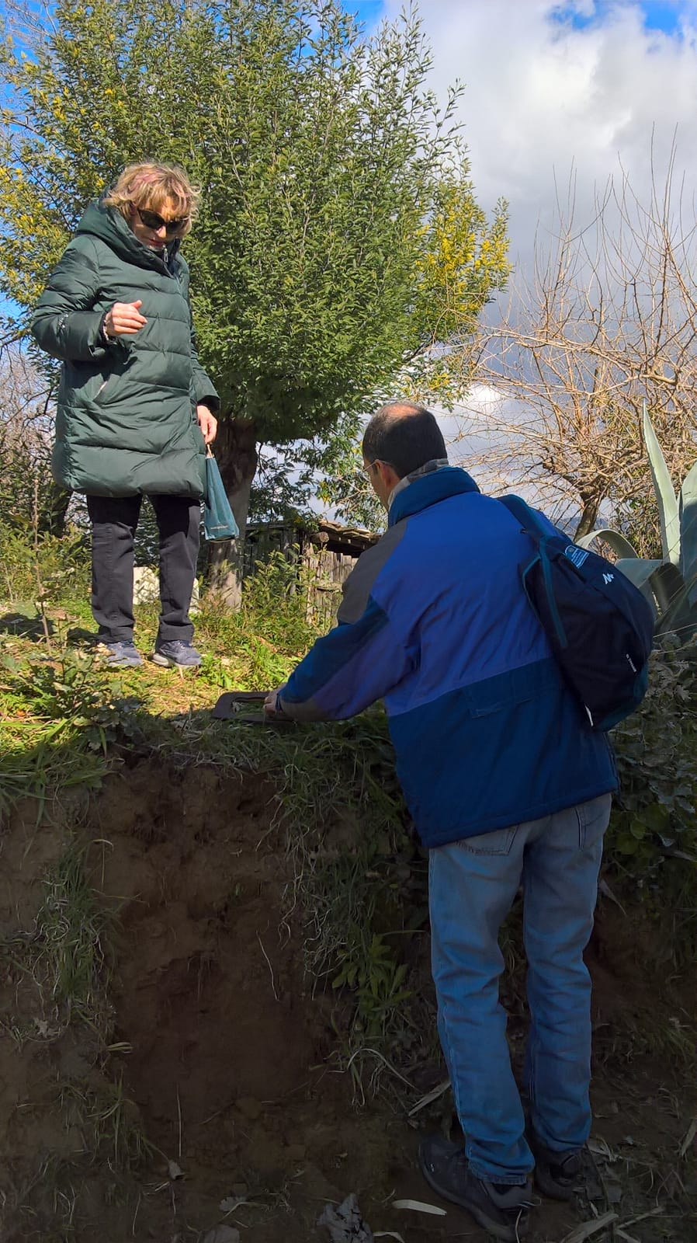
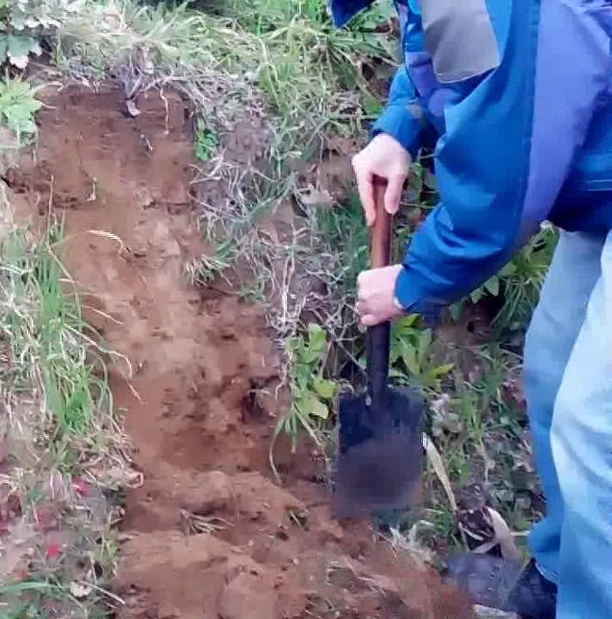
Since there was an existing escarpment, we were able to see the various soil profiles.

Slide 19
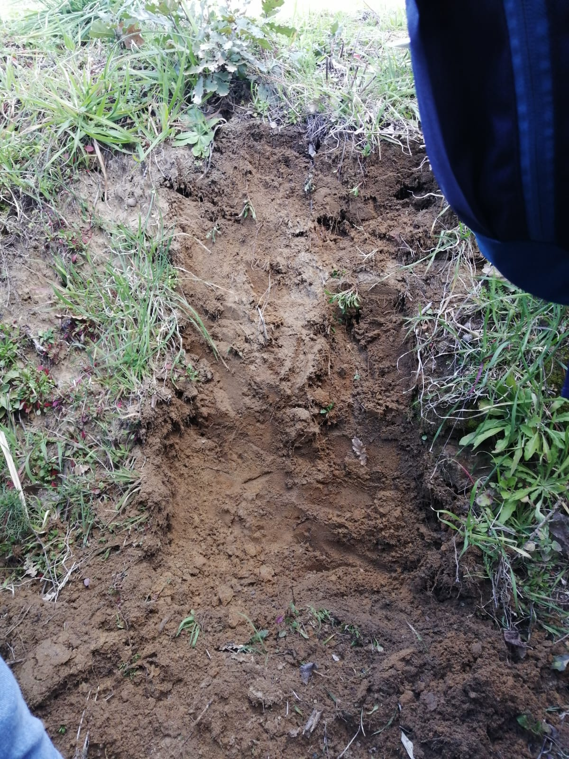
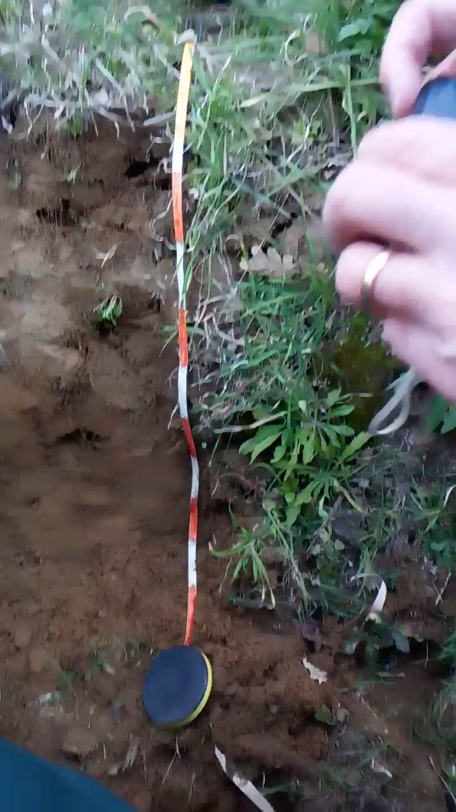
We did not have to dig deep to take some soil samples from various layers.

Slide 20
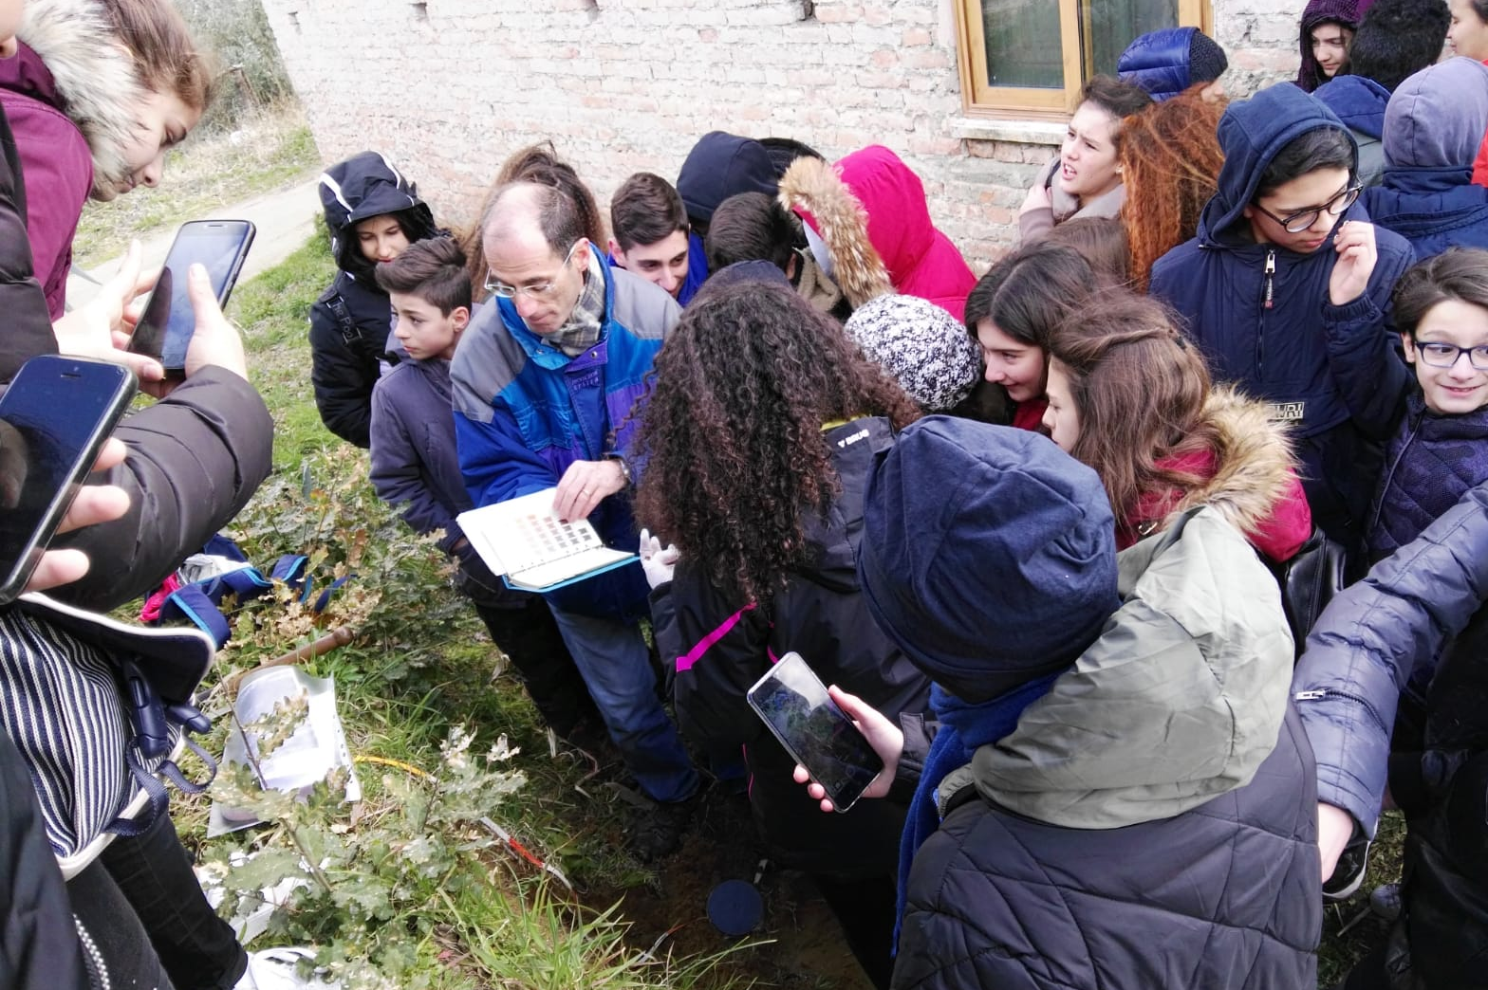
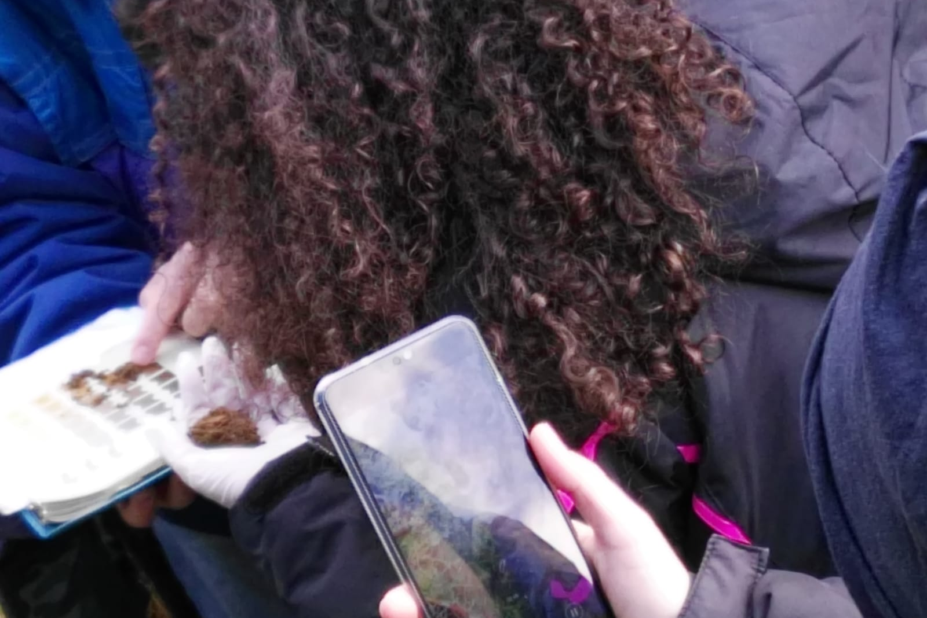
Then we catalogued the soil samples with Mensell's table, which classifies the soil according to its colour.

Slide 21
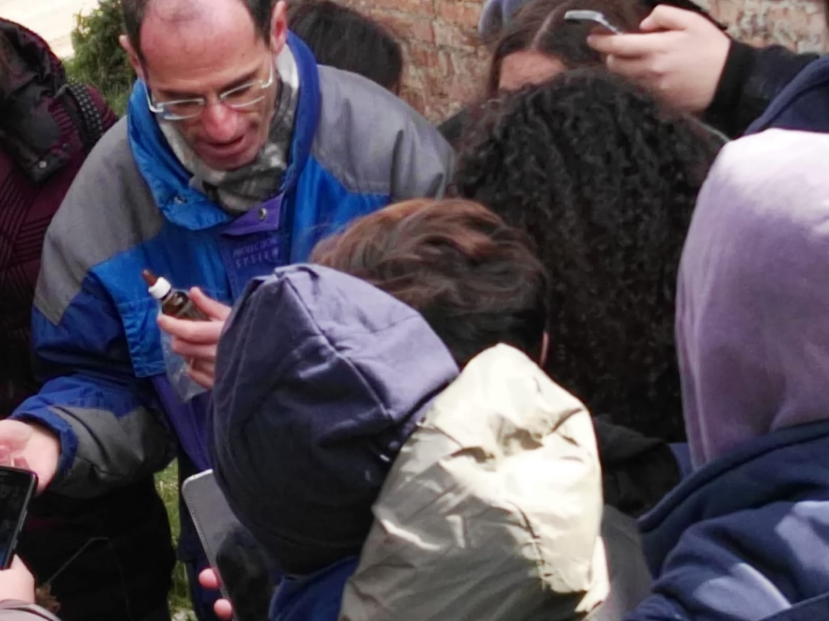
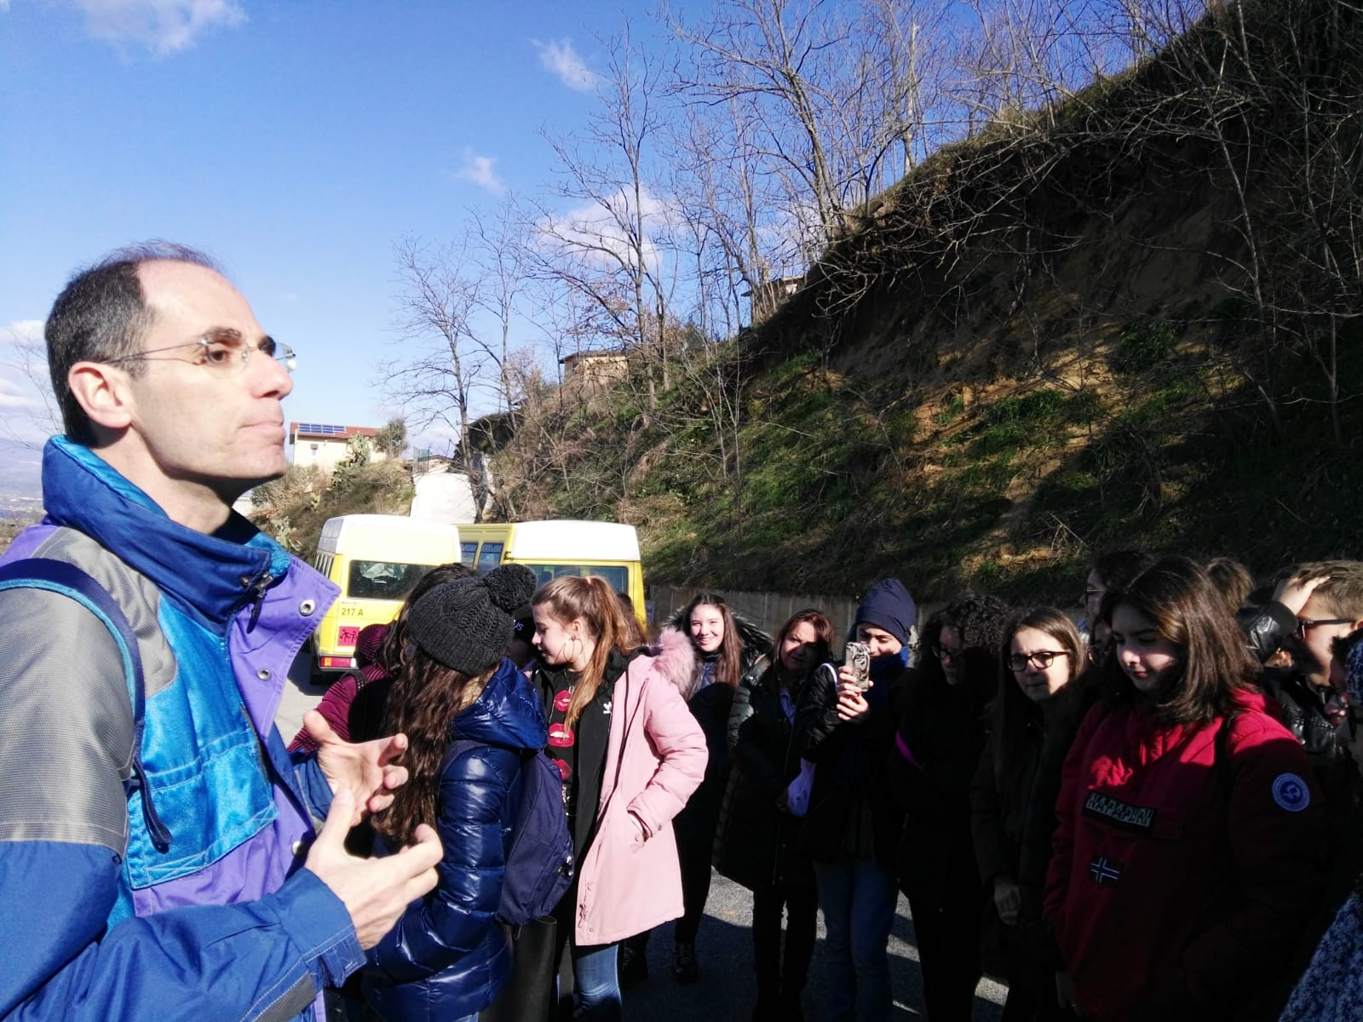
Then the professor explained various things about the observed clay sedimentary soil and its geological origin.

Slide 22
LABORATORY ANALYSIS

Slide 23
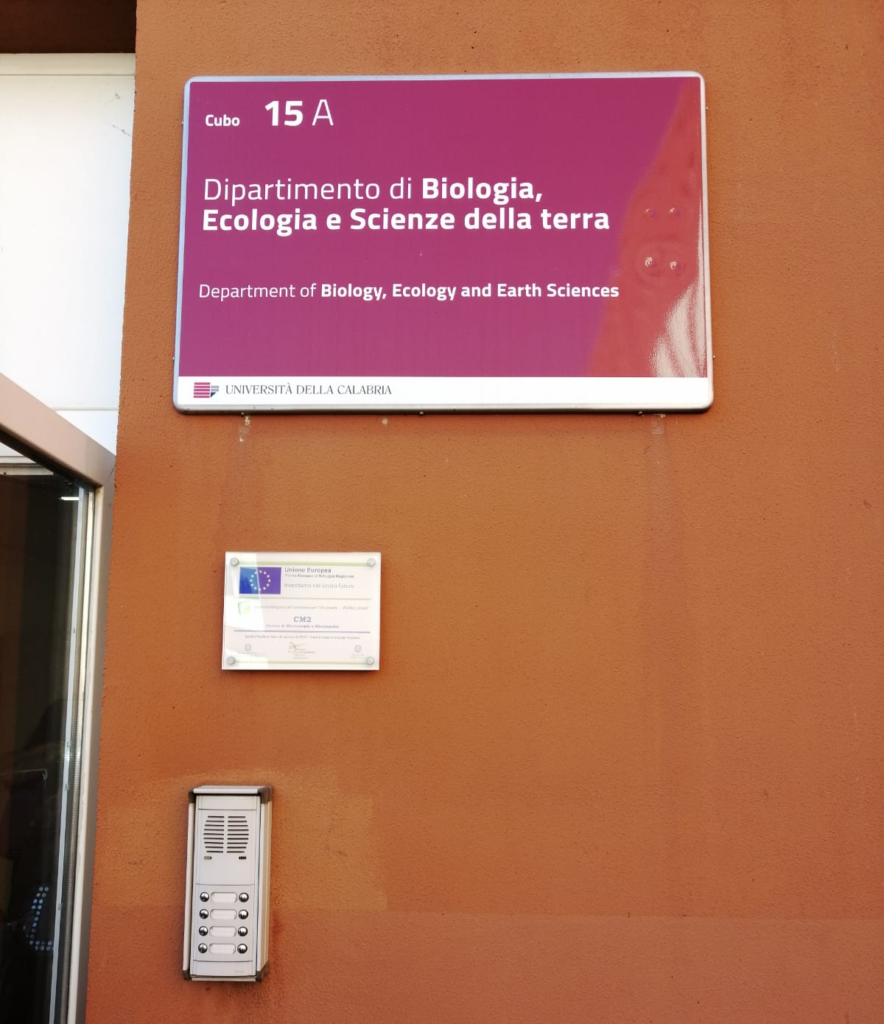

On Friday, March 1st we went to the University of Calabria. We observed various tools and equipment,
such as an electronic microscope.

Slide 24
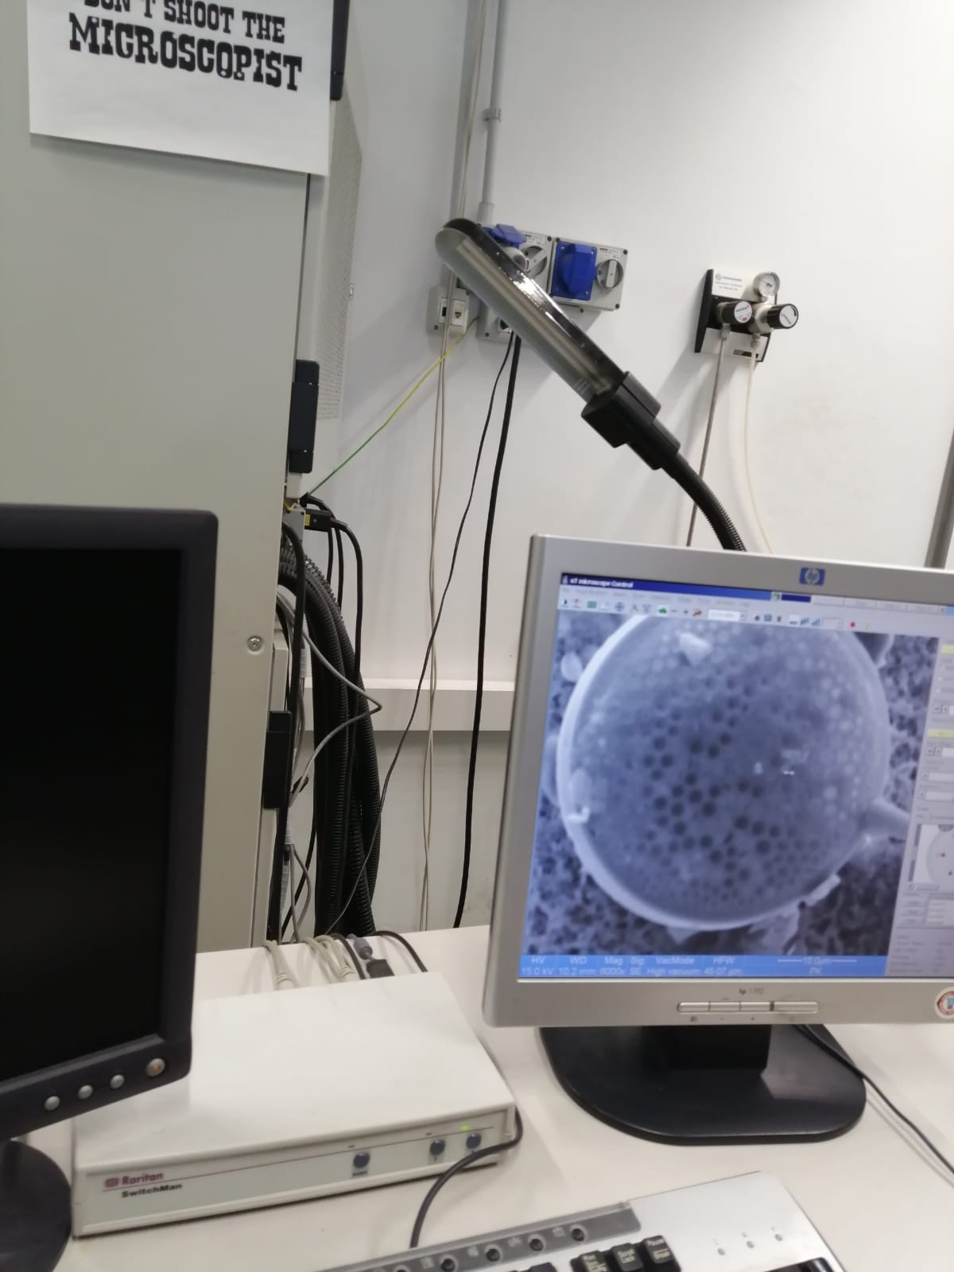
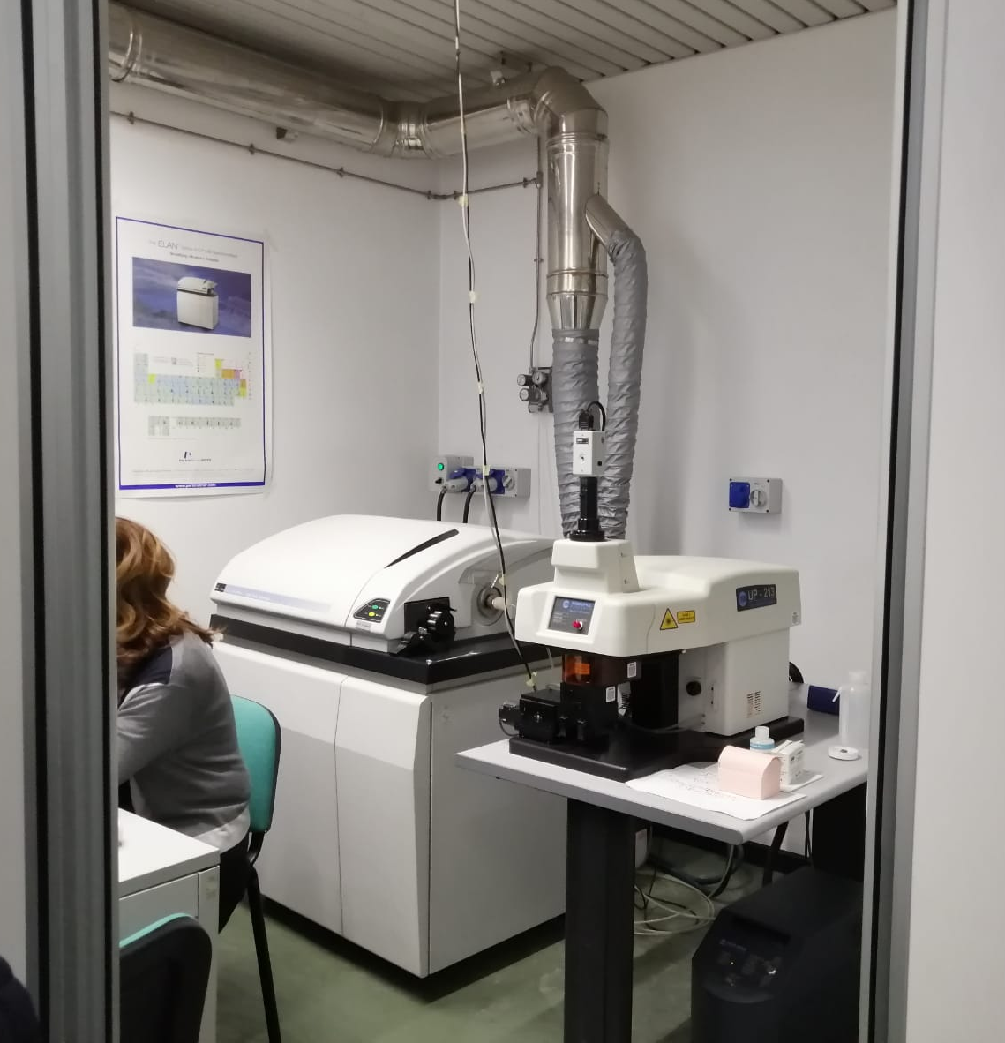
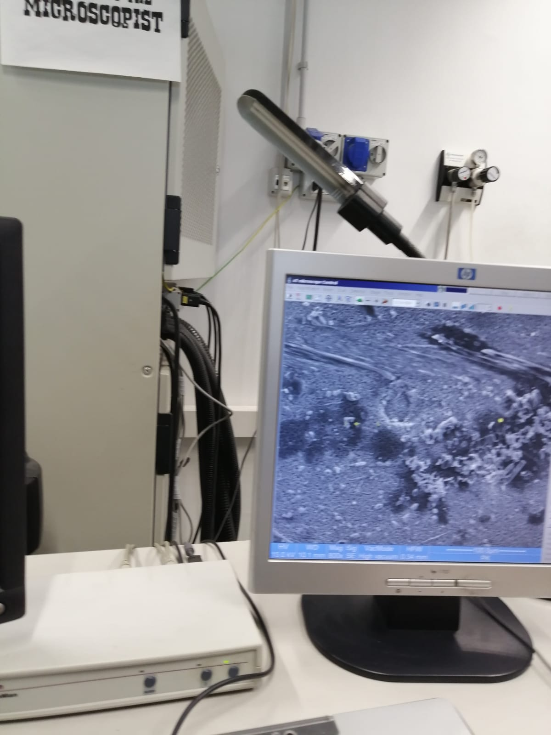
We used various tools; and equipment, such as an electronic microscope, for example.

Slide 25
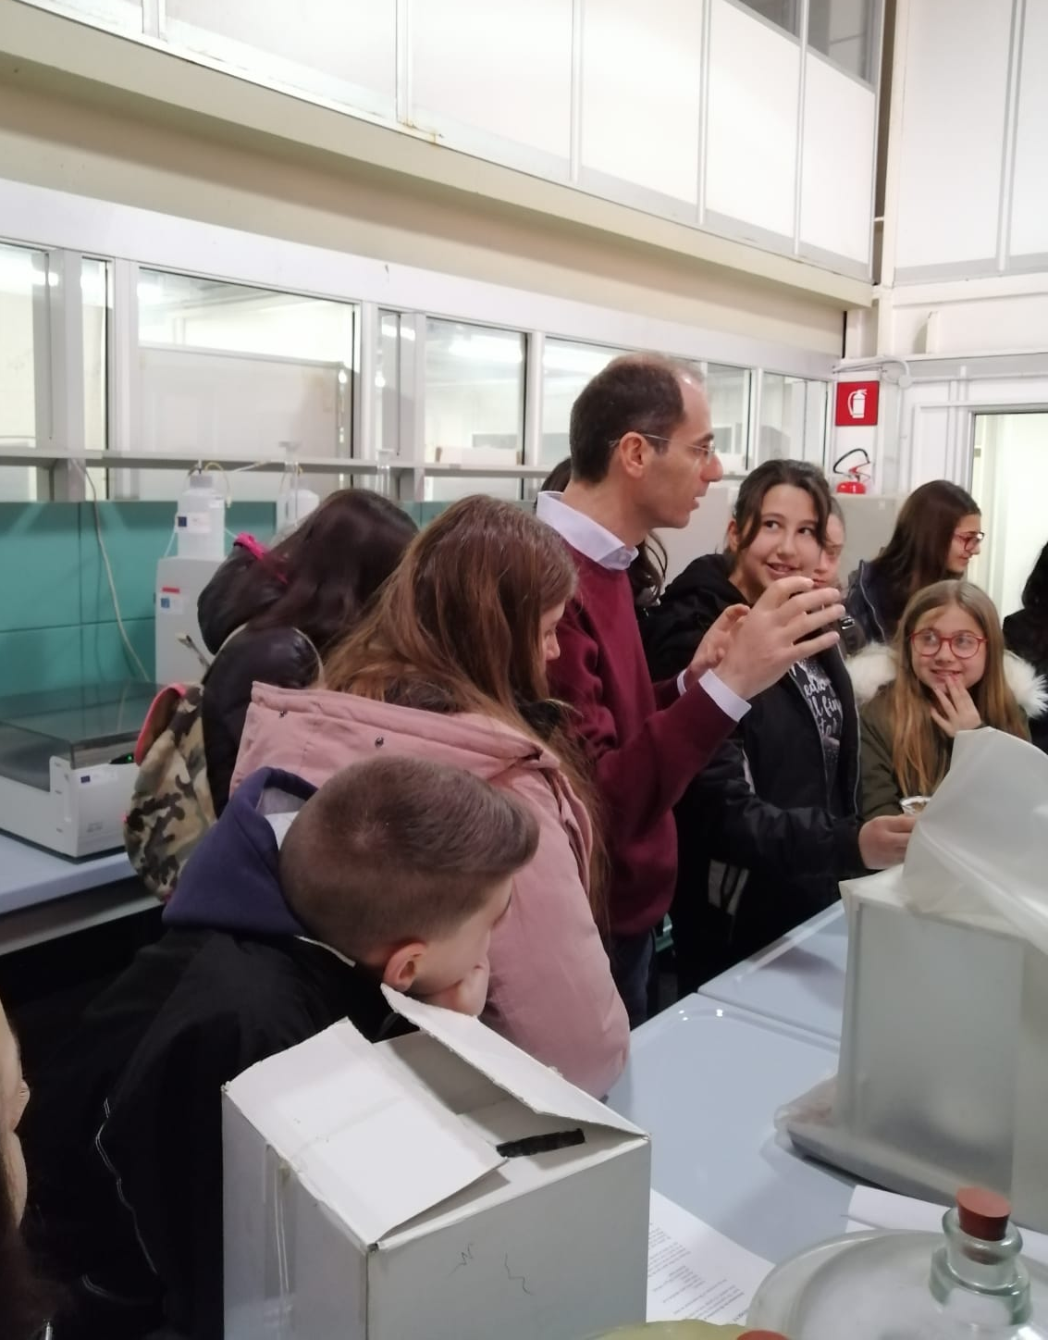
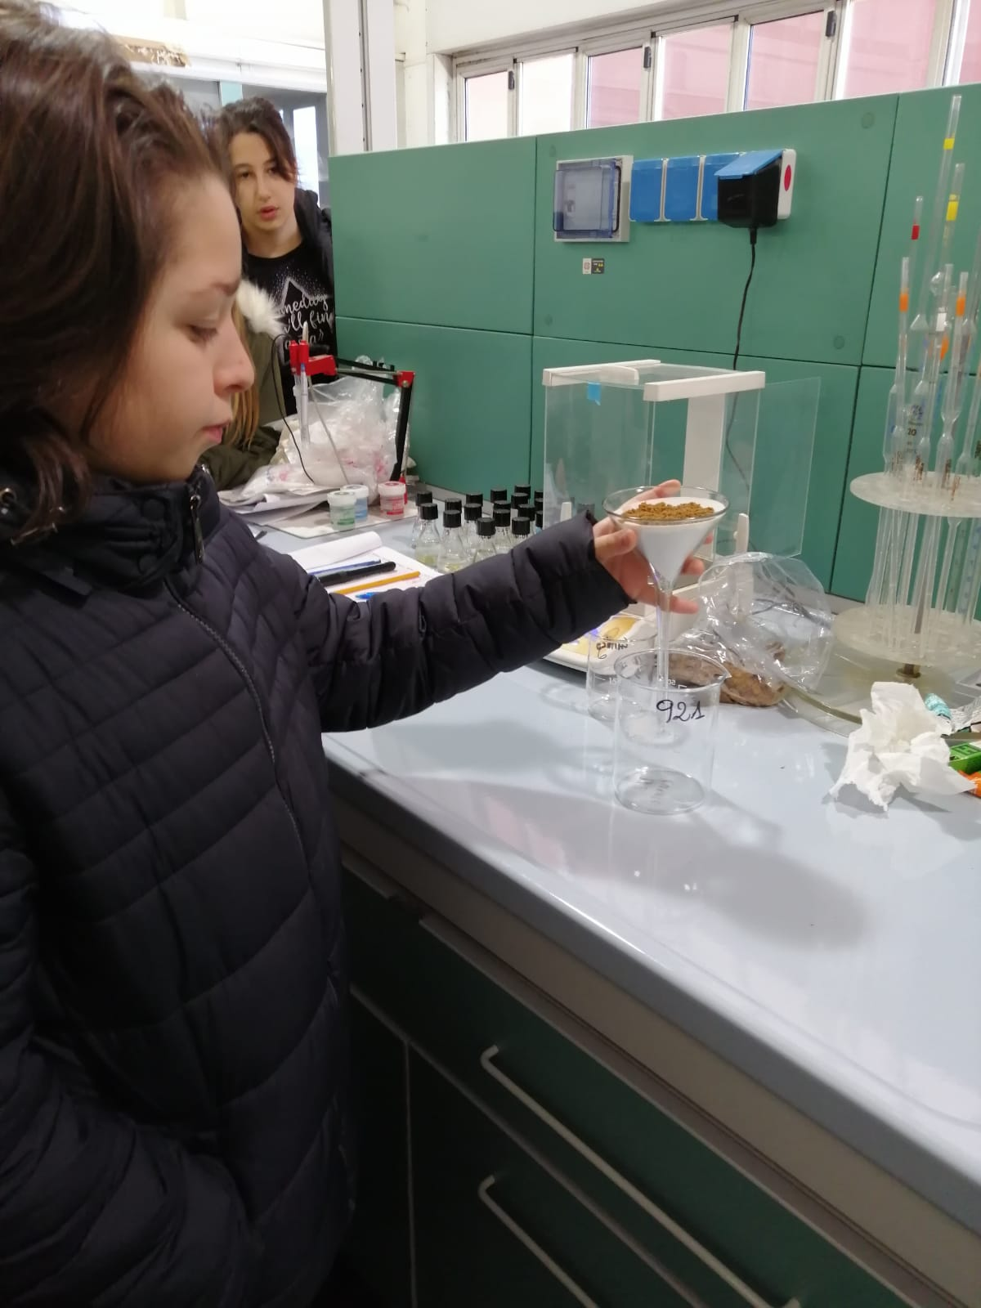
Then we did some experiments with soil samples that we had taken on Monday 25th February.

Slide 26
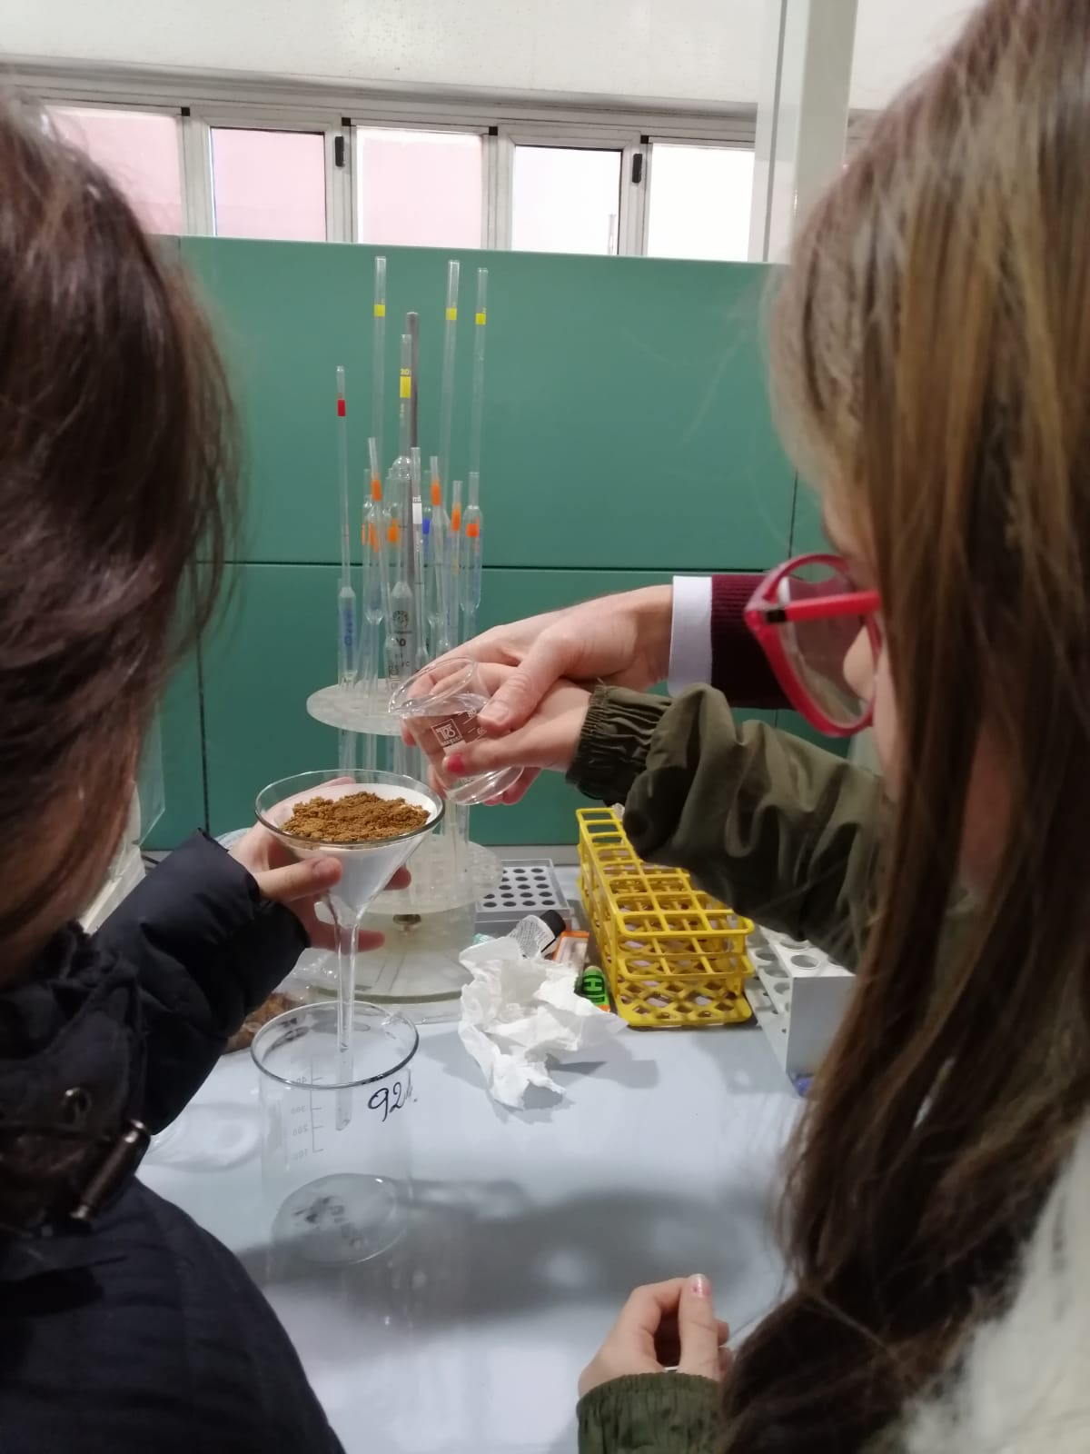
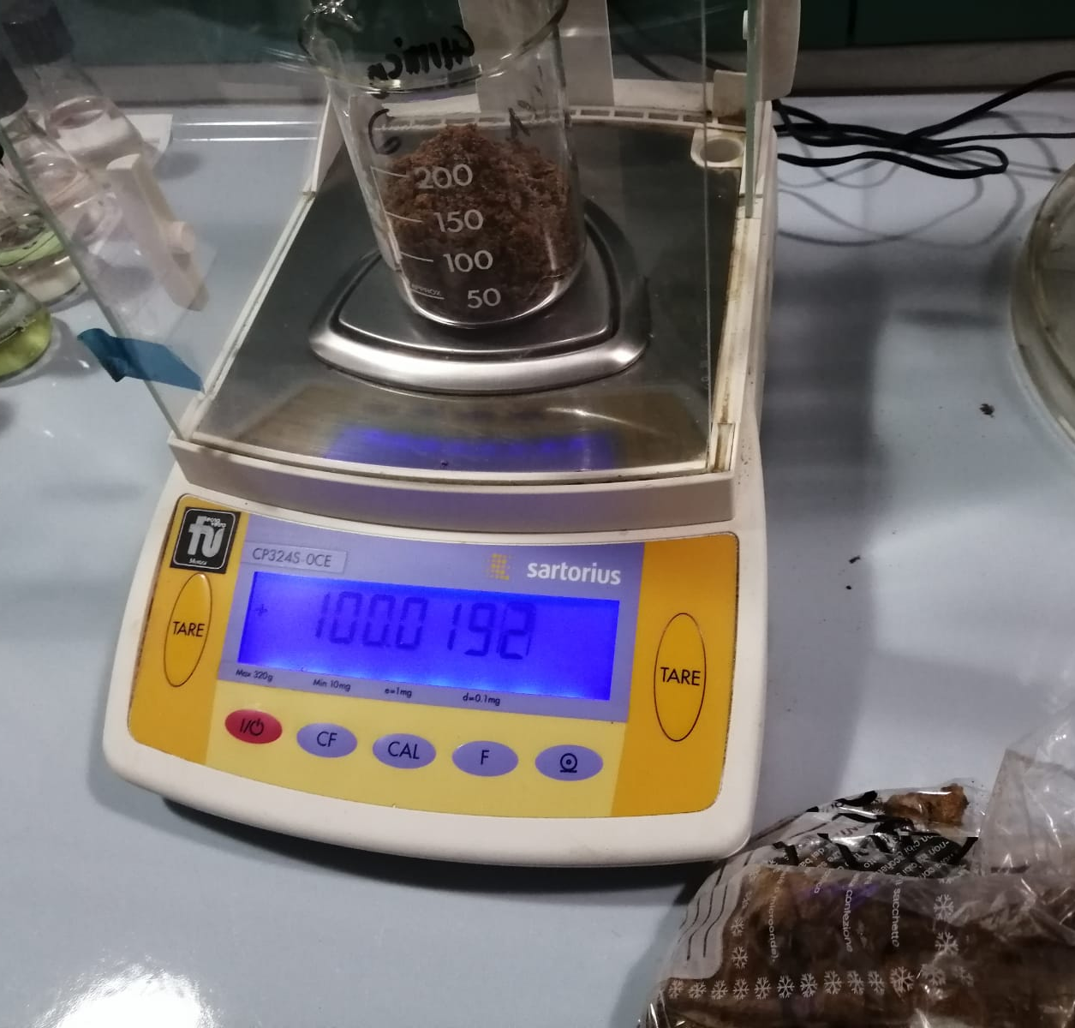
We checked the weight, we measured the porosity and compared it with another sample of soil taken from a soil profile in Crotone.

Slide 27
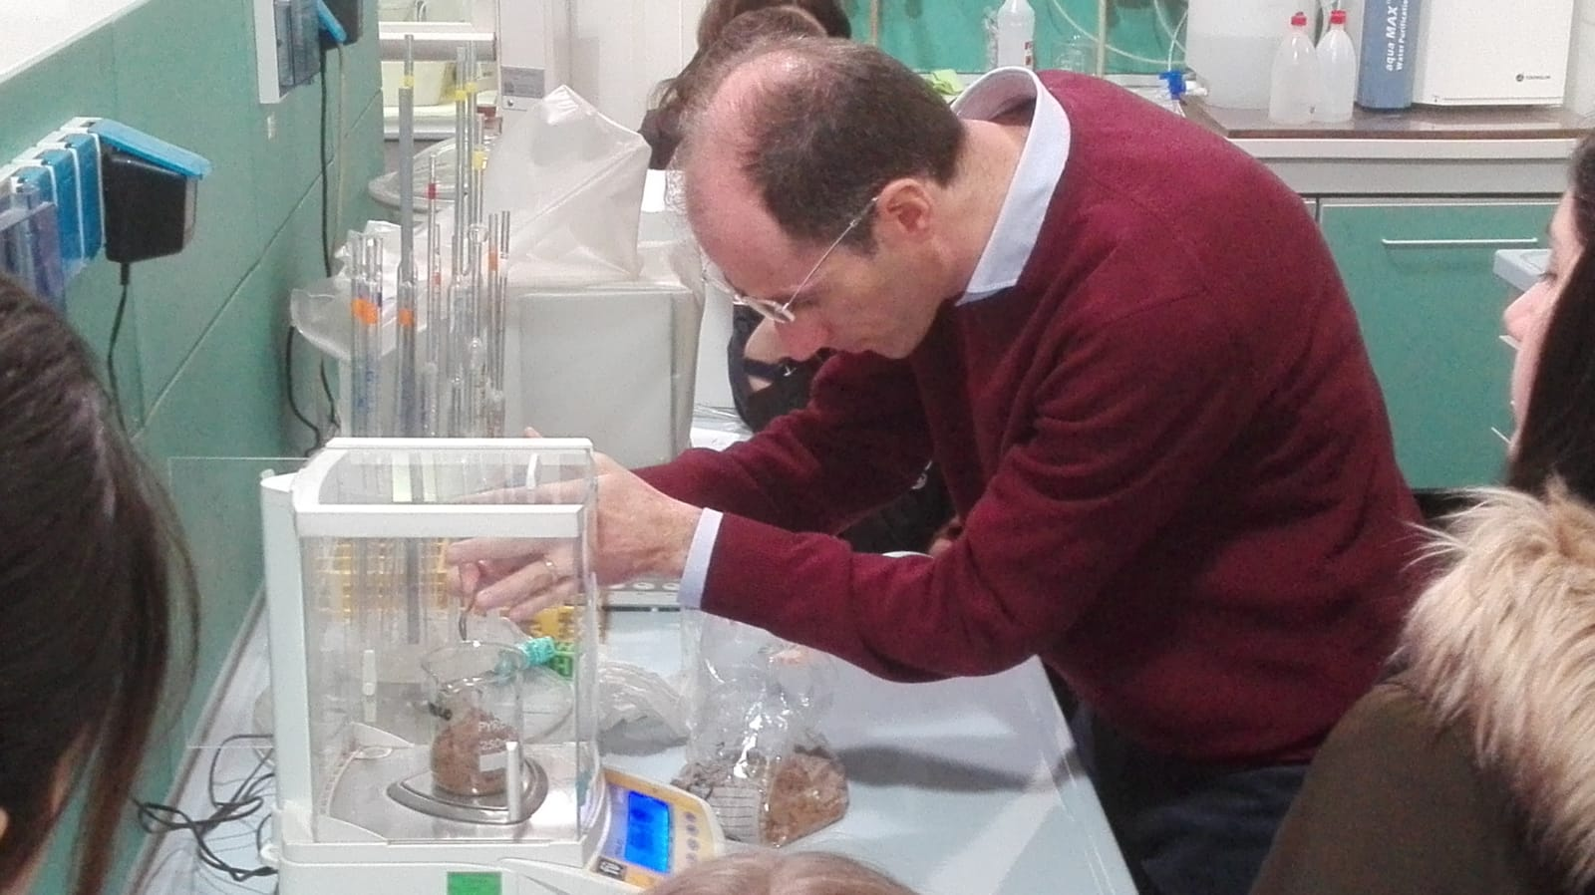
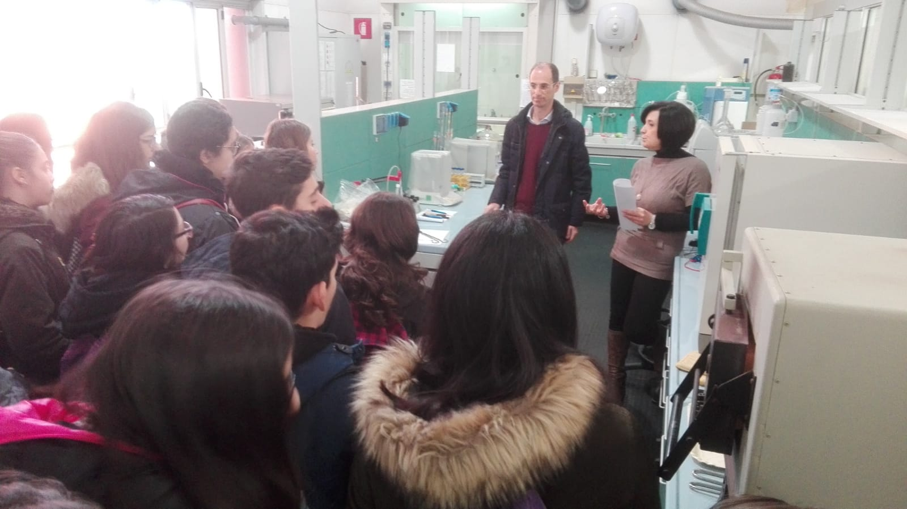
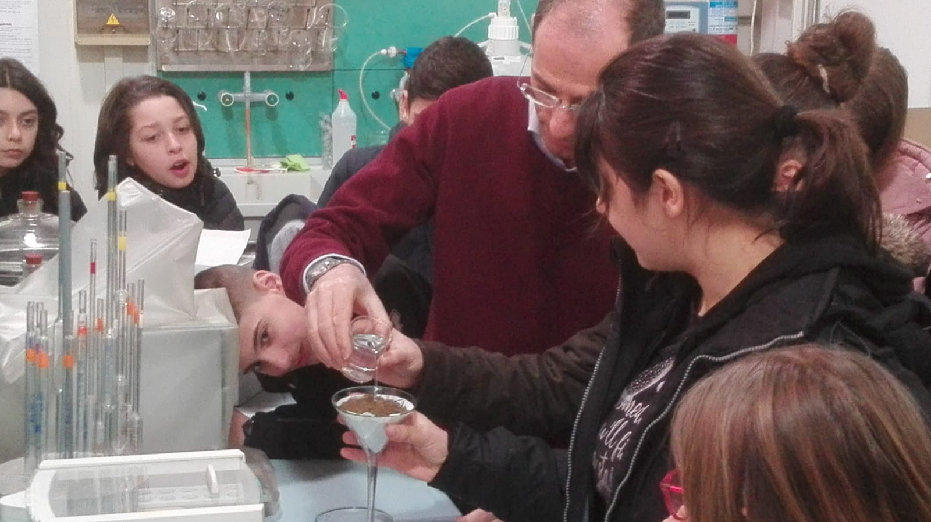
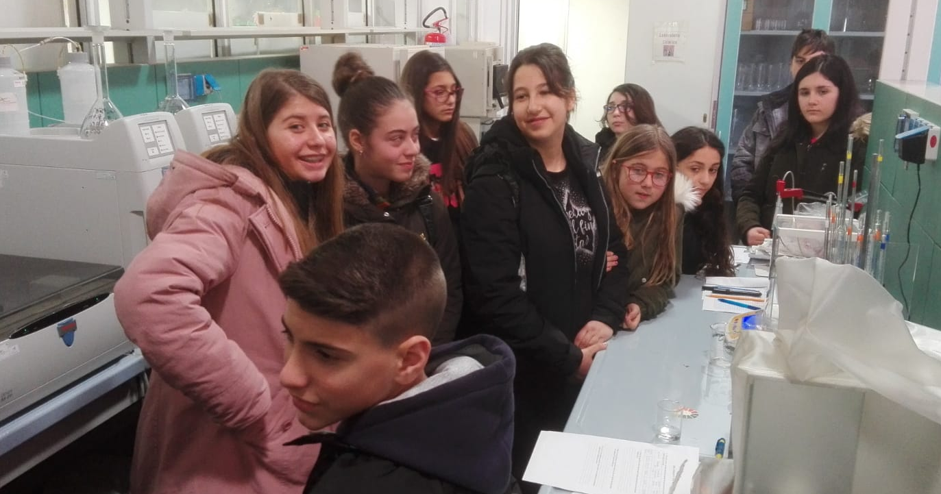

Slide 28
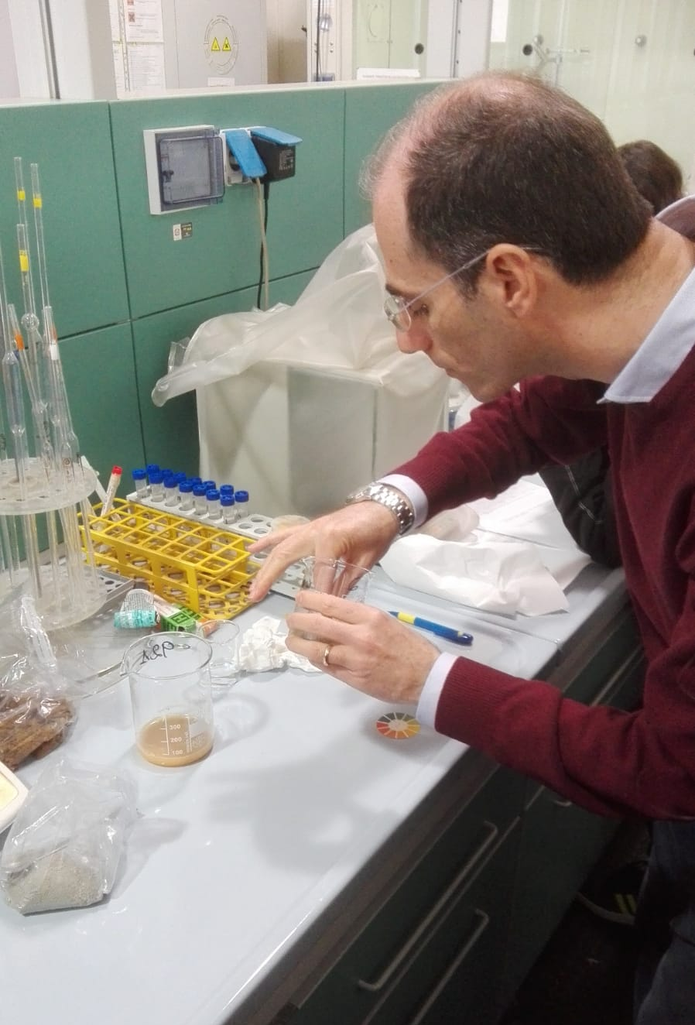
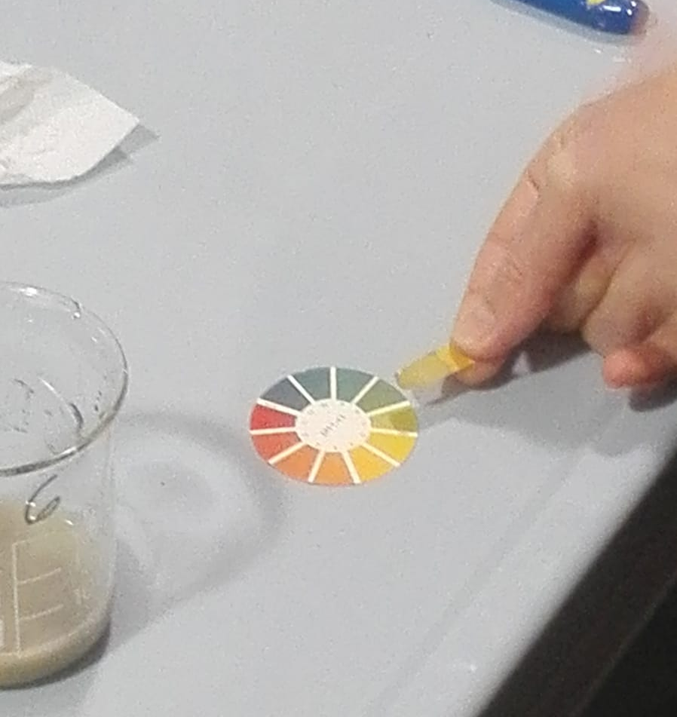
Then we measured the pH in a sample of soil.

Slide 29
Thanks!

