Slide 1
Istituto Comprensivo Cosenza III «Via Negroni» Scuole Infanzia, Primaria e Secondaria di Primo Grado Cosenza CUP: C89F18000610001 ERASMUS PLUS KA229 Codice 2018-1-S101-KA229-046994_4
Co-funded by the
Erasmus+ Programme
of the European Union
Workshop at UNICAL March 1st, 2019
Giada Filice
Marianna Porcarelli

Slide 2
On Friday, 1st March 2019 we went to the University of Calabria (UNICAL), together with two teachers of our school.
We visited various laboratories and observed how some very precise devices work. Among the equipment we noticed an electron microscope.

Slide 3
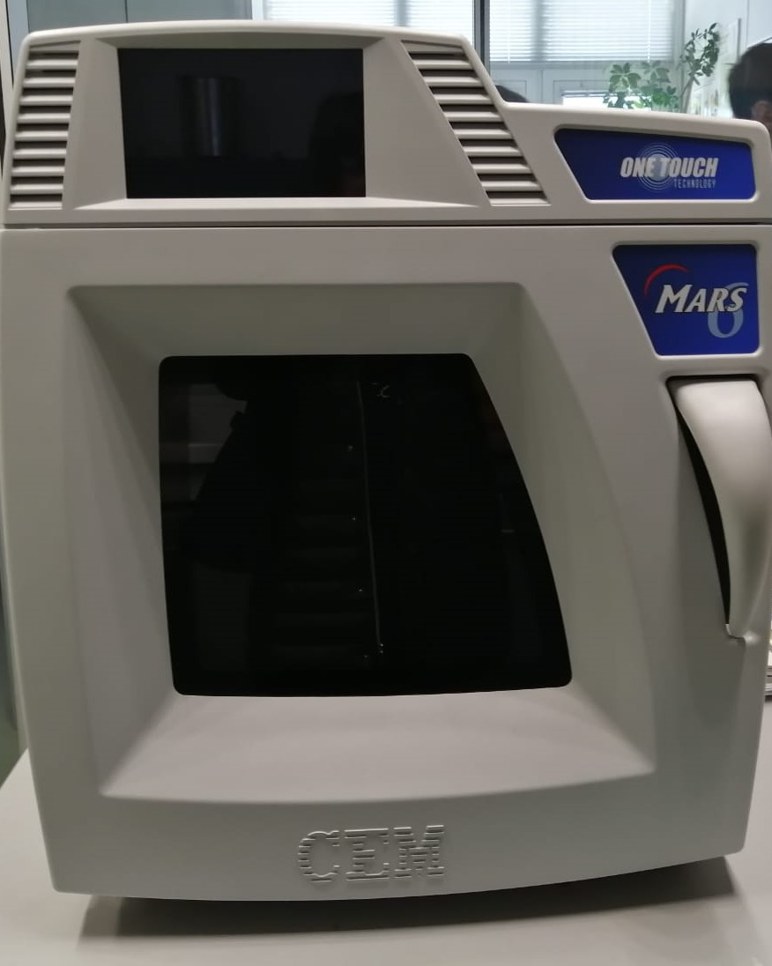
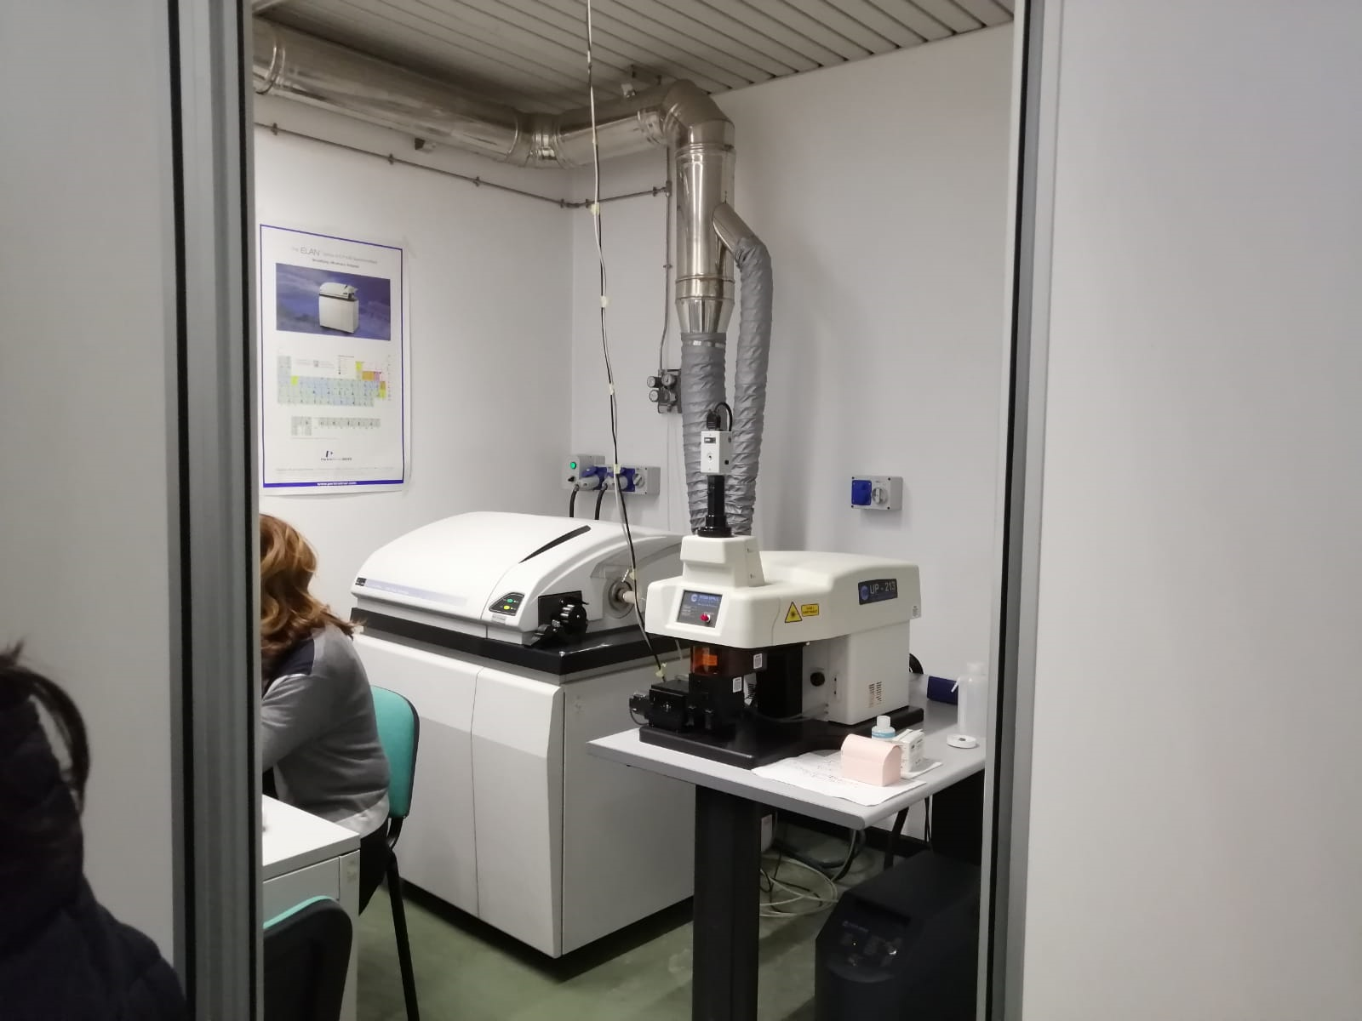

Slide 4
It was interesting to look at a computer screen, which showed us some water filtered by a very small filter. There were a lot of living and not living particles in it.

Slide 5
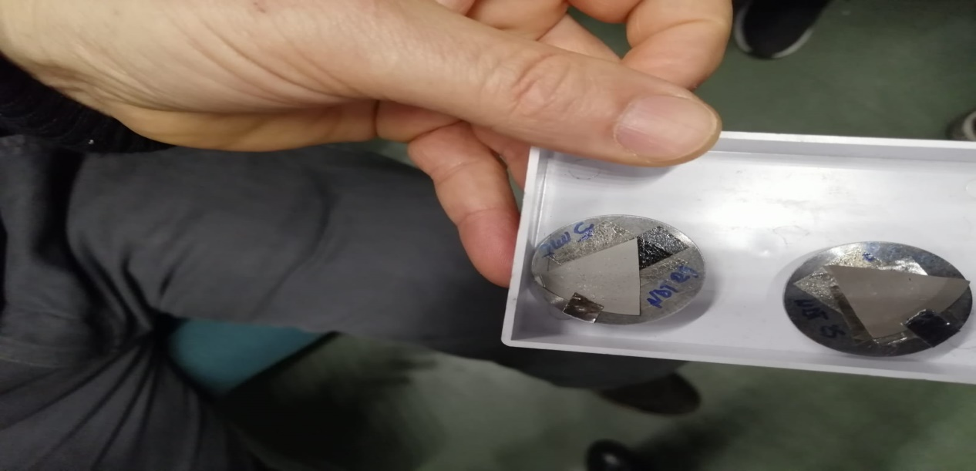
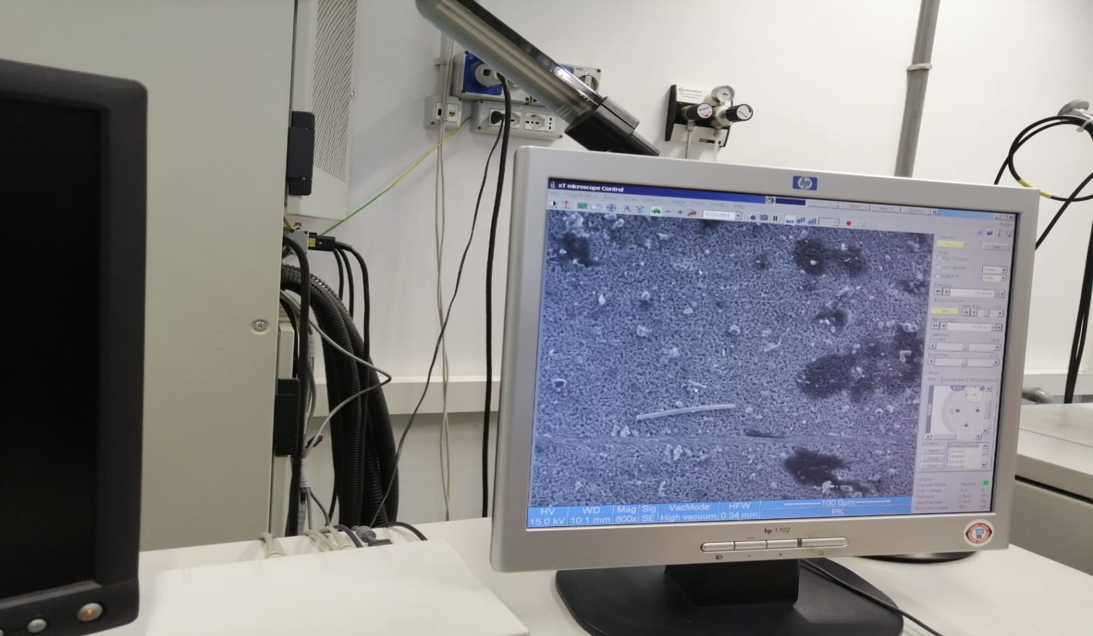

Slide 6
After that, we did various experiments with some soil samples (both rich and poor in humus) that we had taken on Monday 25th February, 2019. For example we checked the weight, we measured the porosity.

Slide 7
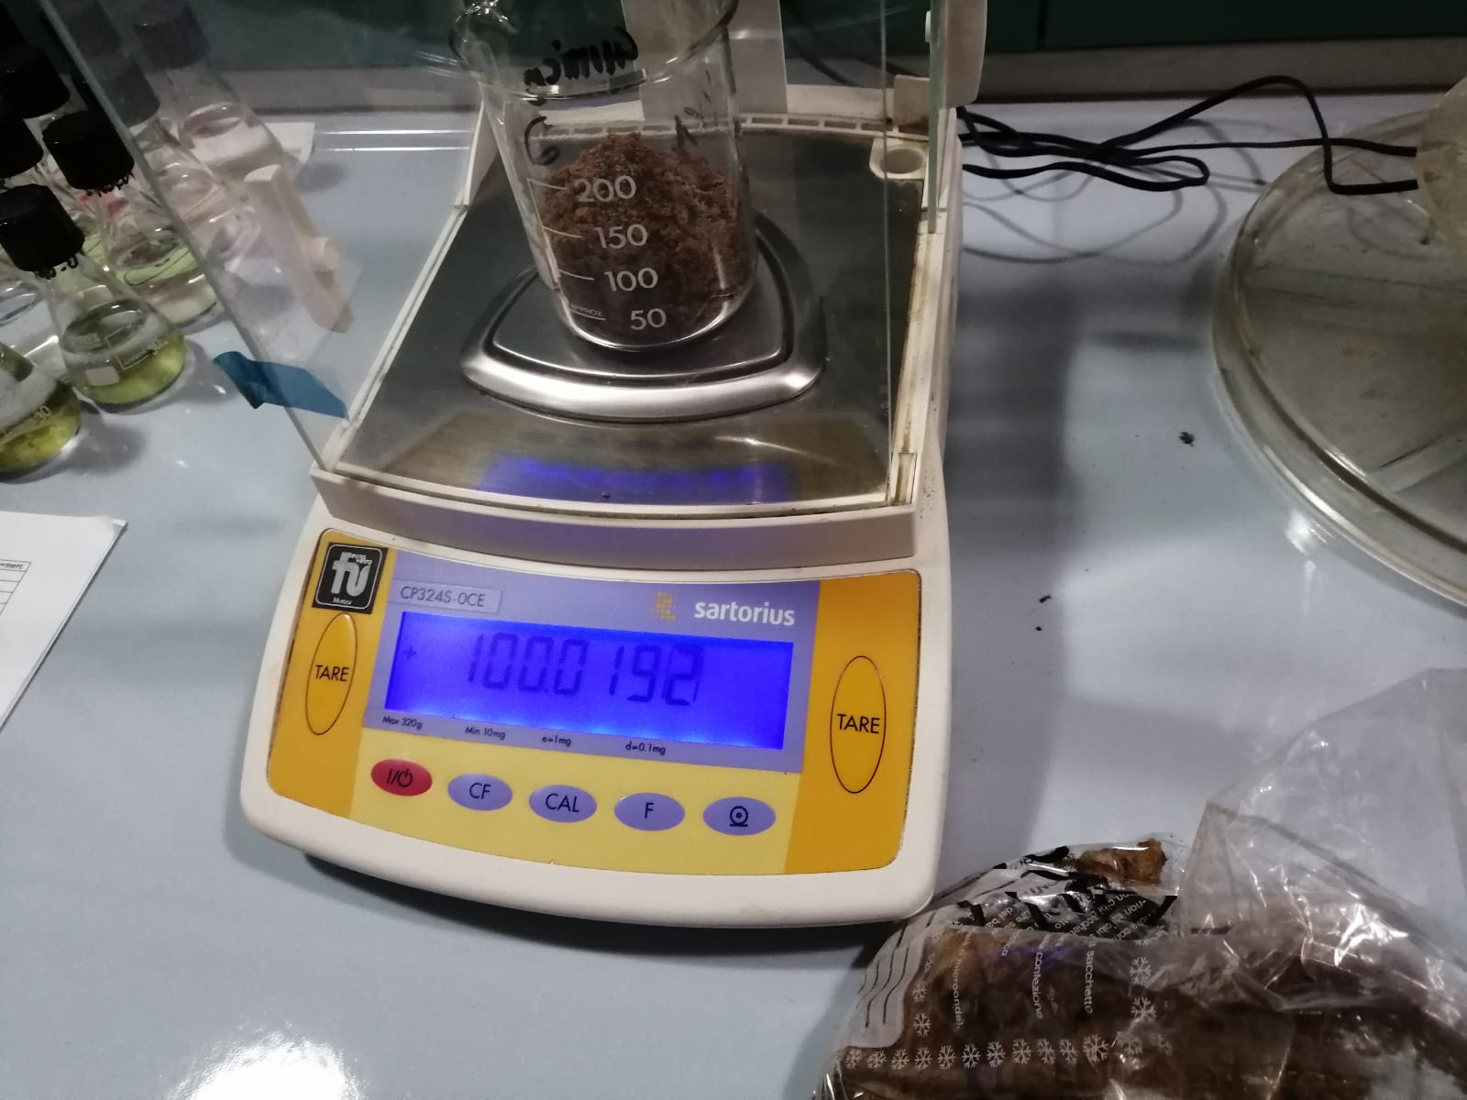
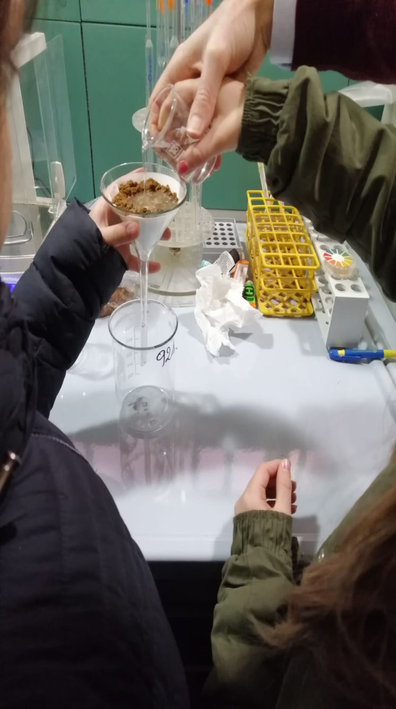

Slide 8
We also observed what happens when hydrochloric acid, diluted with distilled water (10%), is poured onto a soil sample taken from a different ground (the soil sample was at our disposal in the lab. and it had been taken in Crotone). It immediately gave a strong effervescence reaction, forming bubbles of several millimeters, testifying the presence of limestone.

Slide 9
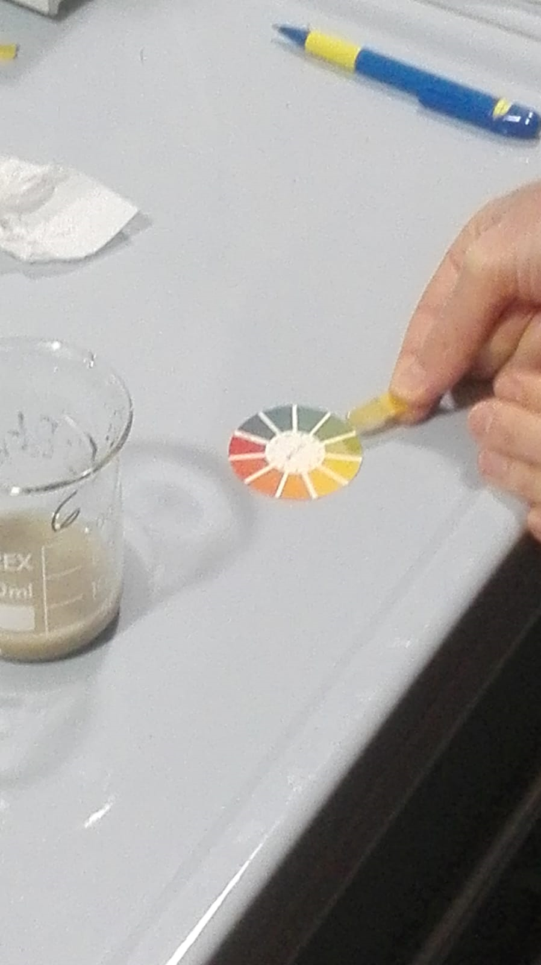
We kept on calculating its ph. by using a litmus test.

Slide 10
at the end of the experiments we noticed that the soil rich in humus is more porous and acid than that poor in humus.

Slide 11
tHE END

